Slide 1
DSAI 3201
Indoor Localization
Machine
Learning
Project
Using WLAN Fingerprinting
Predicting indoor position from WiFi signal patterns
using classification and regression models
Winter 2026
19,937
520
3
5
Member 1: Nouresham|60103990
Training Samples
WAP Features
Buildings
Floor Levels
Member 2: Arlene Riona | 60304739
Member 3: Zahra Alwaili | 60307052

Slide 2
PART 1
Data Understanding
& Preprocessing
Presented by: Arlene Riona

Slide 3
PART 1 › PROJECT INTRODUCTION
Project Objective
To build an indoor localization system that predicts a user's building, floor, and exact geographical coordinates (longitude & latitude) using only WiFi fingerprint data (RSSI readings), since GPS is unreliable indoors.
This is decomposed into two tasks:
Classification: predicting building ID and floor
Regression: estimating exact longitude and latitude

Slide 4
PART 1 › DATASET EXPLORATION
Key Insights of the Dataset
19,937
1,111
520
96.5%
Training Samples
Validation Samples
WAP Features
Data Sparsity
WAP001–WAP520
BUILDINGID
-104 dBm to 0 dBm. Value +100 = not detected (96.5% of readings)
3 buildings (IDs 0, 1, 2)
FLOOR
LONGITUDE & LATITUDE
5 floors (0 to 4)
Longitude: -7691 to -7301 m. Latitude: 4,864,746 to 4,865,017 m.

Slide 5
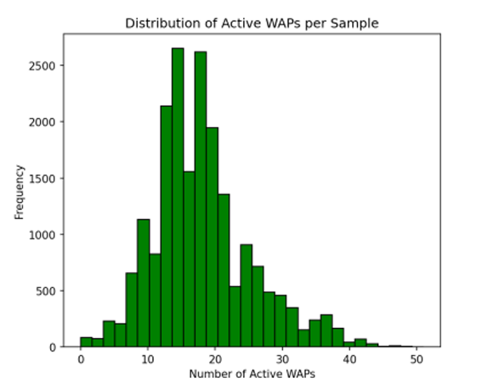
PART 1 › EXPLORATORY DATA ANALYSIS
3 Key EDA Findings
Extreme sparsity
(18/520 active WAPs)

Slide 6
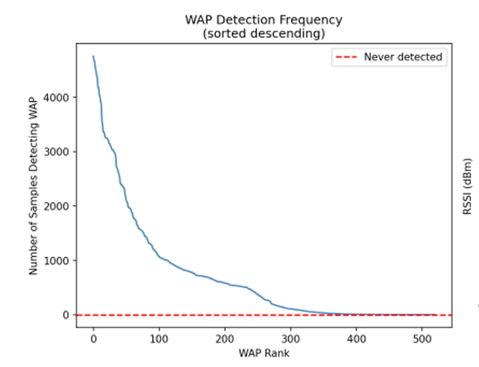
PART 1 › EXPLORATORY DATA ANALYSIS
3 Key EDA Findings
Dead data (55 WAPs never detected, 76 zero-reading samples)

Slide 7
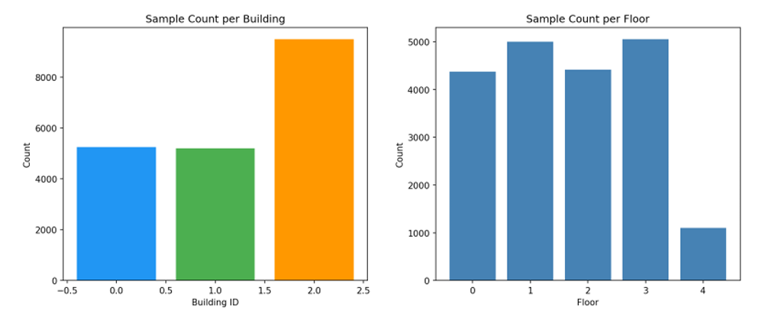
PART 1 › EXPLORATORY DATA ANALYSIS
3 Key EDA Findings
Class imbalance (Building 2 double, Floor 4 underrepresented)

Slide 8
PART 1 › DATA CLEANING & PREPROCESSING
Data Cleaning Pipeline
Step 1: No Missing Values
Step 2: Sentinel Replacement
Step 3: Feature Scaling
Training set: 0 NaN.
Validation set: 0 NaN.
WAP value 100 means 'not detected'. Replaced with -105 dBm (below dataset minimum of -104 dBm) to preserve semantic gap.
StandardScaler fit on training data only, then applied to validation. Critical for SVM and neural network models that are distance-sensitive.
Step 4: Target Separation
Step 5: Coord Scaling (Regression)
Step 6: Dimensionality Note
Features split into 3 task-specific sets: Classification (FLOOR), Classification (BUILDINGID), and Regression (LONGITUDE, LATITUDE).
Target coordinates additionally scaled with a separate StandardScaler. Inverse-transformed after prediction to restore meter units.
PCA was considered but not applied tree-based ensemble models (XGBoost, DT) handle sparse high-dim data natively without PCA.

Slide 9
PART 2
Model Development
& Optimization
Presented by: Zahra Alwaili

Slide 10
PART 2 › MODEL DEVELOPMENT
Team Model Assignment
CLASSIFICATION
REGRESSION
Member 1
Nouresham
Decision Tree
(Simple)
XGBoost
(Advanced)
Member 2
Arlene
Neural Network MLP
(Advanced)
Decision Tree
(Simple)
Member 3
Zahra
Logistic Regression
(Simple)
Neural Network MLP
(Advanced)

Slide 11
PART 2 › CLASSIFICATION MODELS
Building & Floor Classification
SIMPLE · Member 1
ADVANCED · Member 2
SIMPLE · Member 3
Decision Tree Classifier
Neural Network (MLP Classifier)
Logistic Regression
Task: Floor Prediction (0–4)
Task: Floor Prediction (0–4)
Task: Building Prediction (0–2)
Parameters:
Parameters:
Parameters:
• max_depth = 25
• Layers: 128 → 64 → 32
• Solver: lbfgs
• min_samples_leaf = 2
• Activation: ReLU
• Multi-class: auto
• class_weight = 'balanced'
• Solver: Adam, max_iter=400
• max_iter: 1000
Why chosen: Handles high-dim sparse data; interpretable; fast training. class_weight='balanced' corrects for Floor 1 dominance.
Why chosen: Deep architecture captures non-linear RSSI-floor relationships across 5 floors more accurately than shallow models.
Why chosen: Buildings are linearly separable in coordinate/RSSI space. Logistic regression is ideal for well-separated classes.
Accuracy: 72.3%
F1 (weighted): 0.73
Accuracy: 87.8%
F1 (weighted): 0.88
Accuracy: 100%
F1 (weighted): 1.00

Slide 12
PART 2 › REGRESSION MODELS
Coordinate Prediction: Longitude & Latitude
ADVANCED · Member 1
SIMPLE · Member 2
ADVANCED · Member 3
XGBoost Regressor
Decision Tree Regressor
Neural Network (MLP Regressor)
Parameters:
Parameters:
Parameters:
• n_estimators = 200
• Standard DecisionTreeRegressor
• Layers: 128 → 64 → 32
• max_depth = 6
• max_depth = default
• Activation: ReLU
• learning_rate = 0.1
• MultiOutputRegressor wrapper
• Early stopping, val_frac=0.1
• subsample = 0.8
• Target scaling + inverse transform
• MultiOutputRegressor wrapper
Interpretable baseline. Demonstrates that even a simple non-linear model can achieve reasonable coordinate prediction.
Deep learning captures complex non-linear RSSI-coordinate relationships across all 3 buildings simultaneously.
Gradient boosting iteratively corrects errors. Natively handles 520 sparse WAP features. Best balance of accuracy and speed.
RMSE: 19.95 m | MAE: 12.56 m | R²: 0.9541
RMSE: 38.78 m | MAE: 20.87 m | R²: 0.8388
RMSE: 22.22 m | MAE: 11.16 m | R²: 0.9475

Slide 13
PART 2 › OPTIMIZATION & EVALUATION METRICS
Hyperparameter Tuning & Evaluation Framework
Evaluation Metrics
Optimization Strategies
Classification:
Decision Tree Tuning
• Accuracy: % of correctly classified samples
max_depth: 8 → 25; added class_weight='balanced'; accuracy: 56.9% → 72.3%
• Precision: TP / (TP + FP): how precise predictions are
Cross-Validation
• Recall: TP / (TP + FN): how many positives caught
3-Fold and 10-Fold CV used to detect overfitting and validate generalization
• F1-Score: Harmonic mean of Precision and Recall
Early Stopping (MLP)
Neural networks use validation_fraction=0.1 to stop before overfitting
Regression:
• RMSE: Root Mean Squared Error: penalizes large errors (in meters)
XGBoost Hyperparams
n_estimators=200, lr=0.1, subsample=0.8 tuned for sparse WiFi data
• MAE: Mean Absolute Error: average distance error (in meters)
StandardScaler
• R²: Coefficient of determination: 1.0 = perfect prediction
Fit only on training data; prevents data leakage into validation metrics

Slide 14
PART 3
Results, Applications
& Conclusion
Presented by: Nouresham Katrmiz

Slide 15
PART 3 › MODEL EVALUATION
Classification Results: Building & Floor
Best Classifier
Logistic Regression (Member 3) achieves perfect 100% accuracy on building prediction buildings are linearly separable.
MLP vs Decision Tree
MLP Neural Network (M2) outperforms Decision Tree (M1) by +15.5% on floor prediction (87.8% vs 72.3%).
Floor Challenge
Floor 1 and Floor 2 are most confused due to RSSI signal leakage between adjacent floors in the multi-storey building.

Slide 16
PART 3 › MODEL EVALUATION
Regression Results: Coordinate Prediction
XGBoost (M1)
RMSE: 19.95m MAE: 12.56m R²: 0.9541
Decision Tree (M2)
RMSE: 38.78m MAE: 20.87m R²: 0.8388
Neural Net (M3)
RMSE: 22.22m MAE: 11.16m R²: 0.9475

Slide 17
PART 3 › APPLIED ANALYSIS & INTERPRETATION
Real-World Applications
Airport & Mall Navigation
Emergency Response
Asset Tracking
Passengers navigate complex terminals using indoor maps updated in real-time. Our system achieves ~12–20m accuracy — sufficient for turn-by-turn guidance.
Firefighters and paramedics locate personnel inside smoke-filled buildings. Building + floor prediction guides responders to within one floor.
Warehouses track inventory carts, equipment, and packages. Coordinate regression at ~20m accuracy enables zone-level and aisle-level tracking.
Hospital Wayfinding
Security & Access Control
Crowd Analytics
Patients and visitors navigate multi-floor hospital buildings. Floor classification + coordinate regression creates an accessible indoor GPS.
Detect unauthorized personnel in restricted zones. Building and floor classification flags access policy violations in real-time.
Facility managers analyze foot traffic patterns, optimize space usage, and identify congestion hotspots using anonymized localization data.

Slide 18
PART 3 › STAKEHOLDER RELEVANCE
Who Benefits & How
Facility Managers
End Users / Visitors
Needs: Space utilization, congestion analysis, maintenance routing
Needs: Turn-by-turn indoor navigation, accessibility routing
Building + floor classification enables zone heatmaps. Coordinate regression identifies exact high-traffic areas for resource allocation.
12–20m accuracy is sufficient for step-by-step guidance. Floor prediction ensures vertical navigation (elevator vs. stairs).
Technology Developers
Emergency Services
Needs: Scalable, device-agnostic, low-latency localization API
Needs: Real-time personnel location inside buildings
100% building accuracy + 87.8% floor accuracy gives responders floor-level situational awareness within seconds of deployment.
RSSI-based approach works on any WiFi-enabled device. XGBoost inference is fast enough for real-time mobile applications.

Slide 19
PART 3 › CONCLUSION & FUTURE WORK
Conclusion
Building Classification
100% accuracy (Logistic Regression)
Floor Classification
87.8% accuracy (Neural Network MLP)
Coordinate Regression
R² = 0.9541 / RMSE = 19.95m (XGBoost)
Best MAE
11.16m (Neural Net MLP Regressor)
Limitations & Future Work
• Signal variability: RSSI readings are affected by device heterogeneity (different phones, orientations), a device-adaptive calibration layer could improve robustness
• Floor accuracy: 87.8% floor classification leaves room for improvement ensemble voting or hierarchical classification (predict building first, then floor) could help
• Real-time deployment: future work could implement the model as a REST API, integrating with mobile apps for live indoor navigation using on-device WiFi scanning

