Slide 1
CME 334 Project: Model Predictive Control
An Introduction and Application to a Quadrotor
Zouhair Mahboubi (11/2012)

Slide 2
Outline
Introduction
Motivation
Literature Review
Quadrotor
Equations of Motion
Problem Formulation
Results
Cat & mouse investigation approach
Comparison with PID and discrete LQR

Slide 3
Introduction
Model Predictive Control
Subset of Optimal Control Theory
Relies on model of dynamical system to control a plant
Formulated as an optimization problem
Objective is a function of the states and controls
Constraints can be on both states and controls
Design variables are the control inputs

Slide 4
Motivation
Achieves optimal objective
Can deal with complex dynamical systems
Including non-linear dynamics
Can account for actuator saturation
Can provide ‘envelope’ protection through state constraints

Slide 5
Drawbacks
Requires the solution of an optimization problem
Feasibility? Convergence? Speed?
Problem size can grow quickly
Except for slow systems, or simplified models; online solution is difficult
Difficult to establish stability guarantees & margins
Lack of ‘classical’ damping, gain-phase margin metrics
Robustness to model uncertainty?
Disturbance rejection?

Slide 6
Literature Review
Predictive Control for linear and hybrid systems; F. Borrelli, A. Bemporad, M. Morari; 2012
MPC: Review of Three Decades; J.H. Lee; 2011
Robust MPC: A survey; Bemporad et Al.; 1999
Constrained Optimal Attitude Control of a Quadrotor; K.Alexis et Al.; 2010
State and Output Feedback Nonlinear MPC; R. Findeise et Al.; 2003

Slide 7
Literature Review
MPC is a success story in process industry
Chemical plants have complex but slow dynamics
i.e. more time to solve the optimization problem
But generally, NMPC has a large computational complexity
We will therefore focus on “Linear Quadratic Optimal Control”
Convex quadratic objective function
Linear dynamics and Convex linear constraints
Fast MPC
Existence of offline solutions to optimization problem
Customized algorithms to exploit MPC structure

Slide 8
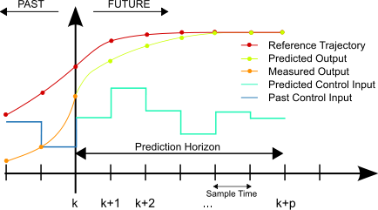
Literature Review: Receding Horizon Control

Slide 9
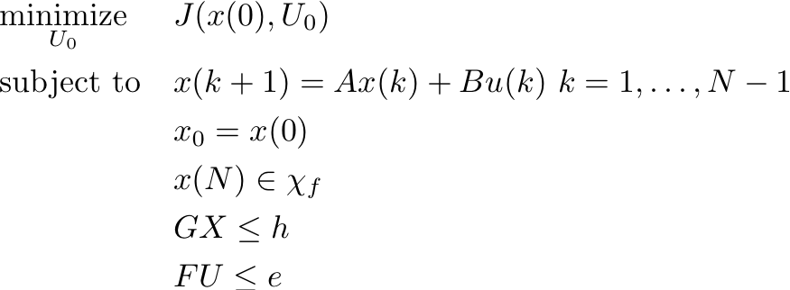

Constrained Linear Quadratic Optimal Control (CLOQC)
Discrete LTI dynamics
Quadratic Objective Function
Convex Optimization problem:

Slide 10

CLOCQ: Observations
Without constraints:
Collapses to discrete LQR
Lots of existing work on stability, robustness, design methodology (to pick Q & R)
The final cost and set are used to impose stability requirements
Borelli et Al. use set-theory to obtain conditions for feasibility and stability
Previous formulation is a regulator
Can be easily expanded to the tracker problem
i.e. drive a desired output y to yref instead of x to 0

Slide 11
CLOCQ: Solution
Offline solution to constrained problem:
The optimization problem is a multi-parametric QP
Solution is piece-wise affine in polyhedra regions of x
Compare to linear in x for discrete LQR
Unfortunately this has some limitations:
Polyhedra regions are exponential with number of constraints and horizon length
Only works for the regulator problem
Online solution possible but depends on:
Required control rate and available computational power
Planning and re-planning horizons
Number of states, control inputs, constraints

Slide 12
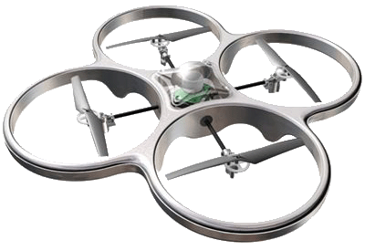
Quadrotor
Lots of interest by research community
Applications as UAVs:
Power lines, oil rigs or wind turbine inspection
Border patrol, perimeter search, surveillance

Slide 13
Quadrotor & MPC
Three options:
monolothic MPC to find thrust commands to get to a desired position. Fast dynamics and requires long horizon)
MPC for high-level trajectory planning and leave inner loop control to classical controller. Slow dynamics, but requires longer horizon.
MPC for inner-loop control and classical controller for outer loop. Fast dynamics, but requires shorter horizon.
Interested in the last one:
The complex dynamics that need to be handled are those of the inner loop (actuator saturation, control allocation, etc.)
Non-linearities in outer loops are easier to handle if the inner loop is well behaved

Slide 14
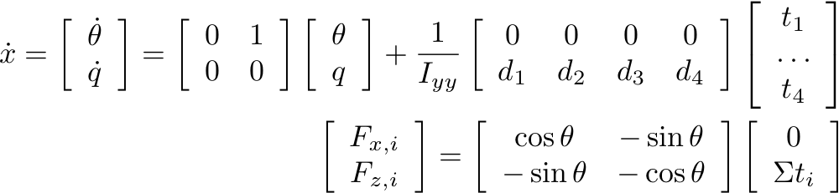
Equations of Motion
Focusing on 2 DOF, pitch and vertical axis
The goal is to achieve inertial lateral and vertical forces Fx, Fz (commanded by a position/velocity controller)
EOM are:

Slide 15
‘Classical’ Controller
We use as a benchmark a classical PID controller:
Successive loop PID controller:
Given Fx command, synthesize pitch command
Run pitch controller, synthesize My command
Solve control allocation problem with (Fz, My) to find required controls
Note that this can be posed as an optimization problem as well, but is relatively ‘trivial’

Slide 16
Cat & Mouse game
Start with a mouse that’s easy to catch
Teach the cat how to catch it
Make the mouse harder to catch
Teach the cat a new trick
Repeat until the mouse is the desired problem and the cat is the solution ☺

Slide 17
Game #1
MPC has perfect knowledge of the model
Should be able to solve the optimization problem once
And then apply the solution in a feed-forward manner
The solution should compare to the discrete LQR in the absence of constraints
This was mostly to verify that the problem formulation and solver worked as expected
A lot of the work was to setup the framework…

Slide 18
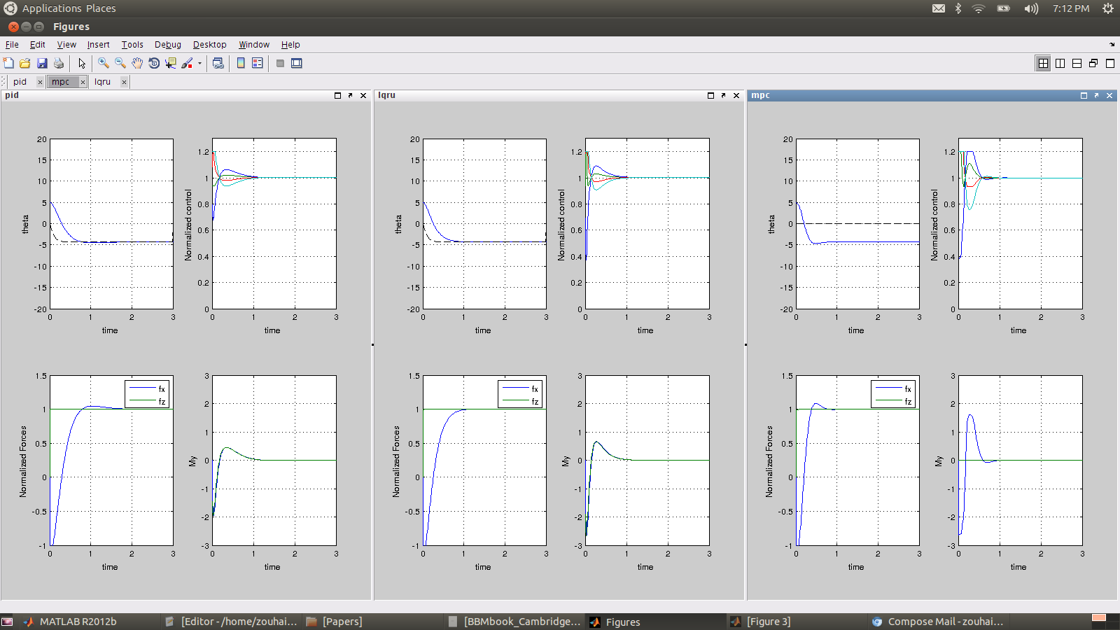
Game #1

Slide 19
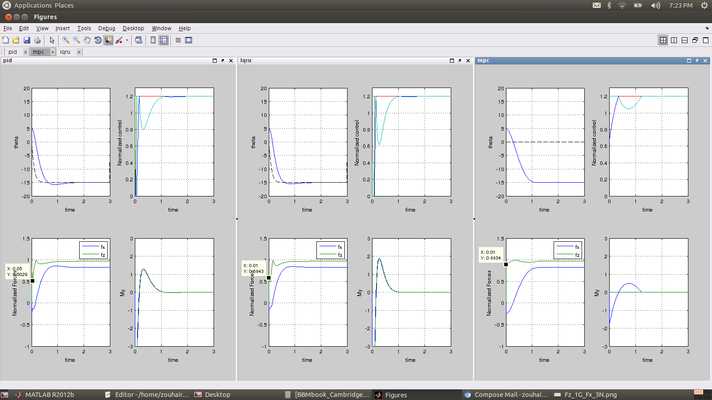
Game #1

Slide 20
Game #2
Add a disturbance My to the system:
Feed-forward diverges
How does one handle disturbances in MPC framework?
Literature review turned out two options:
Augment state with an integrator (not ideal…)
Synthesize a disturbance estimator and include disturbance in dynamics

Slide 21
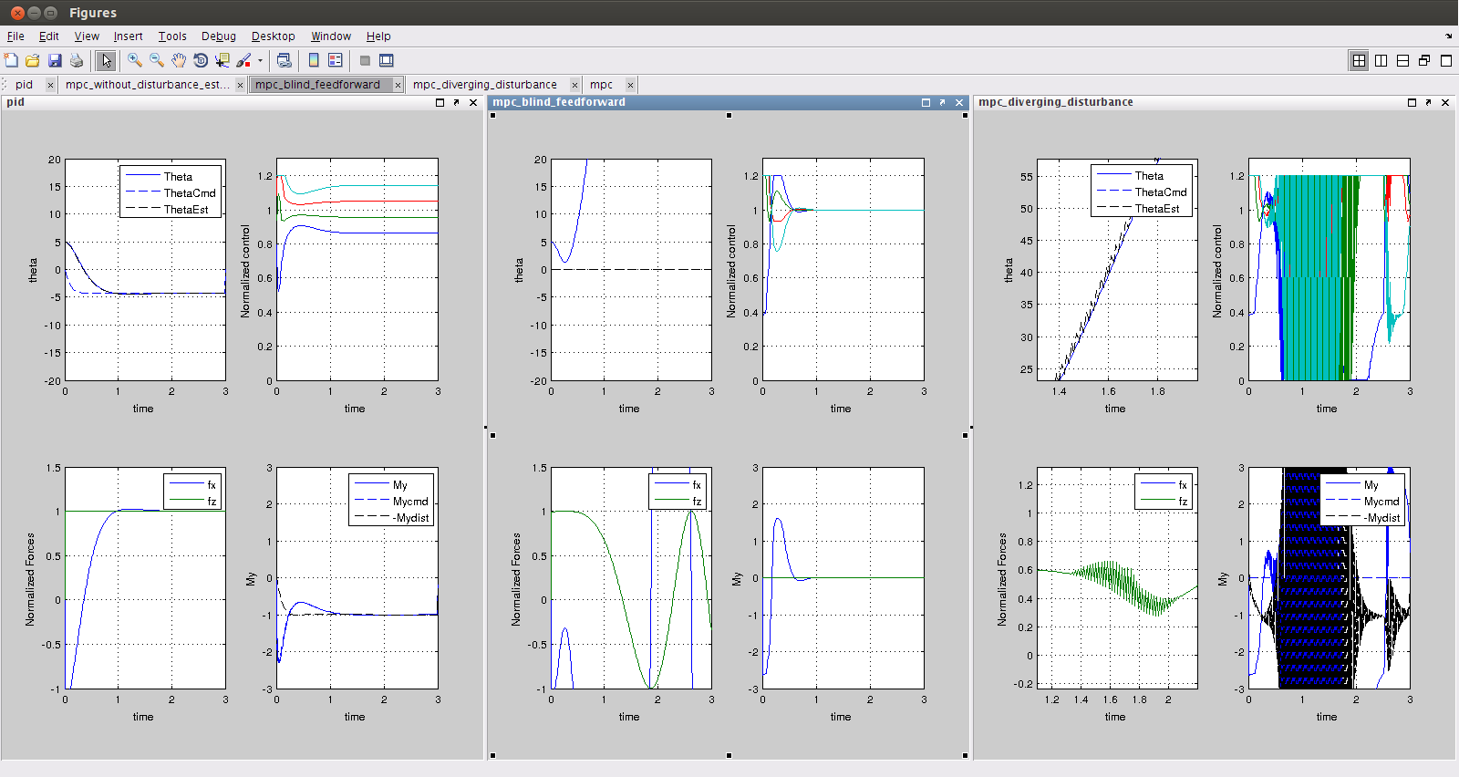
Game #2

Slide 22
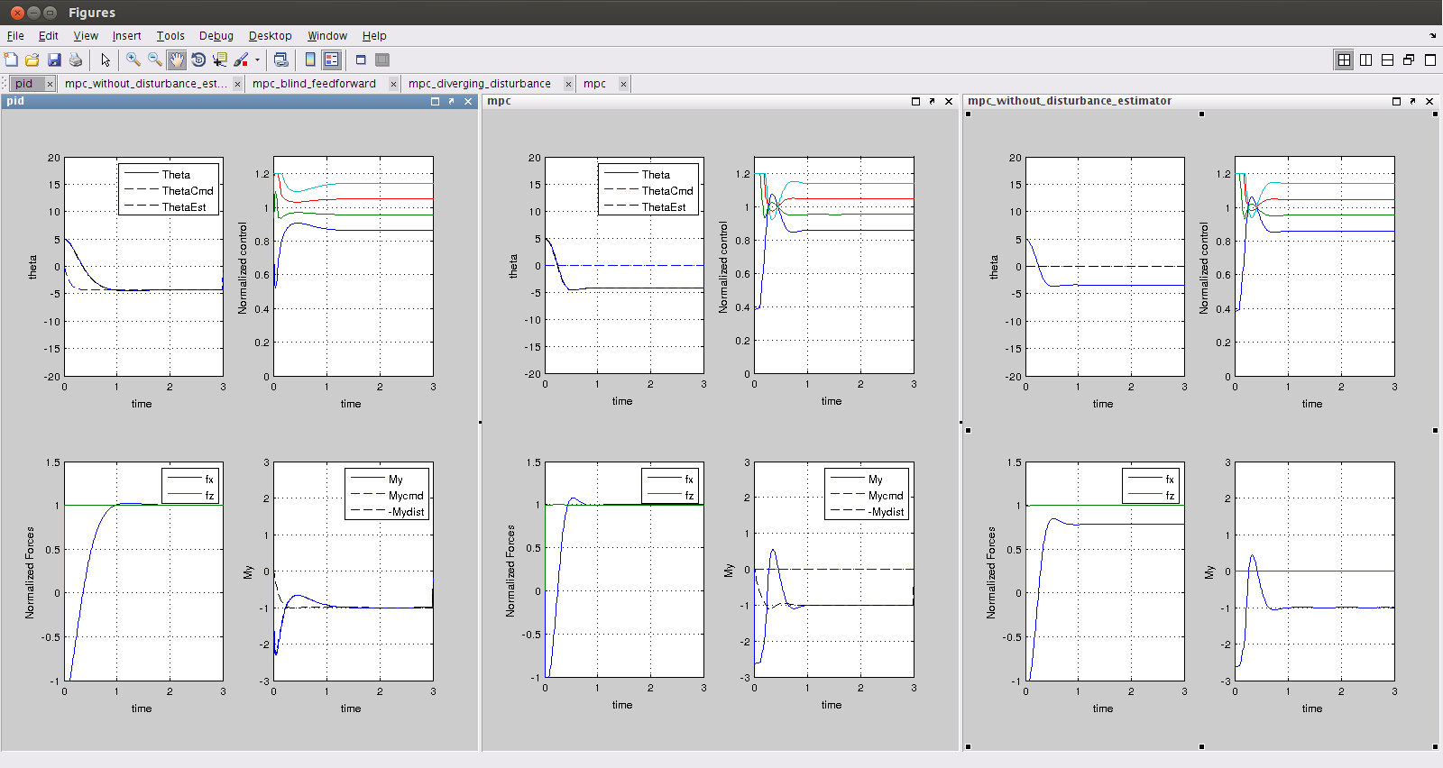
Game #2

Slide 23

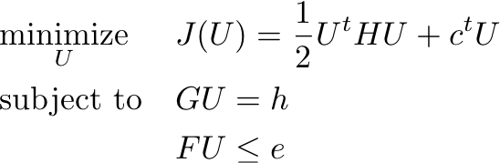
Game #3
Include a stabilizing final set constraint
Include more dynamics:
So far we ignored actuator dynamics. These are pretty important and performance is very bad if not accounted for; but to take them into account we introduce a lot of states:
The increase in the number of states slows things down…
Fortunately, reformulating the problem allows for an amazing simplification

Slide 24
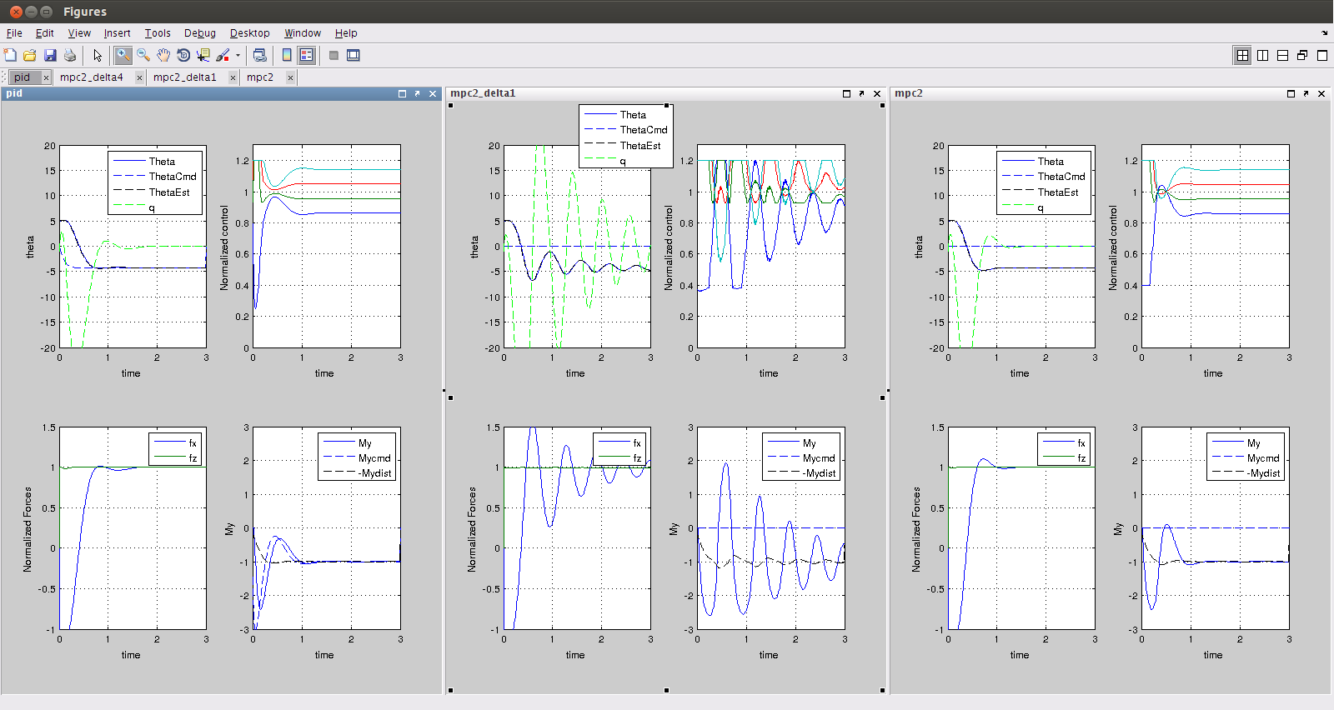
Game #3

Slide 25
Game #4-5
Now that we can handle more states:
Include even more dynamics (velocity-pitch interaction)
Add additional axes (roll-Fy and yaw-Mz)
We expect to still have the same problem to solve, which is promising!

Slide 26
Game #4-5
Do it as fast as possible
Look into ‘inexact’ and fast solvers tailored for MPC
Work by Y.Wang and S.Boyd might be relevant
Investigate the trade-off between performance and computational delay w.r.t. changes in control rate, planning and re-planning horizon lengths, number of constraints, move-blocking, etc.
Can this be done online?
If not with a CPU, what about FPGA or other parallel architectures?
If not, how much speed-up are we missing?

Slide 27
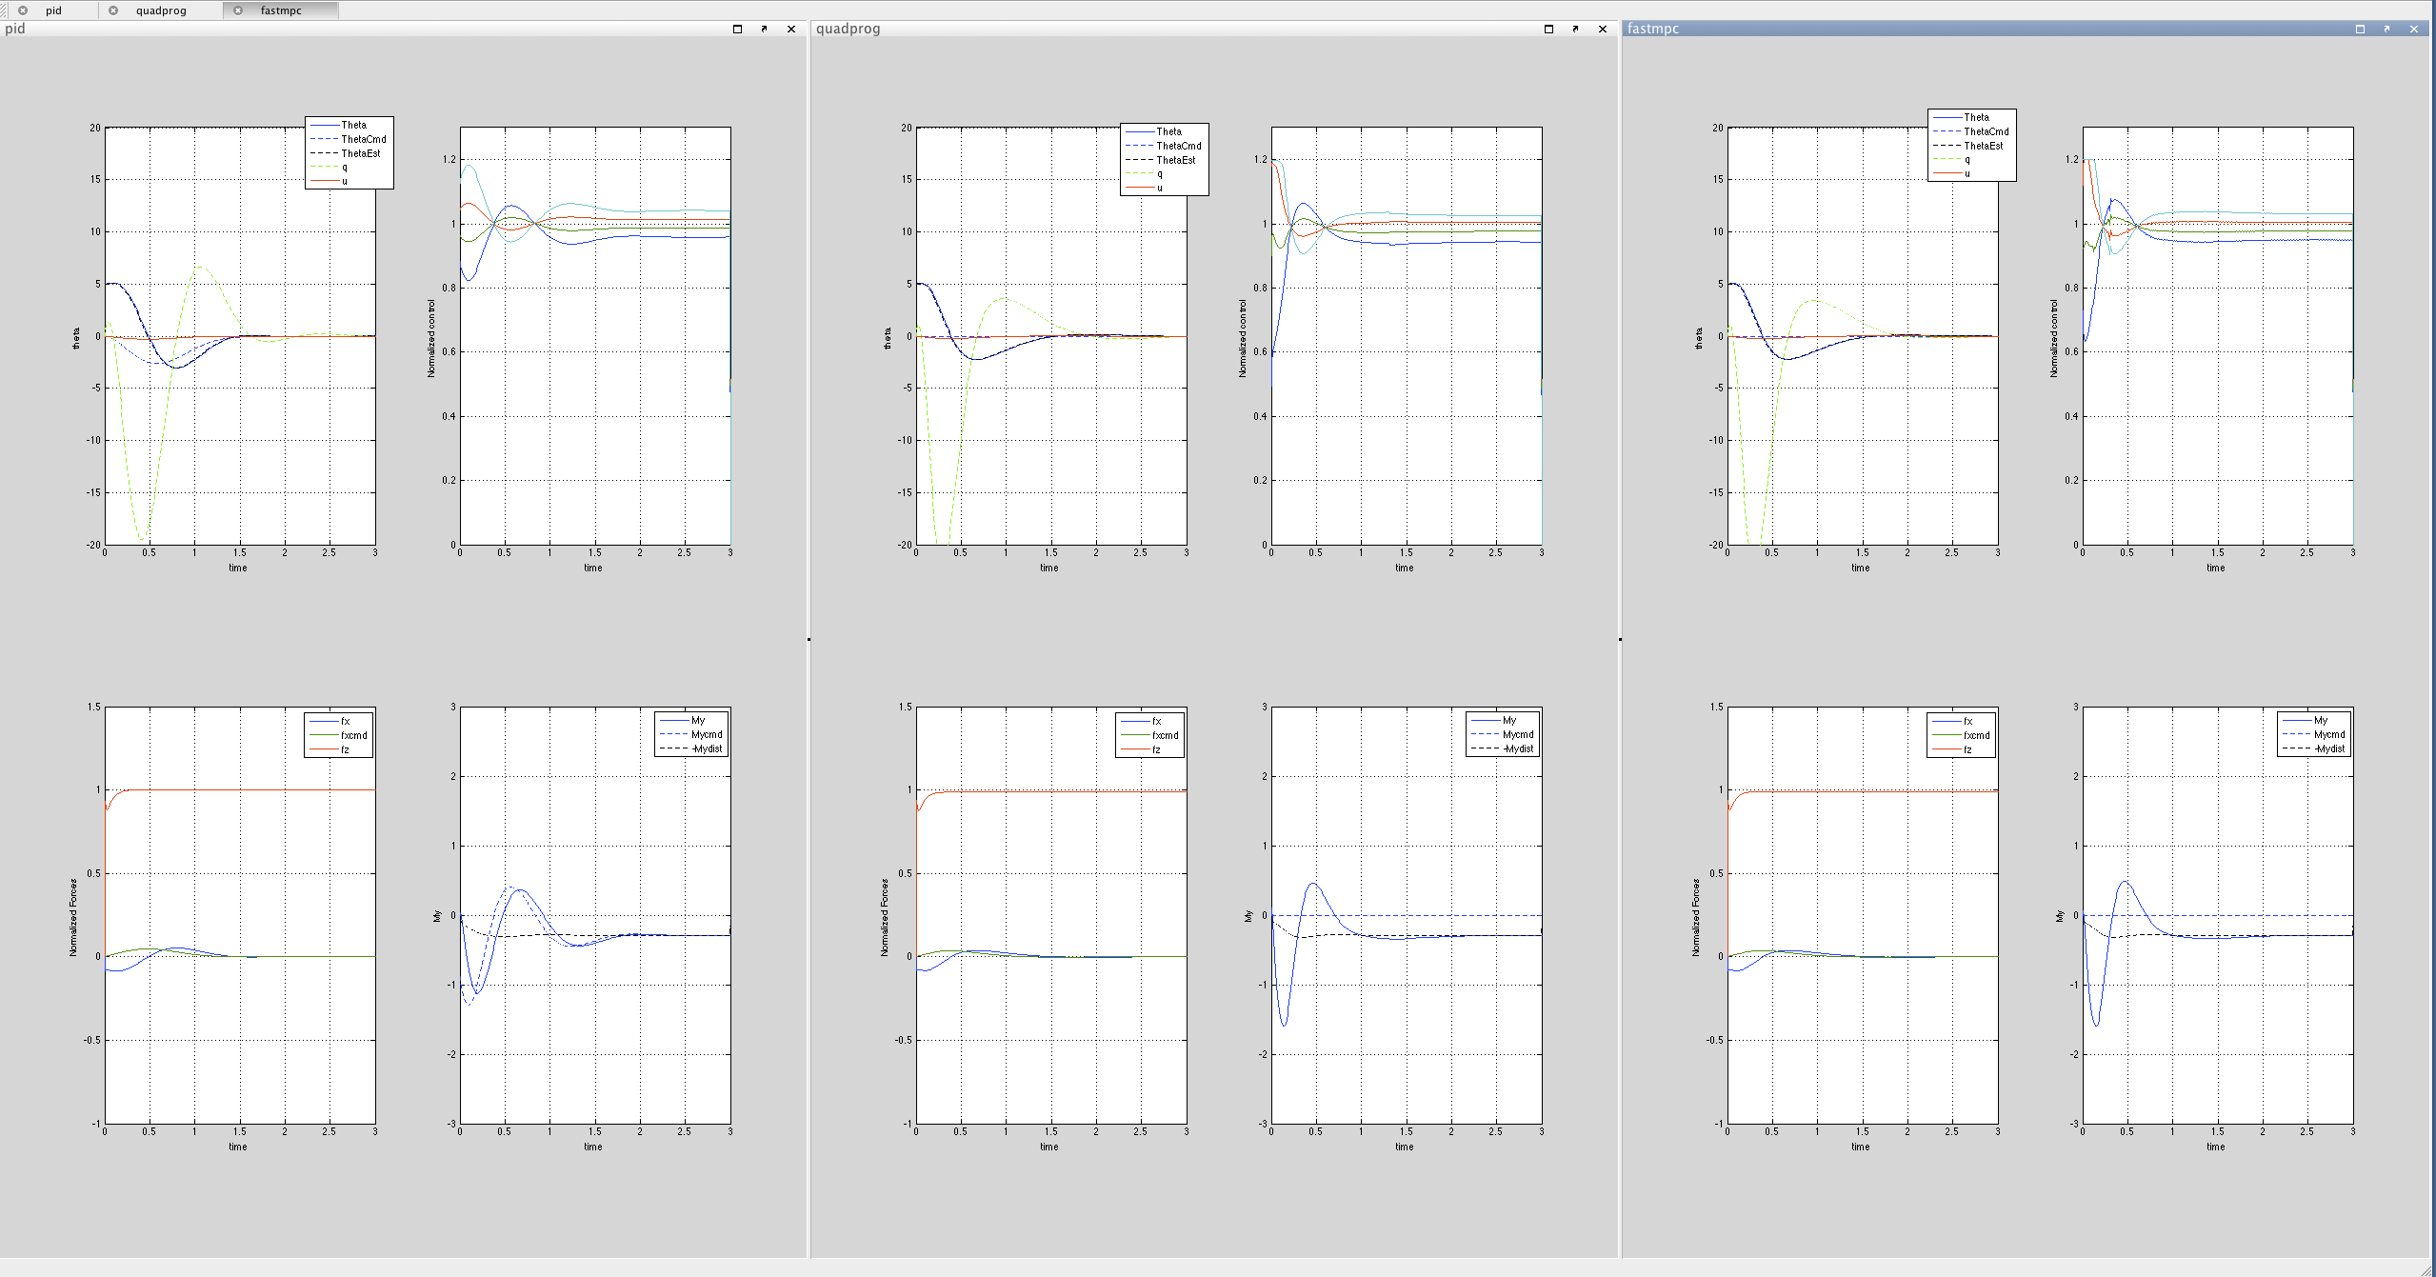
Game #4-5

Slide 28
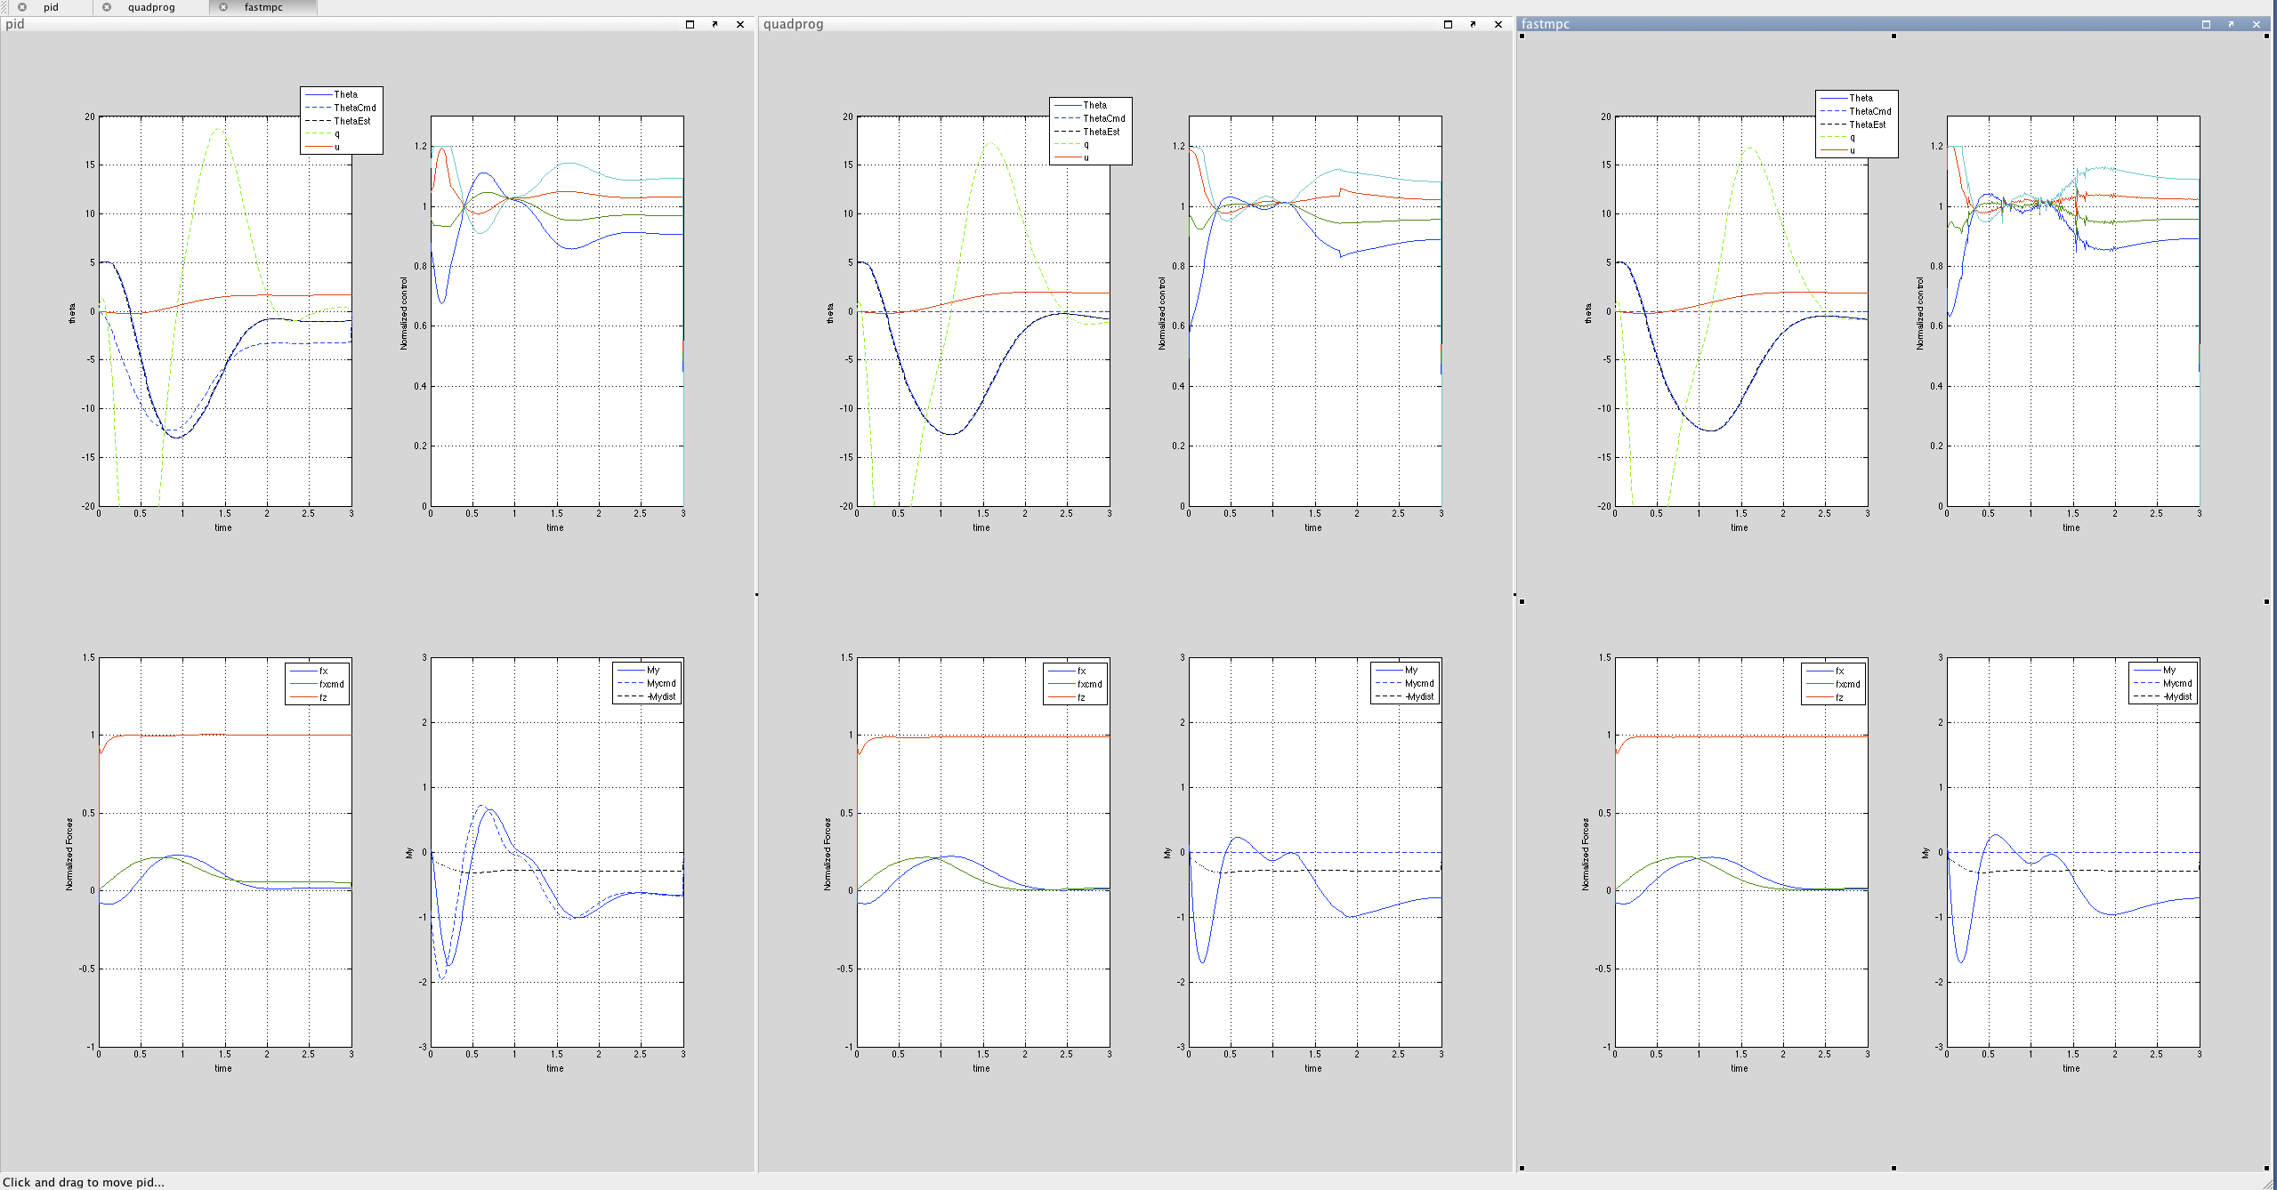
Game #4-5

Slide 29
Current Status
Fast MPC implementation from Wang/Boyd does not handle tracker case:
Expanded implementation of the code.
takes about 10ms on PC
Formulation in Wang/Boyd requires a full-rank hessian
Discuss implications…
Literature indicates that people are using FPGAs to speed-up MPC problems;
Seems like the computation power is there;
Just found out about one group at Berkley that has flown MPC online at 40Hz control rate

Slide 30
Equations …
Objective: J(x(0),U_0) = \overset{N-1}{\underset{k=0}{\Sigma}}(x^t_kQx_k + u^t_kRu_k) + x^t_NPx_N
Optimization: \begin{aligned}& \underset{U_0}{\text{minimize}}& & J(x(0),U_0) \\& \text{subject to}& & x(k+1) = Ax(k) + Bu(k)\ k = 1, \ldots, N-1 \\& & & x_0 = x(0) \\& & & x(N) \in \chi_{f} \\& & & G X \le h \\& & & F U \le e\end{aligned}
EOM: \dot{x} = \left[\begin{array}{c}\dot{\theta} \\\dot{q}\end{array}\right] = \left[\begin{array}{cc}0 & 1\\0 & 0\end{array}\right]\left[\begin{array}{c}\theta \\q\end{array}\right] + \frac{1}{I_{yy}}\left[\begin{array}{cccc}0 & 0 & 0 & 0\\d_1 & d_2 & d_3 & d_4\end{array}\right]\left[\begin{array}{c}t_1 \\\ldots\\t_4\end{array}\right] \\\left[\begin{array}{c}F_{x,i} \\F_{z,i}\end{array}\right] = \left[\begin{array}{cc}\cos \theta & -\sin \theta \\-\sin \theta & -\cos \theta\end{array}\right]\left[\begin{array}{c}0 \\\Sigma t_i\end{array}\right]
Final Set constraint: x_N = Ax_N + Bu_{N-1} + B_d \hat{M}_{yd}\\
Disturbance: x_{k+1} = Ax_{k} + Bu_{k} + B_d \hat{M}_{yd}\\

