Slide 1
Causal Inference and Disentanglement Techniques for Robust Prediction Under Distribution Shift
Zahra Rahiminasab

Slide 2
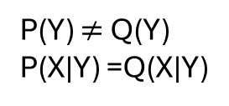
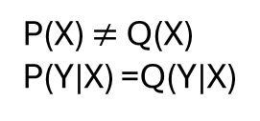
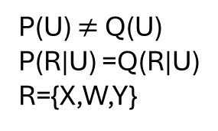
Why Latent shift?
Covariate shift
Latent shift
Label shift
Cancer stage
Gene
program
score
X
Y
Z
U
Cancer mic env
X
Y
Genes
Tissue texture
P(X) $≠$ Q(X)
P(Y|X) =Q(Y|X)
P(Y) $≠$ Q(Y)
P(X|Y) =Q(X|Y)
X
W
Genes
Y
Gene program score
P(U) $≠$ Q(U)
P(R|U) =Q(R|U)
R={X,W,Y}

Slide 3
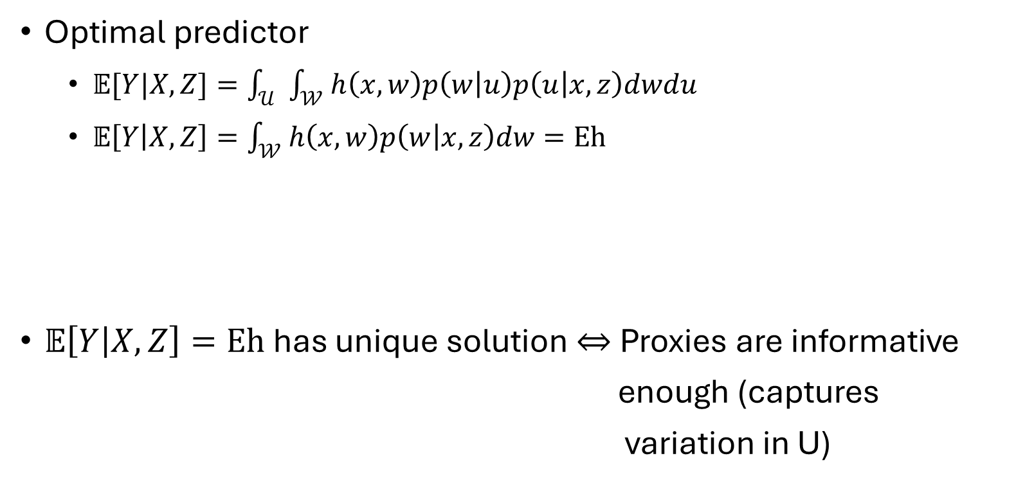
How Proximal causal inference (PCI) handles shift in latent confounders?
Optimal predictor
  $𝔼[Y|X,Z]=\int_{𝒰}{\int_{𝒲}{h\left(x,w\right)p\left(w | u\right)p\left(u | x,z\right)dwdu}}$
  $𝔼\left[Y | X,Z\right]=\int_{𝒲}{h\left(x,w\right)p\left(w | x,z\right)dw}=Eh$
$𝔼\left[Y | X,Z\right]=Eh$ has unique solution $⇔$Proxies are informative
enough (captures
variation in U)
Z
U
Conditional expectation
operator
Bridge
function
X
W
Y
E is injective

Slide 4


Our solution when completeness does not hold in practice
Latent equivalent classes (LECs):
  Proxies provide natural partition in latent space
Decomposing conditional distribution P(W|X,Z) at LEC level ${\{O_{j}\}}_{j=1}^{|O|}$
Environment dependent term
Enough variation in environment
to capture different LECs
Environment invariant term

Slide 5
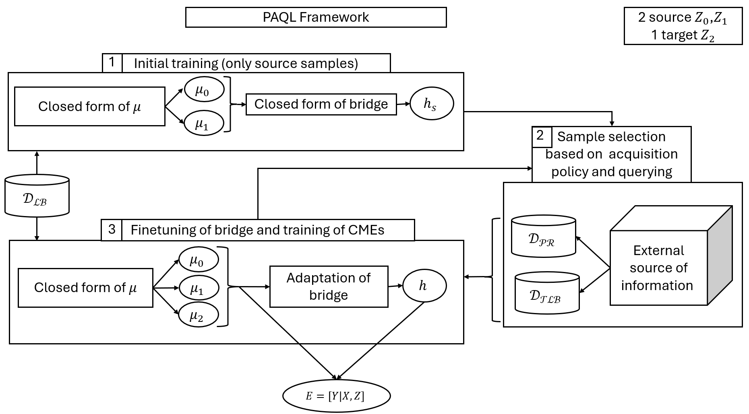
Proximal Quasi-Bayesian Active Learning (PQAL) PQAL

Slide 6
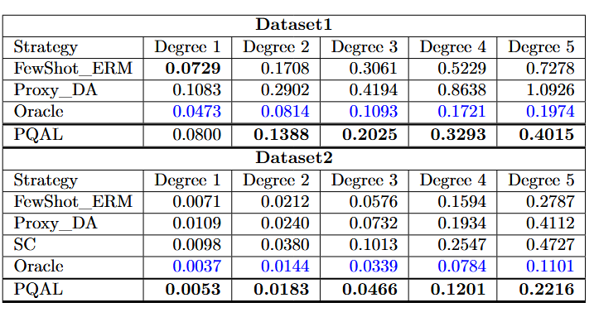
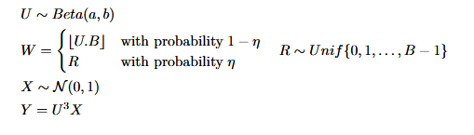
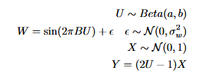
Experiments

Slide 7
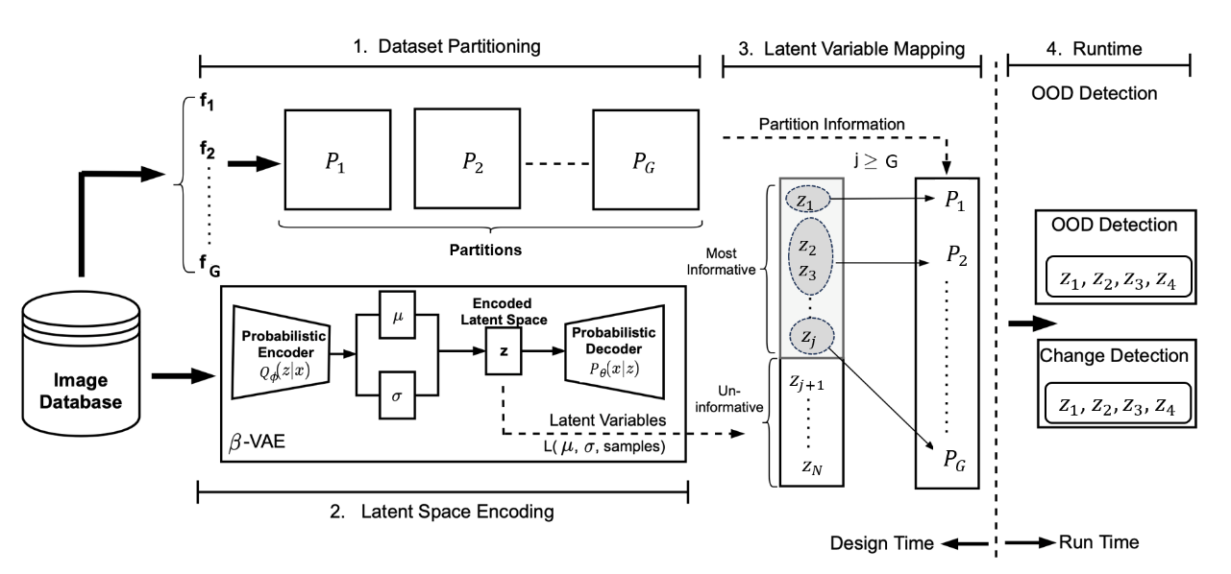
Disentanglement of latent space of Beta-VAE

Slide 8
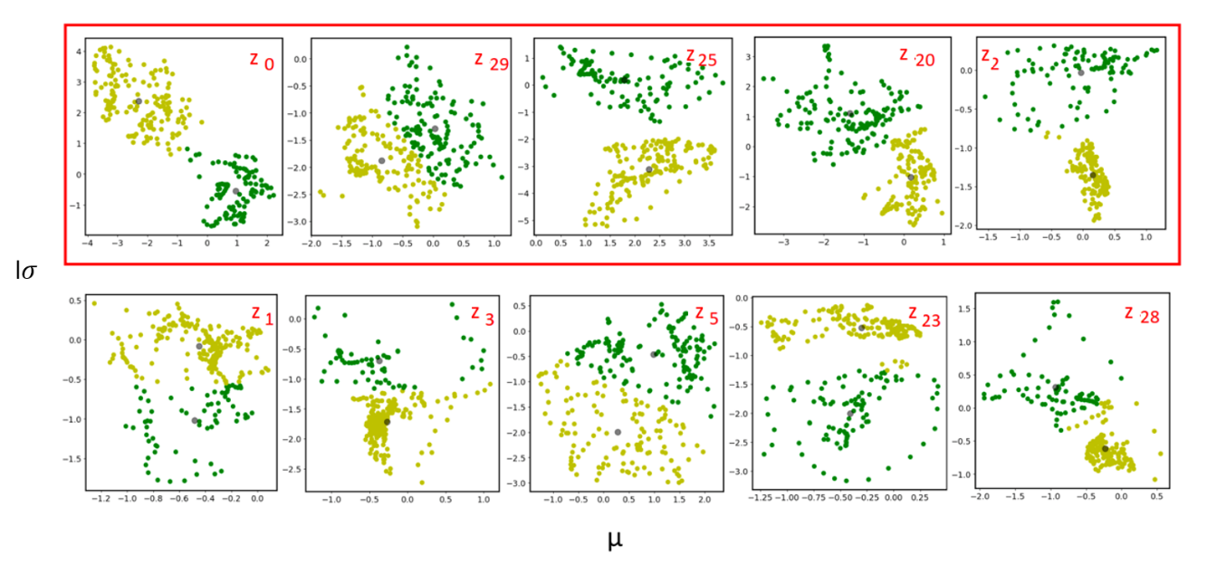
Most informative dimensions

Slide 9
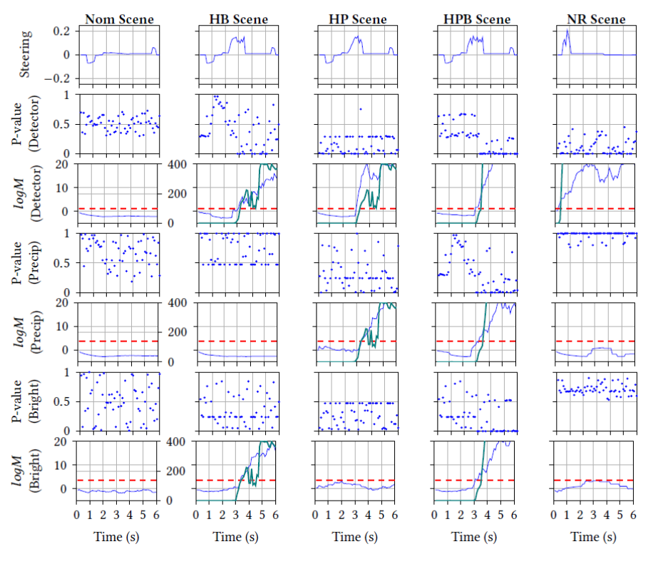
Martingale for change point detection

Slide 10
Next steps to connect current research to niche identification or genomic data
Addressing latent shift in presence of imperfect proxies
Creating robust models that provide
identifiable average treatment effect
Z
U
X
W
Y

Slide 11
Q &A

