Slide 1

PATIENT-REVIEW INTELLIGENCE
MedReview Insight
AI-powered analysis of medication experiences
Predict satisfaction · explain language evidence · retrieve similar patient reviews
Hybrid TF-IDF classifier
MiniLM semantic retrieval
ISBA 2411 · Group 1
Zahra Fahimfar · Varsha Pai · Krystle Jozen Dario
Notes:
Open with the project promise: patient reviews contain useful experience signals, but the evidence is buried in unstructured text.
[Sources]
- Project materials and final MedReview Insight notebook.

Slide 2
PROBLEM → OBJECTIVE
02
From thousands of reviews to usable evidence
The challenge
Our objective
Medication reviews contain effectiveness, side effects, symptoms, and overall experience—but the information is unstructured and difficult to compare at scale.
Use NLP to predict low / medium / high satisfaction from review text, then show the language and similar reviews supporting the result.
→
CLASSIFY
EXPLAIN
RETRIEVE
Satisfaction from patient-written language.
Evidence terms and experience themes.
Semantically similar patient experiences.
ISBA 2411 · Group 1 · MedReview Insight
Research & educational use only
Notes:
Zahra
The problem we wanted to address is that patient reviews contain a lot of information, but that information is mostly unstructured text.
A rating such as a 7 or an 8 tells us the overall score, but the written review can tell us why the patient gave that rating. For example, someone may say that a medication helped their symptoms but caused nausea.
When we have thousands of reviews, manually reading and comparing them becomes difficult. NLP gives us a way to systematically analyze those experiences.

Slide 3
DATASET
03
Data strategy: full source, focused experiments
FULL DRUGS.COM SOURCE SPLIT
ORIGINAL TRAINING FILE
ORIGINAL TEST FILE
SATISFACTION LABELS
161,297
53,766
1–4 · 5–6 · 7–10
patient-written reviews
held-out source reviews
Low · Medium · High
FINAL EXPERIMENT SAMPLES
CLASSIFIER TRAINING
MODEL EVALUATION
SEMANTIC LIBRARY
90,000
15,000
35,000
reviews used to fit the model
reviews used for reported metrics
reviews embedded for retrieval
Drugs.com Medication Reviews Dataset · project experiment sampling shown separately
Research & educational use only
Notes:
Zahra
Make the distinction explicit: the project starts from the full Drugs.com train/test files, but uses focused samples for reproducible Colab experiments and fast app retrieval.
[Sources]
- Drugs.com Medication Reviews Dataset (project-provided source files).
- Final MedReview Insight notebook experiment configuration.

Slide 4
METHOD
04
A two-model architecture—each model does what it does best
1
Prepare data
2
Represent text
3
Classify
4
Retrieve + ground
Clean text, handle missing context, remove unusably short reviews.
Combine word-level and character-level TF-IDF features.
Balanced averaged SGD logistic classifier predicts 3 satisfaction classes.
MiniLM embeddings find similar reviews and surface supporting evidence.
TF-IDF = strongest classifier · MiniLM = semantic retrieval layer
ISBA 2411 · Group 1 · MedReview Insight
Research & educational use only
Notes:
Zahra
Our approach has two major NLP components: classification and retrieval.
First, we clean the reviews and combine the medication, condition, and review text.
For classification, we use a hybrid TF-IDF representation. Word-level TF-IDF captures meaningful words and phrases, while character-level TF-IDF helps with things like misspellings, word variations, and medication names.
We then use a class-balanced averaged logistic classifier to predict satisfaction.
Separately, we use the MiniLM sentence-transformer model to create semantic embeddings. This allows us to retrieve reviews that have similar meanings, even if they don't use exactly the same words.

Slide 5
MODEL PERFORMANCE
05
Hybrid TF-IDF clearly outperformed the alternatives
+17.4
percentage points
over the majority baseline
Why Macro-F1 matters
The medium class is rare, so accuracy alone can hide poor minority-class performance.
Reported on the 15,000-review evaluation sample.
ISBA 2411 · Group 1 · MedReview Insight
Research & educational use only
Notes:
Varsha
Lead with the result: the hybrid TF-IDF classifier reached 83.3% accuracy and 0.710 Macro-F1. MiniLM remained valuable, but for retrieval rather than classification. Metrics were computed on the 15,000-review evaluation sample.
[Sources]
- Final MedReview Insight notebook evaluation output.

Slide 6
SYSTEM WORKFLOW
06
The application turns a prediction into an evidence trail
1
Analyze
2
Explain
3
Retrieve
4
Ground
Drug + condition + review → satisfaction prediction and confidence.
Highlight evidence terms and patient-experience themes.
Find semantically similar reviews with MiniLM embeddings.
Answer follow-ups using retrieved evidence and safety guardrails.
›
›
›
Research tool—not a diagnosis, prescription, or treatment recommendation.
ISBA 2411 · Group 1 · MedReview Insight
Research & educational use only
Notes:
Varsha
This is where our project moves from a machine learning model into an actual application.
A user enters a medication, condition, and patient review. The system then predicts the satisfaction level and provides the probabilities for each class.
It also identifies text features that contributed to the prediction. Then, using MiniLM embeddings, it retrieves similar patient reviews.
We designed the workflow around four steps: analyze, explain, retrieve, and ground. The idea is that the prediction should not just appear as a black-box answer. The user should be able to see supporting information from the patient-review dataset.

Slide 7
KEY FINDINGS
08
Three findings shaped the final product
1 · Representation matters
2 · One model need not do everything
3 · Evidence improves trust
Hybrid word + character TF-IDF was the strongest satisfaction classifier, improving accuracy by 17.4 points over the majority baseline.
MiniLM underperformed for classification but added useful meaning-based retrieval of related patient experiences.
Class probabilities, evidence terms, themes, and retrieved reviews make the result easier to inspect than a black-box label.
ISBA 2411 · Group 1 · MedReview Insight
Research & educational use only
Notes:
Krystle
Overall, our results show that NLP can successfully extract useful satisfaction signals from patient reviews.
One of our biggest findings is that the hybrid TF-IDF model works very well for classification, while MiniLM is more useful for finding semantically similar reviews.
By showing probabilities, key terms, and actual patient reviews instead of a black-box label, users can easily verify why a prediction was made.

Slide 8
LIMITATIONS & FUTURE WORK
09
What remains unresolved—and where we go next
CURRENT LIMITATIONS
NEXT STEPS
Medium class is hardest
Calibrate probabilities
Ratings 5–6 often describe mixed, ambiguous experiences.
Make confidence scores better aligned with observed accuracy.
Patient reviews are noisy
Evaluate subgroups
Subjectivity, misspellings, bias, sarcasm, and missing context remain.
Measure performance by medication, condition, and confidence band.
Not clinical evidence
Audit retrieval quality
Predictions summarize patient-reported experiences—not medical advice.
Review high-confidence errors and the relevance of retrieved evidence.
ISBA 2411 · Group 1 · MedReview Insight
Research & educational use only
Notes:
Krystle
However, there are important limitations. The medium class is the hardest to predict, probably because ratings from 5 to 6 can represent mixed experiences. Patient reviews can also be subjective, incomplete, misspelled, or sarcastic.
For future work, we would focus on probability calibration, evaluating the model across different medications and conditions, and analyzing high-confidence errors.
Most importantly, this system should be viewed as patient-experience analysis, not clinical evidence or medical advice.

Slide 9
MedReview Insight
The right model for each task.
Hybrid TF-IDF delivered the strongest satisfaction classification.
MiniLM added semantic retrieval and transparent supporting evidence.
A practical NLP system for exploring patient experiences—not making clinical decisions.
ISBA 2411 · Group 1
Notes:
Krystle
To summarize: MedReview Insight proves that matching the right NLP tool to the right job gets the best results—hybrid TF-IDF delivers accurate classification, while MiniLM gives us transparent, searchable evidence. It's a practical research tool designed to make patient experiences easier to analyze, without taking on the role of clinical decision-making.

Slide 10
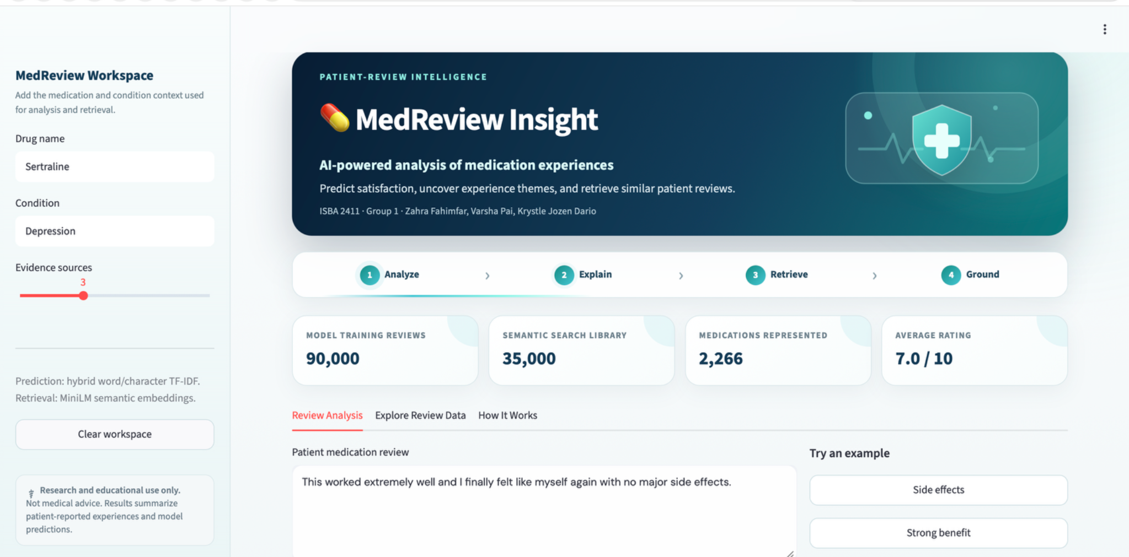
APPLICATION PREVIEW
07
Presentation-ready interface—with a live-demo fallback
LIVE DEMO
1 · Input
Medication, condition, and patient review.
2 · Analyze
Prediction, explanation, and similar reviews.
If Colab is unavailable, present this screenshot and continue the story.
ISBA 2411 · Group 1 · MedReview Insight
Research & educational use only
Notes:
Recommended delivery: show this screenshot first, then switch to the separate live demo. If the Colab tunnel or runtime fails, return to this slide and explain the same flow without losing time.
[Sources]
- MedReview Insight application screenshot generated by the project team, August 2026.

