Slide 1
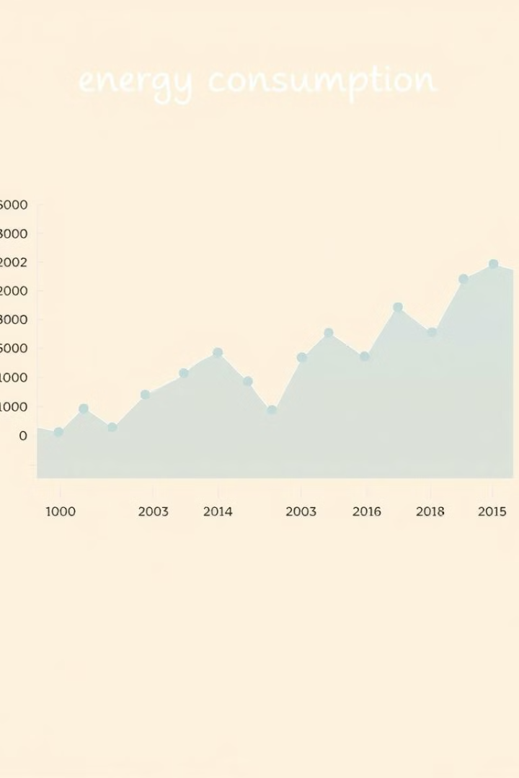
Energy Time Series Forecasting
Name: ID:
Zahraa Albahrani 220023993
Raihana Jawad 220016140

Slide 2
Introduction
This presentation explores various methods for forecasting energy consumption, examining the strengths and weaknesses of ARIMA, SVR, and Neural Networks. We will delve into the dataset, model implementations, evaluation metrics, and conclude with insights on the best performing model.
The Problem
Our Approach
Forecasting energy consumption is critical for efficient resource allocation and grid stability.
We investigate three widely used methods: ARIMA, SVR, and Neural Networks.

Slide 3

The Problem
Predicting future energy consumption is crucial for optimizing energy production, managing demand, and ensuring grid reliability. Accurate forecasts help utilities allocate resources efficiently and minimize energy waste.

Slide 4
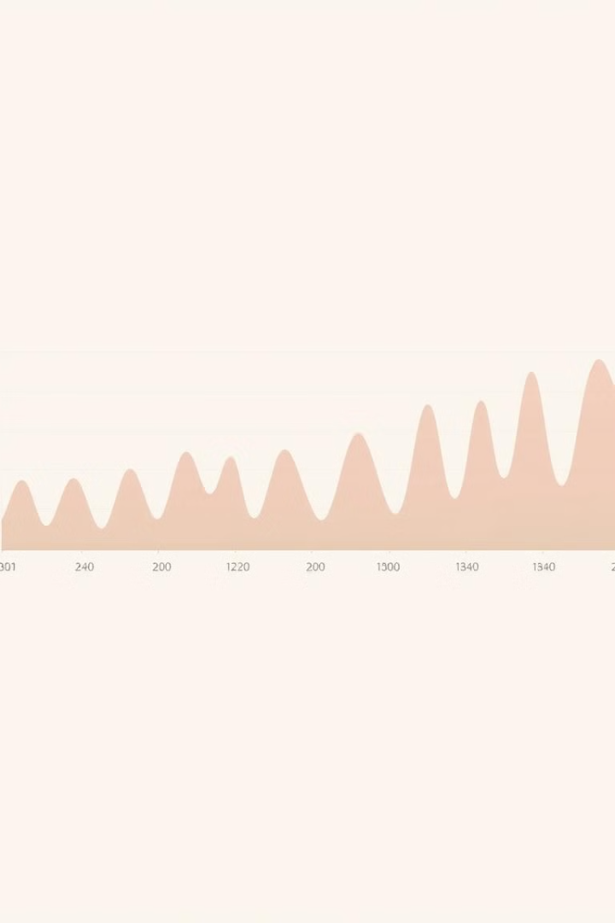
The Dataset
We utilized the energy\_data.csv dataset, comprising historical energy consumption data with timestamps. This dataset allows us to train and evaluate our forecasting models.

Slide 5

Model Implementation
1
ARIMA
2
SVR
Autoregressive Integrated Moving Average (ARIMA) models are a common statistical technique for time series forecasting, utilizing past data to predict future values. It uses the parameters (p, d, q) to represent the autoregressive, integrated, and moving average components of the model.
Support Vector Regression (SVR) is a powerful machine learning algorithm using kernel functions to map data into a higher-dimensional space, allowing for complex nonlinear relationships. This method is well-suited for regression tasks like energy forecasting.
3
Neural Network
We implemented a feedforward neural network with an input window size of 10, multiple hidden layers, and activation functions like ReLU and sigmoid. The network learns complex patterns from historical data to generate accurate predictions.

Slide 6

Evaluation Metrics
MAE
MSE
Mean Absolute Error (MAE) measures the average absolute difference between the predicted and actual values. Lower MAE indicates better accuracy.
Mean Squared Error (MSE) calculates the average squared difference between predicted and actual values, penalizing larger errors. Lower MSE signifies better accuracy.
RMSE
Root Mean Squared Error (RMSE) is the square root of MSE, providing a more interpretable measure of the error magnitude. Lower RMSE indicates better performance.

Slide 7
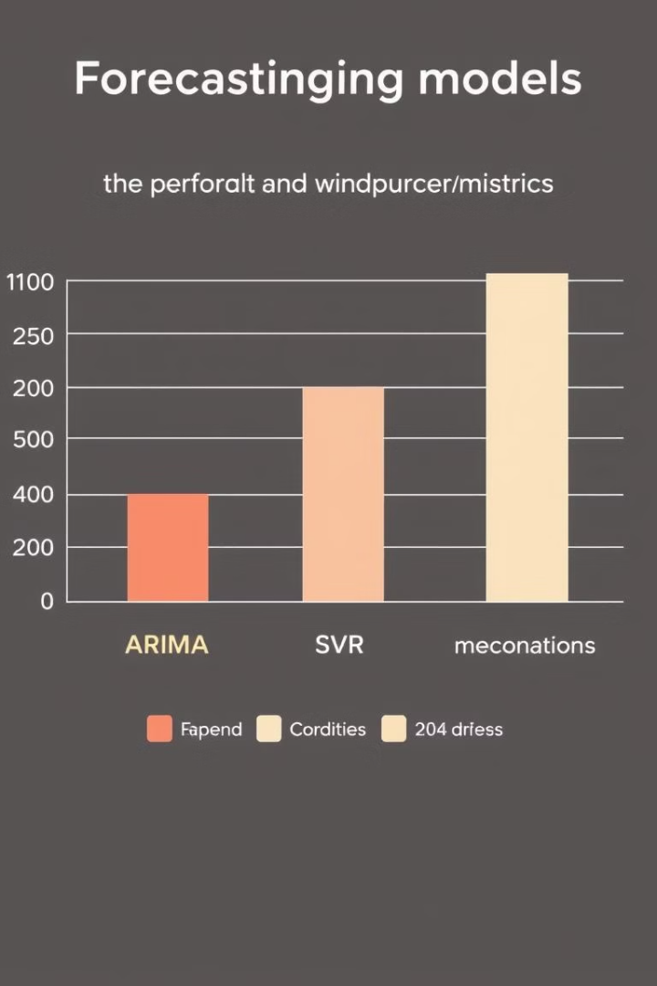
Conclusion
Our results indicated that the Neural Network model achieved the highest accuracy, as measured by MAE, MSE, and RMSE, outperforming both ARIMA and SVR. However, the model's complexity requires a significant amount of data for training, and it may be more susceptible to overfitting than the simpler ARIMA and SVR models. Further investigation is needed to explore the optimal model parameters and data preprocessing techniques for achieving the best possible forecasting accuracy.

Slide 8

Thank You
Thank you for your attention. We hope this presentation provided valuable insights into energy time series forecasting and the potential of various models for this task.

