Slide 1
BANK TRANSACTION
Supervised by
Dr. Khaled Khankan
Prepared by:
Zahraa Badawi | 3820003
Donna Al-Amri | 3910233
Fatma Alrehaily | 3910090

Slide 2
Introduction

Slide 3
Project description

Slide 4
Requirements specifications
1- Functional requirements
2- Non-functional requirements

Slide 5
Models

Slide 6
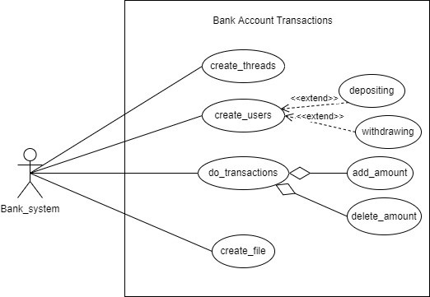
Use-case diagram

Slide 7
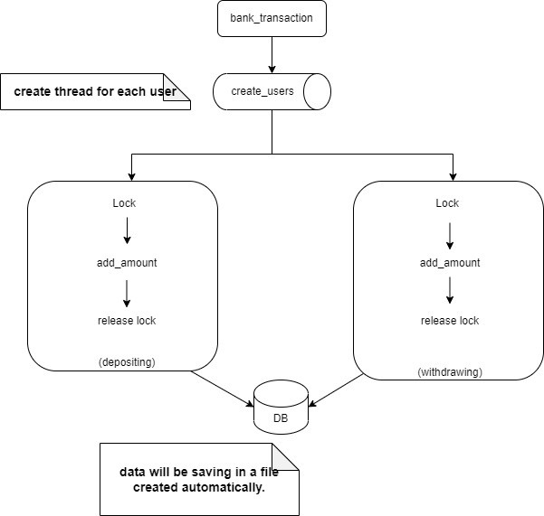
Overall architecture

Slide 8
Code discussion

Slide 9
Conclusion

