Slide 1
Introduction

Slide 2
Agenda
Binary System
Computer Languages
Compiler vs Interpreter
Hello World Explanation
Variables
Data types
Arithmetic Operators
Standard Input (Cin)
Error Types

Slide 3
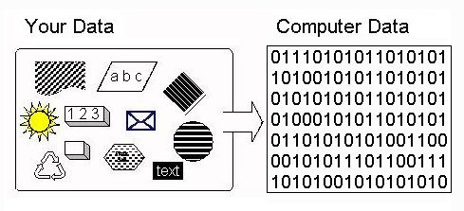
Binary System
Computers only understand binary 01
Computers use the binary number system to manipulate and store all of their data including numbers, words, videos, graphics, and music

Slide 4
Computer Languages
A computer language is a formal language used in communication with a computer
There are three main types of computer languages:
Machine Language: Zeroes and Ones. It is very difficult to understand, but it is the only thing that the computer can work with
Low-Level Languages: Assembly
High-Level Languages: C/C++, Python, Java, ……

Slide 5
Compiler vs. Interpreter
A compiler first takes in the entire program, checks for errors, compiles it and then executes it.
Languages like Assembly Language, C, C++, Fortran, Pascal are compiled into machine code.
Longer process than that of an interpreter but program runs faster.
An interpreter does this line by line, so it takes one line, checks it for errors and then executes it.
Languages like Basic, VbScript and JavaScript are interpreted.
interpreted programs run much slower than compiled programs, as much as 5-10 times slower as every line of code has to be re-read, then re-processed.

Slide 6
Hello World C++
#include <iostream>
using namespace std;
int main() {
cout << "Hello World!" << endl;
return 0;
}

Slide 7
Variables
Used to store values in memory.
When naming a variable you should consider the following:
A variable name is a sequence of one or more letters (a-z) (A-Z), digits (0-9) or underscore characters (_).
Neither spaces nor punctuation marks or symbols can be part of a variable name.
In addition, variable names always have to begin with a letter.
Another rule that you have to consider when naming a variable is that they cannot match any keyword of the C++ language nor your compiler's specific ones.

Slide 8
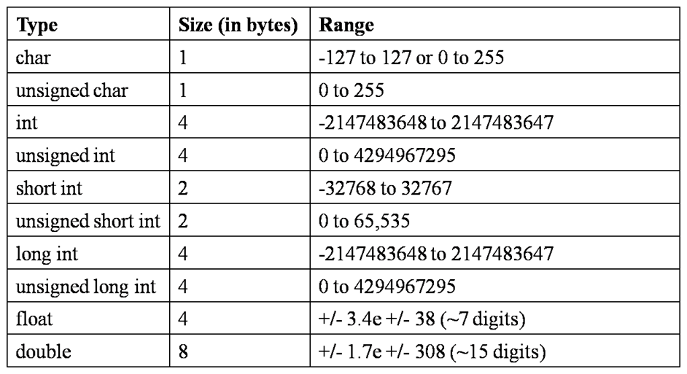
Data types

Slide 9
Declaring Variables
dataType variableName;
int num;
double num2;
int x,y,z;
unsigned short int num3;
bool isOk;

Slide 10
Declaring and Initializing Variables
Initialization: is to give your variable an initial value at the beginning of the program.
int sum=0;
int multiplication=1;
int counter=100;
bool isOk= true;

Slide 11
Assignment (=)
The assignment operator assigns the value of the right side to the variable and only one variable of the left side.
int sum=0;
sum = 10;
sum = sum + 10*7/2

Slide 12
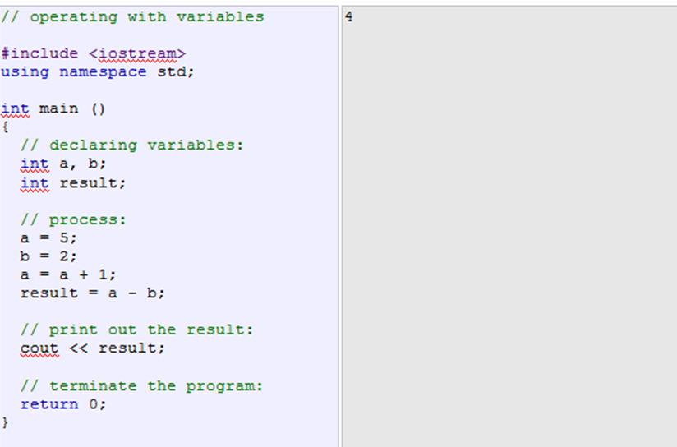
Example

Slide 13
Arithmetic Operators ( + - * / % )
Order of precedence of arithmetic operators:
( )
* / %
+ -
L
OW
E
R

Slide 14
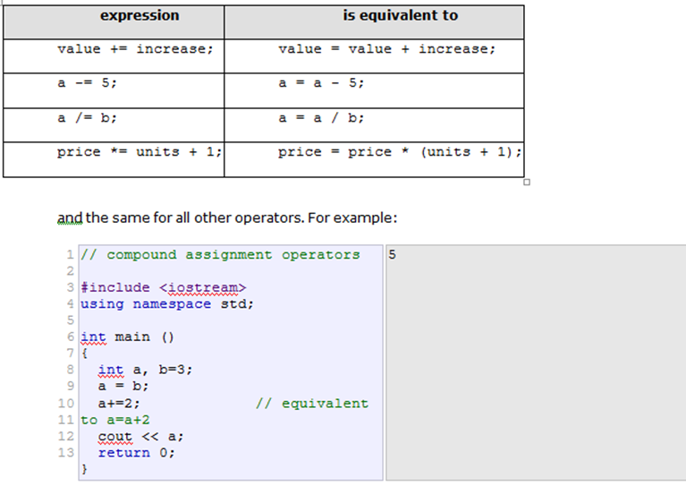
Compound Assignment ( += | -= | %= | *= | /= )

Slide 15
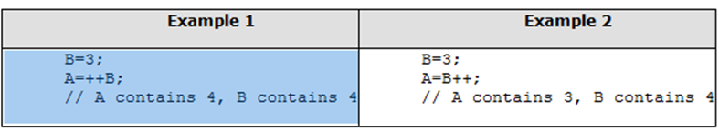
Increment and Decrement ( ++ | --)
++ increments the value by 1
-- decrements the value by 1
++B differs from B++

Slide 16
Standard Input (Cin)
int age;
cin >> age;
int a,b;
cin >> a >> b;

Slide 17
Errors
Syntax Errors – Typing Errors
Errors in programming language rules.
You can use the compiler or interpreter to uncover syntax errors.
You must have a good working knowledge of error messages to discover the cause of the error.
Semantic Errors – Logic or Meaning Errors
Errors that indicate the logic used when coding the program failed to solve the problem.
You do not get error messages with logic errors.
Your only clue to the existence of logic errors is the production of wrong solutions.
Run-time Errors (Exceptions)
Code does something illegal when it is run (hence runtime) E.g., divide by zero

Slide 18
Quiz
Write a program to calculate the sum, multiplication, division, remainder of two given numbers.
Input:
2 7
3 0

Slide 19
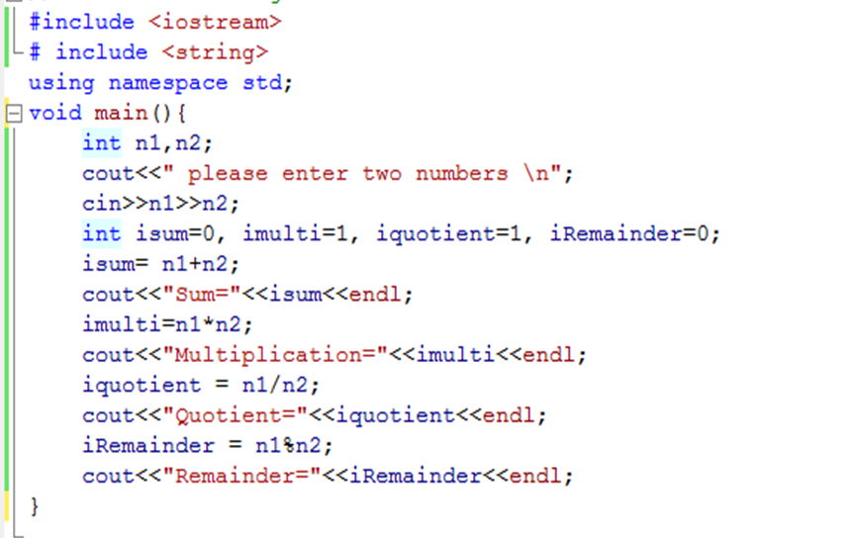
Calculator Program

