Slide 1
Leave Management System <//Dr Mohammad Aoude//>
<Mini Project>
Faculty of Engineering
Fatima Jawad Fatima Moselmani

Slide 2
Table of contents
<//
//>
01
02
03
Introduction
Objective
System Architecture
04
05
06
Implementation
Results
Conclusion

Slide 3
01
<// Intro duction//>
< Leave Management System >
<
<
Faculty of Engineering

Slide 4
<//Introduction//>
< Leave Management System >
What is leave management system?
Why this project?
What is an AI agent?
Faculty of Engineering
Manual → Rule-Based → AI-Powered

Slide 5
02
<// Project Objectives//>
< Leave Management System >
<
<
Faculty of Engineering

Slide 6
Objectives
01
02
03
04
<//
//>
To build a dual-engine Leave Management System that processes leave requests
Build a traditional rule-based engine + an AI agent powered by an LLM
To compare both engines in terms of performance, decision accuracy, and adaptability.
To build a user-friendly web-based interface that shows decisions and justifications.

Slide 7
03
<// System Architecture//>
< Leave Management System >
<
<
Faculty of Engineering
“What our system do?”

Slide 8
<Leave Management System>
“What our system do?”
<//The system allows employees to submit leave requests through a web interface. //>
<// It process these leave requests. //>
<// Then tells whether to accept or reject the request with the reason if rejected.//>
Faculity of Engineering

Slide 9
<Leave Management System>
User
(Employee)
→
send a Leave Request Form
→
Backend (Flask App)
Rule-Based Engine | AI Agent (LLM via Ollama)
→
→
Decision + Explanation
→
Store in Database
→
Display both outputs to the user

Slide 10
04
<// System Implementation//>
< Leave Management System >
<
<
Faculty of Engineering

Slide 11
Implementation Tasks
<//
//>
Task 01
Task 02
Task 03
Task 04
Design and Build Database
Connect the database
(database.py)
Define Leave Logic Rules
Write the main python file (app.py)

Slide 12
Implementation Tasks
<//
//>
Task 5
Task 6
Task 7
Task 8
Implement Rule-Based Engine
Integrate LLM AI Agent
Try different models
Select a model
Finally, we select:
qwen3:1.7b
via ollama

Slide 13
<//
//>
Compare the results from both engines
Design Frontend
(Login, Dashboard, Submit request form)
Task 11
Task 09
Task 12
Containerize with Docker
Task 10
Test System with Case Studies

Slide 14
Task 01
No leave during critical project deadlines.
Leave duration
= max 7 consecutive days.
maximum 3 team members on leave at the same time
Leave Logic Rules
max 15 days per year
Approve directly if reason is “sick leave” or “emergency”,
Requested leave at least 2 days in advance

Slide 15
Task 02
employees table:
id | name | userName | password | Team_name | Employee_role
Leave_requests table:
id | employee_id | start_date | end_date | reason | request_date | rule_decision | rule_decision | ml_decision | ml_reason
Project_deadlines table:
id | team | project_name | Deadline_date

Slide 16
Task 03
app.py file:
→ main backend controller of the Leave Management System
→ handles all the server-side logic
→ It takes the submitted request form
→ Calculate these parameters:
*team_on_leave
*has_deadline_conflict
*used_annual_leave
*notice_days
*leave_requested_days
*reason
Based on the information stored in the database about this employee
→ Then pass them to both the rule-based engine and the AI agent (LLM)
→ collects their decisions and explanations
→ stores the results in the database
→ Displays results on the web

Slide 17
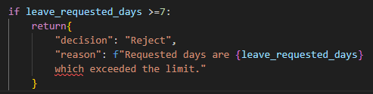
Rule-Based Engine
Task 05
→ takes the parameters from the app.py
→ process them based on the predefined company policies
→ For example:

Slide 18
AI Agent
Task 06
powered by an LLM
we try several models
It evaluates requests based on context
finally, we choose qwen3:1.7b
provide natural language explanations
It gives acceptable result

Slide 19
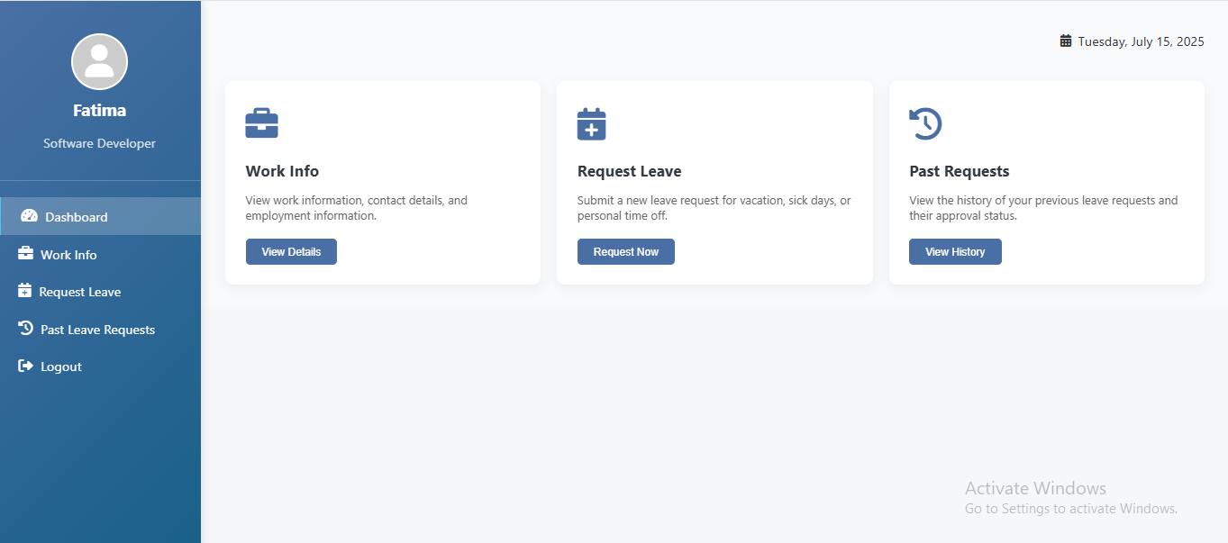
Main Dashboard

Slide 20
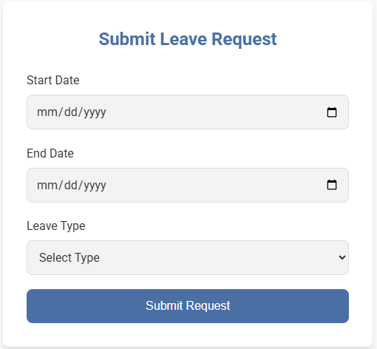
Submit Request Form

Slide 21
04
<// System Results//>
< Leave Management System >
<
<
Faculty of Engineering

Slide 22
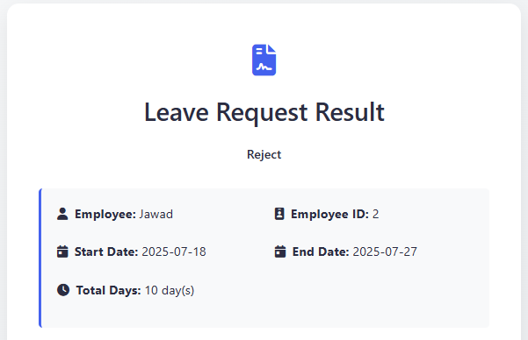
Results
The employee submit this form:
- Start Date: 17/07/2025
- End Date: 25/07/2025
- Leave type: other

Slide 23
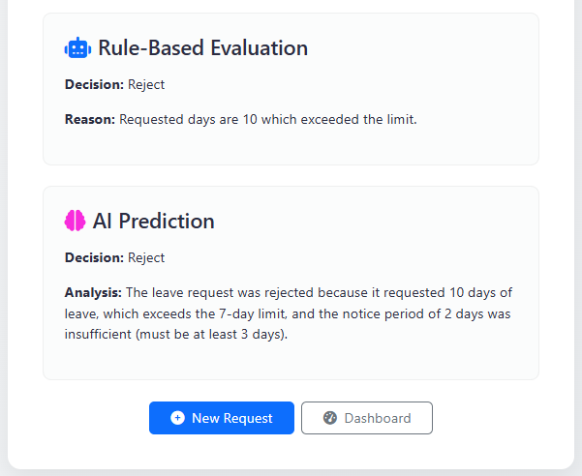

Slide 24
05
<// System Conclusion//>
< Leave Management System >
<
<
Faculty of Engineering

Slide 25
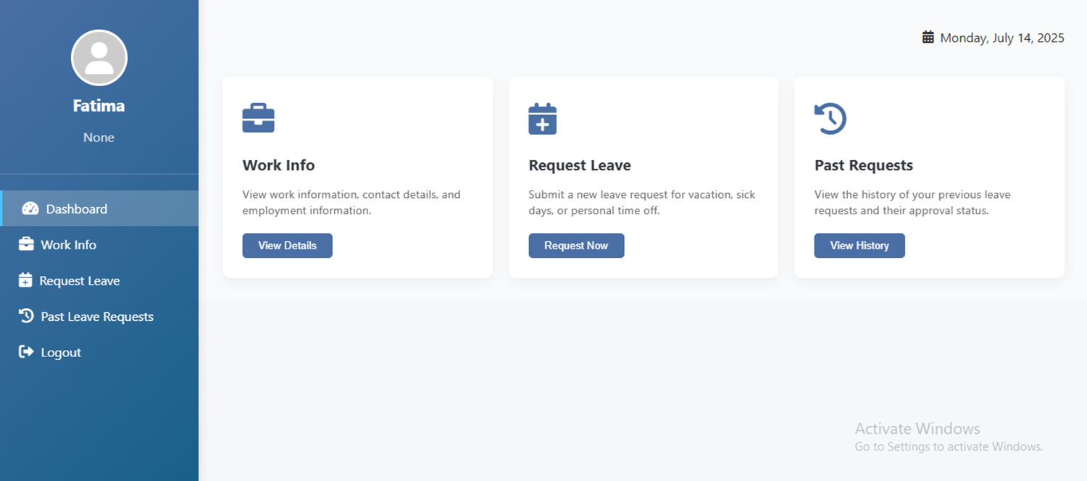
Conclusion
<//
//>

Slide 26
THANK YOU! <//Any Question//>
<Leave Management System>
Faculty of Engineering

