Slide 1
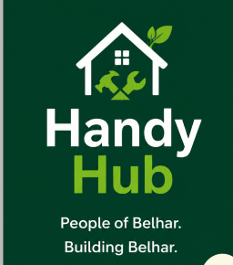
Connecting the People of Belhar
to Reliable Local Services
People of Belhar. Building Belhar.
Andile Pamela Masina · Olona Metia Williams · Zahrah Vermaak

Slide 2



A Community With Skills and Unmet Needs
Belhar is a working class Cape Town suburb where residents regularly need home services like plumbing, electrical work, carpentry, painting but struggle to find people they can trust. At the same time, skilled residents struggle to find consistent work.
THE PROBLEM
Difficulty connecting skilled workers with people who need home services in Belhar.
Who is affected
Homeowners needing repairs, skilled tradespeople, and unemployed residents with practical skills.
How often
If solved, this model could also be adapted to other communities facing the same challenge.
Constantly, home maintenance is ongoing, and today's search method (word of mouth) is slow and inconsistent.
Why it matters
No central platform exists, so residents risk hiring unreliable workers, while unemployment stays high despite real local skill.
HANDYHUB
2 / 14

Slide 3

Validated by the Community: 27 Belhar Residents Surveyed
100%
96.3%
100%
77.8%
have needed a local service such as plumbing, electrical work, or painting
have had difficulty finding a reliable service provider
would use an app or website to find trusted, verified providers
of skilled residents want to list their services online for more jobs
Reviews and photos of past work matter most for trust
66.7% of respondents said customer reviews build trust, and 63% pointed to photos of past work, the two features HandyHub is built around.
HANDYHUB
3 / 14

Slide 4


Introducing HandyHub
A community platform connecting Belhar residents with skilled local workers.
For Residents
For Workers
Search verified workers by category
Create a profile
View ratings, reviews & past-work photos
List skills & qualifications
Request a job in one place
Receive job requests directly
Instead of random referrals through WhatsApp groups, HandyHub creates a structured, searchable platform that builds trust and creates local jobs.
HANDYHUB
4 / 14

Slide 5
Solution Architecture: Technology Stack
How HandyHub will be engineered after the MVP phase, a lean, serverless stack chosen for low cost and fast development.
LAYER
TECHNOLOGY
REASON FOR CHOICE
Mobile Application
React Native + TypeScript
Single codebase for Android & iOS; typing keeps the small team fast.
Navigation & State
React Navigation, Redux Toolkit
Manages screen flow and shared app state, like the logged-in user.
Backend / API
Firebase Cloud Functions (Node.js + TS)
Serverless — no dedicated server to manage or pay for.
Authentication
Firebase Authentication
Phone or email sign-up/login without custom security logic.
Database
Cloud Firestore (NoSQL)
Real-time updates for job requests, ratings and reviews.
File Storage
Firebase Cloud Storage
Profile photos and past-work photos — key to building trust.
Push Notifications
Firebase Cloud Messaging (FCM)
Notifies workers of new jobs, residents of replies.
Maps & Location
Google Maps API
Shows worker locations and nearby service areas.
HANDYHUB
5 / 14

Slide 6
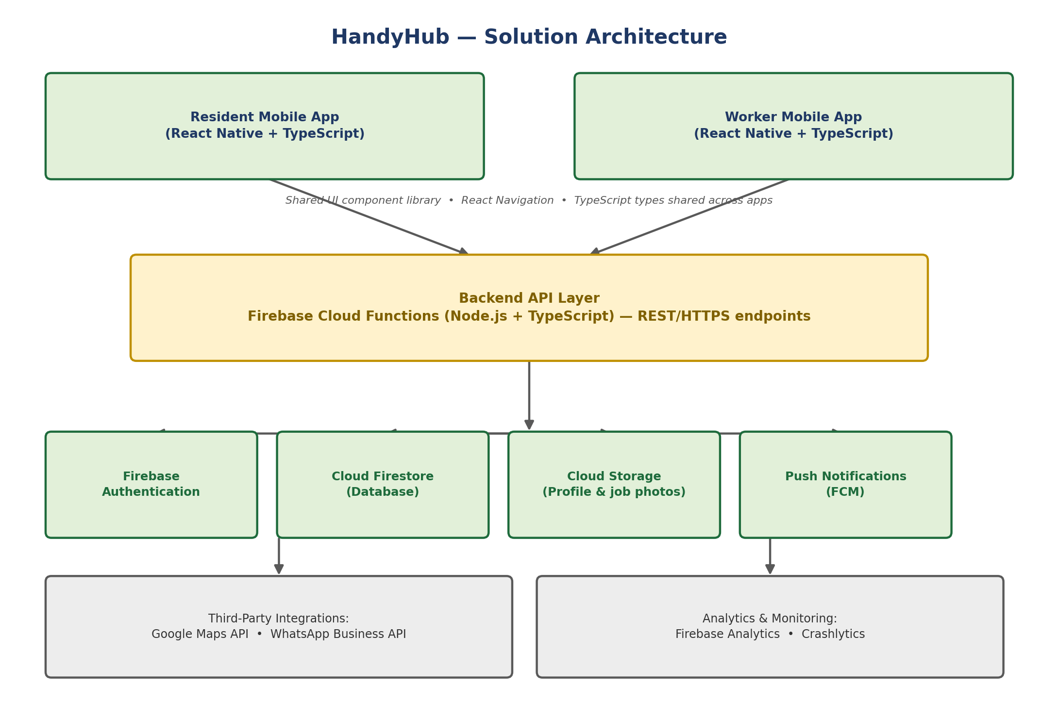
How It All Connects
The mobile app talks to serverless backend services. Residents and workers share one codebase but see different screens based on their role.
HANDYHUB
6 / 14

Slide 7


Frontend & Backend, Working Together
One codebase, one shared language — TypeScript end to end — so the team of three moves fast without switching contexts.
Frontend: Mobile App
Backend & Services
One React Native + TS codebase for iOS & Android
Cloud Functions expose REST endpoints (Node + TS)
Role-based navigation for residents vs. workers
Firestore stores data with real-time listeners
Shared UI components for a consistent look
Firebase Auth handles sign-up & login
Shared TS types keep frontend & backend in sync
Cloud Storage holds profile & job photos
Google Maps API and Firebase Cloud Messaging plug in as third-party service, keeping the team's effort focused on HandyHub's core value.
HANDYHUB
7 / 14

Slide 8




Why This Architecture Fits HandyHub
Chosen specifically to support the feasibility conclusions already presented in Section 3.4.
Low Cost to Build & Run
Fast Development
Scalable Beyond Belhar
Built for Trust
Firebase's free tier covers auth, database & storage at MVP scale — keeping costs near the R1,350–R2,700 estimate.
TypeScript across app and backend lets the team of three move between frontend and backend without switching languages.
Firestore and Cloud Functions scale automatically if HandyHub grows — no servers for the team to manage.
Reviews, photos and verified profiles — the features the community survey ranked most important — are native to this stack.
HANDYHUB
8 / 14

Slide 9

Value Proposition
“Helping Belhar residents who struggle to find reliable local service providers, through a community-based job connection platform, so they can quickly hire trusted workers while creating employment opportunities.”
Why HandyHub Stands Out
Community focused
Trust Through Reviews
Solves Unemployment
Built specifically for Belhar — every worker is local, keeping trust and money in the community.
66.7% of residents say reviews and photos of past work are what earns their trust — exactly what HandyHub delivers.
A job-creation tool, not just an app — skilled but unemployed residents find paid work without costly advertising.
HANDYHUB
5 / 14

Slide 10
Who We Serve
Two sides of one community marketplace.
Resident (Customer)
Worker (Service Provider)
AGE
AGE
20+ years
20+ years
INCOME
INCOME
R3,000–R12,000/month
R0–R8,000/month (informal)
TECH COMFORT
TECH COMFORT
Uses WhatsApp, Facebook & basic apps daily.
Uses WhatsApp & social media comfortably.
KEY PAIN POINT
KEY PAIN POINT
Can't find reliable, trustworthy local workers quickly or safely.
Struggles to find consistent work despite having useful skills.
HANDYHUB
6 / 14

Slide 11




Reaching Belhar: Channels & Timing
WHERE WE MARKET
WHEN WE MARKET
WhatsApp flyer campaign in community & family groups
Payday Window (25th–31st)
Push promotions when residents have income to spend on repairs.
Facebook community page & existing local groups
Winter (May–Aug)
Instagram posts of app screens & success stories
Plumbing leaks, electrical, waterproofing, indoor painting
Spring (Sep–Oct)
Printed flyers at shops, churches, schools & taxi ranks
Yard work, painting, spring cleaning & maintenance
Summer (Nov–Feb)
Outdoor painting, cleaning, festive-season prep
Best days: weekends & weekday evenings after 6pm, when residents are home and browsing social media.
HANDYHUB
7 / 14

Slide 12



Feasibility: Lean Enough to Launch
MVP STARTUP COSTS
WHY IT'S VIABLE
Figma (design tool)
R0
Validated demand: 100% of surveyed residents need services and would use an app.
Domain name
R150 – R300 / yr
Basic web hosting
R500 – R1,000 / yr
Low entry cost: full MVP launches for under R3,000, using free tools.
Marketing materials
R300 – R500
Mobile data
R200 – R400 / mo
Social media ads (optional)
R200 – R500
Working prototype already designed and ready to test in Figma.
TOTAL ESTIMATED MVP COST
R1,350 – R2,700
Team skills (design, research, marketing) match the MVP phase exactly.
HANDYHUB
8 / 14

Slide 13

Risks We're Watching and Managing
Market Risk
Financial Risk
Operational Risk
Competition Risk
Limited smartphone/data access could limit reach.
No revenue model yet to fund full development.
Hard to verify worker quality up front.
Residents may stick with informal WhatsApp groups.
MITIGATION
MITIGATION
MITIGATION
MITIGATION
Offer a WhatsApp-first, low-data flow with a basic call-in option.
Use free no-code tools; explore SEDA/NYDA youth funding.
Community review/rating system; onboard recommended workers first.
Demonstrate clear advantages via demos and success stories.
HANDYHUB
9 / 14

Slide 14
Testing HandyHub: Our MVP
We'll validate demand with our Figma prototype before building a full app.
SUCCESS METRICS
15+
10+
30+
80%
resident sign-ups via Google Form pre-registration
skilled workers express interest in listing services
WhatsApp / social media interactions across channels
of prototype viewers say they'd use HandyHub
Building Belhar, One Trusted Job at a Time
If our targets are met, we'll build a functional no-code app or partner with a developer. If not, we'll refine the concept using what the community tells us.
HANDYHUB
10 / 14

