Slide 1
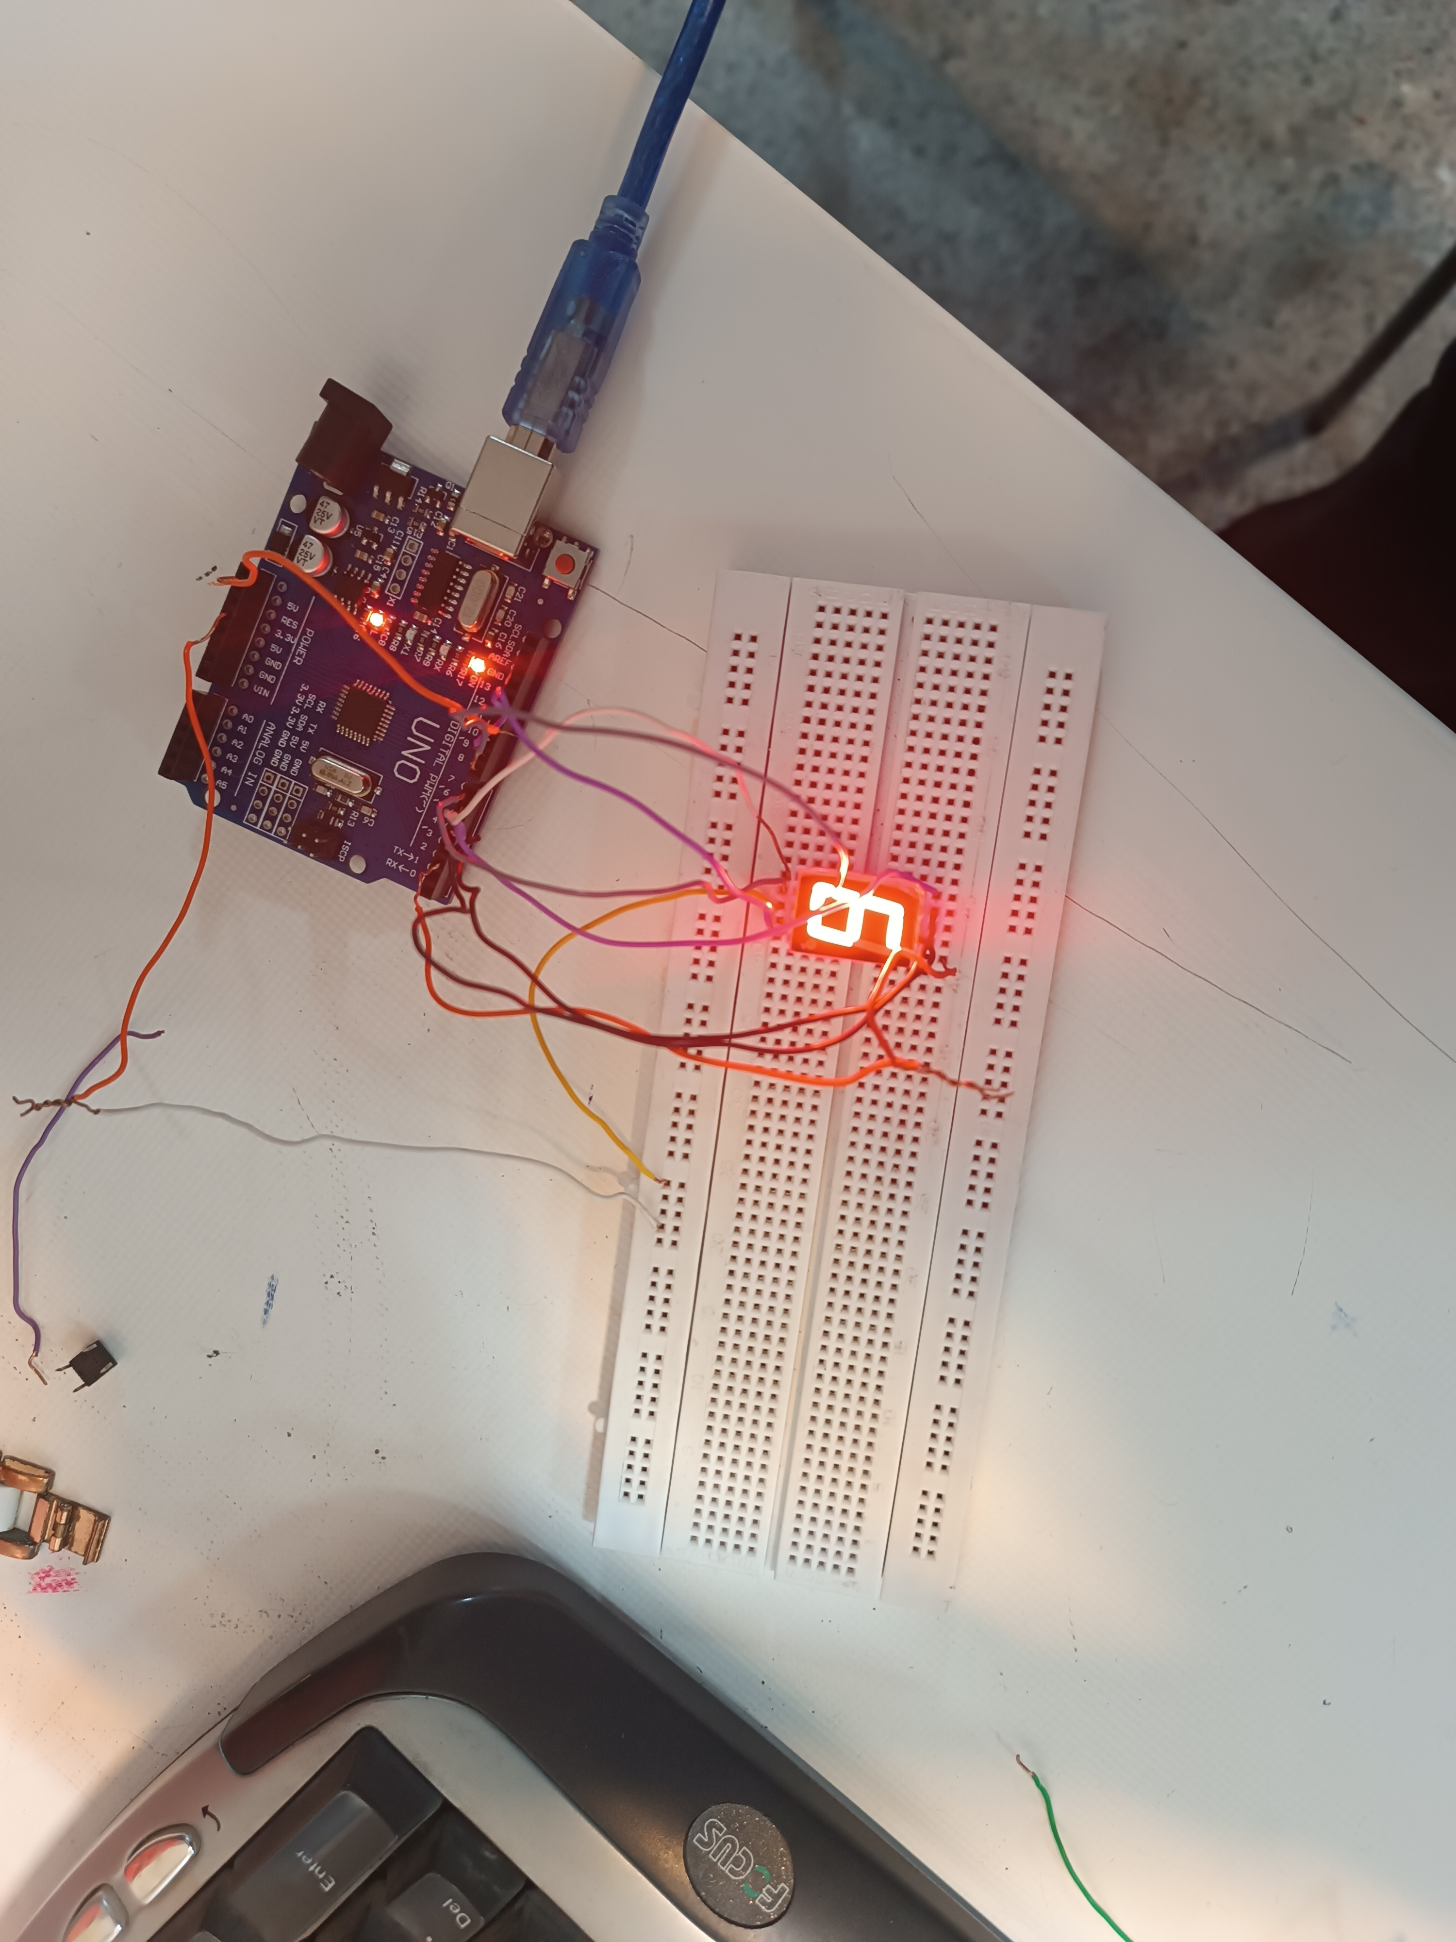

Dice game
After each run , seven segment displays a number from one to six .

