Slide 1
VEHICLE LOAN
Every Mile Counts just like every Penny Counts.

Slide 2
TEAM MEMBERS
ZAID SHAIKH : PSNO = 10684298
PARIDHI GUPTA : PSNO = 10683423
ANITA YADAV : PSNO = 10684311
MAYANK TUSHPENDRE : PSNO = 10683818

Slide 3
PROBLEM STATEMENT
Getting a loan is a very tiring and complicated process in India. It may take from weeks to months for loans to get approved and people have to visit the office again and again for documents and verification.
This processing time can be reduced if we go for online solution of the same problem from bank as well as customer’s side.

Slide 4
APPROACH
We would like to make end-to-end loan cycle management. This will be helpful for all customer interaction with 360 degree view of customer a across organization.
With the implementation of this system we will have robust and real time analytics, customized reports and user specific layout.
Also by implementing this we need not to worry to carry forward the data from local region to global regions.
The main functionality of this system will be check the requirement of the customer and after verification provide online loan as soon as possible and track user record.

Slide 5
LIST OF MODULES
USER MODULE
ADMIN MODULE
LOAN MODULE
EMI CALCULATOR
ELIGIBILITY CHECK

Slide 6
TECHNOLOGIES USED
MS SQL SERVER
ASP.NET CORE MVC
WEB API
ANGULAR
HTML, CSS, BOOTSTRAP

Slide 7
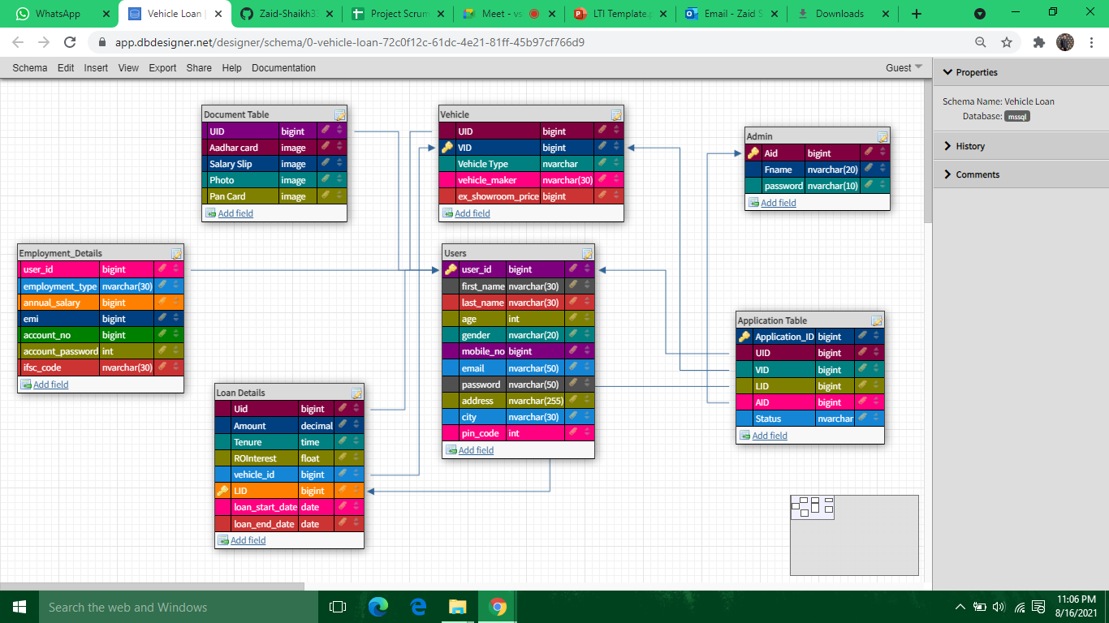
DATABASE DESIGN

Slide 8
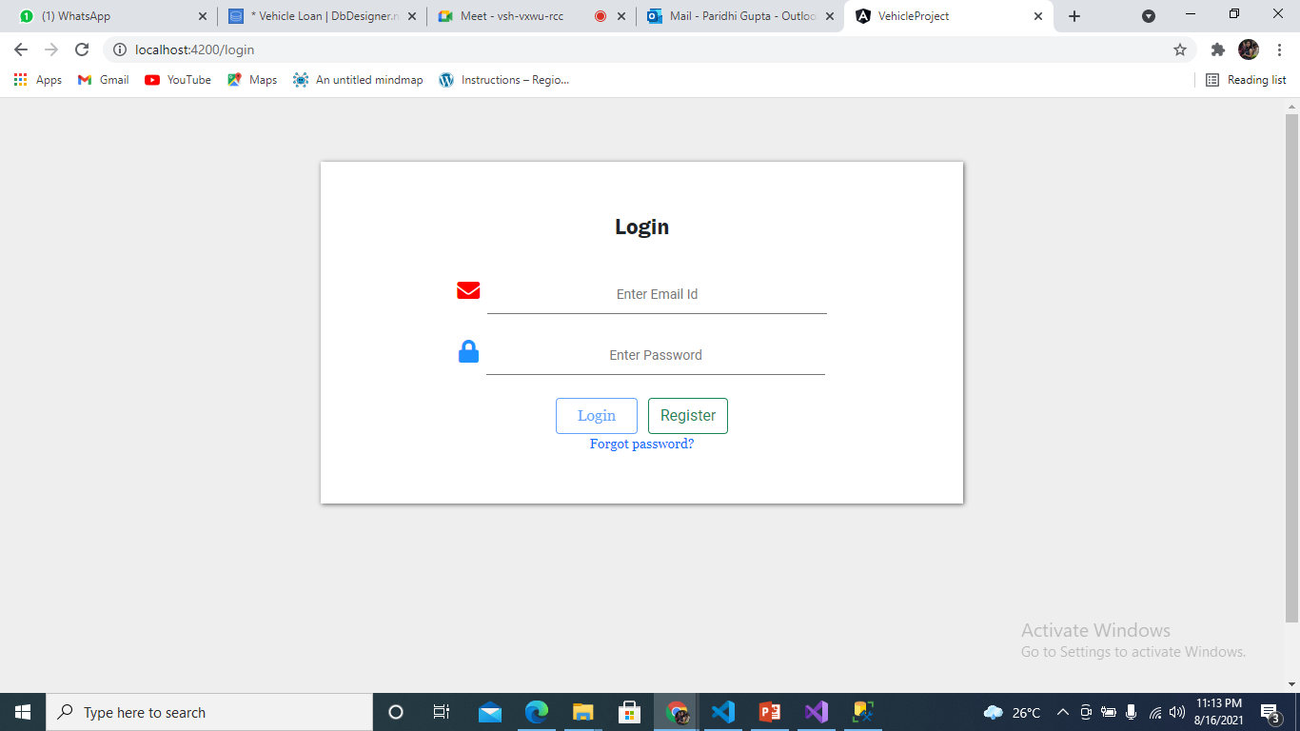
1.LOGIN

Slide 9
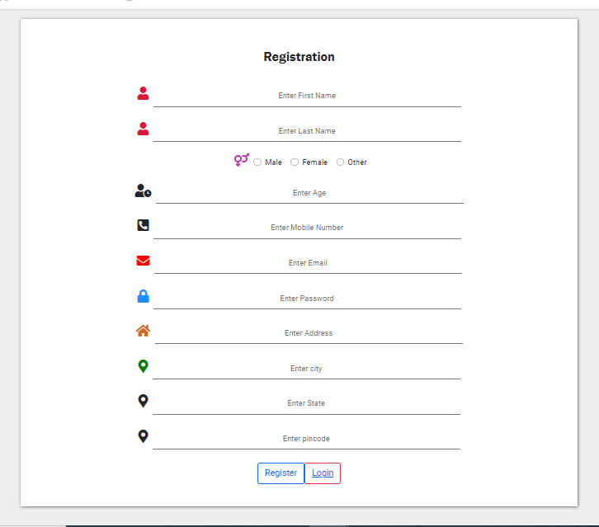
2.USER REGISTRATION

Slide 10
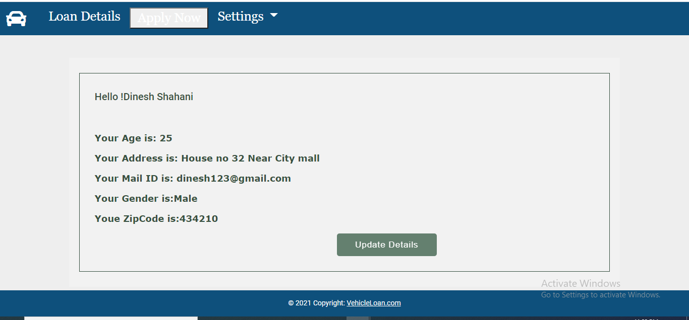
3.USER DASHBOARD

Slide 11
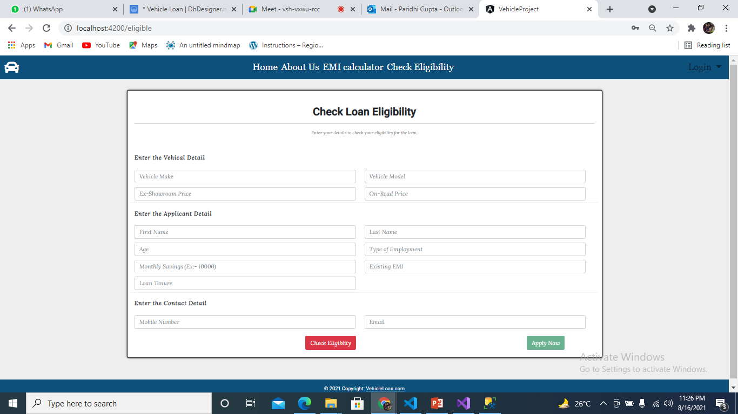
4.CHECK ELIGIBILITY

Slide 12
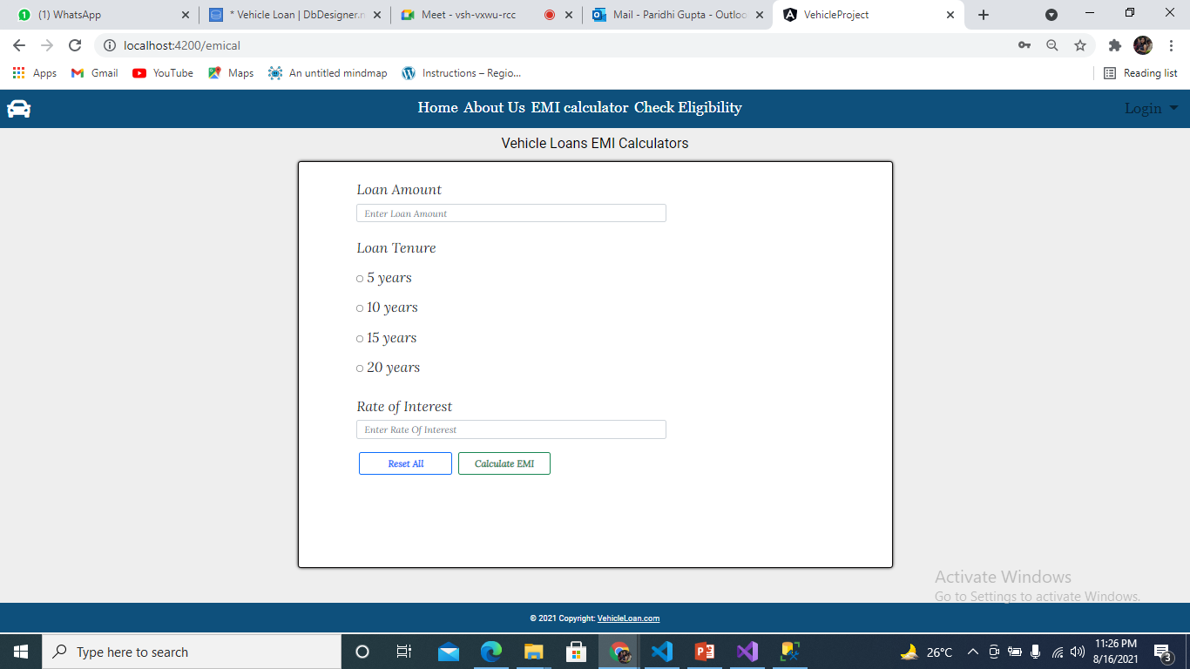
5.EMI CALCULATOR

Slide 13
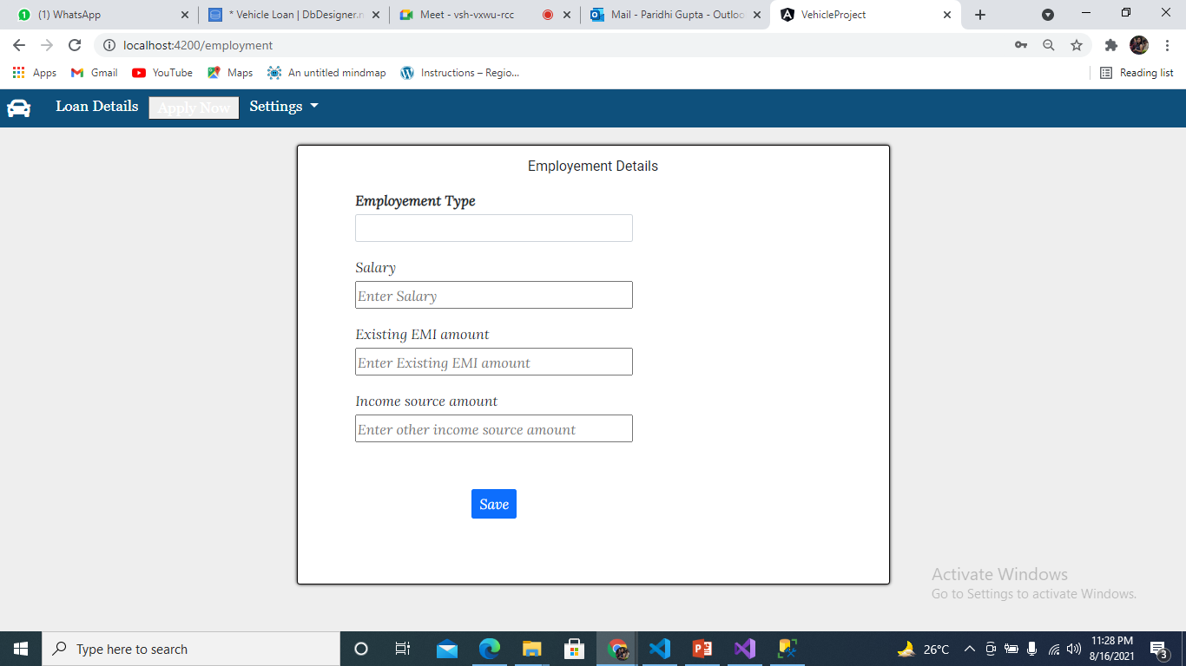
6.EMPLOYMENT DETAILS

Slide 14
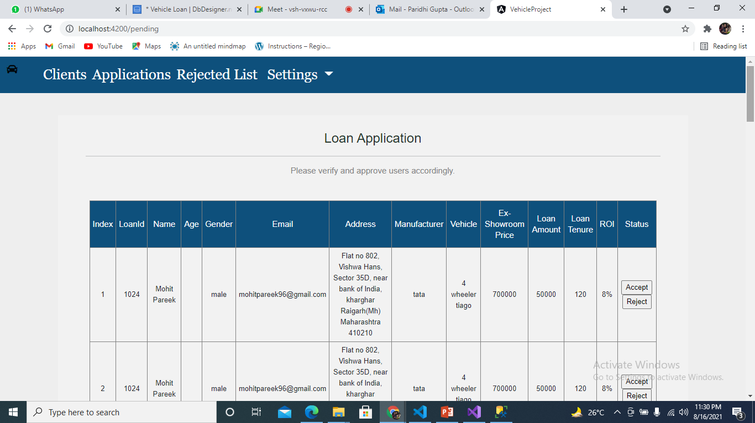
7.ADMIN DASHBOARD

Slide 15
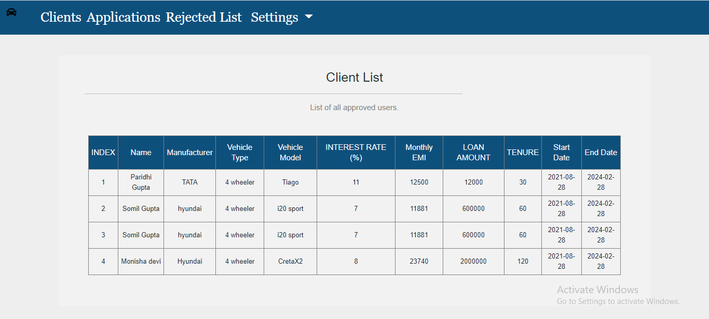
8.CLIENT LIST(LOAN APPROVED)

