Slide 1

Eng.Zaid Nassar
"I am a student at Al-Hussein Bin Talal University, studying Network and Information Security Engineering in the faculity of Engineering, within the Computer Engineering Department."

Slide 2
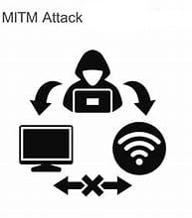
Man in the middle attack
Edit by : zaid nassar
supervision : Dr.Bilal Al-qudah

Slide 3
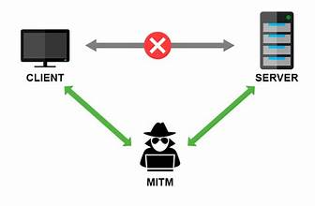
What is the Man in the middle attack(MITM)?
is a type of cyberattack where an attacker secretly intercepts and possibly alters the communication between two parties (e.g., a user and a server) without their knowledge. The attacker aims to eavesdrop on the data being exchanged, modify it, or redirect it for malicious purposes.

Slide 4
Type of MITM Attack
1.Active MITM Attack
2.Passive MITM Attack
In this type, the attacker actively interferes with the communication between the two parties.
The attacker can modify, inject, or manipulate data during transmission.
This can include altering content, redirecting traffic, or stealing information.
Example: In an ARP Spoofing attack
In this type, the attacker only listens to the communication between the two parties without modifying or interfering with the data.
The goal is to collect data, such as passwords or sensitive messages.
Example: In a Wi-Fi Eavesdropping attack

Slide 5







1.Active MITM Attack router 192.168.1.1 server user 192.168.1.104 192.168.1.10 proxy server 192.168.1.1:8080

Slide 6



1.Active MITM Attack (scenario 1) router 192.168.1.1 proxy server user server 192.168.1.1:8080 192.168.1.10
192.168.1.104

Slide 7

1.Active MITM Attack (scenario 1) router 192.168.1.1 fake server user server 192.168.1.1:8080 192.168.1.10
192.168.1.104

Slide 8


1.Active MITM Attack (scenario 1) router 192.168.1.1 server user 192.168.1.104 192.168.1.10 fack server 192.168.1.1:8080

Slide 9


1.Active MITM Attack(scenario 1) router 192.168.1.1 server 192.168.1.104 user 192.168.1.10 fake server 192.168.1.1:8080
fack server 192.168.1.104

Slide 10
1.Active MITM Attack (scenario 2) router 192.168.1.1 server user 192.168.1.104 192.168.1.10 fakeserver 192.168.1.1:8080

Slide 11
1.Active MITM Attack (scenario 2) router 192.168.1.1 server user 192.168.1.104 192.168.1.10 fakeserver 192.168.1.1:8080

Slide 12


1.Active MITM Attack (scenario 2) router 192.168.1.1 server user 192.168.1.104 FAKE SERVER 192.168.1.10 192.168.1.1:8080

Slide 13


Let's do it !!

