Slide 1

Detecting Cassava Leaf Diseases Using CNN-Based Image Classification
Name: Zaid Khan
Student ID: 1307050
Course: INFO-6147 Deep Learning with PyTorch
Date: 5th Aug, 2025

Slide 2
Introduction
Cassava is a major food crop in many developing countries, but its production is often threatened by various leaf diseases.
Early and accurate disease detection is essential to prevent crop loss and improve food security. Traditional disease identification relies on manual inspection, which is time-consuming and prone to human error.
With the rise of deep learning, Convolutional Neural Networks (CNNs) can automatically classify plant leaf images with high accuracy.
This project will use deep learning to classify cassava leaf images into five categories, helping to identify diseases early and support farmers in crop management.

Slide 3
Objective
The main goal of this project is to classify cassava leaves into healthy or diseased categories using a deep learning model.
Classify cassava leaf images into five classes:
Cassava Bacterial Blight (CBB)
Cassava Brown Streak Disease (CBSD)
Cassava Green Mottle (CGM)
Cassava Mosaic Disease (CMD)
Healthy Leaf
Develop a CNN model for accurate classification.
Evaluate model accuracy, precision, recall, F1-score.

Slide 4
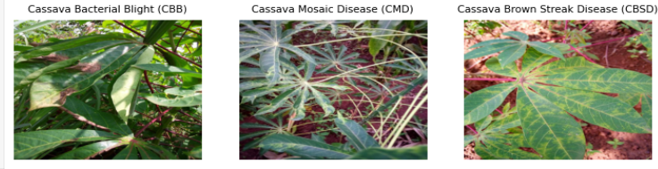
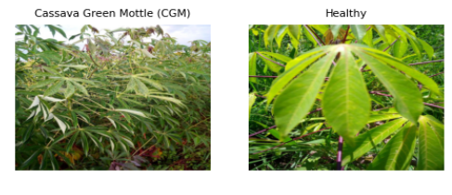
Dataset Overview
Source: Kaggle Cassava Leaf Disease Classification competition.
Total Images: ~21,000 (subset: 5,000 images used)
Data Split:
Training: 3,000 images
Validation: 1,000 images
Testing: 1,000 images
Dataset presents a challenge
due to similar visual patterns across diseases.

Slide 5
Data Preprocessing and Augmentation
Data Preprocessing and Augmentation
Image preprocessing:
Resize: 224x224 pixels
Normalization (ImageNet mean/std)
Data Augmentation:
Horizontal/vertical flips
Random rotations (±30°)
Random resized cropping
Color jitter

Slide 6
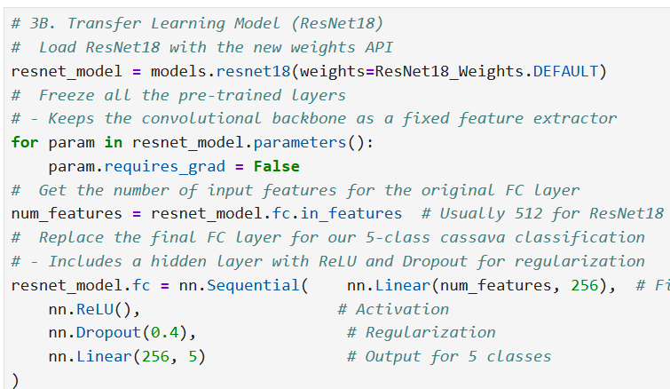
Model Selection & Architecture
Initial Attempt: Custom CNN model → Limited accuracy.
Final Choice: Transfer learning with ResNet18.
Pretrained on ImageNet for robust feature extraction.
Fine-tuned specific layers for cassava disease recognition.
Used Adam optimizer, CrossEntropyLoss, ReduceLROnPlateau scheduler.

Slide 7
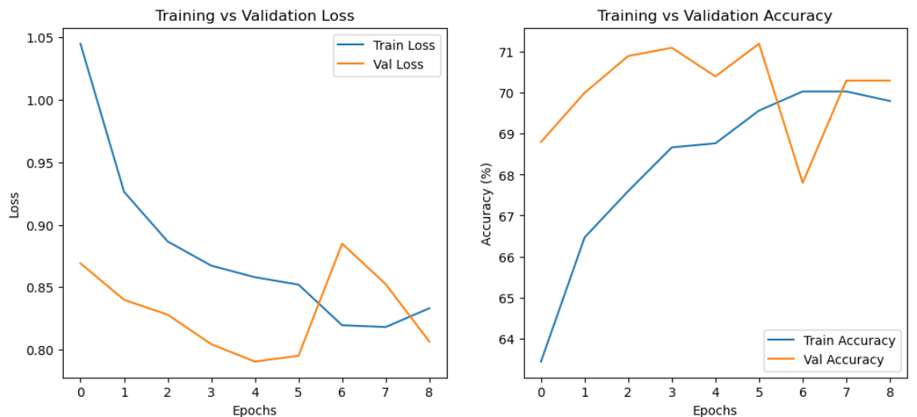
Training and Hyperparameter Tuning
Training Techniques:
Early stopping (patience=5 epochs).
Learning rate scheduler (ReduceLROnPlateau).
Hyperparameter tuning:
Explored learning rates ([1e-4, 5e-4, 1e-3]), batch sizes ([16, 32]), optimizers (Adam, SGD).
Final Selection: LR=0.0001, Batch Size=16, Optimizer=Adam.

Slide 8
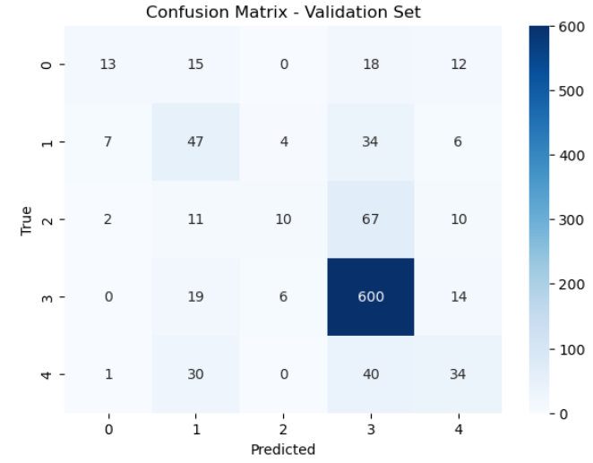
Model Evaluation
Initial Validation Accuracy: 70.40%
Performance insights (validation set):
Strong performance: CMD class (majority class, F1=0.86).
Weak performance: CGM class (F1=0.17), highlighting imbalance issues.
Macro F1-score (0.43) lower than Weighted F1 (0.67), showing imbalance impact clearly.

Slide 9
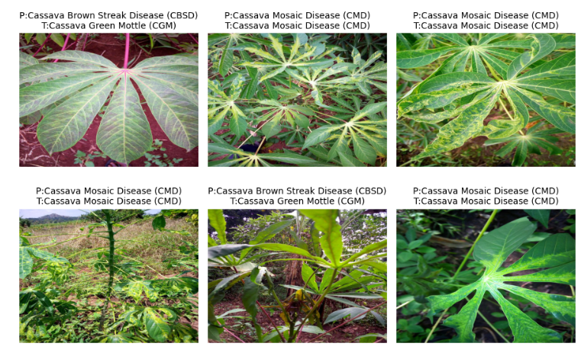
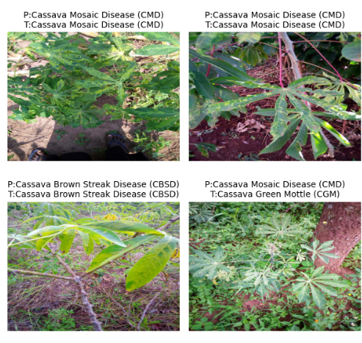
Classified and misclassified samples

Slide 10
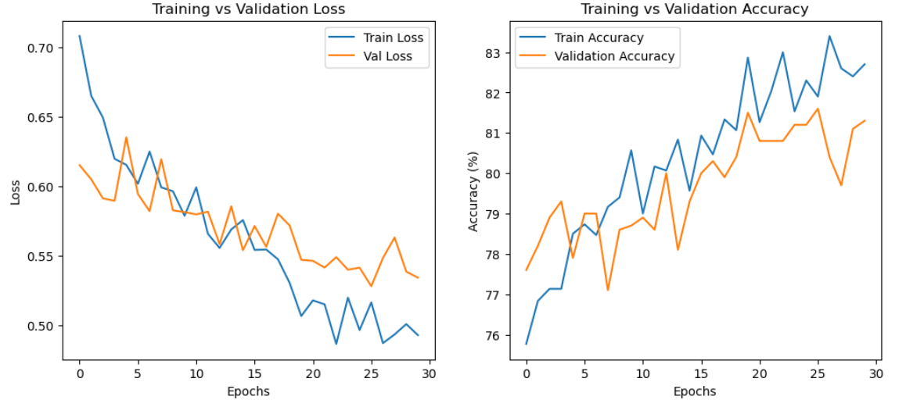
Fine-Tuning & Optimized Training
Partial fine-tuning (ResNet18 layer3, layer4, FC).
Advanced augmentation strategies.
Lower learning rate (1e-4) for stability.
Results after optimization:
Validation accuracy improved significantly from ~70% to ~81.6%.
Reduced overfitting through effective regularization and early stopping.

Slide 11
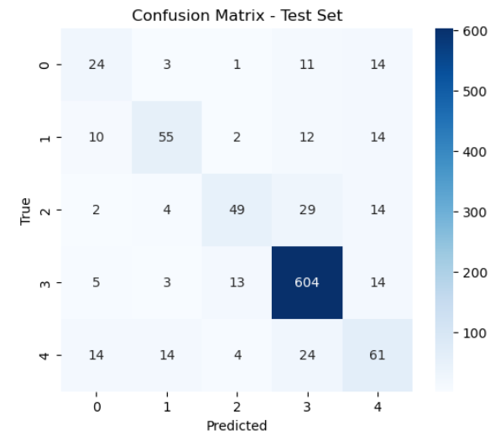
Final Model Testing
Final test accuracy: 79.3%
Classification report insights:
Best-performing class: CMD (94.5% recall, F1=0.92).
Moderate performance for minority classes (F1-scores: 0.44–0.64).
Class imbalance reflected in Macro F1 (0.62) vs Weighted F1 (0.79).

Slide 12
Challenges & Key Learnings
Challenges faced:
Significant class imbalance affecting minority class accuracy.
GPU setup and efficient hardware utilization.
Hyperparameter tuning complexity.
Key Learnings:
Transfer learning substantially improves performance.
Data augmentation and class weighting critical for handling imbalance.
Early stopping & LR scheduling effectively avoid overfitting.
Visualization tools provide clear insights into model strengths/weaknesses.

Slide 13
Conclusion & Future Work
Conclusion & Future Work
Successfully demonstrated CNN effectiveness in agricultural problems.
Final model accuracy (79.3%) supports real-world disease detection.
Future Improvements:
Increase minority-class samples to reduce imbalance.
Experiment with deeper networks (ResNet50/EfficientNet).
Explore ensemble methods for better accuracy.
Deploy model into mobile app or cloud-based solution for farmers.

Slide 14
References
Kaggle Cassava Leaf Disease Classification Competition: Kaggle Link
• PyTorch Documentation: https://pytorch.org/docs
• Torchvision Models: https://pytorch.org/vision/stable/models.html
• scikit-learn Documentation (Evaluation metrics): https://scikit learn.org/stable/modules/model_evaluation.html
• Course Lectures and Materials (INFO-6147 Deep Learning with PyTorch)

Slide 15
Thank You

