Slide 1



{ Team No 39 }
Problem Statement Title: Voice-Enabled Code Assistant
Team Members:
Mohammed Zaid Ahmed
Saad Mohammed
Syed Abur Rahman Atif
CBIT Hacktoberfest 2025
Notes:
3

Slide 2
Team no 39
{ Proposed Solution }
Problem Statement:
Context Switching: Developers constantly interrupt flow by switching between typing, running code, and interacting with external AI tools.
Latency: Traditional AI coding tools involve slow copy-paste cycles or asynchronous requests, reducing productivity.
Accessibility: Reliance on keyboard input limits coding for users with motor disabilities or those preferring natural interaction.
Proposed Solution:
Integrated Google Gemini Live Session directly into the Monaco Editor.
Enables real-time, low-latency, bidirectional voice interaction for coding.
Transcribes natural language commands and executes them instantly as code manipulations or execution triggers.
CBIT Hacktoberfest 2025
Notes:
3

Slide 3
Team no 39
{ Tech Stack }
Category | Key Technologies | Role in Project
AI/Core | Google Gemini API (Live Session) | Real-time speech transcription, natural language analysis, and function calling.
Frontend/Framework | Next.js, React, Tailwind CSS | Application framework; modern, responsive UI design.
Code Editor | Monaco Editor | High-performance, feature-rich code editing environment.
State Management | Zustand | Centralized, performant state for code, language, editor instance, and assistantStatus.
Audio | Web Audio API (AudioContext), audioUtils.ts | Captures microphone audio, encodes/decodes PCM data for Gemini's Live Session.
Tooling | Function Calling | Provides the AI with specific abilities to modify the code (insertCodeAtCursor, updateCode, etc.).
CBIT Hacktoberfest 2025
Notes:
3

Slide 4
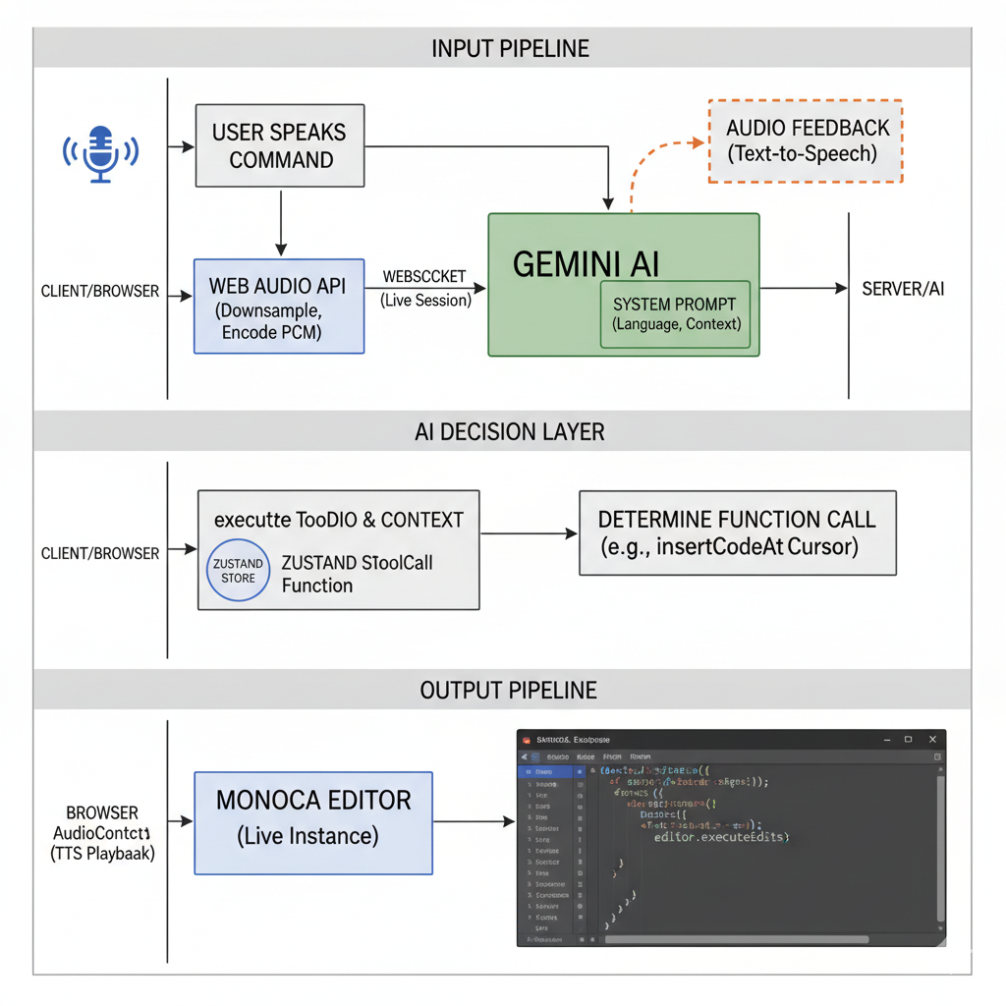
Team no 39
{ System Architecture }
Input Pipeline (Microphone to AI):
User speaks a command (e.g., "Create a Python function to reverse a string").
Web Audio API captures the audio stream, downsamples to 16kHz.
audioUtils.ts encodes the PCM data and sends it to Gemini via WebSocket (Live Session).
AI Decision Layer:
Gemini analyzes the audio, context (current code/language from the System Prompt), and determines the best Function Call (insertCodeAtCursor).
Output Pipeline (AI to Editor):
The executeToolCall function on the client receives the instruction and arguments.
The function uses the Zustand store to access the live Monaco Editor instance.
It calls editor.executeEdits to insert the generated code at the current cursor position.
Gemini optionally sends back audio feedback (Text-to-Speech) which is played via the browser's audio context
CBIT Hacktoberfest 2025
Notes:
3

Slide 5
{ Implementation }
Team no 39
Key Features
Custom Function Calling: Implemented four core tools:
insertCodeAtCursor: For adding small snippets at the user's focus point.
updateCode: For full file replacement (e.g., generating boilerplate).
appendCode: For adding code to the end of the file.
executeCode: Triggers the existing runCode logic via the Zustand store.
Low-Latency Control: Used Next.js Client Components and dynamic imports ({ ssr: false }) to ensure Monaco and Web Audio run without Server-Side Rendering (SSR) conflicts.
State Synchronization: The page.tsx component synchronizes the UI (status, transcriptions) with the live state of the Zustand store to maintain reliability across all parts of the application.
Real-time Status: The Assistant Panel provides immediate visual feedback (LISTENING, PROCESSING, ERROR).
CBIT Hacktoberfest 2025
Notes:
3

Slide 6
Team no 39
{ Challenges and Outcomes }
Challenges
SSR Compatibility: Resolving the major conflict between Next.js's Server-Side Rendering and the browser-specific Monaco Editor/Web Audio APIs.
Asynchronous State: Ensuring the AI always had the latest code and language, solved by using Zustand Store Refs (codeEditorStoreRef.current).
Audio Stream Management: Setting up the audio graph (ScriptProcessorNode) and handling the custom encoding for Gemini's required 16kHz audio format.
Outcomes
A fully integrated coding environment supporting 10+ languages (Python, JS, C++, etc.).
Demonstrably functional, hands-free code generation and execution.
Achieved a clean, modular architecture separating UI, state, and Gemini logic.
CBIT Hacktoberfest 2025
Notes:
3

Slide 7
Team no 39
{ Impact & Use Cases }
Impact
Productivity Boost: Reduces mental load and physical context switching (keyboard to mouse to AI chat) to zero.
Accessibility: Provides a powerful, voice-first development pathway, opening coding to a wider audience.
Future-Proofing: Establishes a foundation for complex code debugging, refactoring, and AI-assisted pair programming via voice.
Use Cases
Rapid Prototyping: Generating large functions or file structures with a single command.
Debugging: Commanding the AI to "Run the code" or "Insert a print statement here to check X variable."
Refactoring: Directing the AI to "Change this for loop to a while loop."
Documentation: Generating quick documentation comments via voice.
CBIT Hacktoberfest 2025
Notes:
3

