Slide 1

Predictive Maintenance for Mechatronics Systems
Using Machine Learning to Prevent Industrial Equipment Failure
Presented By:
Omar Emad Ibrahim Hamdi Elmanhy
Ali Mohamed Ali Sheashae
Zaid Walid Mohamed Soliman

Slide 2
Problem Statement
• The Challenge: Unexpected failure in industrial milling machines causes costly downtime and safety risks.
• Our Goal: Build a system that predicts machine failure before it happens using sensor data.
• The Impact:
- Reduces maintenance costs.
- Increases factory efficiency.
- Moves from 'Reactive' to 'Proactive' maintenance.

Slide 3
The Data Source
• Source: AI4I 2020 Predictive Maintenance Dataset (UCI Machine Learning Repository).
• Volume: 10,000 data points representing individual machine cycles.
• Key Sensor Inputs (Features):
- Torque [Nm]: Force applied during operation.
- Rotational Speed [rpm]: Spindle speed.
- Temperatures [K]: Air and Process temperatures.
- Tool Wear [min]: Usage duration.
• Target: Machine Failure (0 = No, 1 = Yes).

Slide 4
Methodology & Technology
• Tech Stack:
- Language: Python (Data Science Standard)
- Cloud: Google Collab (Cloud-based Jupyter Notebooks)for deployment
• Algorithm: Random Forest Classifier
• Why Random Forest?
- Robust against 'noise' in sensor data.
- Handles non-linear relationships (e.g. High Torque + Low Speed).
- Uses voting from 100+ decision trees.

Slide 5
Implementation (Code)
Data Science Life Cycle Steps:
1. Data Cleaning: Removed non-physical columns (ID, Serial).
2. Splitting: 80% Training / 20% Testing.
3. Training: Model learned from physical sensor patterns.
4. Evaluation: Tested on unseen data.
The code is displayed in the next slide.

Slide 6
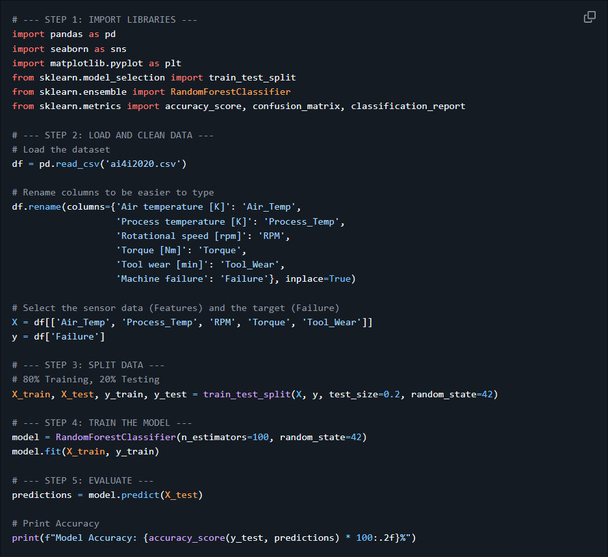

Slide 7
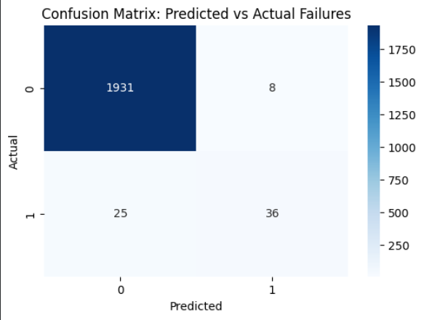
Results & Analysis
• Overall Accuracy: 98.35%
• Performance Breakdown:
- True Positives: Caught 36 failures before they occurred.
- False Alarms: Only 8 false warnings.
- Missed Failures: 25 instances (due to data imbalance).

Slide 8
Future Improvements
• Address Data Imbalance: Use SMOTE (Synthetic Minority Over-sampling) to catch missed failures.
• Real-Time Dashboard: Build a Streamlit web app for live monitoring.
• IoT Integration: Connect model directly to PLC controllers for automated stops.

Slide 9
Conclusion
• Summary: Sensor data is a reliable predictor of machine health.
• Outcome: A deployed Python model with 98% accuracy.
Thank You

