Slide 1

Fields of Artificial Intelligence
Mapping the AI Landscape
Notes:
Last time, we talked about what AI is, its history, and why it’s important today.
Today, we’ll zoom out and see the big picture — the main branches of AI and how they relate to each other.
By the end of this session, you’ll be able to name the major AI fields and understand what each one does.

Slide 2
The AI Umbrella
AI is an umbrella term — it covers many specialized areas.
Each area focuses on solving a different type of problem, but they often work together in real-world solutions.
Main fields: Machine Learning, Deep Learning, NLP, Computer Vision, Robotics, Expert Systems.
Notes:
AI is an umbrella term — it covers many specialized areas.
Each area focuses on solving a different type of problem, but they often work together in real-world solutions.
These are the six main fields we’ll look at today: Machine Learning, Deep Learning, NLP, Computer Vision, Robotics, and Expert Systems.

Slide 3
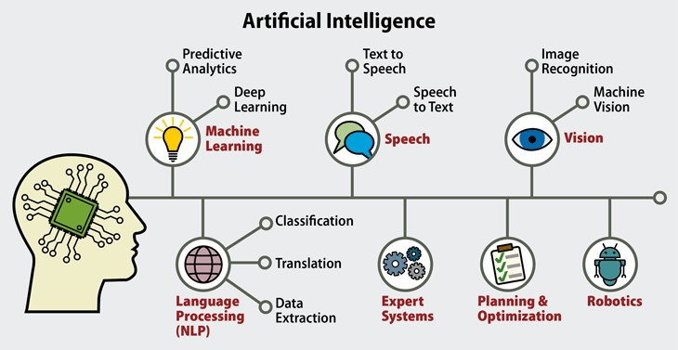
Sub Fields in AI

Slide 4
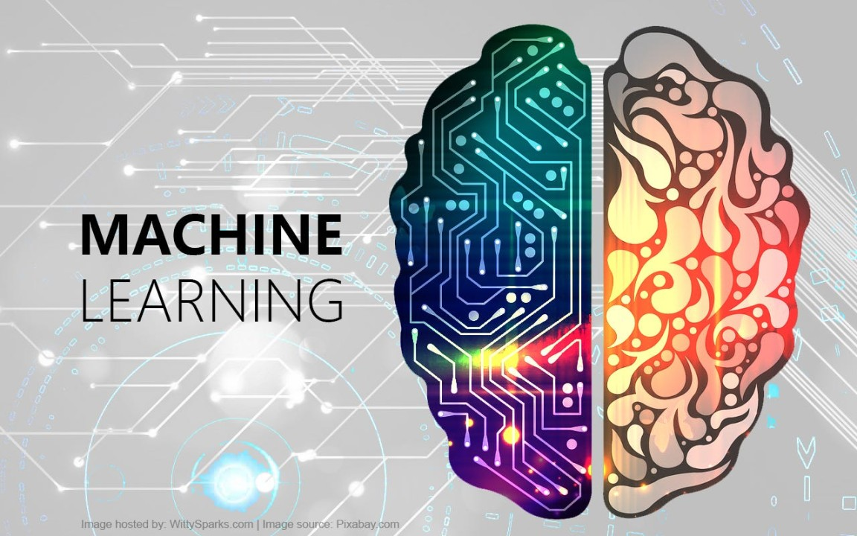

Slide 5

Machine Learning (ML)
Definition: Teaching computers to learn patterns from data and improve over time without explicit programming.
Types: Supervised, Unsupervised, Reinforcement
Examples: Netflix recommendations, spam filter
Notes:
Machine Learning is about creating algorithms that learn from data.
Instead of writing exact step-by-step instructions, we feed the system examples and it figures out the rules.
In supervised learning, we give it labeled examples. In unsupervised, it finds hidden patterns. Reinforcement learning uses trial and error, like teaching a dog tricks.
Example: Netflix learns your viewing habits to suggest shows you might like.

Slide 6
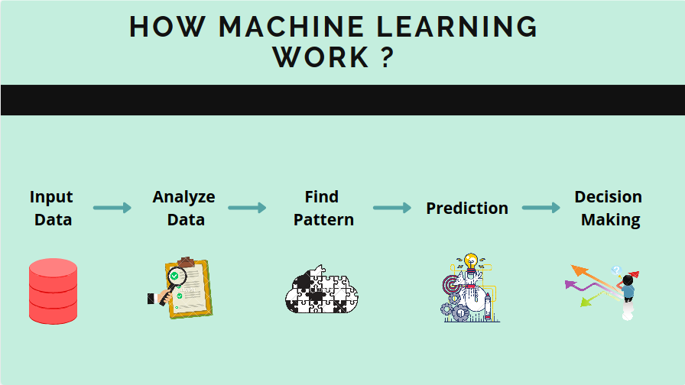

Slide 7




Machine Learning (ML)
Netflix Recommendation System
Email Spam Detection
Stock Price Prediction

Slide 8
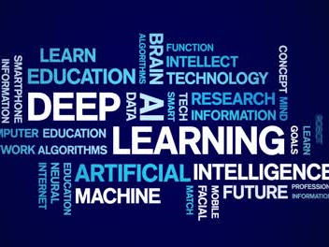

Slide 9
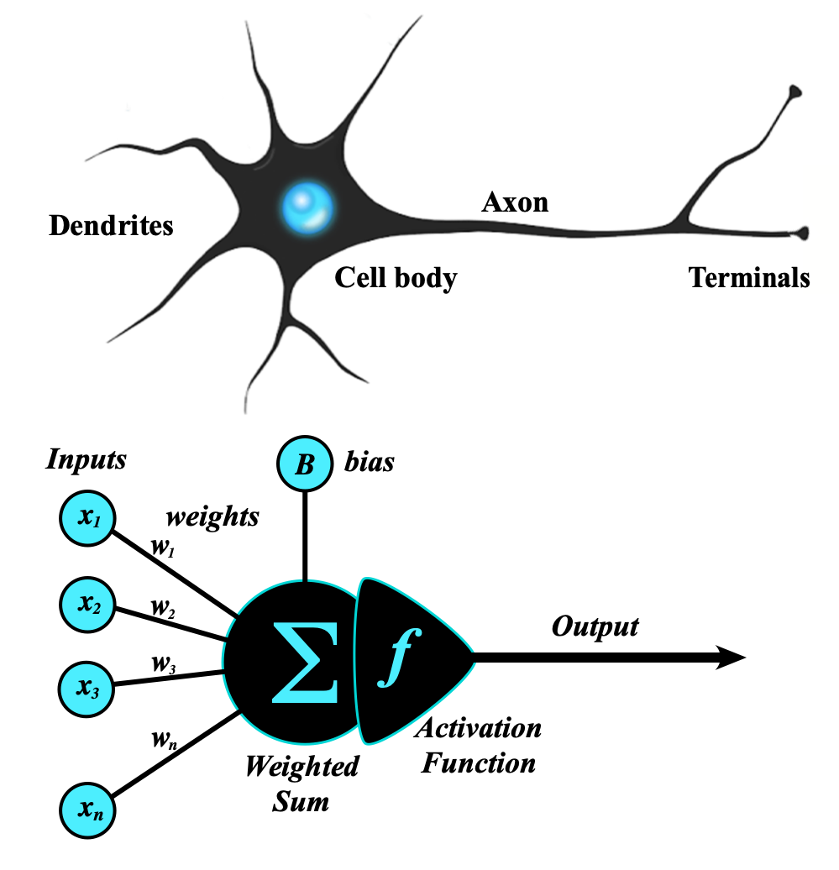
Deep Learning (DL)
Definition: A type of ML using artificial neural networks with many layers.
Examples: Voice assistants, image recognition
Notes:
Deep Learning is a special branch of Machine Learning inspired by how our brain’s neurons work.
It uses networks with many layers — that’s why it’s called ‘deep’.
Deep Learning powers speech recognition, facial recognition, and the tech behind modern chatbots.
If ML is a bicycle, DL is a sports car — faster, more powerful, but needing more data and fuel.

Slide 10
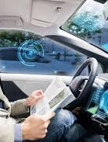
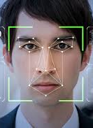
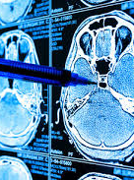
Deep Learning (DL)
Facial Recognition in iPhones
Autonomous Vehicles
Medical Image Analysis

Slide 11
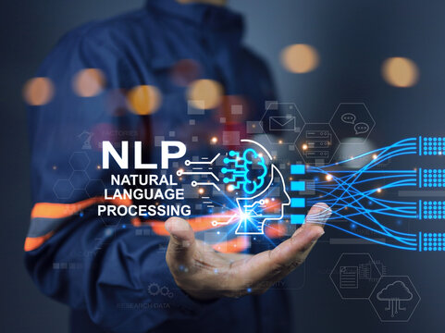

Slide 12
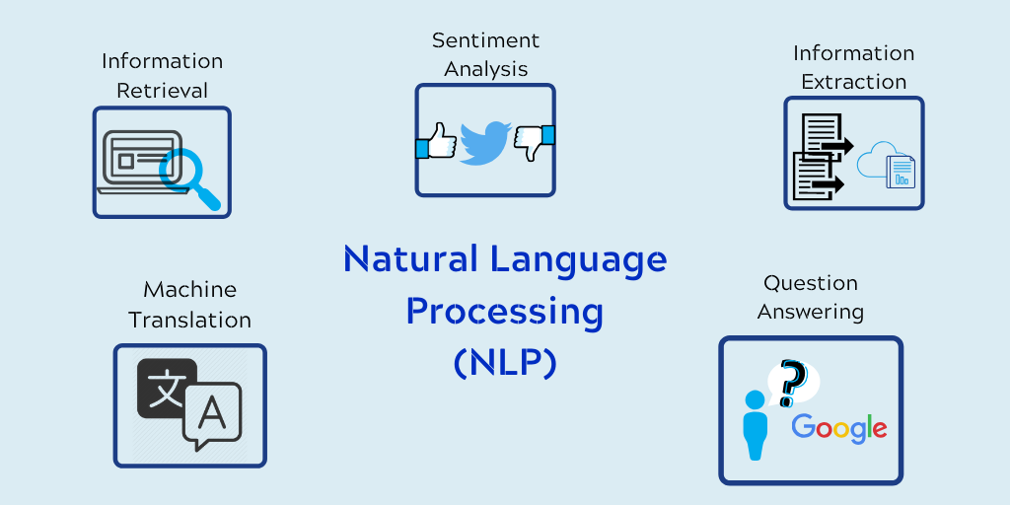
Natural Language Processing (NLP)
Definition: Enabling computers to understand, interpret, and generate human language.
Examples: Google Translate, Siri, sentiment analysis on tweets
Notes:
NLP lets machines work with human language — text or speech.
It’s what allows your phone to understand ‘What’s the weather today?’ and respond correctly.
Businesses use NLP for chatbots, document analysis, and detecting customer sentiment in feedback.

Slide 13
How NLP Understands a Sentence
Text Input → The machine receives the sentence as text or voice.
Tokenization → Breaks it into words: ["Turn", "off", "the", "lights", "in", "the", "living", "room"]
Part-of-Speech Tagging → Identifies word roles: - Verb: Turn off - Object: lights - Location: living room

Slide 14


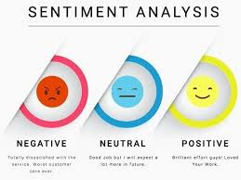
Natural Language Processing (NLP)
Google Translate
ChatGPT/ Copilot
Sentiment Analysis on Tweets

Slide 15
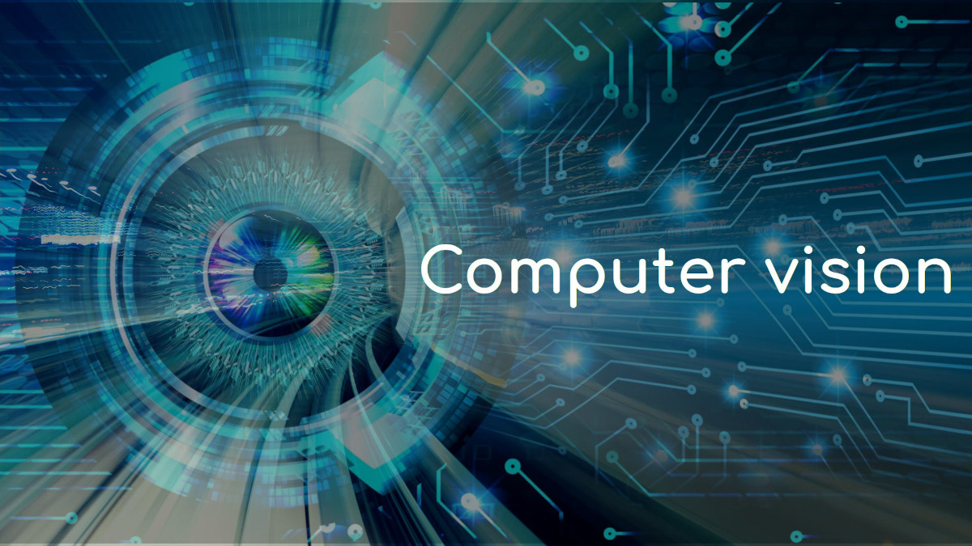

Slide 16
Computer Vision (CV)
Definition: Enabling machines to interpret and understand visual information.
Examples: Self-driving cars, medical imaging, barcode scanning
Notes:
Computer Vision lets machines see and understand images or videos.
In self-driving cars, CV detects traffic lights, pedestrians, and road signs.
In healthcare, it helps doctors find tumors in scans.
Think of it as giving AI a pair of eyes.

Slide 17
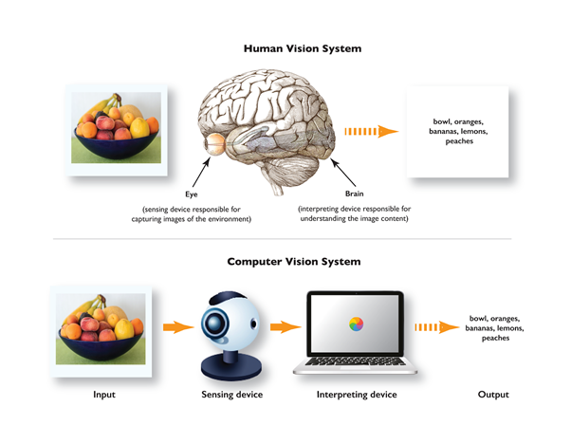
Working of Computer Vision

Slide 19

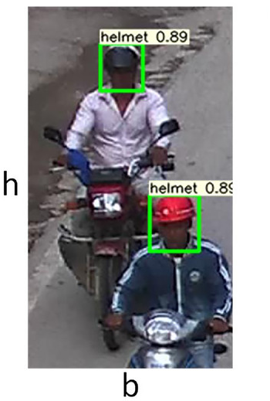
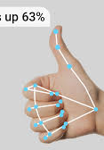
Computer Vision (CV)
Face Mask Detection
Traffic Monitoring
Hand Gesture detection

Slide 20
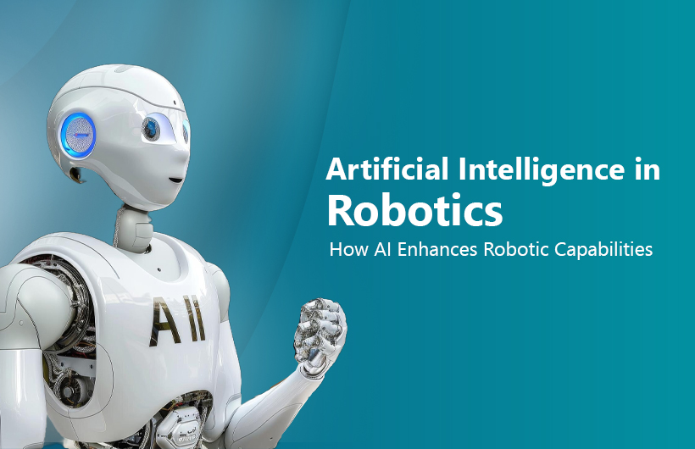

Slide 21
Robotics
Definition: Combining AI with machines to sense, plan, and act in the physical world.
Examples: Factory robots, surgical robots, delivery drones
Notes:
Robotics combines AI’s decision-making with mechanical systems.
In warehouses, robots move products around.
In hospitals, they assist in surgery with extreme precision.
AI makes them adaptable — not just pre-programmed.

Slide 22
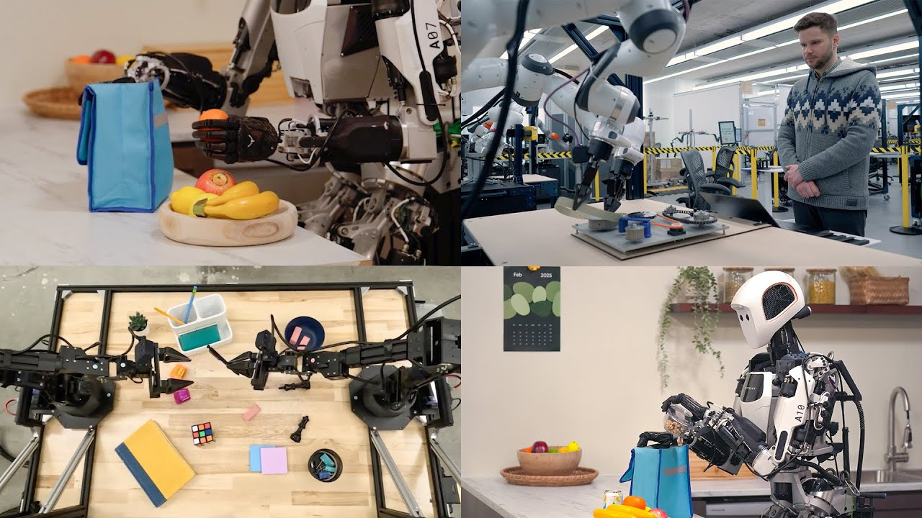
Gemini Robotics: Where AI Meets the Physical World

Slide 23
How These Fields Work Together
Modern AI systems are hybrids.
Example: Self-driving car uses CV for seeing, ML/DL for decision-making, NLP for voice commands, Robotics for movement.
Notes:
In real life, these fields don’t work alone.
A self-driving car ‘sees’ using Computer Vision, understands driver speech using NLP, makes decisions using ML/DL, and moves via Robotics.
The magic happens when these fields come together.

Slide 24

Recap
ML – learn
DL – neural
NLP – language
CV – vision
Robotics – physical
Notes:
We’ve just toured the major fields of AI: Machine Learning, Deep Learning, NLP, Computer Vision, Robotics, and Expert Systems.
Remember, these are the building blocks — in our next sessions, we’ll zoom into the ones that are most relevant to our work.

Slide 25
What’s Next
Next Session: Machine Learning
How machines learn from data
Notes:
Next time, we’ll go deeper into Machine Learning — the core engine that drives much of modern AI.

