Slide 1
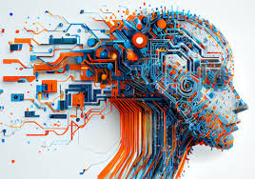
Generative AI – From Data to Creativity
Transforming raw data into innovative creative solutions
Notes:
AI-generated content may be incorrect. ---

Slide 2
Introduction to Generative AI
Notes:
What is Generative AI?, How Does It Work?

Slide 3
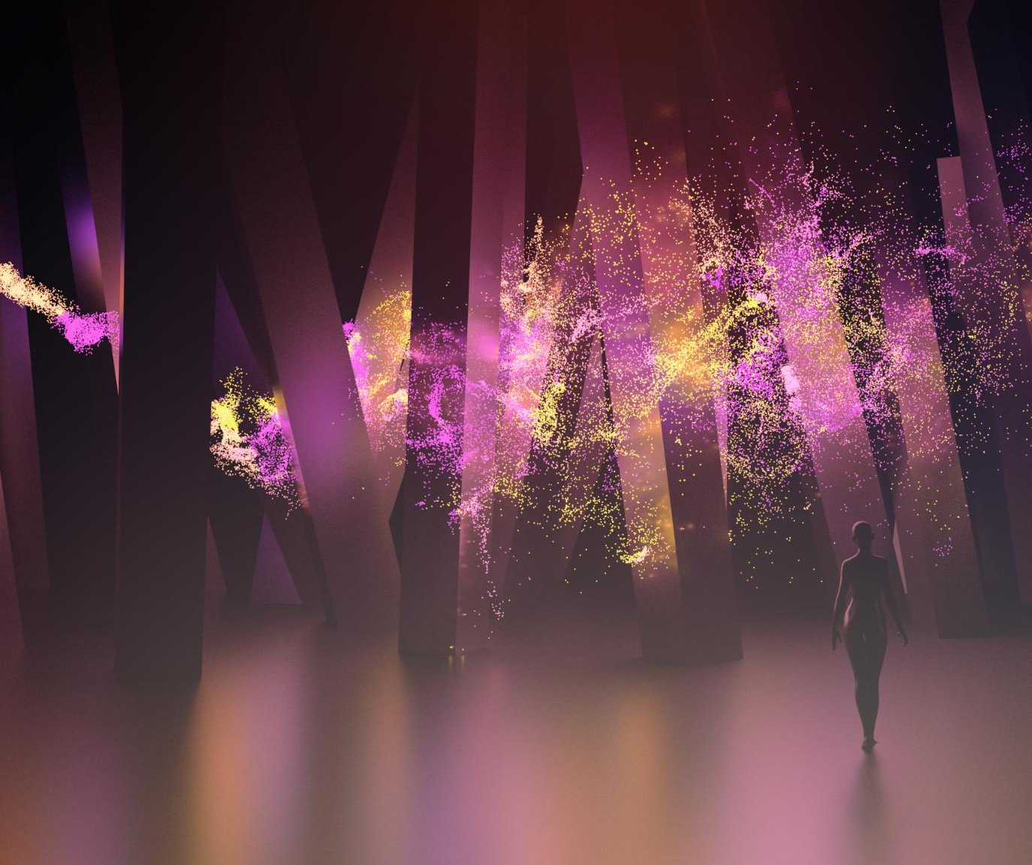
What is Generative AI?
Definition of Generative AI
Generative AI creates new content by learning patterns from existing data, unlike traditional AI.
Creative Output Types
Generative AI produces original text, images, music, code, and more, mimicking human creativity.
Examples of Generative AI
Tools like text generators, image synthesizers, and code assistants showcase generative AI capabilities.
Notes:
Generative AI refers to artificial intelligence systems capable of creating new content by learning patterns from existing data. Unlike traditional AI, which primarily focuses on classification or prediction tasks, generative AI is designed to produce original outputs such as text, images, music, code, and more. These systems analyze vast datasets to understand the underlying structure and semantics, enabling them to generate content that mimics human creativity. Popular examples include ChatGPT for text generation, DALL·E for image synthesis, and GitHub Copilot for code suggestions. These tools demonstrate how generative AI can emulate human-like creativity and provide innovative solutions across various domains.

Slide 4
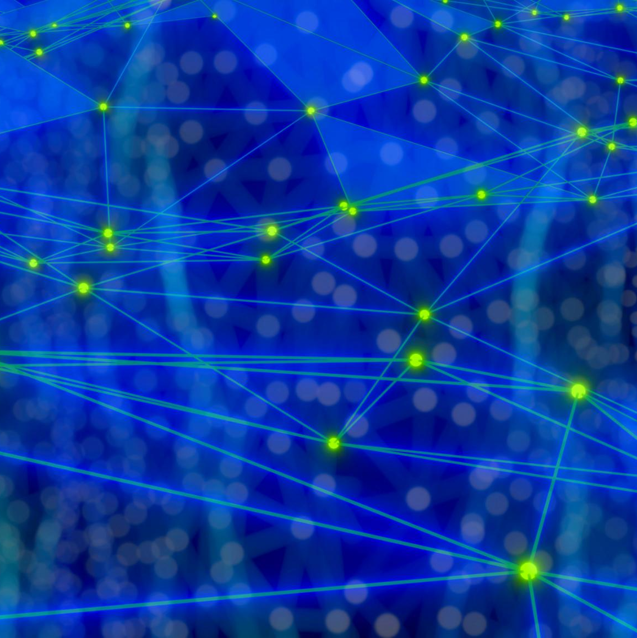
How Does It Work?
Training on Diverse Data
Generative AI learns from large datasets including text, images, and audio to understand various data forms.
Use of Deep Learning Models
Transformer-based deep learning models capture patterns and relationships within data effectively.
Sequential Prediction
AI predicts the next element in a sequence based on previous context, enabling coherent generation.
Creative Content Generation
The AI generates new, contextually relevant content by sampling learned patterns from training data.
Notes:
Generative AI operates by training on large datasets comprising text, images, audio, and other forms of data. It employs deep learning models, particularly Transformers, to learn the statistical patterns and relationships within the data. These models are trained to predict the next element in a sequence—be it a word, pixel, or musical note—based on the context provided by previous elements. Once trained, the AI generates new content by sampling from these learned patterns, effectively creating outputs that resemble the training data but are entirely new. This process allows generative AI to produce coherent and contextually relevant content, showcasing its ability to simulate human-like creativity.

Slide 5
Technologies Behind Generative AI
Notes:
Key Technologies

Slide 6
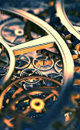
Key Technologies
Transformers in AI
Transformers revolutionize how machines process and generate human-like language in generative AI models.
VAEs (Variational Autoencoders)
How it works: Encodes data into a latent space and decodes it back to generate new samples.
Best for: Image reconstruction, anomaly detection.
Diffusion Models for Images
Diffusion models iteratively refine noisy inputs to create high-quality, coherent images in AI generation tasks.
Generative Adversarial Networks
GANs use two competing neural networks to produce realistic images and digital art by improving generated content.
Notes:
Generative AI is powered by several advanced technologies that enable its creative capabilities. Transformers are the backbone of modern generative models, revolutionizing how machines process and generate language. Large Language Models (LLMs) like GPT and BERT utilize transformer architectures to understand and produce human-like text. Diffusion Models are employed in image generation tasks, such as those performed by DALL·E and Midjourney, by iteratively refining noisy inputs into coherent images. Generative Adversarial Networks (GANs) are another critical technology, used in applications like deepfakes and digital art. These models work by pitting two neural networks against each other—a generator and a discriminator—to improve the realism of generated content.

Slide 7
Applications and Examples
Notes:
Applications of Generative AI, Real-World Examples

Slide 8
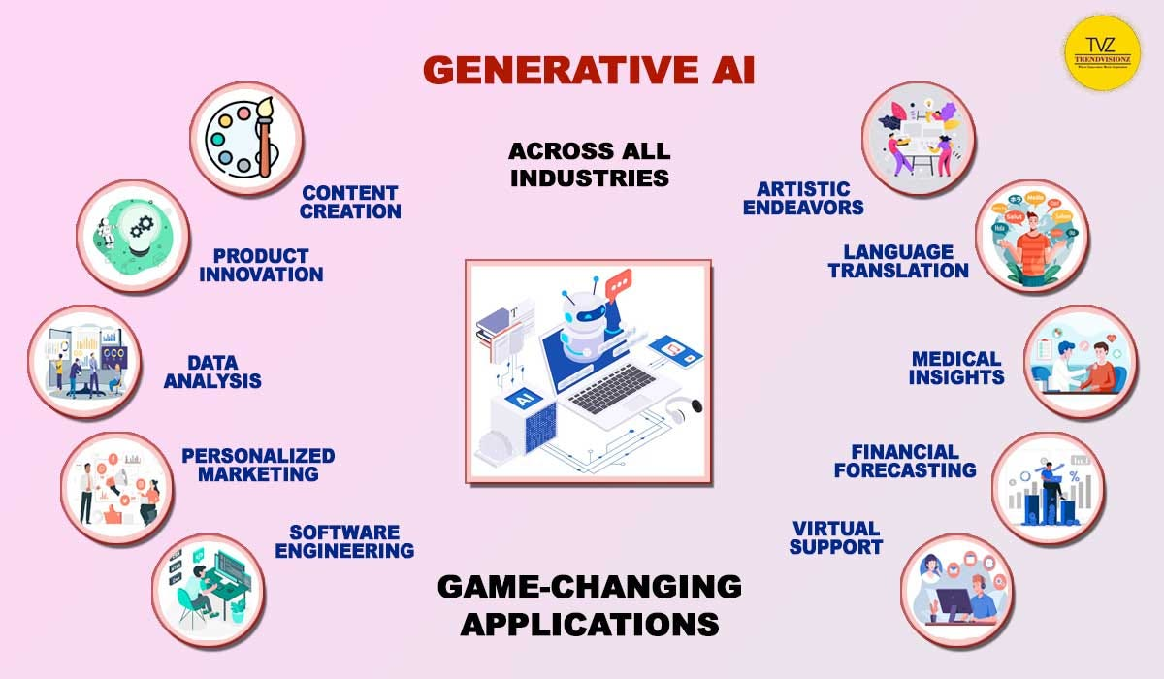
Application of Generative AI
Healthcare: Drug discovery, medical imaging.
Finance: Fraud detection, algorithmic trading.
Entertainment: Content creation, game design.
Real-world Examples: DeepMind's AlphaFold for protein folding, OpenAI's DALL-E for image generation.

Slide 9
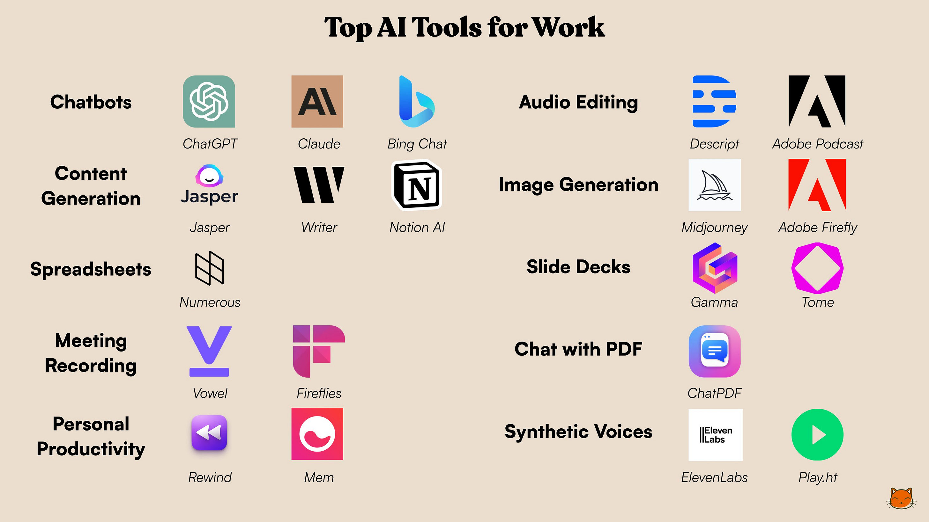

Slide 10
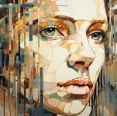
Real-World Examples
Conversational AI
Conversational AI tools generate human-like responses to enhance dialogue and communication.
AI Image Generation
AI models create images from text prompts, merging language and visual creativity.
Video Editing with AI
Generative AI powers video editing tools, enabling creative manipulation of video content.
AI Code Assistance
AI assists programmers by suggesting context-aware code to boost productivity.
Notes:
Several real-world tools exemplify the capabilities of generative AI. ChatGPT is a conversational AI that generates human-like responses in dialogue. DALL·E creates images from textual prompts, showcasing the fusion of language and visual understanding. Runway ML offers video editing features powered by generative models, enabling creative professionals to manipulate video content with ease. GitHub Copilot assists programmers by suggesting code based on context, improving productivity. Adobe Firefly integrates generative AI into design workflows, allowing users to create and modify visuals using natural language commands. These examples highlight how generative AI is being integrated into everyday tools and workflows.

Slide 11
Understanding GAN
Notes:
Introduction to GANs, How GANs Work, Sample GAN Data Flow, GAN Applications

Slide 12
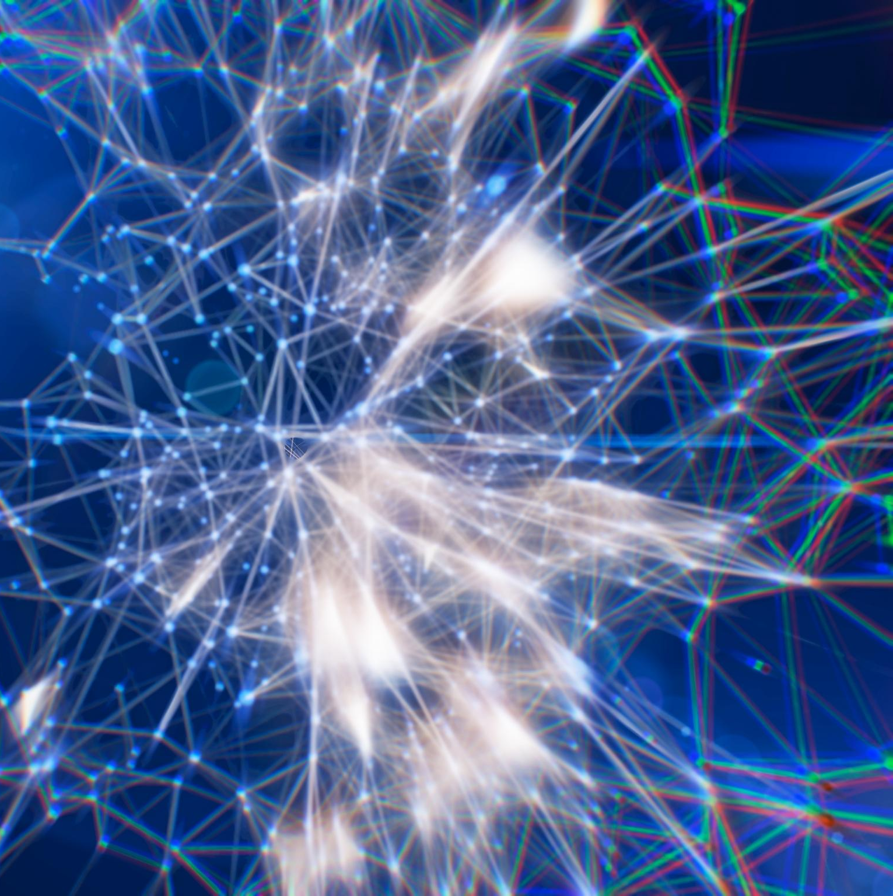
Introduction to GANs
Core GAN Components
GANs consist of two neural networks: a generator that creates data and a discriminator that evaluates data authenticity.
Adversarial Training Process
The generator and discriminator compete, improving each other to produce highly realistic synthetic content.
Applications in AI
GANs are fundamental in generative AI, especially for synthesizing realistic images and videos.
Notes:
Generative Adversarial Networks (GANs) are a class of generative models introduced by Ian Goodfellow in 2014. They consist of two neural networks: a generator and a discriminator. The generator creates fake data, while the discriminator evaluates whether the data is real or fake. These networks are trained in a competitive setting, where the generator aims to produce increasingly realistic data to fool the discriminator, and the discriminator strives to accurately distinguish between real and generated data. This adversarial process leads to the improvement of both models, resulting in highly realistic synthetic content. GANs have become a foundational technology in generative AI, particularly in image and video synthesis.

Slide 13
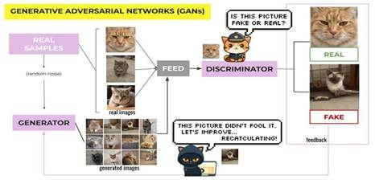
Working of GAN

Slide 15
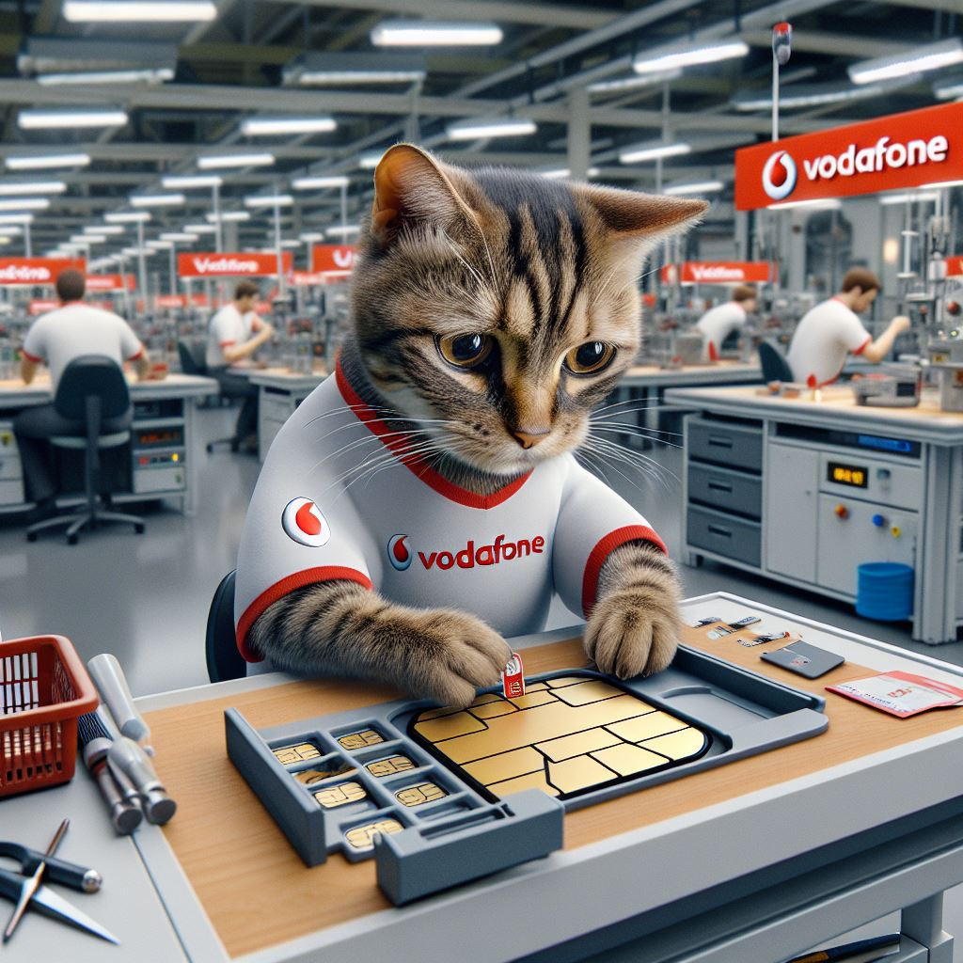
Cat as a Vodafone Employee

Slide 16
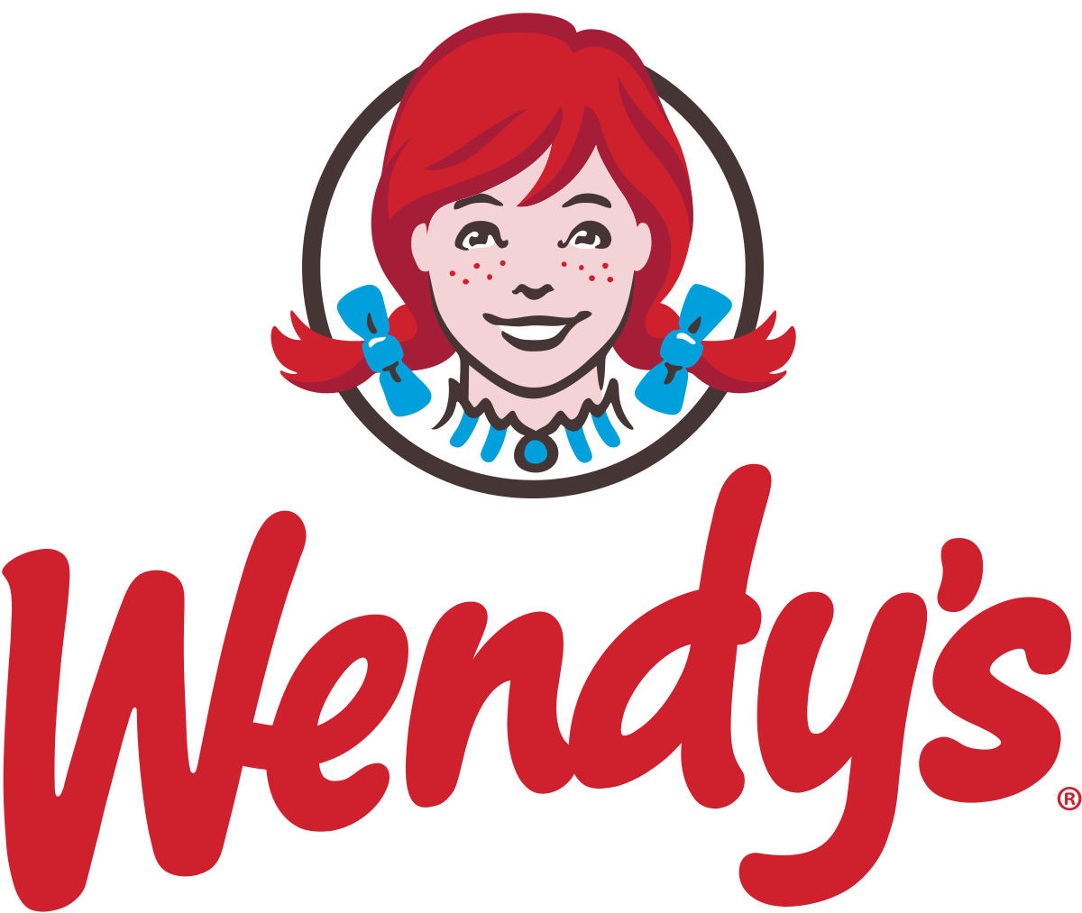
Wendy's FreshAI: Revolutionizing Drive-Thru Orders
Overview:
Company: Wendy's
Objective: Improve drive-thru order accuracy and speed.
Implementation:
Technology: Generative AI from Google Cloud.
Application: AI handles customer orders at the drive-thru.
Results:
Efficiency: Faster and more accurate order processing.
Customer Satisfaction: Better service with fewer mistakes.
Employee Support: AI assists staff, allowing them to focus on food preparation.

Slide 17
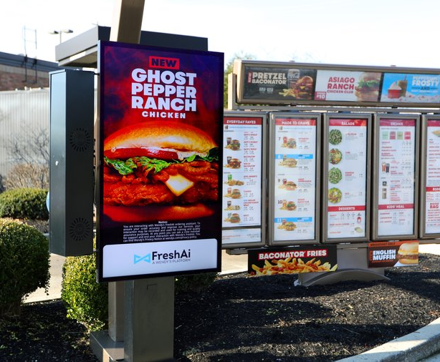
Impact:
Operational Improvement: Streamlined operations and better resource management.
Competitive Edge: Positioned Wendy's as a leader in leveraging AI for customer service.

Slide 18
Benefits and Risks
Notes:
Benefits of Generative AI, Risks and Challenges

Slide 19
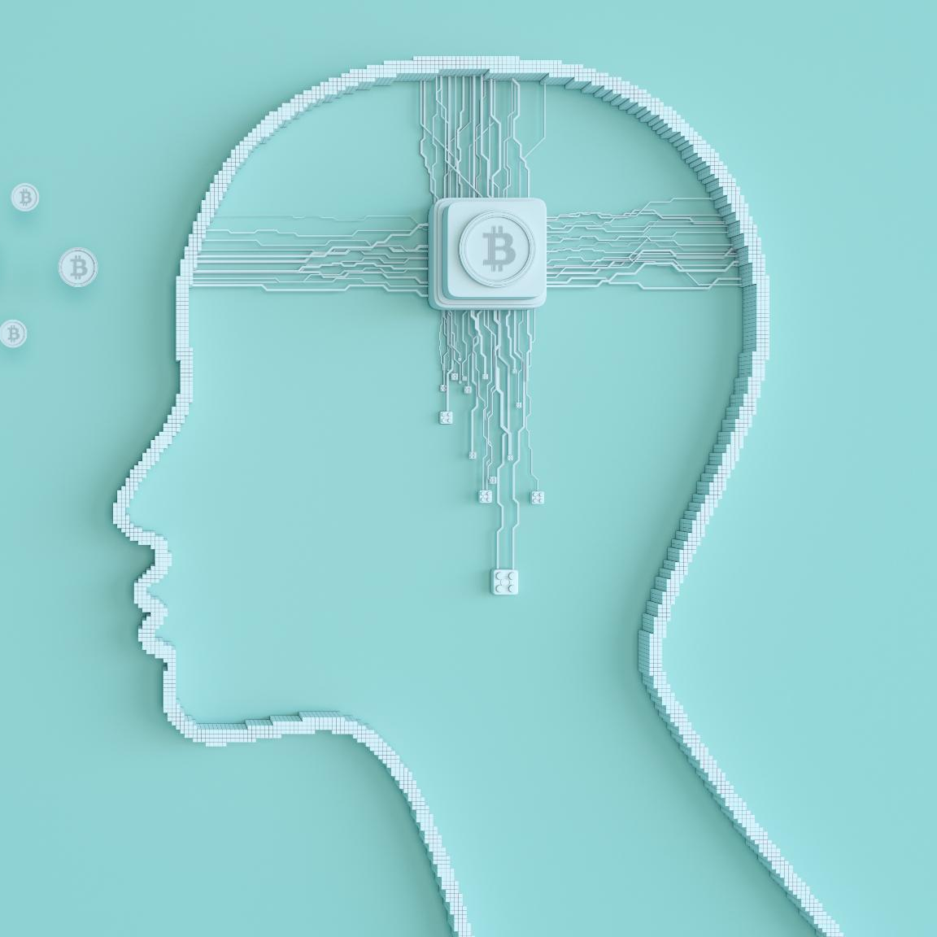
Benefits of Generative AI
Enhanced Creativity and Productivity
Generative AI boosts creativity by producing personalized content quickly, increasing productivity significantly.
Automation of Repetitive Tasks
Automating routine tasks with generative AI frees time for strategic and creative work.
Applications Across Industries
Generative AI enables innovative and customized solutions in education, healthcare, and design.
Competitive Innovation Tool
High-quality, efficient content creation helps individuals and organizations stay competitive and innovative.
Notes:
Generative AI offers numerous benefits that enhance creativity and productivity. It enables users to generate personalized content at scale, reducing the manual effort required in traditional content creation processes. By automating repetitive tasks, generative AI frees up time for more strategic and creative endeavors. It also opens new possibilities in fields like education, healthcare, and design, where customized and innovative solutions are increasingly valuable. The ability to produce high-quality content quickly and efficiently makes generative AI a powerful tool for individuals and organizations looking to innovate and stay competitive in a rapidly evolving digital landscape.

Slide 20
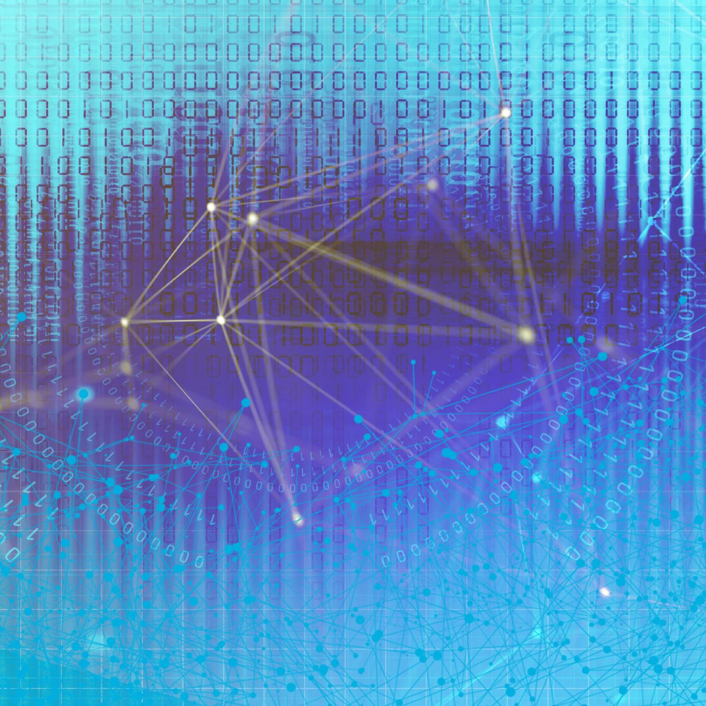
Risks and Challenges
Bias in Generated Content
Bias in AI-generated content can reinforce stereotypes and spread misinformation, impacting fairness and accuracy.
Deepfakes and Deceptive Media
Generative AI enables creation of deepfakes, raising serious ethical and legal concerns about media authenticity.
Copyright Infringement Risks
AI models may generate content resembling existing works, posing challenges to copyright and intellectual property laws.
Impact on Human Creativity
Over-reliance on AI for creativity can reduce human critical thinking and originality over time.
Notes:
Despite its advantages, generative AI poses several risks and challenges. One major concern is bias in generated content, which can perpetuate stereotypes and misinformation. The technology also facilitates the creation of deepfakes and other forms of deceptive media, raising ethical and legal issues. Copyright infringement is another challenge, as generative models may produce content that closely resembles existing works. Additionally, over-reliance on AI for creative tasks can diminish human creativity and critical thinking. Addressing these risks requires robust governance, transparency in model training, and ethical guidelines to ensure responsible use of generative AI technologies.

