Slide 1

Machine Learning – Making Machines to Learn
The Core of Modern AI
Notes:
Today we move from the map to our first deep dive — Machine Learning. This is the technology powering most of the AI applications we hear about today. By the end of this session, you’ll understand what ML is, the main types, how the process works, and where it’s used in real life.

Slide 2


What is Machine Learning?
Definition: Machine Learning is the science of getting computers to learn patterns from data and make predictions without being explicitly programmed.
Notes:
Traditionally, we tell computers exactly what to do step-by-step. With ML, instead of rules, we give it examples, and the computer figures out the rules itself. For example, a spam filter learns from examples of spam and not-spam emails. Over time, it gets better without us manually coding every keyword.

Slide 3
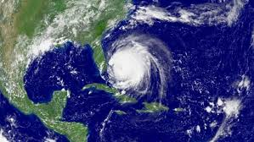

Real Use Case of Machine Learning
Hurricane Frances was approaching Florida in 2004, and Walmart needed to stock stores efficiently for emergency demand
Walmart often waited for demand to spike before responding, leading to delays, stockouts, and missed sales opportunities

Slide 4

Walmart & Hurricane Frances
Walmart used ML to analyze past hurricane sales data
Discovered unexpected demand patterns (e.g., Pop-Tarts, beer)
Pre-positioned inventory based on predictions
Boosted customer satisfaction and sales
Shows ML's power to find hidden patterns and drive smart decisions
Notes:
In 2004, Walmart used machine learning to prepare for Hurricane Frances.
Instead of guessing, they analyzed years of sales data from previous storms.
ML revealed surprising insights — like a huge spike in Pop-Tarts and beer sales.
Walmart acted on these predictions by sending the right inventory to stores in advance.
This example shows how ML can uncover hidden patterns and make real-world decisions smarter.

Slide 5

Why Machine Learning Matters
Benefits:
Automation
Accuracy
Scalability
Personalization
Notes:
ML matters because it can spot patterns too complex for humans, and it can scale to huge amounts of data. It powers fraud detection in banks, product recommendations on Amazon, and even predicts when machines will need repairs.

Slide 6
Types of Machine Learning
Supervised Learning:
Labeled examples
E.g., predicting house prices
Unsupervised Learning:
Finds hidden patterns
E.g., customer segmentation
Reinforcement Learning:
Learns by trial and error
E.g., game-playing AIs
Notes:
ML comes in three main flavors: Supervised Learning – we train with labeled examples, like showing a child flashcards with answers. Unsupervised Learning – no labels; the system finds hidden patterns. Reinforcement Learning – the system learns by trial and error, getting rewards for good moves.

Slide 7

Supervised
Definition: ML technique where the model learns from labeled data (input + correct output).
Goal: Predict outcomes for new data based on learned patterns.
How it works: Train the model using examples with known answers.

Slide 8
Real World Example of Supervised
Email Spam Detection
Input: Email content
Output: "Spam" or "Not Spam"
Use Case: Gmail and other email services use supervised models trained on labeled emails to filter spam.
Loan Default Prediction
Input: Customer financial data (income, credit score, etc.)
Output: "Will Default" or "Will Not Default"
Use Case: Banks use this to assess risk before approving loans.

Slide 9
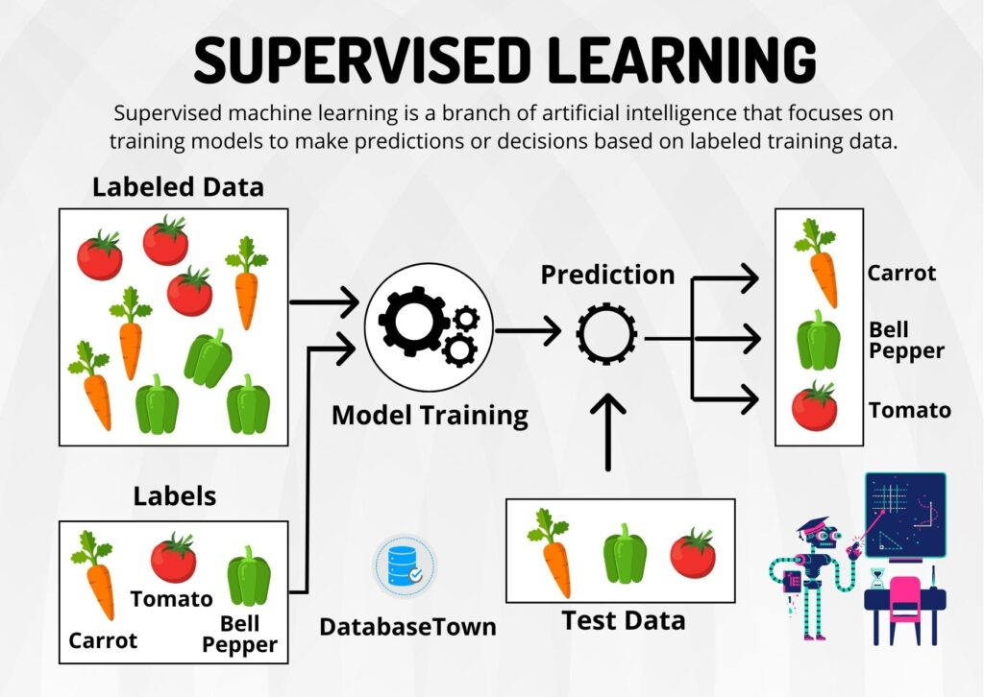

Slide 10

Unsupervised
Definition: ML technique where the model learns from unlabeled data — no correct answers provided.
Goal: Discover hidden patterns, groupings, or structures in the data.
How it works: The model explores the data and organizes it based on similarities or relationships.
Example: Segmenting customers into groups based on shopping behavior — without knowing their preferences in advance.

Slide 11
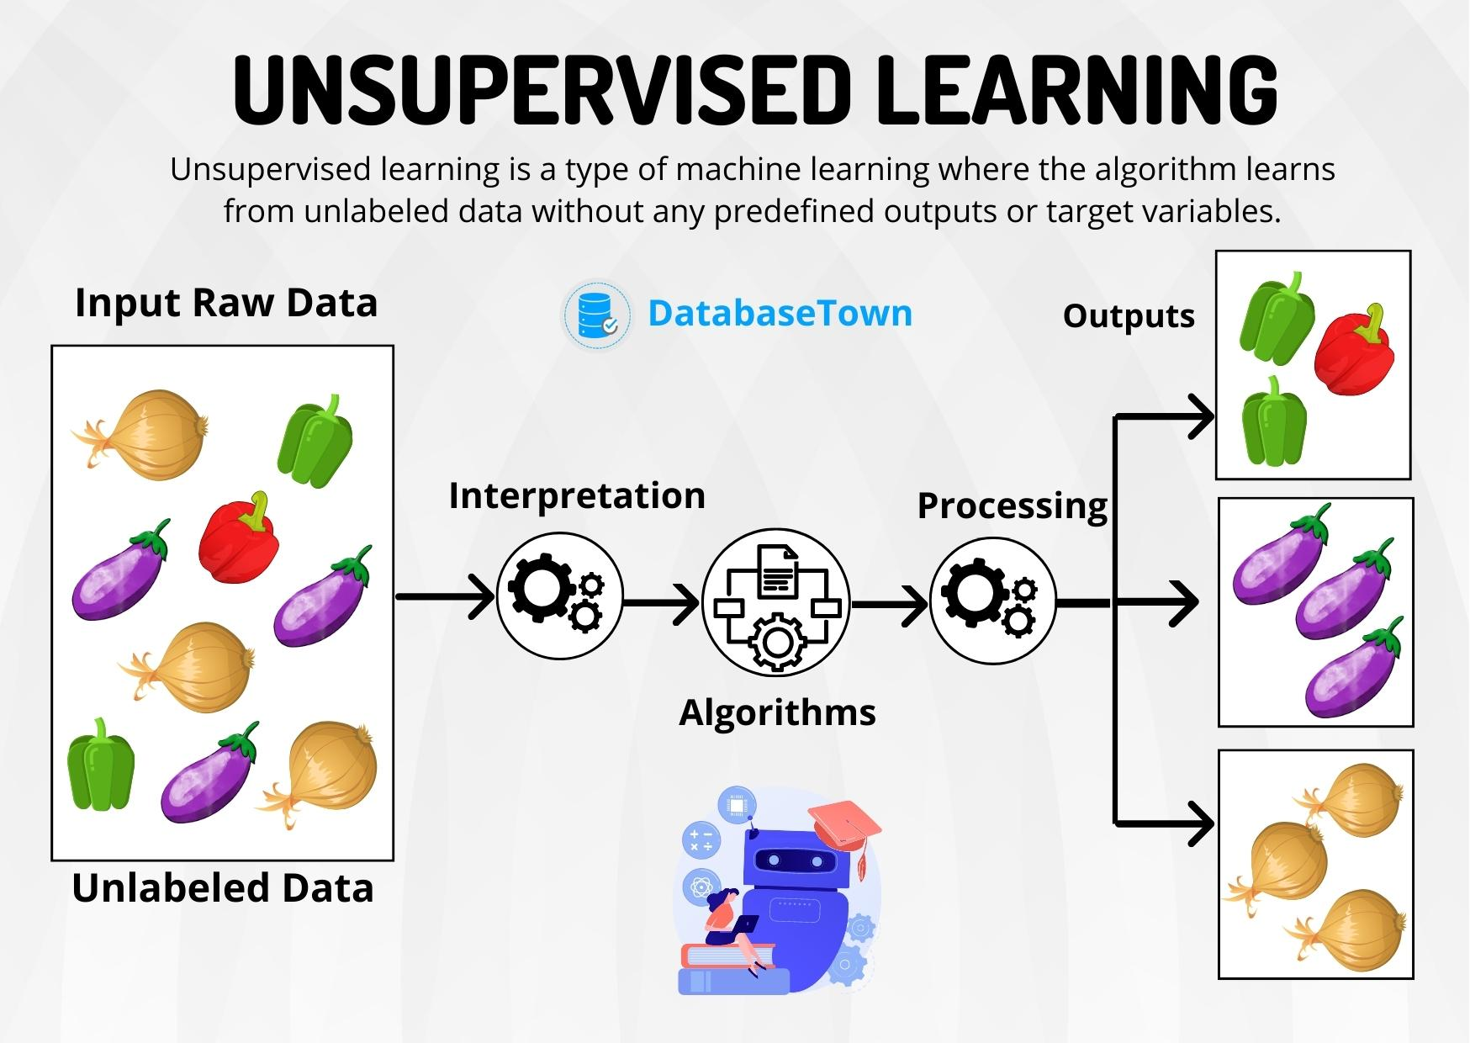

Slide 12
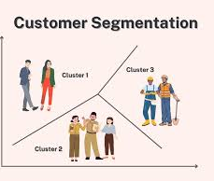
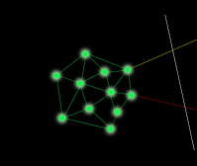
Real World Examples
Customer Segmentation
Input: Purchase history, browsing behavior
Output: Clusters of similar customers
Use Case: E-commerce platforms use this to target marketing campaigns more effectively.
Anomaly Detection in Network Traffic
Input: Network usage logs
Output: Identification of unusual patterns
Use Case: Cybersecurity systems use this to detect potential intrusions or attacks.

Slide 13
Reinforcement Learning
Definition: ML technique where an agent learns by interacting with an environment and receiving feedback (rewards or penalties).
Goal: Maximize cumulative reward by learning the best actions over time.
How it works: The agent tries different actions, learns from outcomes, and improves its strategy.
Example: Training a robot to walk or an AI to play chess — it learns by trial and error, improving with each attempt.

Slide 14
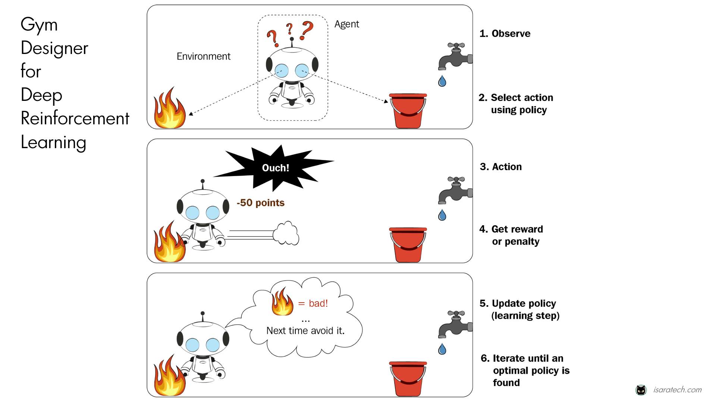

Slide 15
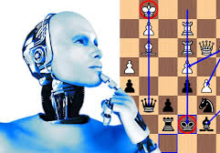
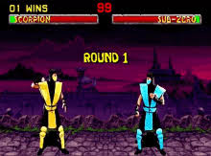
Example for Reinforcement learning
Video Games
Chess Bot

Slide 16

The ML Workflow
1. Collect and prepare data
2. Choose a suitable algorithm
3. Train the model on data
4. Test it to see how well it works
5. Use it in real life and keep improving with feedback
Notes:
The ML process follows a cycle: Collect and prepare data, choose a suitable algorithm, train the model, test it, and improve it with feedback.

Slide 17
Data is the Fuel
Examples of data:
Images
Text
Sensor data
Transaction logs
Tip: Garbage in → garbage out
Notes:
Data is the fuel for ML. The quality of your data often matters more than the algorithm. If your data is bad, biased, or incomplete, your results will be poor — this is why we say garbage in, garbage out.

Slide 18

Real-World Applications
Use Cases:
Predicting customer churn
Detecting credit card fraud
Recommending movies/products
Medical diagnosis
Demand forecasting
Notes:
ML is everywhere: Your bank flags suspicious activity in real time, streaming platforms recommend shows you’ll like, and hospitals use ML to help detect diseases earlier.

Slide 19
Challenges in Machine Learning
Challenges:
Data quality
Bias
Overfitting
Explainability
Ethics
Notes:
ML is powerful but not magic. Bad or biased data can lead to unfair or wrong results. Overfitting happens when a model memorizes instead of learning. We also need to make ML decisions explainable for trust and accountability.

Slide 20
Recap
Summary:
1. ML = learning from data
2. Types: supervised, unsupervised, reinforcement
3. Workflow: data → model → prediction → improve
4. Many real-world uses
5. Challenges and opportunities
Notes:
To recap: ML is about teaching computers to learn from examples instead of coding rules. It comes in three main types, follows a clear workflow, and is powering countless applications around us.

Slide 21
Next Session
Title: Next: Deep Learning
Subtitle: Going deeper into neural networks
Notes:
In our next session, we’ll look at Deep Learning — a special kind of ML that has transformed speech, vision, and language AI.

Slide 22



