Slide 1

Agentic AI: The Next Evolution Beyond LLMs
Exploring autonomous capabilities in artificial intelligence
Notes:
AI-generated content may be incorrect. ---

Slide 2
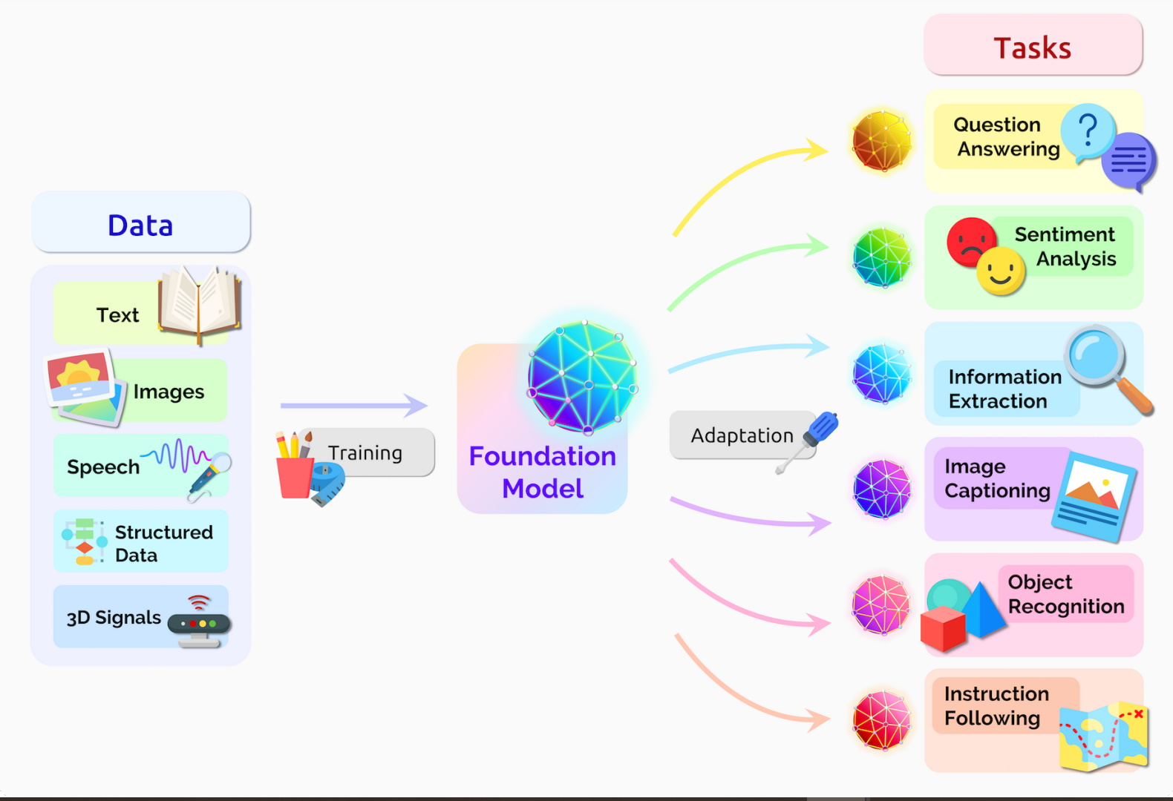
Large Language Model

Slide 3
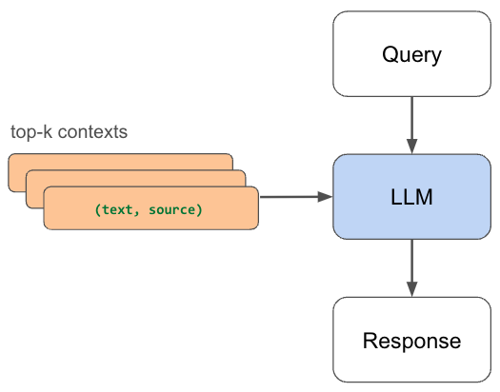
Workflow of LLM

Slide 4

Introduction
Agentic AI Overview
Agentic AI represents an advanced form of AI that performs autonomous actions beyond simple prompt responses.
Presentation Scope
The talk will cover Agentic AI’s definition, workings, real-world examples, useful tools, limitations, and importance.
Notes:
Good [morning/afternoon], everyone. Today, we’ll explore Agentic AI — a powerful new evolution of AI that goes beyond just responding to prompts. We’ll cover what it is, how it works, real-time examples, tools you can use, limitations, and why it matters for us.

Slide 6
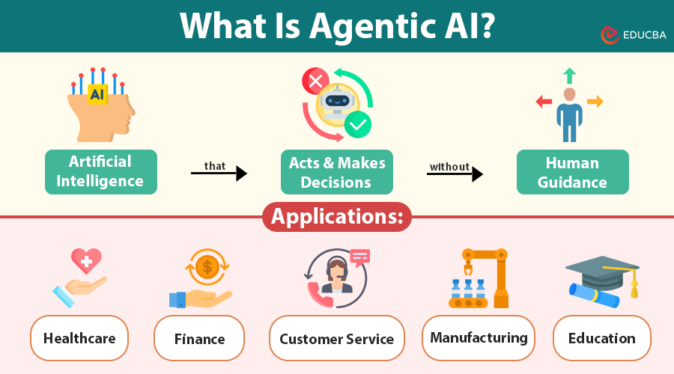

Slide 7
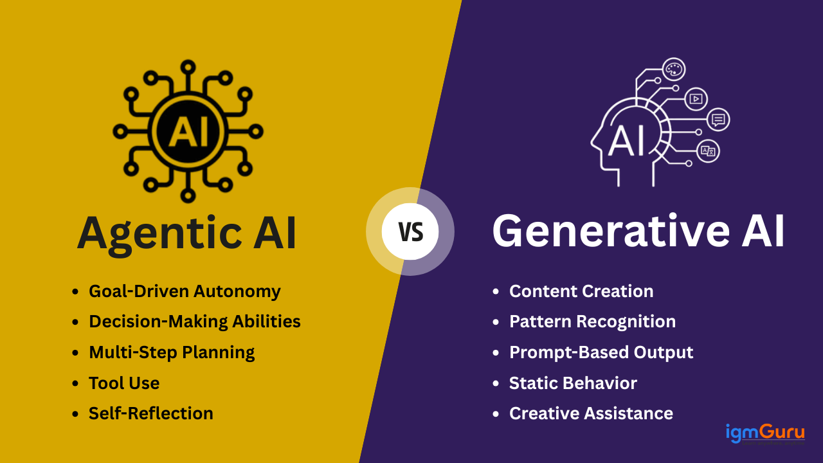

Slide 8
Introduction to Agentic AI
Notes:
Introduction, What is Agentic AI?

Slide 9
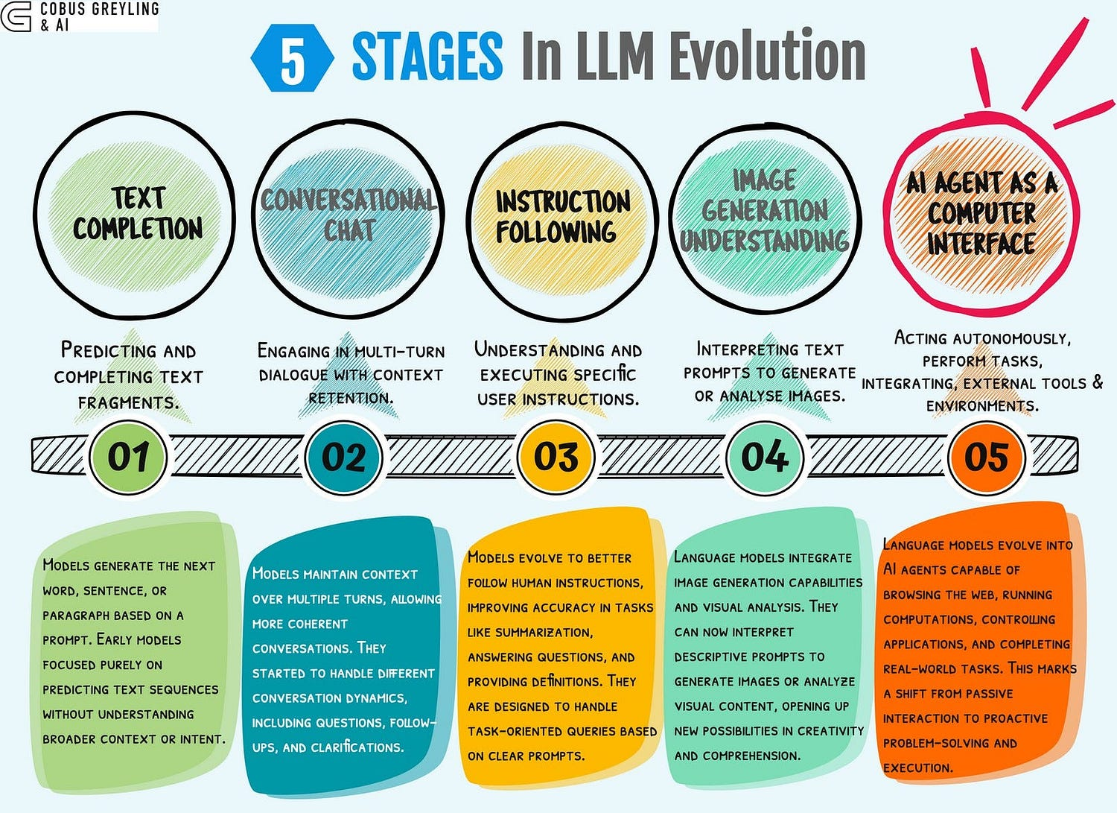

Slide 11

What is Agentic AI?
Beyond Traditional AI
Agentic AI goes beyond simple responses by planning and making decisions independently to achieve goals.
Goal-Oriented Behavior
This AI actively pursues specific goals, showing initiative unlike conventional chatbots or language models.
Active Task Execution
Agentic AI integrates reasoning, planning, and action, becoming an active participant in tasks.
Independent Problem Solving
It operates independently in dynamic environments, enabling proactive and effective problem-solving.
Notes:
Agentic AI is an advanced form of artificial intelligence that transcends the traditional capabilities of chatbots and language models. Unlike conventional AI systems that merely respond to user prompts, Agentic AI possesses the ability to plan, make decisions, and take autonomous actions toward achieving specific goals. This evolution marks a significant shift in AI functionality, introducing initiative and goal-oriented behavior into machine intelligence. By integrating reasoning, planning, and action, Agentic AI transforms from a passive responder into an active participant in task execution. This capability allows it to operate more independently, making it a valuable asset in dynamic and complex environments where proactive problem-solving is essential.

Slide 12
Mechanics and Differentiation
Notes:
How It Works (High Level), Why It’s Different from LLMs

Slide 13

How It Works (High Level)
Reasoning Layer
The reasoning layer helps AI understand goals and break them into manageable steps for effective processing.
Planning Layer
Planning selects the right tools, data, and actions necessary to meet the objectives efficiently.
Acting Layer
The acting layer executes actions, learns from results, and refines future steps for continuous improvement.
Autonomous Execution
Agentic AI works independently, initiating and completing tasks without user input, enhancing versatility.
Notes:
Agentic AI operates through a layered approach that includes reasoning, planning, and acting. The reasoning layer enables the AI to comprehend goals and deconstruct them into manageable steps. Planning involves selecting appropriate tools, data sources, and actions required to achieve the objectives. Finally, the acting layer executes these actions, learns from the outcomes, and refines future steps accordingly. This structured methodology empowers Agentic AI to function autonomously, adapting to changing circumstances and improving its performance over time. Unlike traditional LLMs that rely on user input for each step, Agentic AI can initiate and complete tasks independently, making it a more robust and versatile solution for real-world applications.

Slide 14

How Agentic AI Chooses the Right App
Agentic AI doesn't randomly open apps — it uses smart decision-making:
1. Goal Understanding: Breaks down your request into tasks.
2. Tool Awareness: Knows what each app/API can do.
3. Planning Logic: Chooses the best tool for each step.
4. Autonomous Execution: Executes actions and adapts if needed.
Analogy: It's like a smart intern who knows which software to use for each task —
you just tell them the goal, and they figure out the rest.

Slide 15
Applications and Examples
Notes:
Real-Time Example, Current Applications

Slide 16

Real-Time Example
Traditional LLM Assistance
Traditional language models suggest flight options when given necessary input but lack proactive task management capabilities.
Agentic AI Autonomy
Agentic AI autonomously searches flights, compares hotel prices, schedules meetings, and adjusts plans automatically.
Proactive Digital Teammate
Agentic AI acts as a proactive teammate managing complex tasks independently to enhance productivity and streamline processes.
Notes:
Consider the scenario of planning a business trip. A traditional LLM can suggest flight options if provided with all necessary details. However, an Agentic AI can take this a step further by autonomously searching for flight options online, comparing hotel prices, scheduling meetings on your calendar, and adjusting plans if a flight gets canceled. This level of functionality transforms the AI into a proactive digital teammate that not only assists but also manages tasks independently. Such real-time examples highlight the practical benefits of Agentic AI in streamlining complex processes and enhancing productivity through intelligent automation.

Slide 17


Slide 18

Video game NPCs are now powered by Agentic AI, allowing characters to evolve across playthroughs.

Slide 19
Current Applications
Customer Support Automation
Agentic AI manages customer issues end-to-end, providing solutions without human intervention.
Financial Monitoring and Investing
It monitors transactions and performs automated investing using predefined strategies.
Healthcare Management
Agentic AI schedules appointments, manages follow-ups, and generates healthcare reports.
Software Development Assistance
It aids in writing, testing, and deploying code, accelerating software development cycles.
Sales and Marketing Optimization
Agentic AI supports lead qualification, outreach, and campaign optimization in sales and marketing.
Notes:
Agentic AI is already making significant impacts across various industries. In customer support, it handles issues end-to-end, providing comprehensive solutions without human intervention. In finance, it monitors transactions and performs auto-investing based on predefined strategies. Healthcare applications include scheduling appointments, managing follow-ups, and generating reports. In software engineering, Agentic AI assists in writing, testing, and deploying code, thereby accelerating development cycles. Sales and marketing teams use it for lead qualification, outreach, and campaign optimization. These diverse applications demonstrate the versatility and effectiveness of Agentic AI in enhancing operational efficiency and delivering value across sectors.

Slide 20
Building and Supporting Technologies
Notes:
How to Create an Agentic AI, Tools & Frameworks Available

Slide 21

How to Create an Agentic AI
LLM Core Foundation
The LLM core provides essential reasoning and language capabilities for agentic AI development.
Integration of Tools and APIs
Tools like web search, email, and databases enable the AI to interact with external systems effectively.
Memory for Context Awareness
Memory allows AI to track history, preferences, and context for personalized decision-making.
Orchestration Framework
An orchestration framework coordinates planning, actions, and monitoring ensuring smooth AI operations.
Notes:
Creating an Agentic AI involves integrating several key components. The foundation is an LLM core that provides reasoning and language capabilities. This core is augmented with tools and APIs such as web search, email, and databases to enable interaction with external systems. Memory is another crucial element, allowing the AI to track history, preferences, and context for more personalized and informed decision-making. An orchestration framework ties these components together, coordinating planning, actions, and monitoring to ensure seamless operation. By combining these elements, developers can build AI agents that are not only intelligent but also capable of autonomous execution and continuous improvement.

Slide 22

Tools & Frameworks Available
LangChain Framework
LangChain is a popular framework for building AI agents with integrated tool support, enhancing agent capabilities.
Multi-Agent Collaboration
AutoGen enables multi-agent collaboration for executing complex tasks through coordinated AI agents.
Agent Coordination by CrewAI
CrewAI specializes in coordinating multiple specialized agents to improve overall AI performance.
Enhanced Data Integration
LlamaIndex connects AI to diverse data sources, improving contextual understanding and decision-making.
Notes:
Several frameworks and platforms are available to facilitate the development of Agentic AI. LangChain is widely used for building AI agents with integrated tools. AutoGen by Microsoft supports multi-agent collaboration, enabling complex task execution. CrewAI specializes in coordinating multiple specialized agents for enhanced performance. OpenAI’s Function Calling and Assistants API offer structured agentic capabilities, allowing developers to define and manage agent behaviors effectively. LlamaIndex connects AI with diverse data sources, enhancing its contextual understanding and decision-making. These tools simplify the development process, providing robust infrastructure and features that accelerate the creation of sophisticated AI agents.

Slide 23
Challenges and Future Outlook
Notes:
Limitations & Risks, The Future of Work with Agentic AI

Slide 24
Limitations & Risks
Reliability Challenges
Agentic AI systems are prone to errors and hallucinations, raising concerns about their reliability.
Reduced Human Oversight
Over-dependence on AI may reduce human involvement and critical decision-making in processes.
Security Risks
AI agents accessing sensitive data pose security risks requiring strong protective measures.
High Operational Costs
Running complex AI agents can be costly, affecting scalability and widespread accessibility.
Ethical Considerations
Granting autonomy to AI systems raises ethical questions about responsibility and control.
Notes:
Despite its advantages, Agentic AI faces several limitations and risks. Reliability remains a concern, as the technology is still prone to errors or hallucinations. Over-dependence on AI can lead to reduced human oversight and decision-making. Security risks arise when agents access sensitive tools or data, necessitating robust safeguards. The cost of running complex agents can be high, impacting scalability and accessibility. Ethical considerations also come into play, particularly regarding the level of autonomy granted to AI systems. Addressing these challenges is crucial to ensuring the safe and effective deployment of Agentic AI in various domains.

Slide 25

The Future of Work with Agentic AI
Human-AI Collaboration
Agentic AI enables seamless teamwork where humans and AI agents collaborate effectively.
Personalized Adaptive Agents
AI agents adapt to individual working styles, providing tailored and dynamic support.
Workflow Management
Agentic AI manages workflows holistically, improving efficiency beyond isolated tasks.
Productivity and Innovation
Integration of Agentic AI will redefine roles, boost productivity, and foster innovation.
Notes:
The future of work is poised to be transformed by Agentic AI. We can expect teams where humans and AI agents collaborate seamlessly, with AI managing workflows rather than just individual tasks. These agents will become more personalized and adaptive, learning users’ working styles to provide tailored support. This evolution represents a paradigm shift comparable to the transition from the internet to smartphones. As Agentic AI becomes more integrated into daily operations, it will redefine roles, enhance productivity, and foster innovation. Embracing this change will be essential for organizations aiming to stay competitive in a rapidly evolving technological landscape.

Slide 26
Conclusion and Call to Action
Notes:
Key Takeaways, Closing

Slide 27

Key Takeaways
Agentic AI Capabilities
Agentic AI integrates LLMs with planning, tools, memory, and actions to create proactive autonomous systems.
Industry Transformation
Agentic AI enhances efficiency and enables intelligent automation, reshaping various industries.
Human Augmentation
Agentic AI augments human abilities, promoting strategic and creative engagement rather than replacement.
Future Advancements
Leveraging Agentic AI technology can lead to significant progress in work and problem-solving.
Notes:
Agentic AI combines the capabilities of LLMs with planning, tools, memory, and action to create a proactive and autonomous system. It is already reshaping industries by enhancing efficiency and enabling intelligent automation. While there are limitations, the potential benefits are substantial. Importantly, Agentic AI is not about replacing humans but augmenting their abilities, allowing for more strategic and creative engagement. Understanding and leveraging this technology can lead to significant advancements in how we work and solve problems.

Slide 28

Closing
Agentic AI Overview
Agentic AI actively executes tasks with autonomy, marking a leap in artificial intelligence capabilities.
Transforming Workflows
This technology enables AI to move from passive tool to active collaborator in various workflows.
Driving Innovation
Adopting Agentic AI wisely can revolutionize innovation and unlock new efficiencies.
Notes:
To wrap up, Agentic AI represents a major leap forward in artificial intelligence. Its proactive and autonomous nature enables it to execute real tasks, transforming AI from a passive tool into an active collaborator. By adopting this technology wisely, we can revolutionize our workflows and drive innovation. The journey begins with exploring how Agentic AI can be applied within our own environments to unlock new possibilities and efficiencies.

