Slide 1
Plant disease

Slide 2
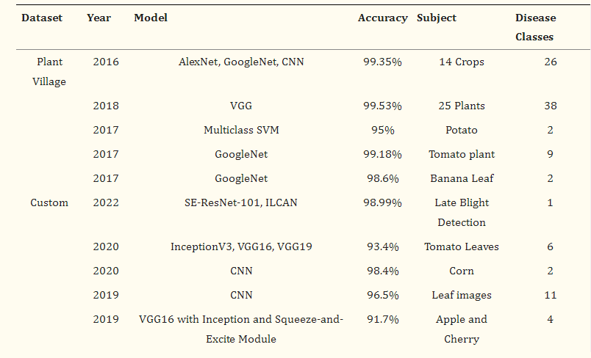

Slide 3
MODEL

Slide 4
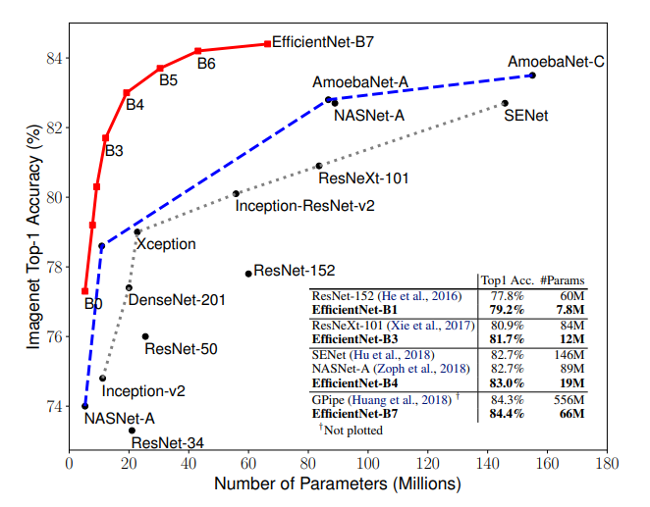

Slide 5
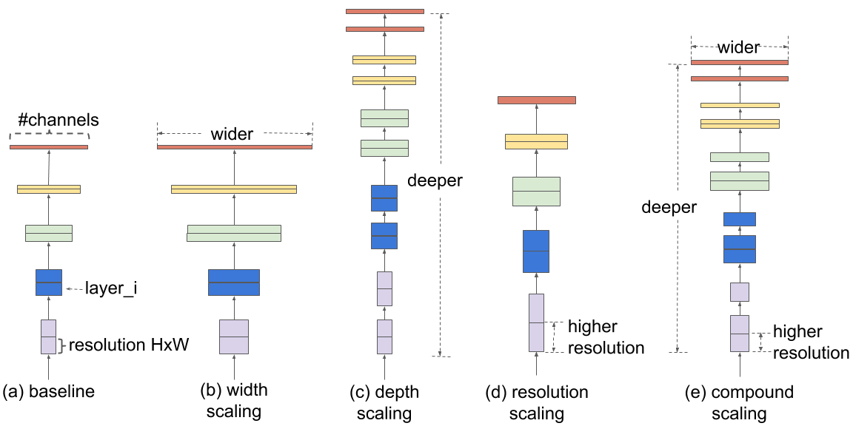
Model
Efficientnet b3

Slide 6
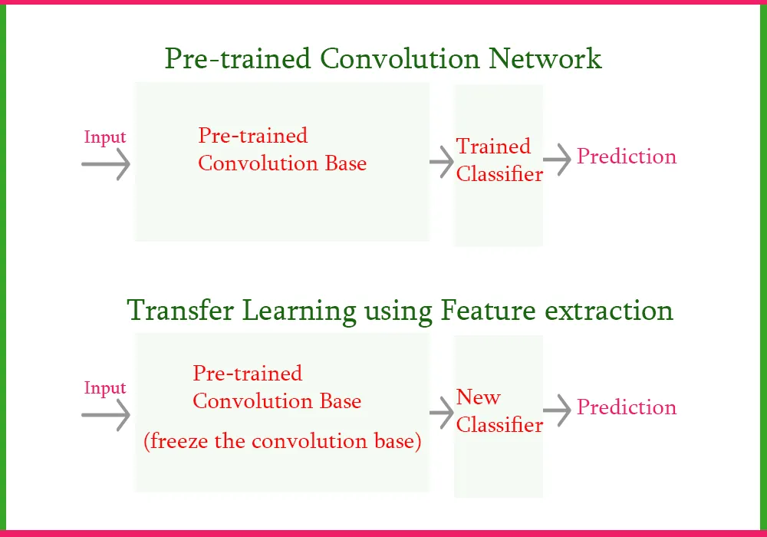

Slide 7
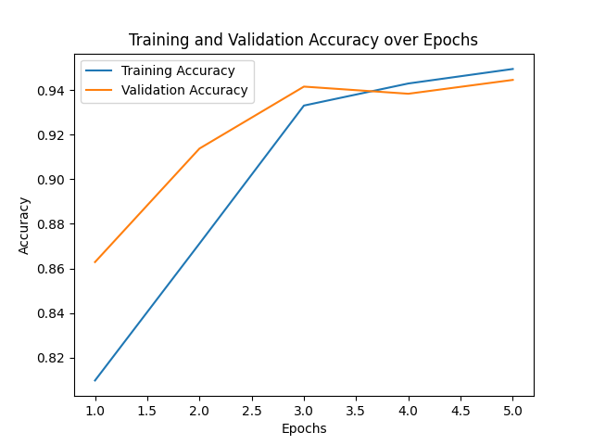
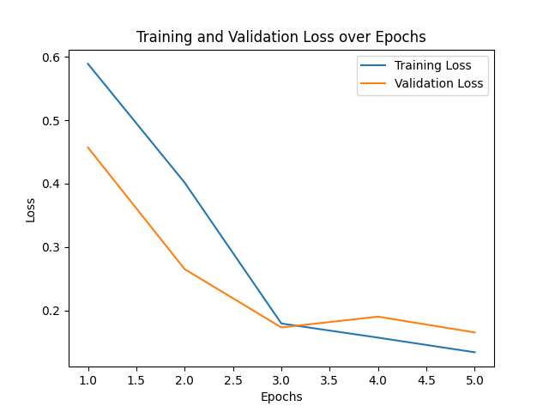


Slide 8
FROM 3 HOURS TO 30 MIN PER EPCOH
just-in-time (JIT)
Rebalancing
TPU (300 ram)
Bathcing 1k

Slide 9
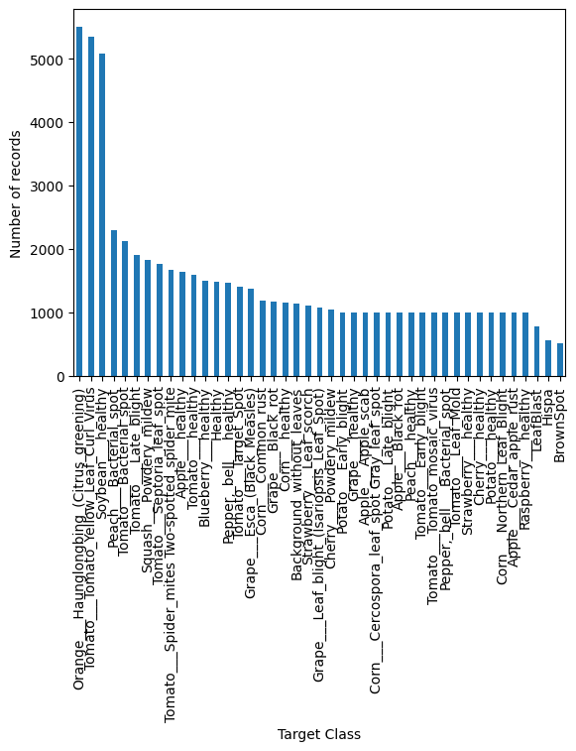

Slide 10
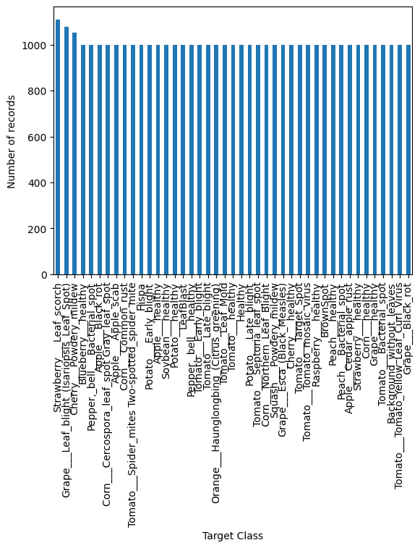

Slide 11
Problem we faced
.importing Dataset
.concatenate datasets
.Out of memory
.notebook crashing
.saving the notebook with the output

Slide 12
We could do way better if
Notebook didn’t keep crashing
Had enough resources
Had more time
Had more experience

