Slide 1
Week 2: Cascading Style Sheets (CSS)
Dr. Maaz Rehan

Slide 2
About W3Schools
A web developers site, with tutorials & references on web development languages such as HTML, CSS, JavaScript, PHP, SQL, Python, jQuery, Java, W3.CSS, and Bootstrap
The site derives its name from the World Wide Web Consortium (W3C), but is not affiliated with the W3C
Created in 1998 by Refsnes Data, a Norwegian software development and consulting company
Link to online CSS resource: https://www.w3schools.com/css/default.asp
Online Exercises can be performed at:
https://www.w3schools.com/css/exercise.asp

Slide 3
What is a CSS?
According to W3Schools
CSS is a language that describes the style of an HTML document
CSS describes how HTML elements are to be displayed on screen, paper, or in other media
CSS saves a lot of work. It can control the layout of multiple web pages all at once
External stylesheets are stored in CSS files

Slide 4
Why use CSS?
HTML only describes the content of a web page, like:
<h1>This is a heading</h1>
<p>This is a paragraph.</p>
When tags like <font>, and color attributes were added to the HTML 3.2 specification, it started a nightmare for web developers. Development of large websites, where fonts and color information were added to every single page, became a long and expensive process.
To solve this problem, the World Wide Web Consortium (W3C) created CSS.
CSS removed the style formatting from the HTML page
CSS Saves a Lot of Work. Just one change in style, can change style of the whole website.

Slide 5
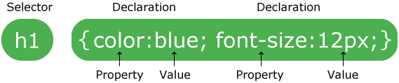
CSS Syntax
A CSS rule-set consists of a selector and a declaration block:
The selector points to the HTML element you want to style.
The declaration block contains one or more declarations separated by semicolons.
Each declaration includes a CSS property name and a value, separated by a colon.
A CSS declaration always ends with a semicolon, and declaration blocks are surrounded by curly braces.

Slide 6
HTML style Tag
The <style> tag is used to define style information for an HTML document
Inside the <style> element you specify how HTML elements should render in a browser
Each HTML document can contain multiple <style> tags

Slide 7
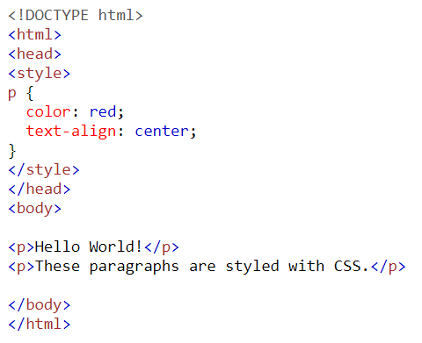
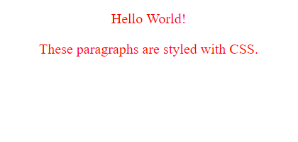
CSS Syntax Example
Example

Slide 8
CSS Syntax - Selector
CSS selectors are used to "find" (or select) the HTML elements you want to style (e.g. <p> in the previous example)
Selectors are of 5 types:
Simple selectors (selects elements based on name, id, class)
Combinator selectors (select elements based-on a specific relationship between them)
Pseudo-class selectors (select elements based-on a certain state)
Pseudo-elements selectors (select and style a part of an element)
Attribute selectors (select elements based on an attribute or attribute value)

Slide 9
CSS Syntax – CSS element Selector
The element selector selects HTML elements based on the element name.
Example
For the following code, all <p> elements on the page will be center-aligned, with a red text color
p { text-align: center; color: red; }

Slide 10
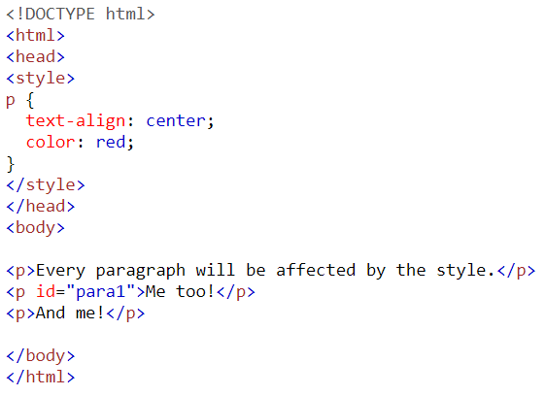
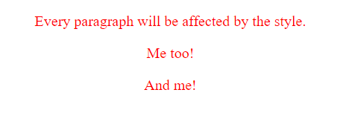
CSS Syntax – CSS element Selector

Slide 11
CSS Syntax – CSS id Selector
The id selector uses the id attribute of an HTML element to select a specific element
If id of an element is unique within a page, the id selector is used to select one unique element!
To select an element with a specific id, write a hash (#) character, followed by the id of the element
Example
The CSS rule below will be applied to the HTML element having id="para1":
#para1 { text-align: center; color: red; }
id name cannot start with a number (#1para is incorrect)

Slide 12
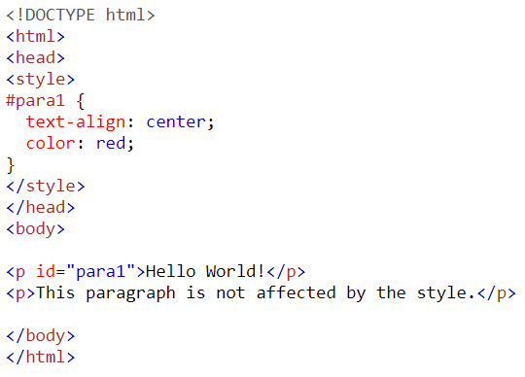

CSS Syntax – CSS id Selector

Slide 13
CSS Syntax – CSS class Selector
The class selector selects HTML elements with a specific class attribute.
To select elements with a specific class, write a period (.) character, followed by the class name.
Example 1
All HTML elements with class="center" will be red and center-aligned:
.center { text-align: center; color: red; }

Slide 14
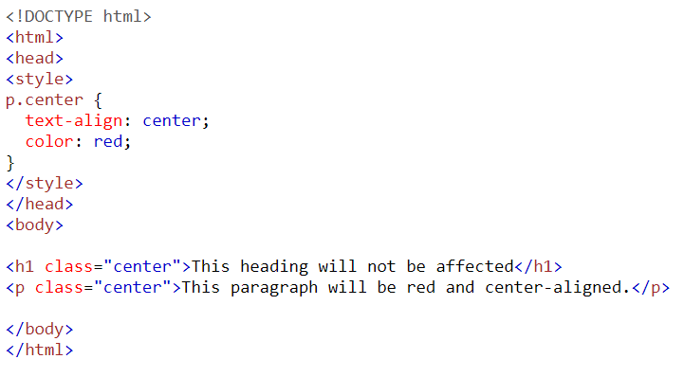

CSS Syntax – CSS class Selector – Single Class

Slide 15
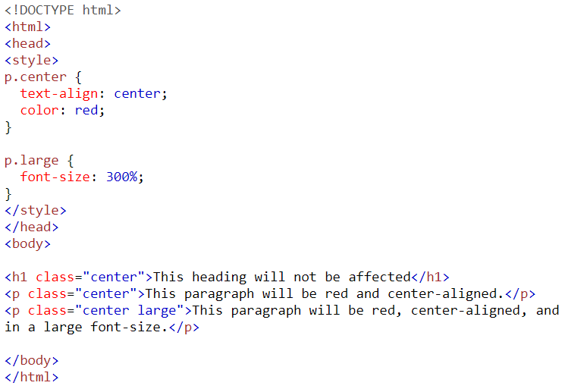
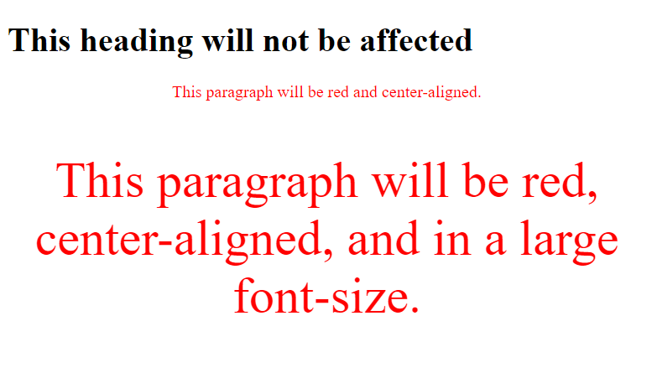
CSS Syntax – CSS class Selector – Multiple Class

Slide 16
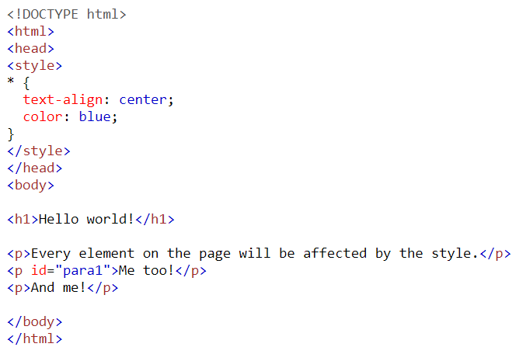
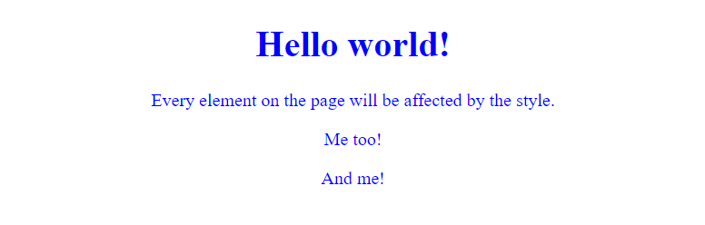
CSS Syntax – CSS Universal Selector (*)

Slide 17
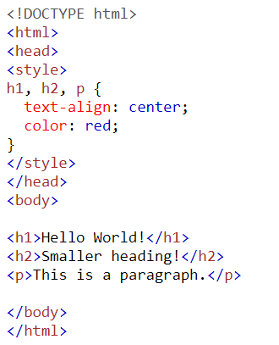
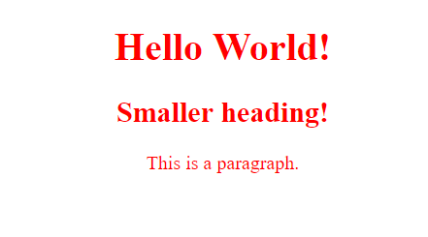
CSS Syntax – CSS Grouping Selector

Slide 18
Online Examples
Do all examples given at the url: https://www.w3schools.com/css/css_selectors.asp

Slide 19
How to add CSS?
There are three ways of inserting a style sheet:
Inline CSS
Internal CSS
External CSS

Slide 20

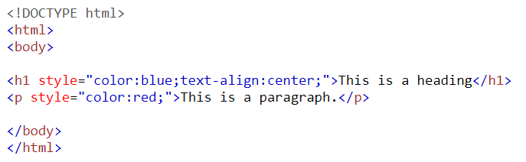
1. How to add Inline CSS?
To apply a unique style for a single element
To use inline styles, add the style attribute to the relevant element along with any CSS property.

Slide 21
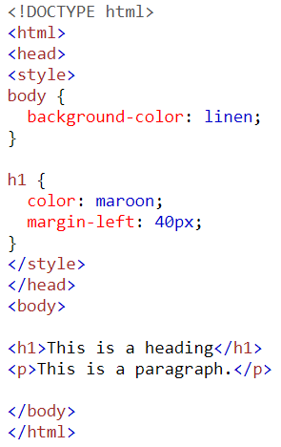
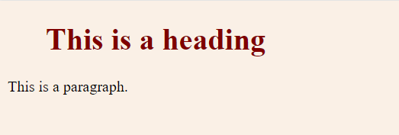
2. How to add Internal CSS?
Used if one single HTML page has a unique style
Internal style is defined inside the <style> element, inside the head section.

Slide 22
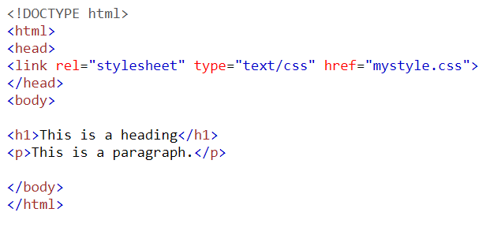
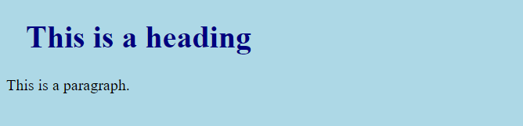
3. How to add External CSS?
Used to change the look of an entire website by changing just one file.
An HTML page must include a reference to the external style sheet file inside the <link> element, inside the head section.

Slide 23
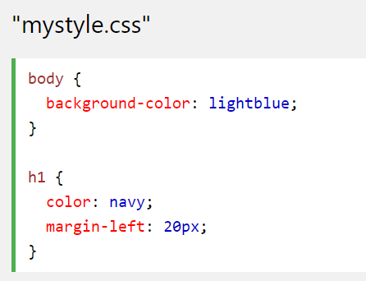
3. How to add External CSS? – writing eternal CSS files
Can be written in any text editor, must be saved with a .css extension.
The external .css file should not contain any HTML tags.
Example: "mystyle.css“
Do not add a space between
the property value and the unit
e.g. 20px is correct, but 20 px
is incorrect.

Slide 24
Cascading Order
Q. If more than one styles exist for an HTML element, what style will be used?
All the styles in a page will "cascade" into a new "virtual" style sheet by the following rules, where number one has the highest priority:
Inline style (inside an HTML element)
External and internal style sheets (in the head section)
Browser default
So, an inline style has the highest priority, and will override external and internal styles and browser defaults.

Slide 25
Recap

Slide 26
Recap – CSS
CSS is a style sheet language
CSS describes the style of an HTML document and that how HTML elements be displayed
CSS code is written inside <style> </style> tags of HTML and is placed inside the <head> </head> tag
External style sheets are stored in .css file (recommended)
CSS can be used inline, by placing inside an HTML tag, but it is not recommended

Slide 27
Recap – CSS Selectors
A selector can be based on element name, id, class, attribute or others. Few examples:
Element selector ➔ p {colour:blue; text-align:center; line-height:1.5em}
ID selector ➔ #box{background:black;}, or div#box{background:black;}
Class selector ➔ .center-text{text-align:center;}, or p.center-text{text-align:center;}
Group selector ➔ h1, p, div {color:red;}

Slide 28
Recap – CSS Comments
h1 {
color:blue;
/*this is single line comment*/
text-align:center;
}
/* this is a
multi-line comment
on three lines. */

Slide 29
HTML 5 <article> Tag
The <article> tag specifies independent, self-contained content.
An article should make sense on its own and it should be possible to distribute it independently from the rest of the site.
Properties:
Column-count: 3
Column-gap: 40px
Column-rule-style: solid
Column-rule-color: green
Column-rule-width:1px
Column-rule: 1px green solid (instead of above 3)
Column-span: all

Slide 30
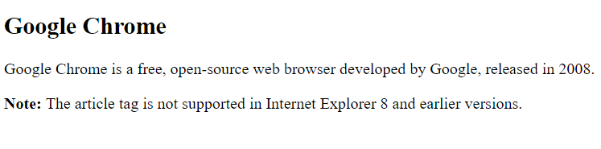
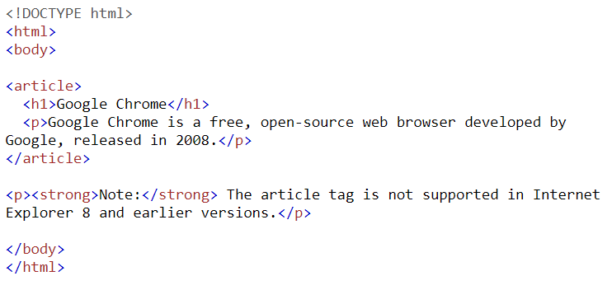
Example – <article> tag

Slide 31
HTML <div> Tag
It defines a division or a section in an HTML document.
The <div> element is often used as a container for other HTML elements to style them with CSS or to perform certain tasks with JavaScript.

Slide 32
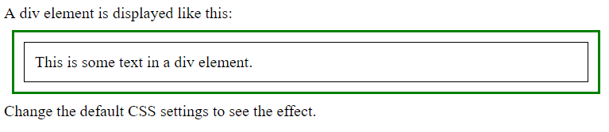
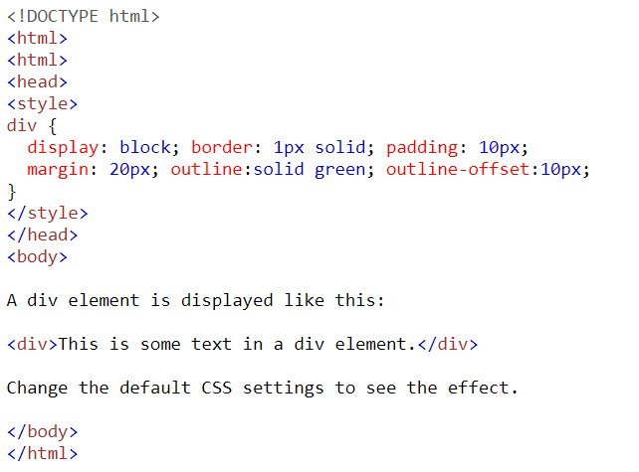
Example – <div> tag

Slide 33
CSS Pseudo-classes
A pseudo-class defines a special state of an element.
For example, it can be used to:
Style an element when a user hovers mouse over it
Style visited and unvisited links differently
Style an element when it gets focus
Syntax
selector:pseudo-class { property: value; }

Slide 34
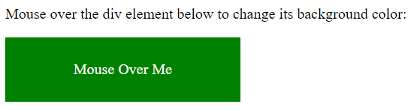
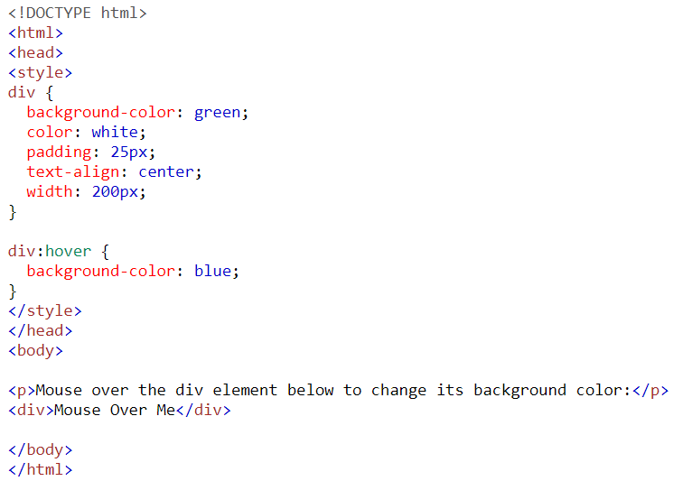
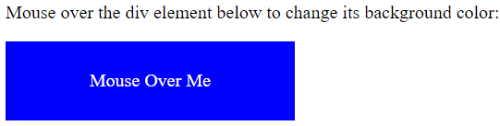
Example: CSS Pseudo-classes

Slide 35
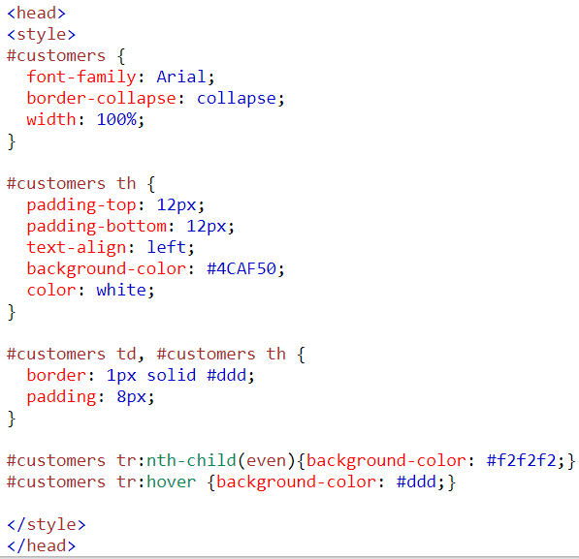
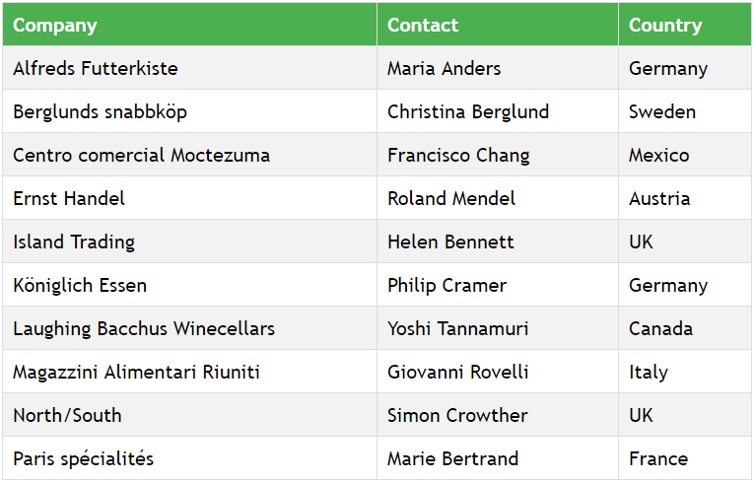
CSS Table Example

Slide 36
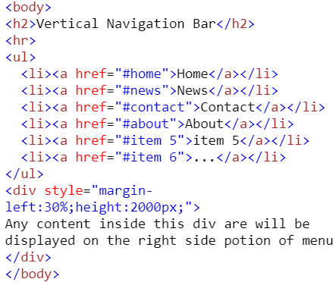
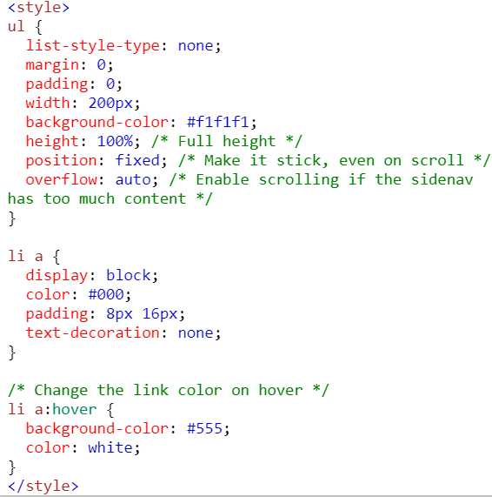
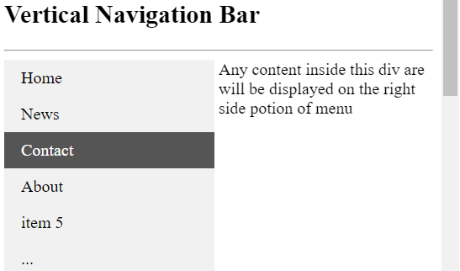
HTML List into CSS Menu

