Slide 1
Week 3: Flexible Box (Flexbox)
Dr. Maaz Rehan

Slide 2
What is a CSS?
According to W3Schools
CSS is a language that describes the style of an HTML document
CSS describes how HTML elements are to be displayed on screen, paper, or in other media
CSS saves a lot of work. It can control the layout of multiple web pages all at once
External stylesheets are stored in CSS files

Slide 3
Why use CSS?
HTML only describes the content of a web page, like:
<h1>This is a heading</h1>
<p>This is a paragraph.</p>
When tags like <font>, and color attributes were added to the HTML 3.2 specification, it started a nightmare for web developers. Development of large websites, where fonts and color information were added to every single page, became a long and expensive process.
To solve this problem, the World Wide Web Consortium (W3C) created CSS.
CSS removed the style formatting from the HTML page
CSS Saves a Lot of Work. Just one change in style, can change style of the whole website.

Slide 4
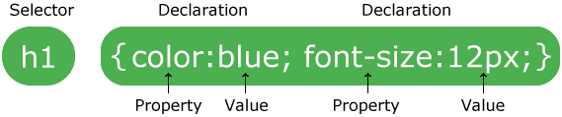
CSS Syntax
A CSS rule-set consists of a selector and a declaration block:
The selector points to the HTML element you want to style.
The declaration block contains one or more declarations separated by semicolons.
Each declaration includes a CSS property name and a value, separated by a colon.
A CSS declaration always ends with a semicolon, and declaration blocks are surrounded by curly braces.

Slide 5
Recap – CSS
CSS is a style sheet language
CSS describes the style of an HTML document and that how HTML elements be displayed
CSS is added to the <style> </style> tag of HTML
Inline CSS means using <style> inside HTML elements, e.g. inside h1
Internal CSS means using the <style> inside the <head> </head> tag
External CSS means using the <style> in a .css file (recommended)

Slide 6
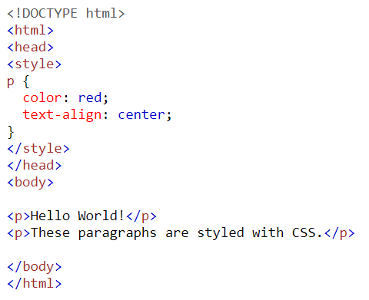
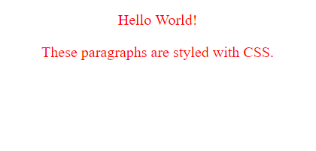
CSS Syntax Example
Internal CSS Example

Slide 7
Recap – CSS Selectors
A selector can be based on element name, id, class, attribute or others
Element selector = p {colour:blue; text-align:center; line-height:1.5em}
ID selector = #box{background:black;}, or div#box{background:black;}
Class selector = .center-text{text-align:center;}, or p.center-text{text-align:center;}
Group selector = h1, p, div {color:red;}

Slide 8
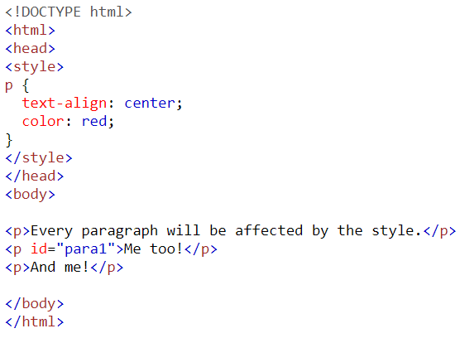
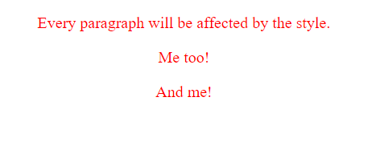
CSS Syntax – CSS element Selector

Slide 9
HTML <div> Tag
It defines a division or a section in an HTML document.
The <div> element is often used as a container for other HTML elements to style them with CSS or to perform certain tasks with JavaScript.

Slide 10
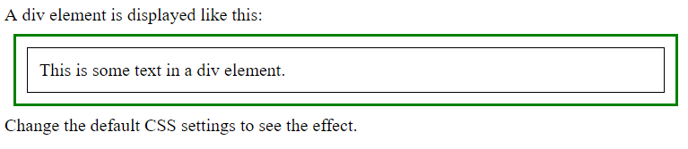
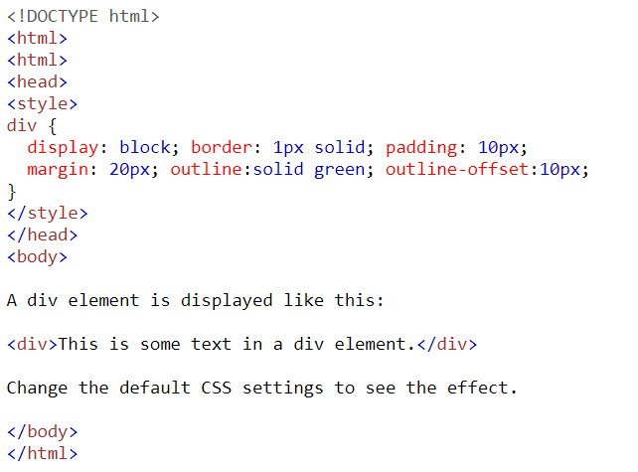
Example – <div> tag

Slide 11
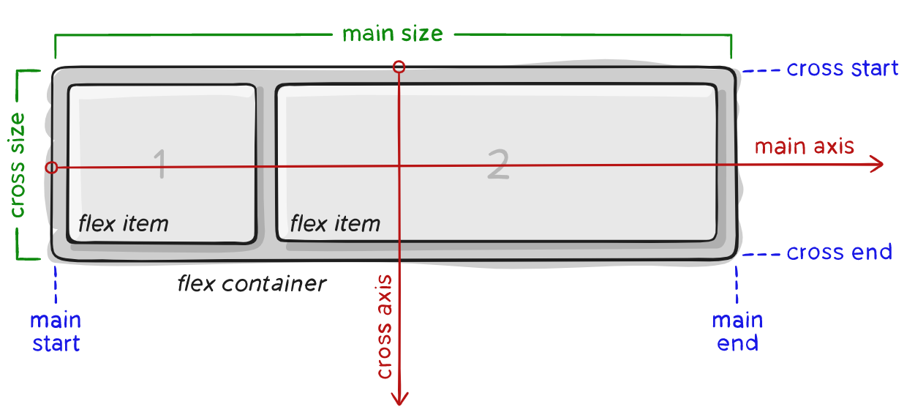
Flexbox Layout (Flexible Box)
An efficient way to layout, align and distribute the space among items in a container, even when their size is unknown and/or dynamic

Slide 12
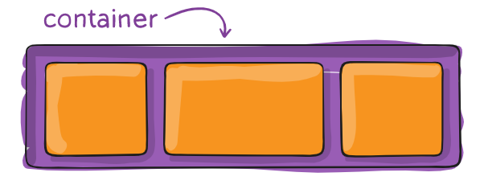
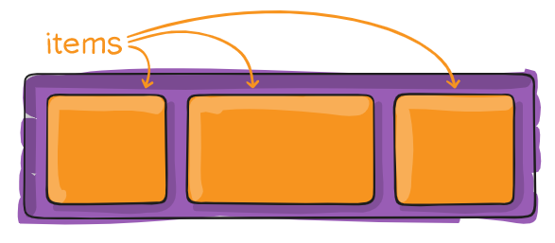
What is CSS Flexbox…?
Flexbox has two elements:
Parent Element (Container)
Child Elements (Items)
Online learning resource
https://css-tricks.com/snippets/css/a-guide-to-flexbox/
https://www.w3schools.com/css/css3_flexbox.asp

Slide 13
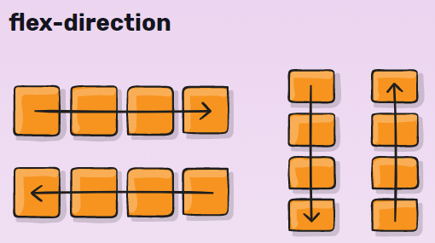
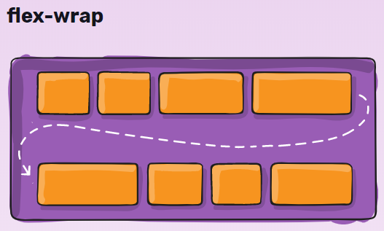
Flexbox Parent Properties (1)
display: flex;
Defines flex container. It enables a flex context for all its direct children.
flex-flow: <flex-direction> || <flex-wrap>
It is shorthand for the flex-direction and flex-wrap properties. Default is ‘row nowrap’

Slide 14
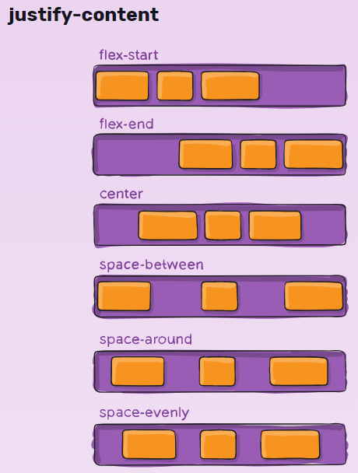
Flexbox Parent Properties (2)
justify-content:
defines the alignment along
the main axis
helps distribute extra free space
leftover when either
all flex items on a line are
inflexible
or are flexible but have
reached their maximum size.
It exerts some control over
the alignment of items when
they overflow the line

Slide 15
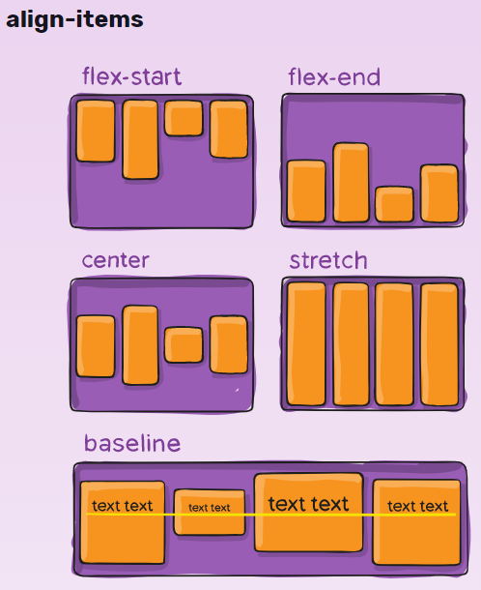
Flexbox Parent Properties (3)
align-items
defines the alignment along
the cross axis on the
current line

Slide 16
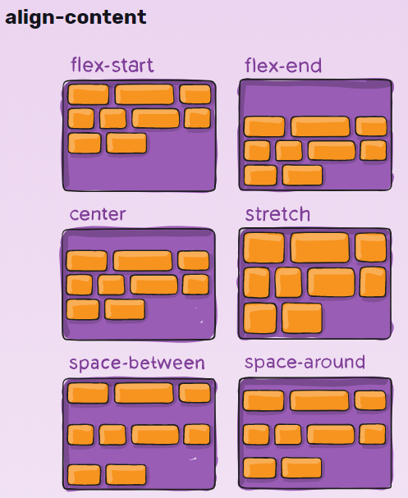
Flexbox Parent Properties (4)
align-content
aligns a flex container's
lines within when there
is extra space in the
cross-axis

Slide 17
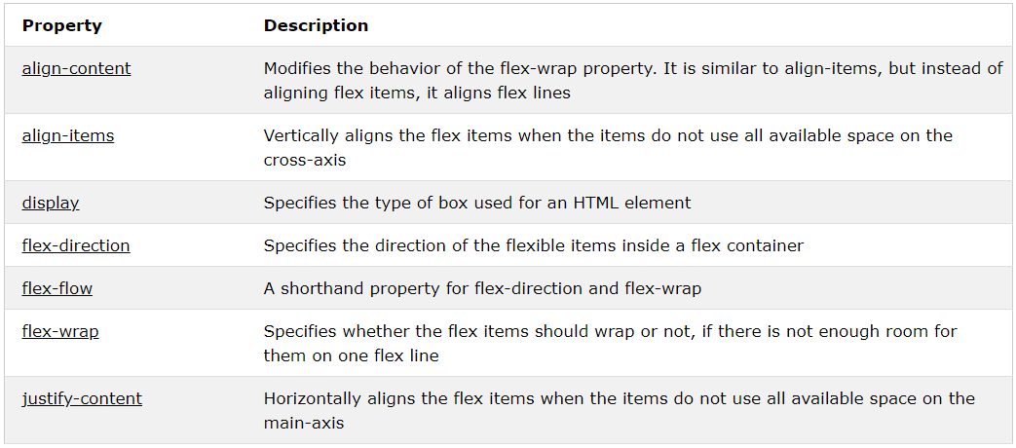
CSS Flexbox Container Properties

Slide 18
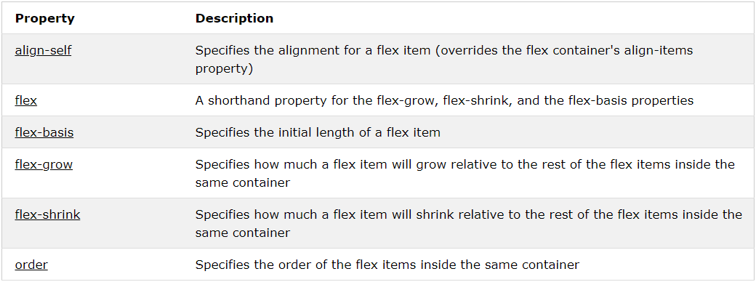
CSS Flexbox Items Properties

Slide 19
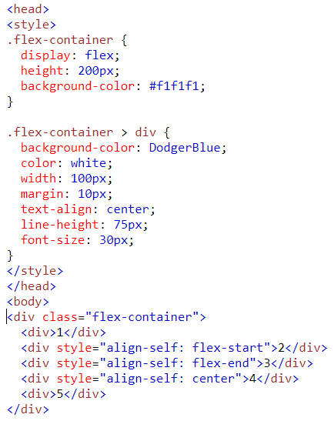
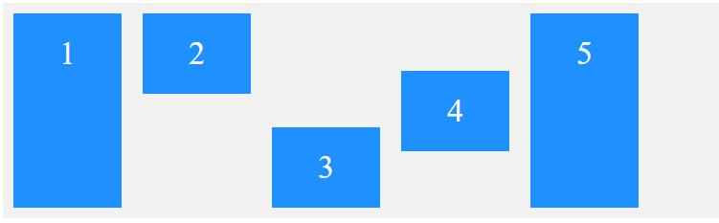
align-self Property

Slide 20
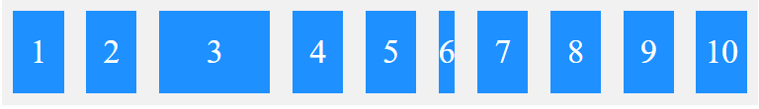
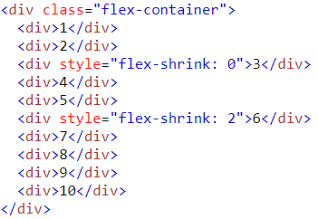
flex-shrink Property
Shrink an item relative to other items in the container. Default value is 1.

Slide 21
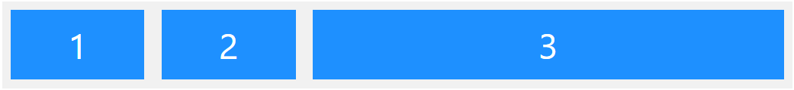
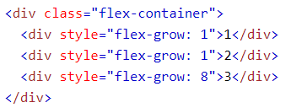
flex-grow Property
Grow an item relative to other items in the container. Default value is 0.

Slide 22
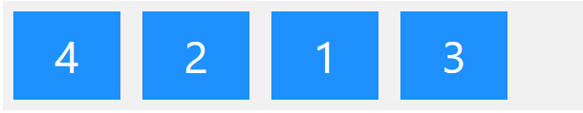
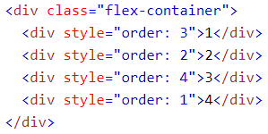
flex-order Property
Order MUST be a number. Default value is 0.

Slide 23
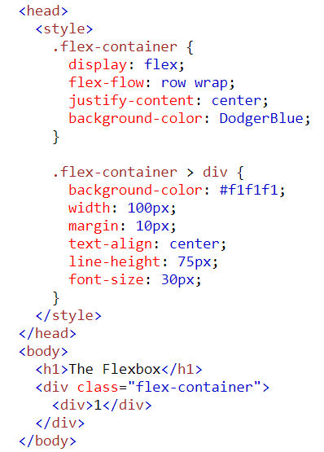
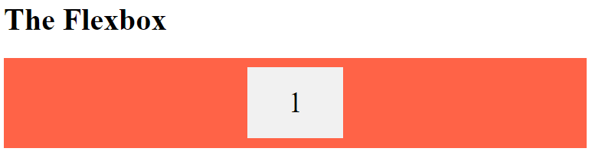
Flexbox Example (1)
Tomato;

Slide 24
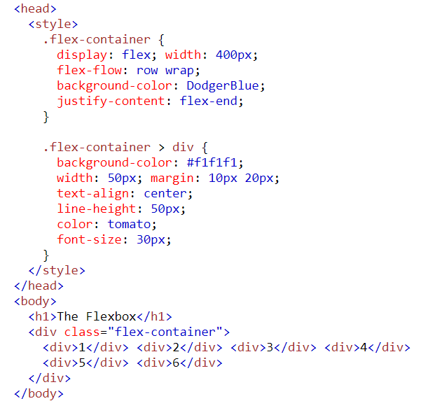
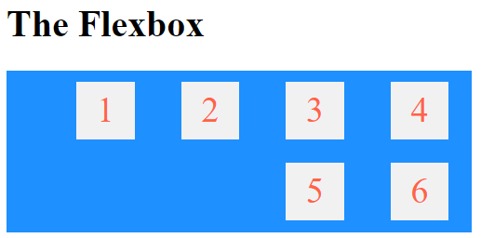
Flexbox Example (2)

Slide 25
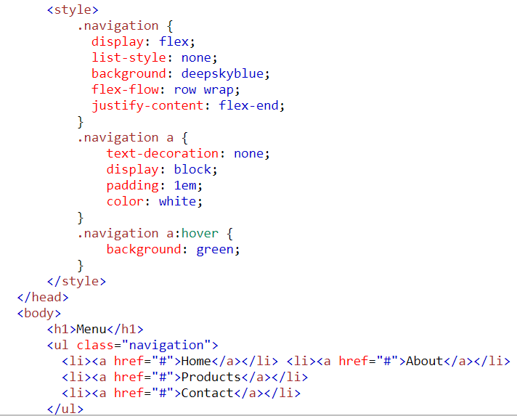
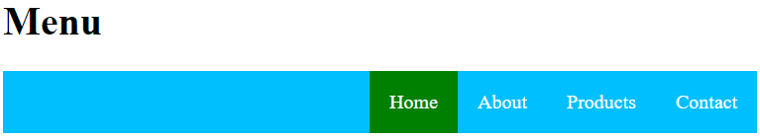
Flexbox Example – Creating a Menu

