Slide 1
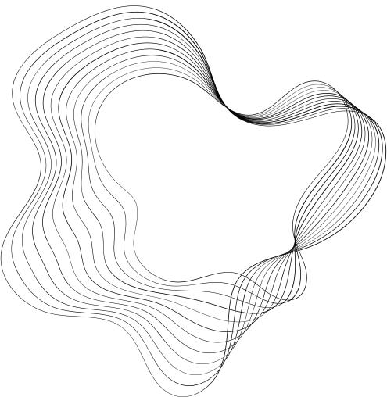

CLASSIFICATION OF
ANIMAL SUPERGROUPS
GROUP 3: ZAID FADA (LEADER), CHRIS WOODS, AND MALEK THABET
DS 4002 | 11/07/4

Slide 2
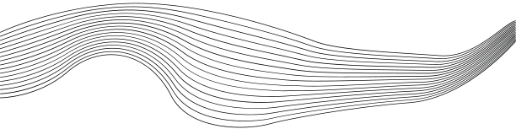
TODAY’S AGENDA
03
CONTEXT
04
DATA OVERVIEW
05
ANALYSIS PLAN
06
DECISION MAKING AND UNCERTAINTY
7-8
RESULTS AND CONCLUSION
09
NEXT STEPS
10
THANK YOU & REFERENCES

Slide 3
PROJECT CONTEXT
MOTIVATION
Identifying animal species from images is crucial for wildlife monitoring, biodiversity conservation, and educational tools. This project aims to develop a machine learning model that classifies species with high accuracy from low resolution images, as recent advancements in deep learning make it feasible to enhance species recognition in trail cam and aerial photos
HYPOTHESIS
We hypothesize that a neural network model, specifically a CNN, is capable of achieving at least 80% accuracy on the image data from the CIFAR-100 dataset. We further hypothesize that a CNN will be optimal as it best captures nuances and local patterns.
GOALS
The goal of this project is to develop a classification model capable of accurately identifying animal species from images, by training it on the CIFAR-100 dataset of labeled animal photos. We will measure the success of the model by aiming for an accuracy of 80% or higher.

Slide 4

DATA OVERVIEW
Dataset: CIFAR-100
The CIFAR-100 dataset is a labeled collection of color images across 100 classes, including animals, plants, and objects.
Key Columns
Image: The pixel data for each image, representing visual data of animal species in RGB format.
Fine Label: A final label value that describes the sub group each image is in
Coarse Label: A course label value that describes the super group each image is in

Slide 5

ANALYSIS PLAN
01
02
03
04
DATA COLLECTION
EDA
EXECUTATION & VALIDATION
CONCLUSION
Downloaded the CIFAR-100 dataset and utilized a script to map metadata (group names) to corresponding images within the dataset.
Conducted EDA to explore the behavior of the dataset, identify patterns, and generate ideas for additional features to improve the predictive model's performance.
Collect summary statistics to assess performance and
reflect on hypothesis
Ensured balanced representation of animal superclasses, and validated our predictive model using performance metrics like accuracy, precision, and recall to uncover trends

Slide 6




TRICKY DECISIONS AND UNCERTAINTY
One of our key challenges was tuning the hyperparameters of our CNN model to achieve the best accuracy. Balancing factors like the number of epochs, batch size, weighting functions, and data augmentation required significant time and effort. This process highlighted the importance of fine-tuning to maximize model performance and achieve results that aligned with our hypothesis
To address uncertainty in our model, we maintained strict separation of validation, test, and training datasets. This approach ensured that our model was evaluated on unseen data during validation, allowing us to accurately assess its performance without overfitting. By keeping these datasets distinct, we could trust that the validation accuracy reflected the model's true predictive ability rather than its memorization of the training data
TRICKY ANALYSIS DECISIION
ADRESSING UNCERTAINTY

Slide 7
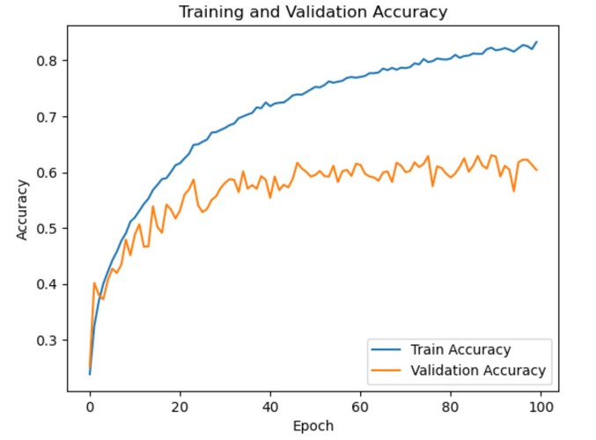
RESULTS
Training accuracy improved steadily, achieving 83.10% by the 100th epoch.
Validation accuracy fluctuated, peaking at around 62%.
Testing results showed a test accuracy of 61.22% and a test loss of 1.4135, aligning with the validation performance.
Takeaways
Validation performance suggests potential overfitting after certain epochs, highlighting need for hyperparameter tuning.
Further architecture adjustments or dataset augmentation may enhance generalization and improve test results.

Slide 8
RESULTS
Supergroup | Precision | Recall | F1-Score | Support
Aquatic Mammals | 0.57 | 0.64 | 0.60 | 484
Fish | 0.70 | 0.67 | 0.69 | 508
Insects | 0.78 | 0.72 | 0.75 | 516
Large Carnivores | 0.69 | 0.56 | 0.62 | 486
Large Omnivores and Herbivores | 0.67 | 0.66 | 0.67 | 471
Medium Mammals | 0.66 | 0.66 | 0.66 | 509
Non-Insect Invertebrates | 0.66 | 0.62 | 0.64 | 500
Reptiles | 0.43 | 0.69 | 0.53 | 510
Small Mammals | 0.73 | 0.49 | 0.59 | 516
Overall Metrics
Accuracy: 0.63
Precision: 0.66
Recall: 0.63
F1-Score: 0.64
Strengths
High performance (F1 score) on insects and fish
Medium Mammals and Large Omnivores and Herbivores had balanced performance (high precision, recall, and F1-scores)
Weaknesses
Low performance on reptiles
Misclassification of small mammals

Slide 9




NEXT STEPS
Explore Causes of Underperforming Classes
Improve Architecture
New Questions
With some classes displaying much lower accuracy, we’d like to explore what attributes within the model we can address to overcome them
With the current architecture mirroring that of a simple baseline model, we’d aim to add more layers, weighting functions, data optimization techniques, etc.
Currently we are addressing the classification of super groups, but with a more advanced model we’d like to learn how well fine groups can be classified

Slide 10
THANK YOU
Drew Holloway
Ceo Of Ingoude Company

Slide 11
REFERENCES
[1] https://www.cs.toronto.edu/~kriz/cifar.html
[2] https://www.analyticsvidhya.com/blog/2021/05/convolutional-neural-networks-cnn/
[3] https://machinelearningmastery.com/how-to-develop-a-cnn-from-scratch-for-cifar-10-photo-classification/

