Slide 1
Income Trajectories: Wage Earners vs. Self Employed
Zaid Ghazi
Notes:
Today I’ll show how income evolves over the life course for wage‑earners versus the self‑employed, using the NLSY panel surveys.

Slide 2
Data & Variables
Cohort | Survey years | N respondents
NLSY79 | 1979 – 1994 (annual), 1996 – 2018 (biennial) | 12,686
NLSY97 | 1997 – 2011 (annual), 2013 – 2017 (biennial) | 8,984
Variable | Description
Income | Annual earnings (2017 USD, CPI‐adjusted)
Age | In years
AFQT | Armed Forces Qualifying Test score
HGC | Highest grade completed
Hours worked | Total annual hours worked
Employment status | Wage‑earner vs. Self‑employed (dynamic)
Gender | Male / Female
Race | Hispanic / Black / Non‑Black, Non‑Hispanic
Sampling weight | Survey sampling weight
Year | Year of Survey
Notes:
I used the NLSY79 and NLSY97, inflation‑adjusted to 2017 dollars, oversampling minorities, with roughly 21,670 unique respondents and 300,000 person‑year records.

Slide 3
Objective & Key Question
How do earnings trajectories differ between wage earners and self-employed workers after controlling for ability, education, hours, demographics and cohort?
Self-Employment
Income Benefit
Notes:
My goal for this project was to estimate the average self‑employment premium in annual income, net of cognitive ability, schooling, work effort, gender, race, and cohort effects.

Slide 4
Preprocessing & Feature Engineering
Imputation
Age interpolated when ≥2 records using Year
AFQT & education carried forward/backward, fill max grade
Employment status LOCF (Last Observation Carried Forward)
Filter complete cases → final N ≈ 247,000 obs, 17,492 IDs
Variable Name | Missing Observations | Percent Missing (%)
Age (Years) | 59,141 | 19.4
AFQT Cognitive Score | 32,034 | 10.5
Highest Grade Completed | 29,920 | 9.8
Employment Status | 12,686 | 4.2
Feature Engineering
Age Centered
AFQT & education scores standardized
Hours worked ÷ 100
Log-transformed income
Survey weights scaled
Introduced cohort as an additional predictor
Notes:
I cleaned and imputed missing age, AFQT and education, carried forward employment gaps, then centered and standardized predictors, log‐transformed income, and scaled survey weights—ending with ~247 K observations on ~17,500 individuals

Slide 5
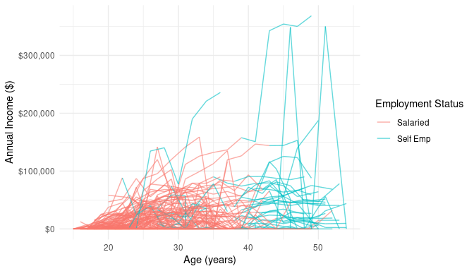
Exploratory Findings (I)
Clear variation in each person’s income-age slope
include a random slope on age
Uneven “jump” when switching to self-employment across individuals
Attempted a random slope on employment status
Spaghetti Plot
Notes:
On this slide you see 100 randomly selected respondents’ raw income trajectories over age. Notice how each line tilts differently—some people’s earnings accelerate rapidly, others remain flat or even dip. That clear heterogeneity in age‐earnings slopes tells us that a single, fixed age effect would misrepresent many individuals. Accordingly, I included a random slope on age so each person can have their own growth rate. You’ll also see that the magnitude of the jump when switching into self‑employment varies by individual, which motivated my (unsuccessful) attempt to add a random slope on the employment status effect.

Slide 6
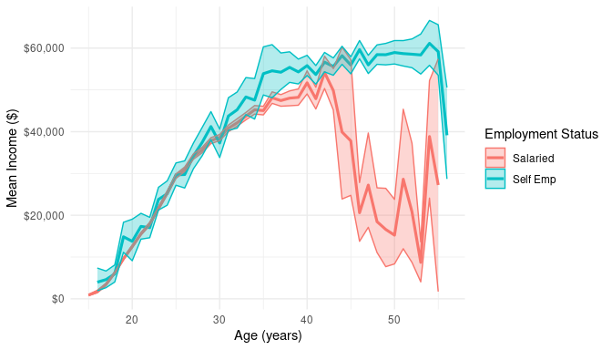
Exploratory Findings (II)
Self‑employed and salaried lines diverge after ~35
add a fixed age × employment interaction.
Mean Income over Age by Employment
Notes:
Here I plotted the average income trajectory—conditional on positive earnings—for wage‑earners (blue) versus self‑employed (orange). Up until about age 35, the lines rise in parallel, but after that point the self‑employed curve pulls sharply ahead. This systematic divergence with age is exactly what the fixed age × employment interaction term captures in the final model, allowing the self‑employment premium to change as people get older.

Slide 7
Modeling Framework
WeMix mixed‐effects models with survey weights — why?
Model | Specification (Fixed Effects) | Random Effects | npar
1 | Age | Intercept only | 2
2 | Model 1 + Employment status | Intercept only | 3
3 | Model 2 + Age × Employment status interaction | Intercept only | 4
4 | Model 3 + AFQT + Education + Annual hours worked (÷100) | Intercept + random slope on age | 7
5 | Model 4 + Race + Gender + Cohort | Intercept + random slope on age | 11
Notes:
To test these patterns formally, I fit five nested mixed‐effects models in the WeMix framework (which handles survey weights). I started with age only, then add employment, their interaction, cognitive/education/hours, and finally demographic and cohort controls.

Slide 8
Modeling Comparison
Model | Specification (Fixed Effects) | npar | AIC | BIC | Delta AIC | weight
1 | Age | 2 | 1,416,456 | 1,416,477 | 112,269 | 0
2 | Model 1 + Employment status | 3 | 1,410,528 | 1,410,559 | 106,341 | 0
3 | Model 2 + Age × Employment status interaction | 4 | 1,410,477 | 1,410,519 | 106,290 | 0
4 | Model 3 + AFQT + Education + Annual hours worked (÷100) | 7 | 1,305,324 | 1,305,397 | 1,137 | 0
5 | Model 4 + Race + Gender + Cohort | 11 | 1,304,187 | 1,304,302 | 0 | 1
Notes:
This table shows that Model 5---with all predictors and random slopes for age---yields the lowest AIC/BIC and essentially 100 % Akaike weight. The biggest single gain comes in Model 4 from adding AFQT, education, hours, and random slopes; the final demographics step adds a modest further improvement.

Slide 9
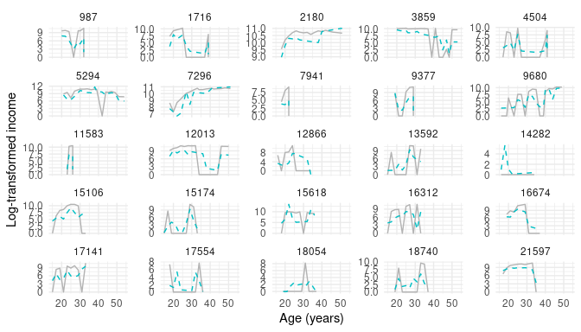
Final Model Evaluation
~57 % higher income at mean age
Predictor | Estimate | SE | t value
Intercept | 3.242 | 0.045 | 72.296
Age | -0.018 | 0.002 | -10.035
Employment: Self | 0.451 | 0.053 | 8.551
AFQT | 0.230 | 0.020 | 11.768
Education Level | 0.498 | 0.017 | 28.537
Annual Hours worked ÷ 100 | 0.254 | 0.002 | 157.333
Race: Black | 0.034 | 0.041 | 0.825
Race: White | 0.093 | 0.039 | 2.398
Gender: Female | -0.083 | 0.029 | -2.892
Cohort: NLSY97 | -1.023 | 0.030 | -33.948
Interaction: Age × Self-employment | 0.040 | 0.004 | 10.162
Actual vs Model-Predicted Log-Income Trajectories over age
Blue Dashed lines = Predicted Grey solid lines = Actual
A positive interaction confirming widening premium with increasing age
Notes:
Above figure overlays observed versus fitted log‑income for a random 25 individuals: the model captures overall trends but misses sharp dips/spikes (RMSE ≈ 2.96 log‑points, R² ≈ 0.65). Above able shows the self‑employment main effect (β = 0.451, ~57 % higher income at mean age) and a positive age × employment interaction (β = 0.040), confirming a widening premium

Slide 10
Conclusion & Limitations
Conclusion
“Self-employment yields a growing earnings premium - ~57 % higher at mean age, widening over time.”
Large residual variance remains.”
Limitations
WeMix models - still not fully design correct SEs
Unobserved confounders remain - could bias our estimates.
Couldn’t fit random slopes for employment type due to computational limits
Notes:
In sum, self‑employment confers a robust, increasing earnings advantage through mid‑life. Our mixed‐effects model explains average trajectories well but individual predictions remain noisy. I used WeMix to incorporate weights for representativeness, but WeMix does not produce fully survey‐correct variance estimates. Future work could explore additional random effects, industry controls, or bootstrap‐based inference.

Slide 11
Thank you
Zaid Ghazi

