Slide 1
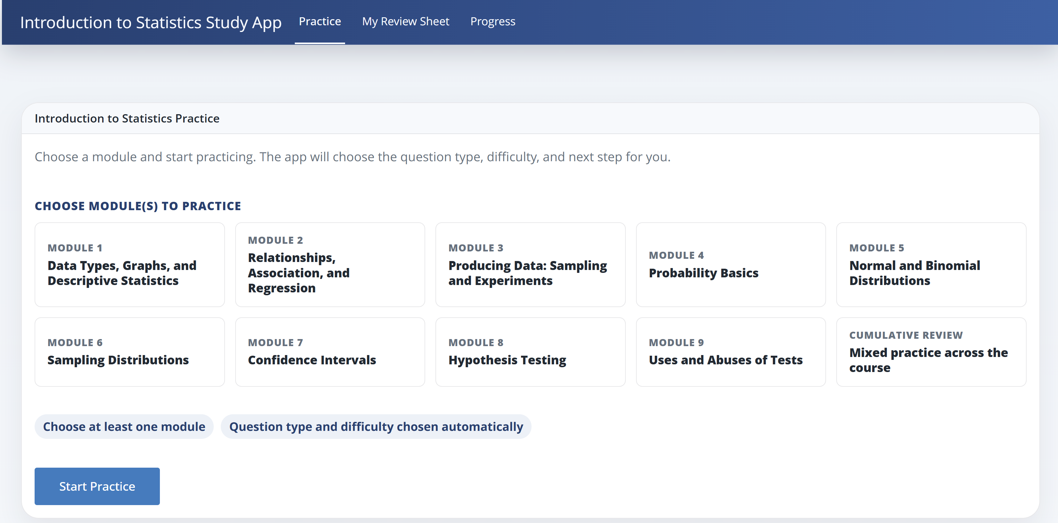
STAT 6395 Final Project
Introduction to Statistics Study App
A module-based Shiny practice app with retrieval-augmented tutoring, answer-safety guardrails, and visual explanations.
Zaid Ghazi | R/Shiny • Claude/ellmer • RAG • vitals
01
Notes:
Open by framing this as a STAT 6395 final project and portfolio proof of concept. The key claim is not simply that I built a Shiny chatbot.
The project combines R/Shiny, RAG, an audited practice bank, tutor guardrails, Anthropic/ellmer when configured, visual explanations, and evaluation.
Emphasize local proof-of-concept status: the architecture is shareable, but private or copyrighted course assets are not redistributed.

Slide 2
MOTIVATION
The gap: students need help while practicing
Static questions are fast, but they do not explain; generic chat is flexible, but hard to control.
1
2
3
Static practice
Generic chatbot
This app
Fast checks, limited explanation.
Flexible, but may hallucinate or give away answers.
Guided practice with grounded, answer-safe support.
Design goal: help students reason through questions without turning the tutor into an answer machine.
02
Notes:
Explain the student pain point: help is most needed while practicing, not after leaving the question.
Static practice is fast but cannot adapt. Generic chat is flexible but can hallucinate, drift off-topic, or reveal final answers.
The product answer is a controlled practice loop with embedded, grounded help.

Slide 3
PRODUCT
What the app does
A proof-of-concept learning workflow for college introductory statistics.
Module-based practice
Audited question bank
Students choose one or more modules, including cumulative review.
Questions, options, answers, and feedback are checked before use.
Contextual tutor
Prototype personalization
Students can ask for hints, concept explanations, or visual follow-ups while practicing.
Progress and review-sheet tabs show future adaptive-learning directions.
The app is intentionally a proof of concept: it demonstrates the architecture and workflow rather than claiming full classroom deployment.
03
Notes:
Walk through the product at a high level: choose one or more module cards, answer audited questions, and ask for contextual help.
Mention that multi-module selection supports cumulative review while still constraining practice and retrieval to the selected module pool.
The tutor quick actions stay simple: hints and concept explanations. Visual help happens through natural follow-up text so the interface does not become crowded.

Slide 4
WORKFLOW
The student loop stays simple
Routine practice is deterministic; GenAI is only used where explanation adds value.
Choose
module(s)
Sample from
audited bank
Show practice
question
Submit
answer
Immediate
feedback
Ask tutor
if stuck
Retrieve
evidence
Run
guardrails
Return tutor
response
Key point for the audience: this is not one giant chatbot. It is a practice app with a controlled LLM support layer.
04
Notes:
Use this slide to separate the deterministic practice loop from the AI support layer.
Starting practice should be fast: it samples from a stored question bank, not from an LLM, and it does not rebuild retrieval assets.
The tutor enters when the student asks for a hint, explanation, visual, or follow-up. That makes the app easier to control and evaluate.

Slide 5
GENAI ROLE
The LLM is selective, not the whole engine
Fast / local
LLM-assisted
• question selection
• concept explanations
• answer checking
• follow-up questions
• standard feedback
• grounded tutor and visual explanations
• R-rendered visuals
• development-time question generation
• audits and smoke tests
• vitals-style evaluation
Result: fewer unnecessary API calls, better latency, and more predictable behavior.
05
Notes:
Stress the design choice: the LLM is selective. Routine work stays local and reproducible.
Stored hints, answer checking, question selection, and R-rendered visuals avoid unnecessary model calls. Anthropic is used when configured for richer explanations and follow-ups.
For visual help, the app renders the visual with R/ggplot or deploy-safe metadata; the LLM explains the selected visual rather than generating the image.

Slide 6
TECHNIQUE
RAG keeps tutoring grounded in course-aligned evidence
Student request
hint, concept, visual, or follow-up
Why it mattered
Current question context
module, topic, concept tag, prompt
Uses textbook-first evidence, not model memory.
Query normalization
aliases, notation, misspellings
Local course materials stay as optional overlays; public repo keeps them out.
Retrieve + rerank evidence
module/concept match; textbook first
Grounded tutor prompt
use evidence and stay answer-safe
06
Notes:
Explain the RAG chain: the student request plus current question context becomes a normalized query, then retrieval and reranking choose evidence.
Important nuance: local professor slides and notes can function as optional overlays in the RAG infrastructure, but the public repo does not include source-derived private artifacts.
The tracked question bank is textbook-aligned and audited. Professor/course materials may have informed local evidence and concept consolidation, but they are not redistributed.

Slide 7
TUTOR GUARDRAILS
Helpful, but not answer-giving
1
Do not reveal
the answer
2
Stay grounded in
retrieved evidence
3
Keep help tied to
the current question
Tutor response pipeline
Draft or stored hint
Answer-leak
check
Faithfulness when needed
check
Student-facing
response
This was the central design tension: students need useful help, but the app should not simply reveal the stored answer.
07
Notes:
Frame this as the tutoring safety problem: helpful support without turning the app into an answer key.
Hints should not diagnose an answer before submission, and early help should nudge rather than reveal. Stored hints are used first when they are specific enough.
Generated responses are cleaned for student-facing language, checked for answer leakage, and kept tied to the current question concept.

Slide 8
CONTENT LAYER
The question bank needed as much engineering as the tutor
450
0
PASS
practice questions audited
answer-option issues
smoke-test result
Quality checks included
Visual + reproducibility strategy
- duplicate questions and duplicate options
- use R/ggplot or recreated visuals
- missing or invalid answer keys
- show visuals only when relevant
- module/topic mismatches
- avoid copying textbook figures into the repo
- weak or repetitive feedback explanations
- include renv, CI, and public-safe demo corpus
- visuals that were irrelevant or forced
08
Notes:
Explain that content quality became a major engineering task, not an afterthought.
The current bank has 450 questions and audit outputs for answer choices, metadata, explanations, visuals, and smoke tests.
Make the source boundary explicit: the public repo includes deploy-safe demo assets and an audited bank; private textbook or professor-source artifacts stay local and ignored.

Slide 9
LIVE DEMO
Demo path: one student practice session
The live app demonstration will show the product; slides only anchor what to look for.
1
Open app
4
Ask tutor for help
no login or role selection
hint, concept, or visual follow-up
2
Choose module cards
5
Ask for visual support
one or more modules
only if useful
3
Answer a question
6
Preview progress/review sheet
see immediate feedback
prototype personalization
If the API is slow, I will use screenshots as backup â€” but the intended demo is live.
09
Notes:
This is the planned live demo path. Keep the demo simple: choose module cards, start practice, submit, then ask for help.
Point out that no login or role switching appears because this is a cold-start proof-of-concept practice app.
For visual support, ask a specific prompt such as "what does a time plot look like?" to show that explicit student requests now take priority over broad context.

Slide 10
ROADBLOCKS
What made this harder than a simple chatbot
Latency
Question quality
Tutor requests may involve retrieval, an LLM call, safety checks, and visual rendering.
Generated content needed audits for duplicates, weak explanations, and wrong metadata.
Visual relevance
Grounding
Visuals helped only when the student request and current concept were both considered.
RAG helped, but retrieval still needed module and concept awareness.
Main lesson: educational AI needs product logic, retrieval design, evaluation, and content audits around the model.
10
Notes:
Use this slide to show that the hard parts were product and evaluation issues around the model.
Latency came from retrieval, model calls, safety checks, and visual work, so the app avoids LLM calls at practice start and caches context where possible.
Visual relevance was a real bug class: the app now prioritizes the student's specific visual request before falling back to current-question context.

Slide 11
LESSONS LEARNED
What worked best
Prebuilt question bank
kept the practice loop fast and testable
Current-question context
made tutor responses more relevant
RAG + reranking
reduced reliance on generic model memory
Audits + smoke tests
caught content and routing issues before the demo
R-rendered visuals
kept explanations visual, relevant, and deploy-safe
Guardrails
kept the tutor helpful without becoming the answer key
11
Notes:
Summarize what worked: prebuilt questions, current-question context, RAG/reranking, smoke tests, R-rendered visuals, and guardrails.
The most important lesson is that the model is only one component; the surrounding workflow makes it useful for education.
Tie this back to course topics: text preprocessing, retrieval, prompt engineering, evaluation, tool use, and deployment tradeoffs.

Slide 12
FUTURE DEVELOPMENT
What a production version would need
Hosted Shiny
server
Secure API-key
management
Response
caching
Streaming
responses
Monitoring +
evaluation
Next feature extensions
• student accounts and secure progress tracking
Latency plan
• instructor dashboard for weak-concept patterns
Cache common tutor responses, stream model output, and route simple help requests to faster models.
• larger reviewed question bank and item analytics
• stronger retrieval / reranking pipeline
• reusable ingestion pipeline for licensed or open course materials
12
Notes:
Be honest about production gaps: hosting, secure API keys, response caching, streaming, monitoring, and more instructor review.
On shinyapps.io, bundling .Renviron is only a proof-of-concept demo convenience; production should use managed secrets and stronger privacy/logging policies.
For public deployment, textbook and visual permissions matter. Recreated visuals are safer, but source-backed RAG requires permission-cleared materials.

Slide 13
TAKEAWAY
The value is the guarded workflow, not just the chatbot
This project shows how LLMs can add value to a statistics learning workflow when they are grounded, constrained, and paired with traditional engineering tools: an audited question bank, R-rendered visuals, automated tests, and reproducible setup.
Final message: AI-supported guided practice, not AI-as-answer-key.
References / resources
• R Shiny and Quarto documentation
• ellmer and Anthropic Claude API documentation
• vitals package for LLM evaluation
• Course lectures on RAG, LLM applications, and tool use
• Introductory statistics textbook/course materials used as local scope guide
• GitHub: ZaidGhazi/Intro-to-Statistics-Study-App
13
Notes:
Close with the central takeaway: the value is the guarded workflow, not just a chatbot interface.
Mention the reproducibility story: GitHub contains the code, tutorial, audits, public-safe demo corpus, deploy-safe visuals, and setup checks.
Restate the source boundary: local permission-cleared materials can support textbook/course RAG, but the public repository avoids redistributing copyrighted or private course content.

