Slide 1
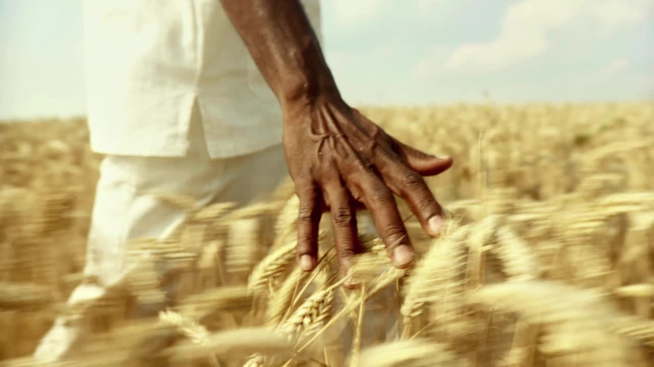
Indian Agriculture Analysis with Power BI
Made by Zaid Hani Allwansah

Slide 2
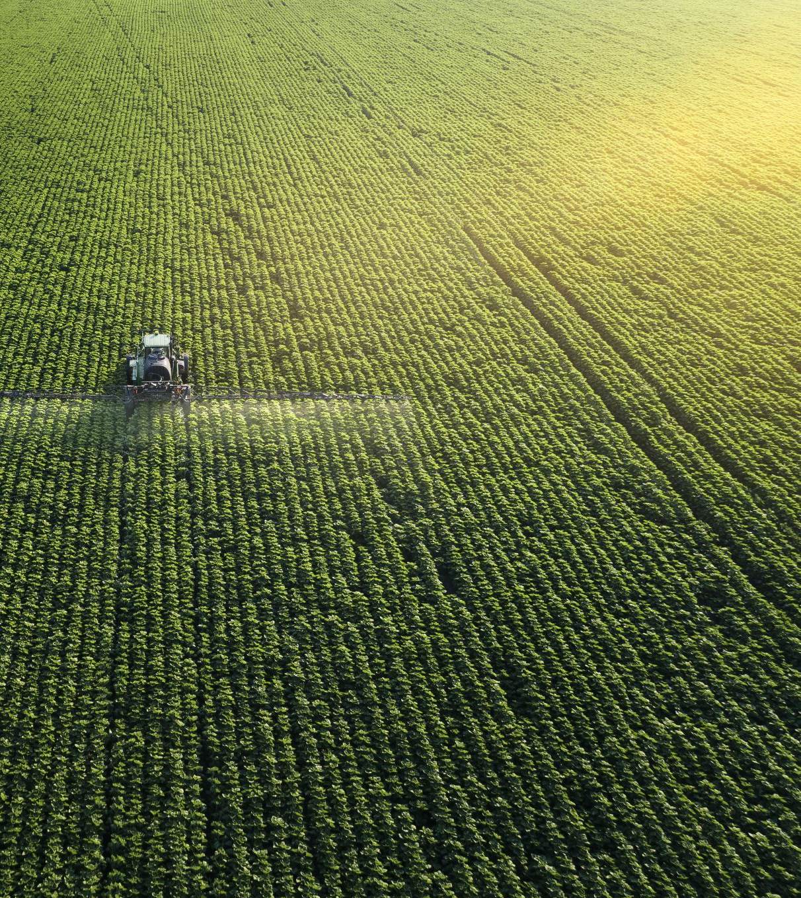
Problem Statement
Indian agriculture plays a vital role in the local economy and food security.
This project conducts a comprehensive analysis of a rich dataset encompassing various crops, areas, production, and yields across Indian districts and years.
Through interactive visualizations, the project seeks to uncover trends, patterns, and disparities in agricultural practices.
These insights will empower stakeholders to make data-driven decisions that promote sustainable farming and optimize resource allocation, ultimately contributing to a more robust and equitable agricultural sector in India.

Slide 3
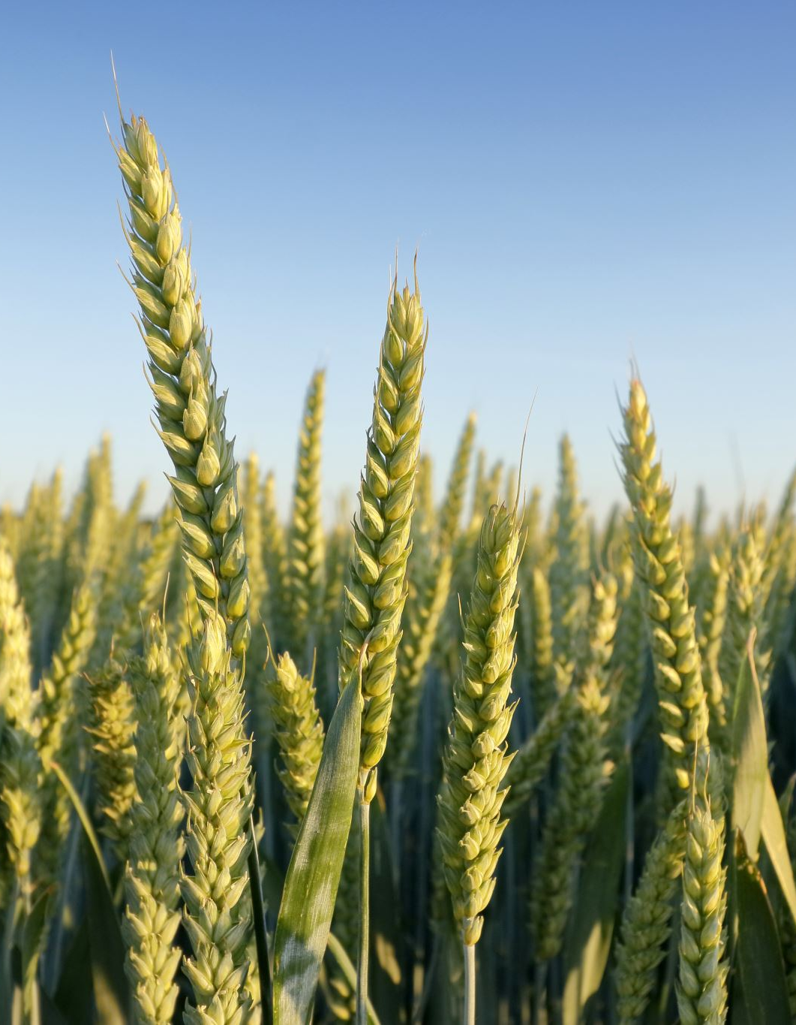
Dataset Exploration
The provided dataset for Indian agriculture presents a vast amount of information with 80 columns.
These columns follow a consistent pattern, containing the crop followed by its production quantity, area cultivated, and yield per unit area for different crops such as rice, wheat, sorghum, millets, pulses, oilseeds, sugarcane, and more.
The data ranges from 1966 to 2017 and includes different Indian’s states and districts.

Slide 4
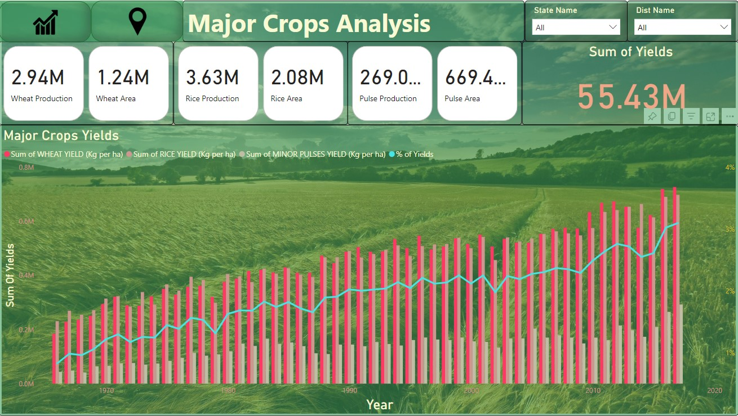
Crop Specific Analysis
Now I’ll be analyzing a specific crops including wheat, rice and pulses.
As you can see the yields of each of these crops are in the rising, there was a slight drop in 2014 but the yield recovered quickly.
After further analysis I’ve discovered that the Uttar Pradesh state was the state that gave the most yields with a total of 10.19M Yields (kg per ha).

Slide 5
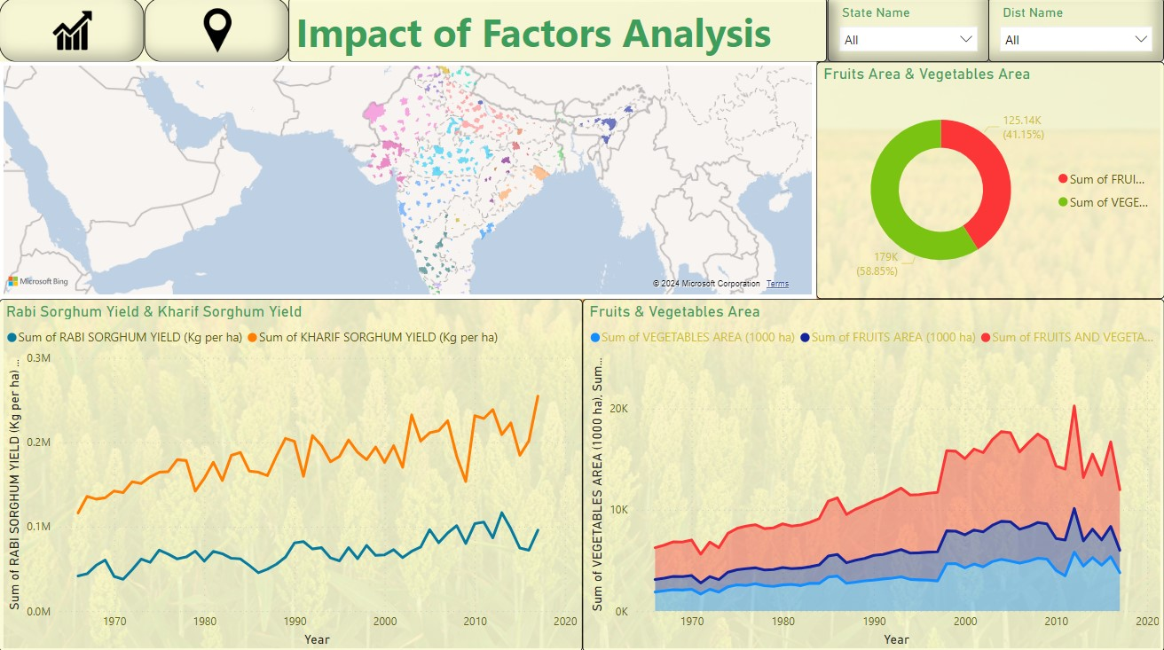
Seasonal Patterns
Now let’s discover the difference between crops grown in the kharif and the rabi seasons.
As you can see in the dashboard, the sorghum crops grown in the kharif season result more yield compared to the rabi season.
The biggest reason for that is that not a lot of states grow their crops on the rabi season.

Slide 6
Impact of External Factors
We can see from the dashboard that there were a drop in yields in 2009.
After some research I’ve discovered this was due to an increase in rainfall at that year which resulted in a huge drop for the kharif crops.

Slide 7
Fruits and Vegetables Analysis
Fruits & vegetables were a little bit tricky to analyze since the dataset did not provide enough data about them.
We can see that the production of fruits & vegetables are increasing over the years.

Slide 8
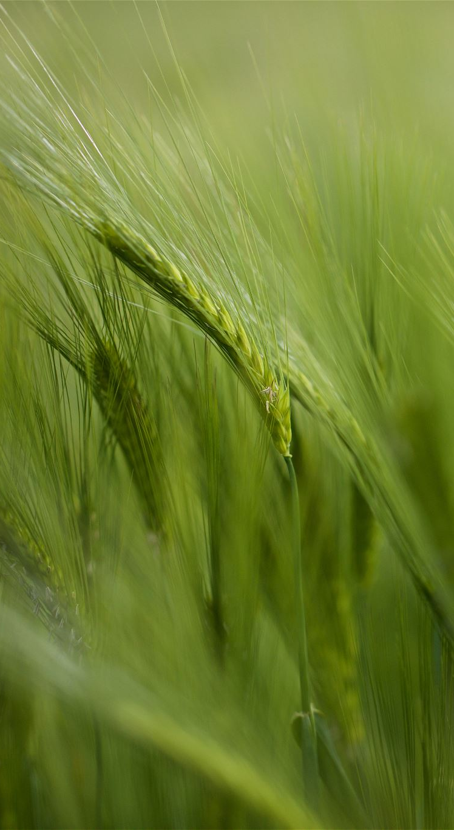
Insights
The previous analysis has provided us with vital information that could prevent drops in production for the future.
After some research, I’ve found out that most of the time a drop of production occurs because of natural causes.
This could be prevented by using modern farming techniques like implementing flood-resistant crops, improved drainage systems, crop rotation and planting on high ground.
It is important to note that taking these actions might be expansive, however if we applied them, we can ensure the safety of crops and an increase in production.

Slide 9

Conclusion
This internship project uncovered trends and disparities across districts and years.
This project also provided an interactive dashboard and insightful report to give valuable information for policymakers and stakeholders.

Slide 10

Thank You
For feedback, please contact me on my email: allwazaid1@gmail.com

