Slide 1
YouTube Videos Trends
Muhammad Zaid Amin
Sprint-Automation-Practicum 100
No. of slides-11

Slide 2
Project Goal
This project aims to determine the content which deserves the marketing attention of YouTube.
The project is divided into two parts. The first part seeks to analyse the data accumulated from YouTube. This data will include information like region, trending date, and category.
In the project’s second part, the aim is to create a dashboard for the marketing manager, completing the requirements of business.

Slide 3
Project Goal
The dashboard will provide answer of three questions as:
What video categories were trending last week?
How were they distributed among various regions?
What categories were especially popular in the United States?

Slide 4
Data Information
The YouTube data trending_by_time.csv has five columns name, record_id, region, trending_date, category_title and videos_count.
The data contains information for different categories and region from the 14-11-2017 to 14-06-2018 (seven months).
The data is collected for each day for each category and region.

Slide 5
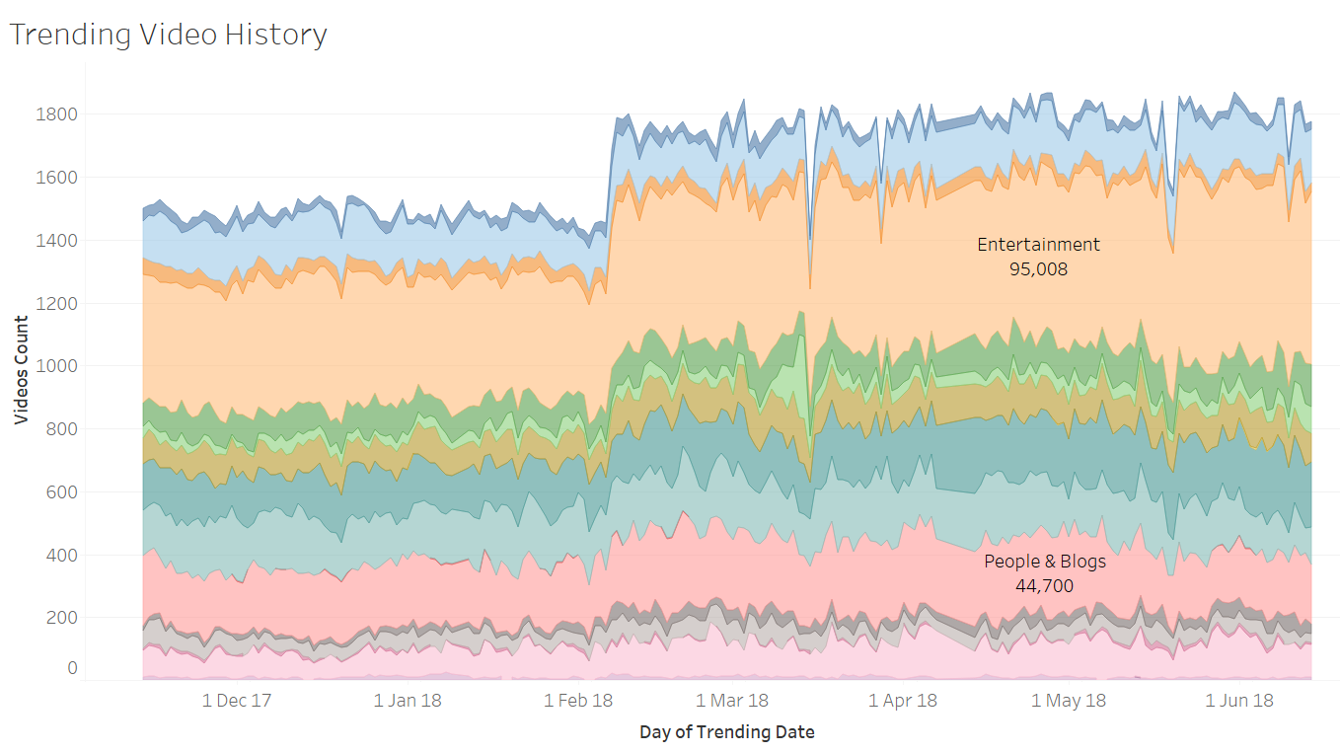
Which video categories trended most often?
The stack graph shows that Entertainment category has trended most often.
The second category is People and Blogs.

Slide 6
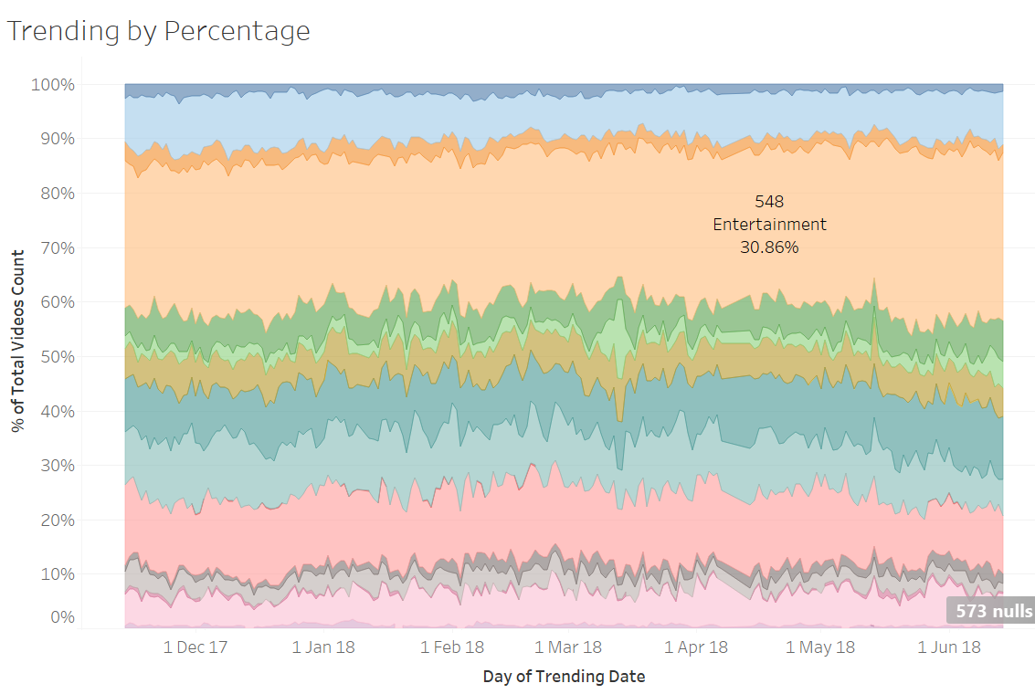
Which video categories trended most often?
Entertainment category has 30.86% share of most trending videos on YouTube.

Slide 7
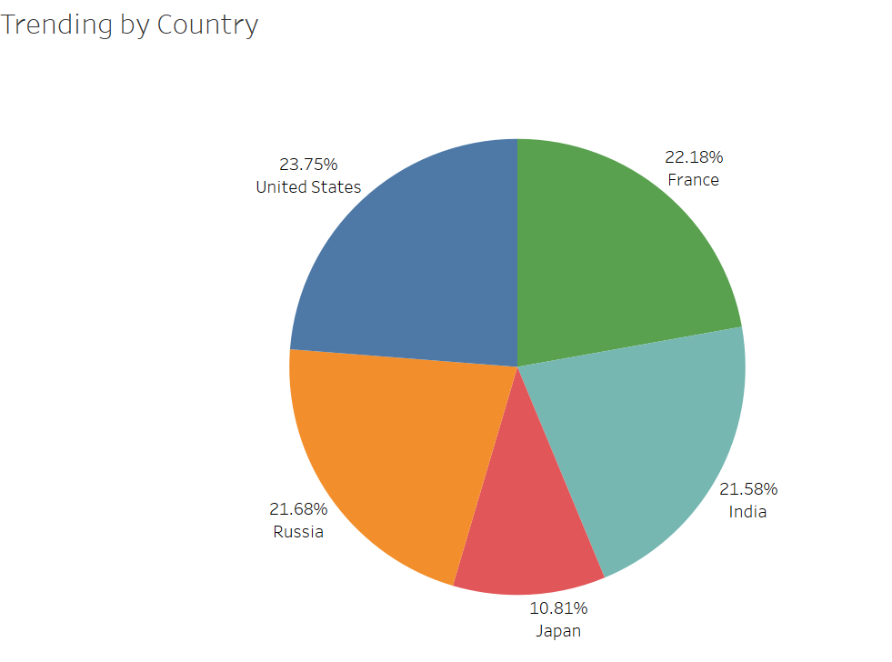
How were they distributed among regions?
The trending videos are almost equally distributed for France, India, Russia and USA regions.
Japan is lacking in these categories.
The distributions show each region equally important for the ad campaign.
One thing that can affect the CTR is the product category. It is required also to keep in mind the product demand in specific region.

Slide 8
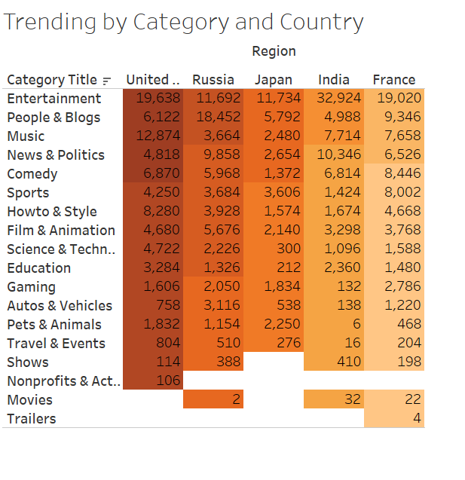
What categories were especially popular in the United States?
In the USA, the Entertainment and Music are most popular categories.
The Entertainment category is also most famous in India, Japan and France.
The population factor may also affect the results as Indian number is very high but the number to population ratio would also affect.
If the USA and Russia are compare, People and Blog is trending in Russia and Entertainment in USA.

Slide 9
Conclusion
The first stack graph shows that Entertainment category (30.86% share ) has trended most often and second category is People and Blogs.
The trending videos are almost equally distributed for France, India, Russia and USA regions but Japan has less share.
In the USA, the Entertainment and Music are most popular categories.
The Entertainment category is also most famous in India, Japan and France.
If the USA and Russia are compare, People and Blog is trending in Russia and Entertainment in USA.

Slide 10
Recommendation
One thing that can affect the CTR is the product category. It is required also to keep in mind the product demand in specific region.
Secondly, the population factor may also impact the trending videos count. As India’s has 1.3 Billion of population and most populous from any other country in analysis.

Slide 11
Thank you

