Slide 1


Université Saint-Joseph de Beyrouth
Faculté d’Ingénierie et d’Architecture
École Supérieure d’Ingénieurs de Beyrouth
Inclusive Employment Platform: AI-Powered Accessible Recruitment Platform for Persons with Physical Disabilities
Soutenu par :
Zaidan MANSOUR
Charbel RIZK
Département de génie informatique et communications
Génie logiciel
Supervisor(s):
Dr. Jean Yves Youssef
Dr. Roger Obeid
Dr. Rima Kilany
Le 28/8/2026

Slide 2
PROJECT PURPOSE
A bridge to real opportunities - not a replacement for people
WHAT EXISTS
THE PLATFORM
HUMAN CONTROL
Real people and real hospitality businesses
Makes connection easier and clearer
People remain responsible for every outcome
Persons with disabilities
Families and associations
Employers and training providers
JoIn inclusion expertise
Shows opportunities
Structures abilities and tasks
Explains compatibility
Supports communication
The platform does not invent jobs.
It does not diagnose disability.
It does not automatically hire or reject.
It helps people approach businesses.
INCLUSIVE WEB PLATFORM | PROGRESS PRESENTATION
02
Notes:
85 seconds. This is the central message: the project digitizes and scales connection. It does not replace the candidate, employer, family, association, or inclusion expert.

Slide 3
PROJECT SCOPE
Functional and non-functional requirements
Functional requirements
Non-functional requirements
+
Secure accounts and authorized verification
+
WCAG 2.1 AA target and responsive design
+
Candidate, company, and employer profiles
+
Security, privacy, consent, and role isolation
+
AI-assisted editable profile workflow
+
English, French, Arabic, and RTL behavior
+
Explainable matching and applications
+
Transparent and auditable decisions
+
Employer, verifier, and admin operations
+
Reliability, automated tests, and monitoring
+
Keyboard and optional voice navigation
+
Measured response-time and performance improvement
INCLUSIVE WEB PLATFORM | PROGRESS PRESENTATION
03
Notes:
70 seconds. Define functional requirements as actions and non-functional requirements as the quality and engineering constraints applied to those actions.

Slide 4
COMPLETED PLATFORM
Implemented feature summary
AI profile builder
Candidate verification
Security controls
Matching + applications
Voice or text -> editable transcript -> consent -> reviewable suggestions
Email confirmation plus private
disability-card review by an authorized verifier
JWT session, server-confirmed role, protected routes and APIs, private storage
Deterministic task score, explanations, applications, and stored outcomes
Employer tools
Admin + verifier
Accessible navigation
Multilingual UI
Company profile, vacancy creation, requirements, important tasks, assistance
Users, applications, candidate
evidence decisions, and dataset catalogue
Keyboard, arrow-key support, visible focus, status announcements, optional voice
English, French, Arabic, RTL layout,
stable codes, and locale tests
INCLUSIVE WEB PLATFORM | PROGRESS PRESENTATION
04
Notes:
75 seconds. Summarize the platform feature by feature. Emphasize that these workflows are integrated, not isolated mock-up pages.

Slide 5
TECHNICAL DESIGN
Architecture and security boundaries
PostgreSQL
Users | profiles
Jobs | applications
React frontend
Symfony backend
REST / JSON
Accessible screens
English | French | Arabic
Security | validation
Business workflows
Python services
AI profile assistance
Deterministic scoring
For example:
React requests jobs using GET /api/jobs.
React submits profile data using POST /api/profile.
INCLUSIVE WEB PLATFORM | PROGRESS PRESENTATION
05
Notes:
75 seconds. Walk left to right, then explain the security boundary. Frontend route checks improve experience, but backend authorization remains decisive.

Slide 6
ENGINEERING DECISION 1
Why deterministic scoring instead of machine learning?
CHOSEN: VERSIONED RULES
Deterministic rules
Task score
+ Uses expert task assessments
+ Every factor is visible
+ Reproducible and auditable
+ Works with the current controlled dataset
Sum(adjusted weight x feasibility factor) / Sum(adjusted weight) x 100
Feasibility factor: 1.00 feasible | 0.75 with offered support | 0.00 avoid
Highlighted task: weight x 1.5
Combined result: tasks + practical abilities (25%) + education (10%) when configured
Required education/ability and mandatory unsafe tasks remain explicit eligibility gates
Machine learning now
+ Needs representative labelled outcomes
+ May reproduce historical hiring bias
+ Harder to explain individual factors
+ No suitable training evidence currently exists
INCLUSIVE WEB PLATFORM | PROGRESS PRESENTATION
06
Notes:
95 seconds. Explain the formula at a high level. The decision is engineering and governance driven: current expert evidence supports versioned rules; it does not support training a defensible predictive model.

Slide 7
ENGINEERING DECISION 2
Why i18next with react-i18next?
Custom React context
Duplicated pages
i18next + React
NOT SELECTED
NOT SELECTED
SELECTED
Few dependencies, but we would rebuild fallback, plural rules, namespaces, formatting, and missing-key checks.
Simple for one screen, but triples maintenance, creates translation drift, and complicates routing and testing.
Runtime switching, namespaces, fallback, interpolation, plural rules, React hooks, and gradual route migration.
Implemented: 3 locales x 7 namespaces | Arabic RTL | English fallback | stable codes/IDs | locale parity tests
INCLUSIVE WEB PLATFORM | PROGRESS PRESENTATION
07
Notes:
85 seconds. Compare the maintenance cost and language correctness. i18next was selected because it fits React and supports gradual migration without changing business rules or routes.

Slide 8
ENGINEERING DECISION 3
Why cloud Whisper-1 and OpenAI services?
Browser speech API
Self-hosted Whisper
OpenAI whisper-1
REJECTED
DEFERRED
SELECTED NOW
Low backend work, but browser support, language quality, behavior, and availability vary by device.
More infrastructure control and offline potential, but requires CPU/GPU capacity, model operations, updates, and load testing.
Multilingual transcription, consistent API, no model hosting, and a replaceable service boundary. Trade-offs: network, cost, and latency.
Current controlled flow
Audio -> whisper-1 transcript -> schema-constrained interpretation -> deterministic registry authorization -> permitted UI action -> cloud TTS or browser fallback
INCLUSIVE WEB PLATFORM | PROGRESS PRESENTATION
08
Notes:
95 seconds. State the trade-off honestly. Cloud services accelerated delivery and removed local model operations, but introduce network latency, provider cost, and availability concerns. The service boundary keeps future replacement possible.

Slide 9
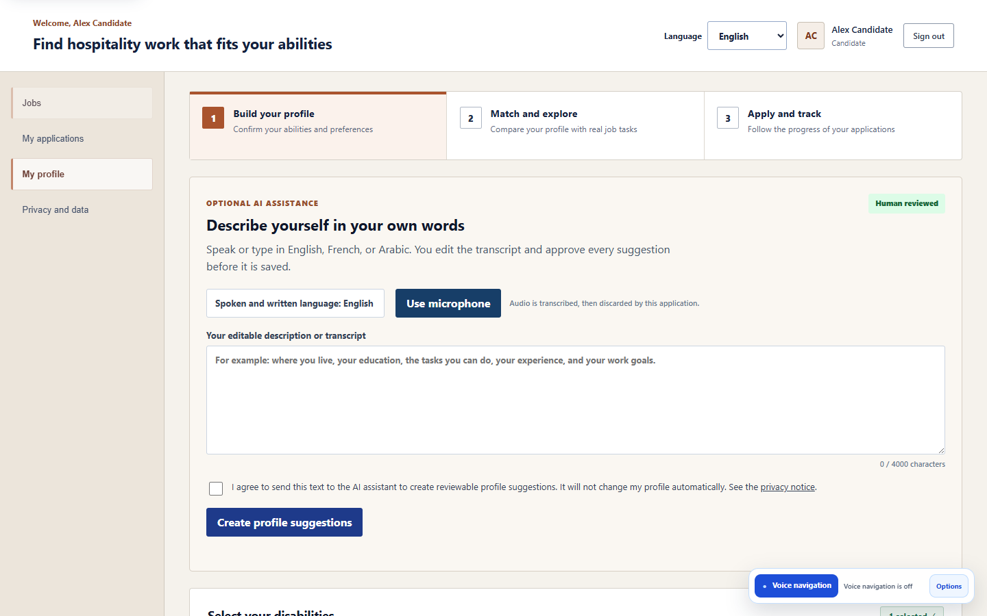
COMPLETED EVIDENCE
Running workflows and automated verification
AI profile + consent
INCLUSIVE WEB PLATFORM | PROGRESS PRESENTATION
09
Notes:
70 seconds. Use this slide as evidence. Mention route security, profile consent, employer control, and verifier authorization, then read the automated totals.

Slide 10
COMPLETED EVIDENCE
AI profile + consent
Choose language and describe
Select English, French, or Arabic, then speak or type.
Create an editable transcript
Voice is converted into text, and the audio is discarded.
Review and give consent
Correct the transcript and approve sending it to the AI.
Generate profile suggestions
The AI converts the description into structured profile information.
Review every suggestion
Edit, accept, or reject each suggested item.
Confirm and save
Only the information selected by the candidate is added to the profile.
INCLUSIVE WEB PLATFORM | PROGRESS PRESENTATION
10
Notes:
70 seconds. Use this slide as evidence. Mention route security, profile consent, employer control, and verifier authorization, then read the automated totals.

Slide 11

COMPLETED EVIDENCE
Running workflows and automated verification
Employer requirements
INCLUSIVE WEB PLATFORM | PROGRESS PRESENTATION
11
Notes:
70 seconds. Use this slide as evidence. Mention route security, profile consent, employer control, and verifier authorization, then read the automated totals.

Slide 12
COMPLETED EVIDENCE
Employer requirements
Select a position
Choose a controlled hospitality role from the catalogue.
Load catalogue tasks
The platform loads the role’s approved tasks automatically.
Enter vacancy details
Add location, job type, work mode, deadline, and description.
Define requirements
Set education, reading, writing, counting, and position knowledge as required, preferred, or not required.
Set priorities and support
Highlight important tasks and record whether workplace assistance is available.
Validate and publish
The backend verifies the information, publishes the vacancy, and sends its requirements to the matching engine.
INCLUSIVE WEB PLATFORM | PROGRESS PRESENTATION
12
Notes:
70 seconds. Use this slide as evidence. Mention route security, profile consent, employer control, and verifier authorization, then read the automated totals.

Slide 13
COMPLETED EVIDENCE
Authorized verification
Capture candidate speech
The browser records the candidate’s voice as WebM/Opus audio.
Send audio for processing
The recording is uploaded to the Python voice service.
Convert speech to text
Whisper-1 produces a written transcript of the command.
Classify the request
Identify it as navigation, an interface action, or a page question.
Validate the command
Check the requested operation against the current page and allowed registry.
Execute or answer
Perform the permitted action or answer the candidate’s question.
Provide accessible feedback
Display the result visually and read it aloud; sensitive actions require confirmation.
INCLUSIVE WEB PLATFORM | PROGRESS PRESENTATION
13
Notes:
70 seconds. Use this slide as evidence. Mention route security, profile consent, employer control, and verifier authorization, then read the automated totals.

Slide 14
IN PROGRESS
What we are improving now
Stability + security
Design + accessibility
Profiles
Resolve workflow and API issues
Retest wrong-role and anonymous access
Improve validation, errors, and notifications
Modernize role dashboards
Improve responsive flow and visual hierarchy
Retest keyboard, zoom, screen reader, and RTL
Preserve Personal Education hierarchy
Improve candidate and company information
INCLUSIVE WEB PLATFORM | PROGRESS PRESENTATION
14
Notes:
80 seconds. Use the terms stabilization, refinement, and retesting. Catalogue work is semantic validation, not only file upload.

Slide 15
PERFORMANCE OBJECTIVE
Reduce AI, voice-navigation, and page response time
1. Measure first
2. Optimize AI path
Measure the response time of every processing stage, identify the slowest part, apply improvements, and compare the results before and after.
Reduce voice-response time by sending smaller requests, limiting AI context, cancelling outdated operations, reusing connections, and handling approved simple commands directly when safe.
3. Optimize platform
Improve page and API speed by identifying slow database queries, loading large lists in pages, reducing frontend file sizes, adding appropriate database indexes, and caching only safe data when testing proves it is necessary.
INCLUSIVE WEB PLATFORM | PROGRESS PRESENTATION
15
Notes:
90 seconds. This is a planned engineering cycle, not an unsupported speed claim. A cache is one possible optimization after measurement; sensitive candidate or AI output must not be cached casually.

Slide 16
NEXT PHASE
Remaining product work and demonstration
REMAINING PRODUCT WORK
5-MINUTE DEMO
Candidate chooses Job, Training, or Both
Visitors safely browse jobs, training, and companies
Employer records adaptation or assistance for each task
Complete candidate-controlled reading and voice dictation
Upgrade company, candidate, and employer profiles
Finish accessibility evidence, performance tests, and deployment
00:00 Candidate profile + consent
01:00 Match score + explanation
02:00 Employer requirements + assistance
03:00 Admin catalogue
04:00 Language + keyboard + protected route
The platform connects people to real businesses and supports human decisions instead of replacing them.
INCLUSIVE WEB PLATFORM | PROGRESS PRESENTATION
16
Notes:
80 seconds. Summarize the roadmap, then introduce the demo. The closing statement returns to the project purpose: connection and support, not automatic hiring.

Slide 17
Thank you
Any questions ?

