Slide 1
Project Title
MDP25-xx
Student 1
Student 2
Student 3
ESIB Multidisciplinary Project
May, 2025
Supervised by:
Supervisor 1
Supervisor 2

Slide 2
Introduction
Present the project members and their disciplines
Introduce the main subject of your project
  Problem Identification
    Context
    Characteristics of your complex engineering problem
    Need for and engineering design

Slide 4


INCLUSIVE EMPLOYMENT PLATFORM
Accessible, AI-Assisted Recruitment for Persons with Physical Disabilities
Final Engineering Presentation
Zaidan MANSOUR | Charbel RIZK
Computer and Communications Engineering - Software Engineering
Supervisors: Dr. Jean Yves Youssef | Dr. Roger Obeid | Dr. Rima Kilany
14 September 2026
UNIVERSITE SAINT-JOSEPH DE BEYROUTH | ESIB
Notes:
20 seconds. Introduce both presenters, the supervisors, and the project. State that the platform connects verified abilities to real hospitality tasks while keeping people in control.

Slide 5
CONTEXT AND PROBLEM
Capability and opportunity remain disconnected
Inaccessible processes hide ability and reduce trust in task-level decisions.
1.3B
30% lower
>80%
people with significant disability
labour-market participation
inclusive-employer barrier
The engineering problem is not a lack of ability.
It is the distance between accessible recruitment, verified candidate profiles, real job tasks, workplace support and employers prepared to evaluate ability.
Sources retained from the report: WHO; ILO Global Disability Summit 2025; Business Disability Forum / Evenbreak survey.
INCLUSIVE WEB PLATFORM | FINAL ENGINEERING PRESENTATION
2
Notes:
55 seconds. Give the three numbers, then frame the issue carefully. JoIn reduces recruitment barriers; it does not claim to create jobs or solve unemployment by itself.

Slide 6
BACKGROUND RESEARCH
Related approaches and the remaining gap
The project combines strengths that usually appear in separate solutions.
General portals
Inclusive portals
AI screening
Human coaching
Large reach
Familiar workflow
Generic candidate profiles
Targeted visibility
Employer awareness
Limited task-level evidence
Speed and scale
Bias and privacy risks
Often opaque decisions
Contextual judgement
Adaptation expertise
Difficult to scale digitally
JoIn gap: one accessible workflow joining controlled hospitality tasks, candidate abilities, workplace assistance, explainable matching and human review.
INCLUSIVE WEB PLATFORM | FINAL ENGINEERING PRESENTATION
3
Notes:
50 seconds. Compare solution categories, not brands. The research gap is integration: accessible interaction, task evidence, explainability and human control in one workflow.

Slide 7
GENIE LOGICIEL
An iterative lifecycle with V-model traceability
Evolutionary delivery uses V-model traceability after every material change.
01
Discover
02
Specify + design
03
Build + integrate
04
Verify + evolve
Needs
Research
Stakeholders
FR / NFR
Architecture
Risk controls
React / Symfony
Python services
Cloud staging
Tests
Human validation
Maintenance
Traceability: stakeholder need -> requirement -> design -> code -> test oracle -> retained evidence
INCLUSIVE WEB PLATFORM | FINAL ENGINEERING PRESENTATION
4
Notes:
55 seconds. Name the course lifecycle. Explain that JoIn used evolutionary prototyping and iterative increments, with V-model-style requirement-to-test traceability in each cycle.

Slide 8
EXPRESSION DES BESOINS
Needs came from people, evidence and prototypes
Stakeholder needs shaped a focused, measurable Phase II delivery.
People
Evidence
Techniques
Candidates with varied access needs
Employers and hospitality teams
Verifier and administrator roles
Phase I artefacts
WCAG and domain research
Arc en Ciel and JAWS sessions
Background study
Scenario observation
Iterative prototype review
4 roles
15 roles
923
3
authorized workspaces
hospitality positions
catalogue tasks
interface languages
INCLUSIVE WEB PLATFORM | FINAL ENGINEERING PRESENTATION
5
Notes:
55 seconds. Explain the sources and elicitation techniques, then use the four figures as delivery evidence. They describe the staging prototype, not production impact.

Slide 9
SPECIFICATIONS DU LOGICIEL
Functional requirements implemented by role
Four authorized workspaces coordinate one auditable recruitment workflow.
Candidate
Employer
Verifier
Administrator
Verify identity
Build accessible profile
Match, explore and apply
Publish job or training
Set tasks and support
Review applications
Review private evidence
Approve or reject
Record an auditable decision
Manage users and catalogue
Import validated datasets
Maintain controlled definitions
Nominal, rejected-role and recovery flows were specified and tested.
INCLUSIVE WEB PLATFORM | FINAL ENGINEERING PRESENTATION
6
Notes:
55 seconds. Walk across the four roles. Mention job and training opportunities, and stress that authorization is enforced by the backend rather than trusted to the interface.

Slide 10
SPECIFICATIONS DU LOGICIEL
Quality constraints, standards and measurable evidence
Non-functional requirements were connected to controls and test evidence.
Accessibility
Security + privacy
Reliability
Maintainability
WCAG 2.1 AA target
Keyboard + screen reader
Responsive reflow
JWT and server RBAC
Private evidence
Consent and erasure
Health endpoints
Repeatable p50 / p95
Transparent limitations
Component boundaries
Versioned policy
Three stable locales
Constraint trade-off: stronger controls and external services can affect latency; correctness and performance are reported separately.
INCLUSIVE WEB PLATFORM | FINAL ENGINEERING PRESENTATION
7
Notes:
60 seconds. Define NFRs as measurable qualities. State WCAG as a target, not a certificate, and introduce the main trade-off between security/external dependencies and response time.

Slide 11
ARCHITECTURAL DESIGN | SOFTWARE DESIGN
Implemented logical architecture and trust boundaries
Provider-neutral view: persistence stays behind Symfony; voice uses one protected backend path and one bounded browser path.
Persistence Layer
Symfony API
Doctrine + storage adapter
React / Vite
PostgreSQL
Users, profiles, jobs,
applications, catalogue
Object storage
Private documents
Public employer logos
JWT + RBAC
Validation
Workflow orchestration
Only persistence gateway
Accessible interface
Role workspaces
JWT client
Executes approved voice actions
JWT API
Users
Scoring Service
Service token
Deterministic, versioned rules
Explainable JSON; no OpenAI
Audio + navigation
Protected profile suggestions
Voice / Profile Service
OpenAI API
Provider API
Transcription and NLP
Schema-constrained suggestions
Bounded command proposals
External provider
No database authority
Replaceable adapter
INCLUSIVE WEB PLATFORM | FINAL ENGINEERING PRESENTATION
8
Notes:
Users interact through React. Standard application requests go to Symfony, which owns authentication, authorization, validation, workflow and persistence. Symfony calls the deterministic scoring service and the protected profile-extraction endpoint. For live transcription and navigation, React calls the voice service directly. Only the voice/profile service calls OpenAI. Neither Python service accesses persistence directly.

Slide 12
CONCEPTION DETAILLEE
Design decisions control complexity and sensitive data
Patterns address coupling, opacity, unsafe action and lost decision history.
Layered services
Adapters + policy
Controller - service - repository
Low coupling and cohesive change
Replaceable OpenAI boundary
Versioned deterministic scoring
Command registry
Privacy + audit
Allowlisted voice actions
Role and page authorization
Private document storage
Consent, retention and snapshots
Evidence: 51/51 route probes passed; one oversized-upload defect remains recorded.
INCLUSIVE WEB PLATFORM | FINAL ENGINEERING PRESENTATION
9
Notes:
60 seconds. Connect each design choice to its risk. Finish with the security evidence and keep the open upload defect visible; a successful campaign should still expose defects.

Slide 13


PROGRAMMATION ET INTEGRATION
Implemented services running on shared cloud staging
Versioned components deploy independently through infrastructure as code.
Render Blueprint
Supabase data layer
React static site | Symfony API | scoring | voice/profile
PostgreSQL | private evidence | public employer logos
INCLUSIVE WEB PLATFORM | FINAL ENGINEERING PRESENTATION
10
Notes:
60 seconds. Point to the four Render resources and the purpose-specific storage buckets. render.yaml and Docker boundaries make the integration reproducible. This is staging evidence, not a production SLA.

Slide 14
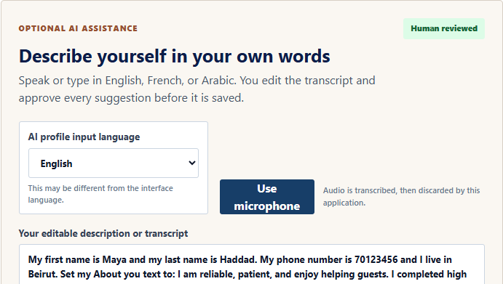
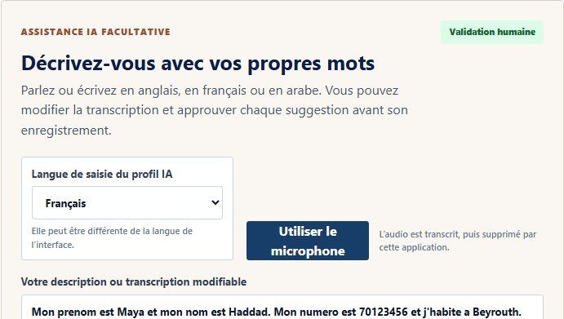

PROGRAMMATION
AI-assisted profile: multilingual, advisory and reversible
The candidate remains in control from transcription to persistence.
Describe
Edit
Consent
Review
Confirm
Type or speak
Correct transcript
Approve AI use
Select or reject
Backend saves
53/60 passed | 7 extraction defects retained | no automatic persistence
INCLUSIVE WEB PLATFORM | FINAL ENGINEERING PRESENTATION
11
Notes:
65 seconds. Explain editable transcript, explicit consent, review and backend validation. Then show deployed English, French and Arabic output. The principal retained weakness was preference extraction, not unsafe persistence.

Slide 15
PROGRAMMATION
Voice navigation: flexible understanding, restricted execution
Natural language proposes an action; only the deterministic registry may authorize it.
Record
Transcribe
Interpret
Authorize
Execute
Bounded audio
Editable text
Schema output
Role + page
Fixed React action
Safety boundary
Evidence and limits
Unknown routes and cross-role actions are rejected. Submission and reset require confirmation.
57/57 registry checks passed. Noise and dictated email characters can still require correction.
Every voice operation keeps a keyboard and mouse equivalent.
INCLUSIVE WEB PLATFORM | FINAL ENGINEERING PRESENTATION
12
Notes:
60 seconds. Separate acoustic quality from action safety. The deterministic registry authorizes commands; manual observations still show noise and character-by-character limitations.

Slide 16
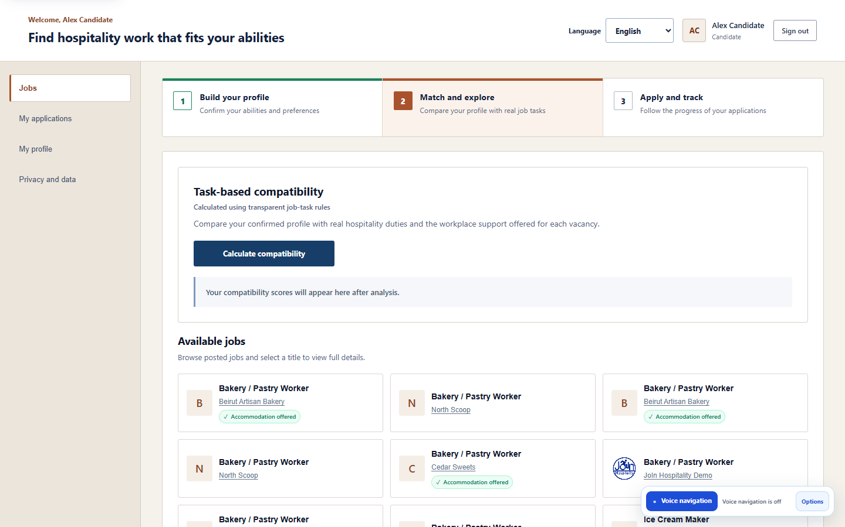
ALGORITHME DE DECISION
Deterministic compatibility is explainable by construction
Controlled assessments produce reproducible task-level reasons.
Compatibility score
Sum(adjusted weight x feasibility factor)
Sum(adjusted weight) x 100
1.00 feasible
0.75 feasible with offered assistance
0.00 avoid; unsafe mandatory tasks remain gates
45 / 45
scoring cases passed
INCLUSIVE WEB PLATFORM | FINAL ENGINEERING PRESENTATION
13
Notes:
65 seconds. Explain the numerator, denominator and feasibility factors. The policy is appropriate because it is versionable, testable and individually explainable. Forty-five staging oracle cases passed.

Slide 17

WORKFLOW INTEGRE
From controlled opportunity to auditable outcome
Candidates and employers contribute bounded choices; AI never creates a hiring decision.
Employer defines
Candidate explores
System explains
Humans decide
Role, tasks, support
Jobs, training or both
Compatibility + gates
Application + outcome
Audit snapshot preserves score context and status history.
INCLUSIVE WEB PLATFORM | FINAL ENGINEERING PRESENTATION
14
Notes:
55 seconds. Trace the four steps. Employers define actual requirements and assistance. The candidate chooses. The engine explains. Employers remain responsible for selection, with an auditable snapshot.

Slide 18
PROJECT MANAGEMENT
Iterative delivery from definition to evidence
A June-September plan controlled through versioned evidence and explicit risks.
JUN
Discover + define
Needs, stakeholders, FR / NFR
JUL
Design
Alternatives, UML / C4, prototype
JUL-AUG
Build + integrate
Catalogue, backend, AI, voice, scoring
AUG-SEP
Verify + deliver
Tests, users, staging, report, defence
Controls
Focused Git commits | staging-deployment | render.yaml | requirement-to-test evidence | retained risks
INCLUSIVE WEB PLATFORM | FINAL ENGINEERING PRESENTATION
15
Notes:
70 seconds. Explain the overlap: requirements informed design while prototypes refined needs; build and integration overlapped; verification intensified before delivery. Project control used focused commits, a staging branch, infrastructure as code, traceability and explicit risk reporting.

Slide 19
TESTS ET MISE AU POINT
Verification and validation across the lifecycle
Verification checks the specification; validation checks the user need.
Static + component
Build, lint, syntax, schema and unit checks
Service + integration
API workflows | scoring oracles | voice registry | AI matrix
System + staging
Browser E2E | security routes | performance | deployed origins
Human validation
Arc en Ciel session | JAWS workflow | stakeholder observation
Documentation: SRS -> architecture -> code/configuration -> test register -> evidence -> operational limits
INCLUSIVE WEB PLATFORM | FINAL ENGINEERING PRESENTATION
16
Notes:
60 seconds. Define verification versus validation, then show the layered evidence. Testing was not an end-of-project activity; it was traced from specifications and repeated after corrections.

Slide 20
MESURES ET MISE AU POINT
310 cases completed; findings remained visible
The campaign records corrections and retained limitations, not only passes.
93.2%
274
15
21
final pass rate
first-run passes
noisy partials corrected
retained failures
Accessibility
Security + AI
Performance
Profile contrast
200% zoom overflow
Oversized upload path
Both-preference omission
Staging write p95
Free-tier latency
All 310 were executed; no case remained blocked or not run.
INCLUSIVE WEB PLATFORM | FINAL ENGINEERING PRESENTATION
17
Notes:
65 seconds. Explain the arithmetic: 274 first passes, 15 partial noisy-transcription cases corrected, and 21 retained failures produce 289 final passes out of 310. Highlight the three defect groups.

Slide 21



VALIDATION UTILISATEUR
The platform was evaluated with its intended users
Human evidence supports tested users, not a universal accessibility claim.
Arabic workflow
20-person session
JAWS workflow
JAWS registration and application completed; open contrast and zoom findings remain reported.
INCLUSIVE WEB PLATFORM | FINAL ENGINEERING PRESENTATION
18
Notes:
65 seconds. Distinguish the 20-person Arc en Ciel session from the focused JAWS workflow. These validate relevance and identify issues; they do not establish universal WCAG conformance.

Slide 22
DELIVERY ET MAINTENANCE
Measured constraints guide the next engineering cycle
Latency and production governance define the remaining work.
Measured now
Cost controls
Next cycle
144/144 shared-load responses
100% functional availability
Latency target not consistent
Bottom-up by subsystem
AI and voice quotas
Measure before caching
Fix five material findings
Monitoring, backups and email
Repeat controlled user tests
Maintenance: corrective defects | adaptive change | perfective features | preventive refactoring
INCLUSIVE WEB PLATFORM | FINAL ENGINEERING PRESENTATION
19
Notes:
65 seconds. Separate functional correctness from latency. Cost includes effort, infrastructure, external services and maintenance. The next cycle begins with known defects and production governance, not an unsupported cache or scaling claim.

Slide 23
CONCLUSION
A validated bridge from ability to opportunity
Three ideas to retain.
1. Human control
2. Explainable engineering
3. Evidence with limits
AI suggests; candidates confirm; employers and verifiers decide.
Deterministic matching, explicit trust boundaries and auditable outcomes.
Cloud staging, 310 cases and human sessions - with open findings retained.
Questions?
Opportunity should be shaped by ability.
INCLUSIVE WEB PLATFORM | FINAL ENGINEERING PRESENTATION
20
Notes:
45 seconds. Conclude with only three ideas: people remain in control, the engineering decisions are explainable, and the evidence is transparent about limits. Then invite questions while facing the jury.

