Slide 1


INCLUSIVE EMPLOYMENT PLATFORM
Accessible, AI-Assisted Recruitment for Persons with Physical Disabilities
Final Engineering Presentation
Presented by
Zaidan MANSOUR | Charbel RIZK
Computer and Communications Engineering - Software Engineering
Supervisors
Dr. Jean Yves Youssef | Dr. Roger Obeid | Dr. Rima Kilany
14 September 2026
UNIVERSITE SAINT-JOSEPH DE BEYROUTH | ESIB
Notes:
20 seconds - Zaidan. Introduce the team and state: this is an accessibility, software architecture, explainable matching, deployment and verification project; AI assists but does not make hiring decisions.

Slide 2
PRESENTATION MAP
Engineering defence roadmap
Concise slides keep the technical evidence readable while respecting the 15-minute limit.
01
02
03
04
05
06
Problem + research
Requirements
Design
Implementation
Verification
Delivery
Need, related work, research gap
FR, NFR and WCAG target
Architecture, data, security
AI, voice, matching, workflows
Automated, staging and human tests
Deployment, cost, limits, demo
Slides 1-12: Zaidan | Slides 13-27: Charbel | Then: 5-minute live demonstration
INCLUSIVE WEB PLATFORM | FINAL ENGINEERING PRESENTATION | 14 SEP 2026
02
Notes:
20 seconds - Zaidan. Give the jury the route: evidence of need, requirements, technical design, implemented workflows, measured verification, then delivery and demo.

Slide 3
PROBLEM AND URGENCY
Capability and opportunity remain disconnected
Digital recruitment can reproduce exclusion when accessibility, trust and task-level ability are missing.
1.3B
30% lower
>80%
people experience significant disability worldwide
labour-market participation than persons without disabilities
of 700+ surveyed candidates named identifying inclusive employers as the greatest barrier
The engineering problem is not a lack of ability.
It is the distance between candidates, accessible recruitment processes, structured job tasks, workplace support and employers prepared to evaluate ability.
Sources: WHO Disability and Health (1.3B / 16%); ILO Global Disability Summit 2025 (30% participation gap); Business Disability Forum / Evenbreak survey (>700 respondents).
INCLUSIVE WEB PLATFORM | FINAL ENGINEERING PRESENTATION | 14 SEP 2026
03
Notes:
35 seconds - Zaidan. State the three numbers, then frame the problem carefully: the platform reduces barriers and distance; it does not claim to create jobs or solve unemployment by itself.

Slide 4
BACKGROUND RESEARCH
From disability-as-deficit to accessible decision support
The project follows the social and rights-based view: barriers can be changed through work design and technology.
01
02
03
04
05
Medical / deficit focus
Social / rights model
Online job portals
AI recruitment
JoIn approach
Recruitment starts from limitation.
Barriers exist in processes and environments.
Visibility increases, but profiles stay generic.
Scale increases, with bias and opacity risks.
Ability-to-task evidence with human control.
Software contribution: change the recruitment interaction and explanation, not the candidate.
INCLUSIVE WEB PLATFORM | FINAL ENGINEERING PRESENTATION | 14 SEP 2026
04
Notes:
30 seconds - Zaidan. Explain the evolution without presenting it as a dated hardware history. The design follows a rights-based view: inaccessible processes are engineering barriers that can be redesigned.

Slide 5
BACKGROUND RESEARCH
Related approaches and the remaining gap
A synthesis of solution categories studied in Phase I and Phase II; not an exhaustive commercial benchmark.
General job platforms
Inclusive job portals
Automated AI screening
Human coaching
Strength: reach and familiar workflows.
Gap: generic profiles and limited disability-specific support.
Strength: targeted visibility and employer awareness.
Gap: listings may not explain task-level feasibility.
Strength: speed and scale.
Gap: data quality, bias, privacy and individual explainability.
Strength: contextual judgement and adaptation.
Gap: intensive case-by-case work is difficult to scale digitally.
Research gap
One accessible workflow joining controlled hospitality tasks, candidate abilities, workplace assistance, explainable matching and human review.
INCLUSIVE WEB PLATFORM | FINAL ENGINEERING PRESENTATION | 14 SEP 2026
05
Notes:
35 seconds - Zaidan. Compare categories, not brands. The gap is integration: accessibility plus task evidence plus human control in one workflow.

Slide 6
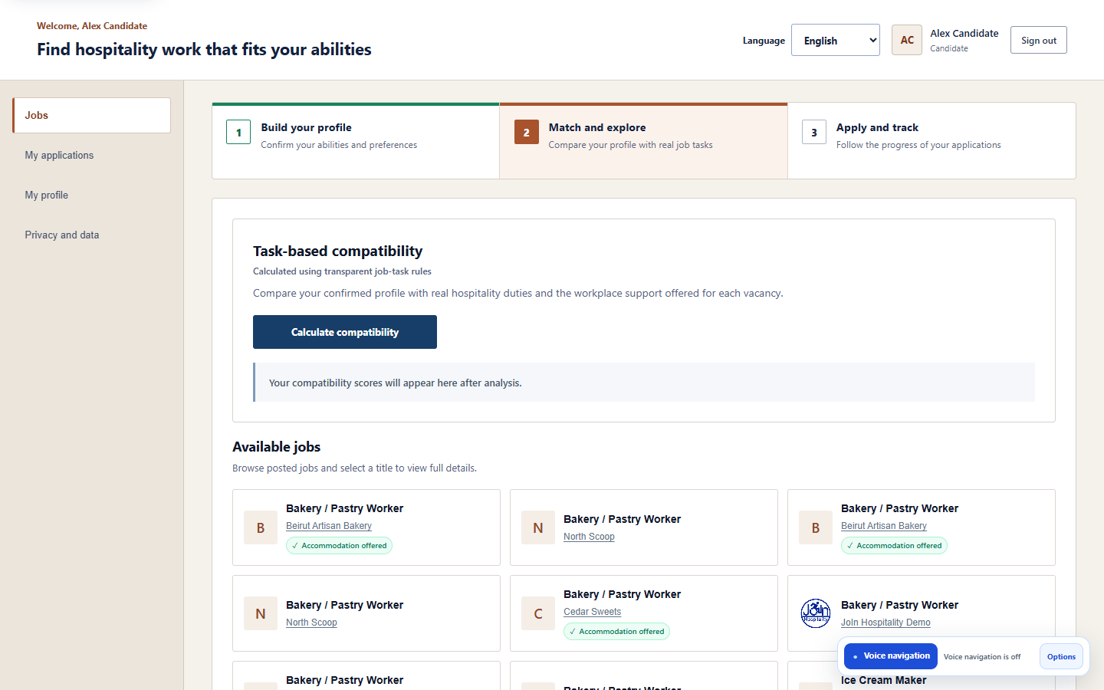
FINAL CONTRIBUTION
What Phase II delivered
The final prototype expands Phase I into a multilingual, multimodal and cloud-deployed engineering system.
4
15
923
14,453
74
3
authorized user roles
hospitality positions
catalogue tasks
task assessments
published opportunities
interface languages
Integrated outcome
Candidate-controlled AI profile assistance
Jobs, hospitality training, or both
Deterministic explainable compatibility
Employer requirements and assistance
Verifier and administrator oversight
English, French and Arabic with RTL
INCLUSIVE WEB PLATFORM | FINAL ENGINEERING PRESENTATION | 14 SEP 2026
06
Notes:
35 seconds - Zaidan. Use the numbers as evidence of engineering scale, then summarize the integrated contribution. The 74 opportunities are the recorded staging snapshot, not a production employment claim.

Slide 7
REQUIREMENTS
Functional requirements implemented by role
The platform is a coordinated workflow, not a collection of disconnected pages.
Candidate
Employer
Verifier
Administrator
Register and verify email
Submit private evidence
Build or reset profile
Choose work, training or both
Match, explore and apply
Manage company profile
Publish job or training offer
Set education and abilities
Prioritize tasks and assistance
Review and update applications
Access authorized requests
Retrieve private evidence
Approve or reject verification
Record auditable decisions
Manage users and catalogue
Import validated role datasets
Inspect jobs and applications
Maintain controlled definitions
INCLUSIVE WEB PLATFORM | FINAL ENGINEERING PRESENTATION | 14 SEP 2026
07
Notes:
35 seconds - Zaidan. Walk across the four roles. Emphasize server-authorized workflows and that training opportunities are handled alongside work offers.

Slide 8
REQUIREMENTS
Non-functional requirements and measurable qualities
Quality attributes were connected to controls and evidence rather than treated as general promises.
Accessibility
Security + privacy
Reliability + performance
Maintainability + i18n
WCAG 2.1 AA target
Keyboard and assistive technology
Responsive reflow and reduced motion
Clear status and error recovery
JWT and server-side RBAC
Private documents and bounded uploads
Consent, export, withdrawal and erasure
Audit events without sensitive payloads
Health endpoints and Docker boundaries
Repeatable p50 / p95 measurements
No silent rollback on email failure
Transparent cold-start and latency limits
Component-based React interface
Controller-service-repository backend
Versioned scoring policy
Three locales with stable codes and IDs
INCLUSIVE WEB PLATFORM | FINAL ENGINEERING PRESENTATION | 14 SEP 2026
08
Notes:
35 seconds - Zaidan. Define NFRs as measurable engineering qualities. State that final evidence includes both passes and open findings.

Slide 9
ACCESSIBILITY STANDARD
WCAG 2.1 Level AA: target, implementation and evidence
WCAG organizes success criteria under four principles; Level AA includes all applicable Level A and AA criteria.
Perceivable
Operable
Understandable
Robust
Labels and alternatives
Structure and headings
Status not based on colour alone
Contrast target
Keyboard workflows
Visible focus
No pointer-only critical path
Reduced-motion support
Consistent navigation
Instructions and linked errors
Confirmation and recovery
Plain-language feedback
Semantic controls
ARIA status / alert patterns
Stable focus management
JAWS-tested workflow
Evidence
18/18 accessibility workflow cases completed | 104 automated route-layout scenarios | JAWS registration and application completed
Honest boundary: 16 scenarios retained axe findings and 2 high-zoom scenarios showed overflow; therefore this is a WCAG 2.1 AA target, not a full conformance claim.
Standard: W3C Web Content Accessibility Guidelines (WCAG) 2.1, Recommendation, Level A and AA success criteria.
INCLUSIVE WEB PLATFORM | FINAL ENGINEERING PRESENTATION | 14 SEP 2026
09
Notes:
45 seconds - Zaidan. Define POUR, show implemented examples, then state the conformance boundary. This honesty is stronger engineering evidence than claiming that an automated scan proves compliance.

Slide 10
SYSTEM DESIGN
Cloud architecture and explicit trust boundaries
The browser presents the interface; Symfony remains the authoritative security and business-workflow boundary.
Supabase
Symfony API
Voice / profile
React / Vite
PostgreSQL
Private documents
Public employer logos
OpenAI API
JWT + RBAC
Validation
Workflow orchestration
Transcription
Schema-constrained AI
Safe command registry
Static frontend
Role workspaces
i18next + RTL
External provider
No database authority
Replaceable adapter
Scoring service
Deterministic
Versioned rules
Explainable JSON
Shared service tokens protect Symfony-to-Python calls; secrets stay server-side and HTTPS protects public origins.
INCLUSIVE WEB PLATFORM | FINAL ENGINEERING PRESENTATION | 14 SEP 2026
10
Notes:
45 seconds - Zaidan. Walk left to right. React never authorizes itself. Symfony validates the session, role and payload. AI and scoring are separate services with different responsibilities.

Slide 11
SYSTEM DESIGN
Design patterns used to control complexity
The implementation combines patterns at the presentation, application, integration and decision layers.
Layered / MVC
Controller-Service-Repository
Adapter / Gateway
React presentation, Symfony APIs, Doctrine persistence, isolated Python services.
HTTP, orchestration and data access remain separately testable.
OpenAI is accessed through bounded replaceable service contracts.
Strategy / Policy
Command Registry + FSM
Audit + Immutable Snapshot
Versioned weights, assistance factors and eligibility gates.
Allowlisted voice actions and mutually exclusive interaction states.
Consent, verification, status events and score context remain traceable.
Engineering value: lower coupling, safer external AI, reproducible decisions and independent verification.
INCLUSIVE WEB PLATFORM | FINAL ENGINEERING PRESENTATION | 14 SEP 2026
11
Notes:
35 seconds - Zaidan. Do not define every textbook term. Show how each pattern solves a concrete project risk: coupling, unsafe AI actions, opaque matching or lost decision history.

Slide 12
SECURITY AND PRIVACY
Sensitive data is controlled by the backend, not the interface
Frontend checks improve usability; Symfony authorization remains decisive for every protected request.
Identity and role isolation
Private evidence and uploads
Consent and auditability
Email verification
JWT via X-Auth-Token
Candidate | Employer | Verifier | Admin
Anonymous, forged and cross-role rejection
Private candidate-verification bucket
Private application documents
Public employer logos only
MIME and size restrictions
Explicit AI consent
No unconfirmed suggestion saved
Export, withdrawal and account erasure
Audited status and verifier decisions
Evidence: 51/51 prerequisite route checks passed | Final security register: 19/20 | Open upload-validation defect retained
INCLUSIVE WEB PLATFORM | FINAL ENGINEERING PRESENTATION | 14 SEP 2026
12
Notes:
40 seconds - Zaidan. End the first half here. Distinguish the 51 route checks from the 20-case security quality register, where one oversized-upload behavior remains open.

Slide 13


IMPLEMENTED DEPLOYMENT
Render and Supabase staging topology
The deployed system proves multi-service integration over public HTTPS; it is a staging prototype, not a production SLA.
Render Blueprint
Supabase data layer
React static site + Symfony API + voice/profile service + scoring service
SSL PostgreSQL pooler + three purpose-specific storage buckets
INCLUSIVE WEB PLATFORM | FINAL ENGINEERING PRESENTATION | 14 SEP 2026
13
Notes:
25 seconds - Charbel. Begin the implementation half with deployment evidence. Services run in Frankfurt except the global static frontend. HTTPS enables remote microphone access.

Slide 14
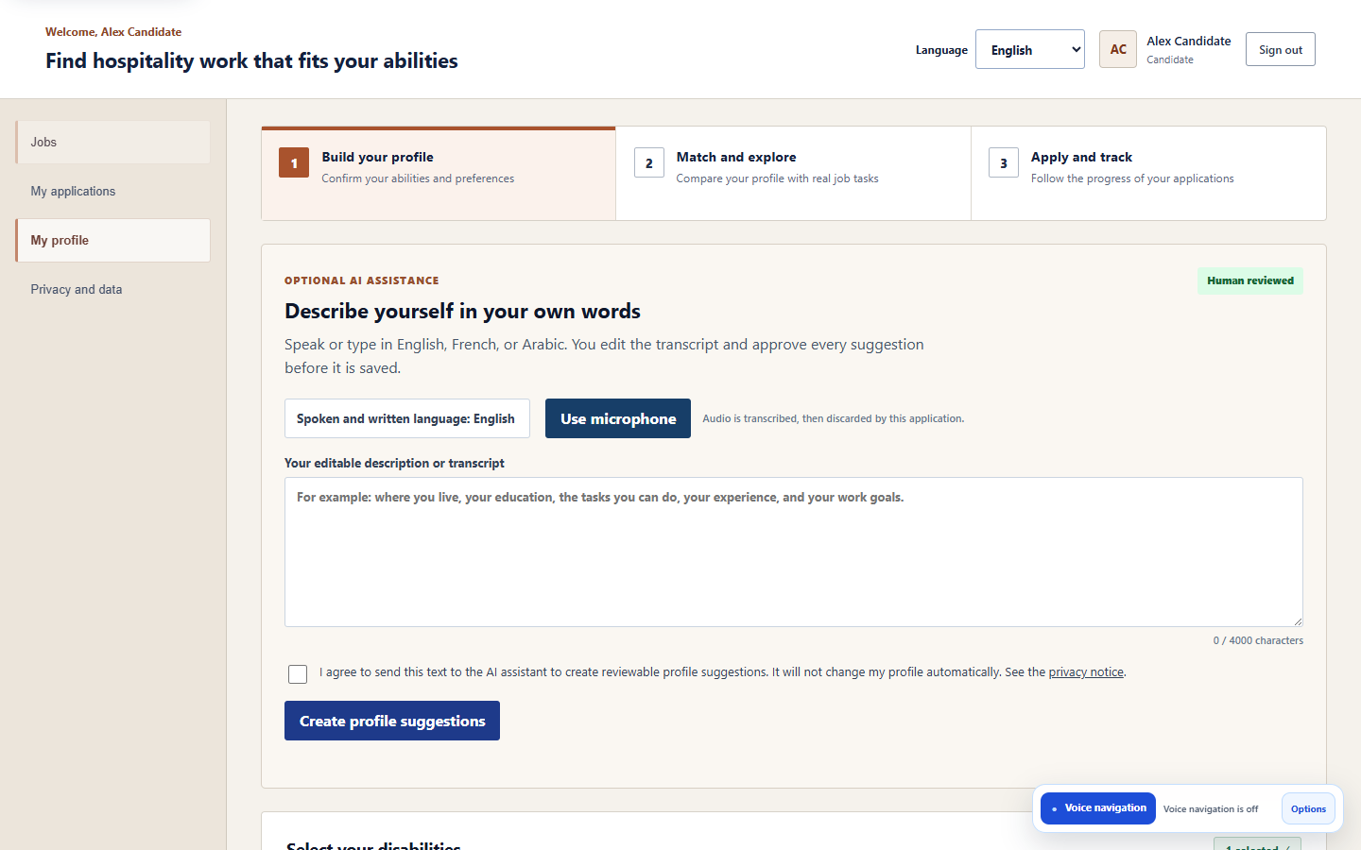
CANDIDATE WORKFLOW
AI-assisted profile: advisory, consent-gated and reversible
The candidate can type or speak; every AI result remains a suggestion until explicit confirmation.
Describe
Edit transcript
Consent
Interpret
Review
Confirm
Select EN, FR or AR; type or record.
Correct speech-to-text before processing.
Approve sending the text to the assistant.
Return schema-constrained suggestions.
Accept, edit or reject every item.
Symfony validates and saves selected values only.
INCLUSIVE WEB PLATFORM | FINAL ENGINEERING PRESENTATION | 14 SEP 2026
14
Notes:
30 seconds - Charbel. The important sequence is editable transcript, explicit consent, structured suggestions, human selection, backend validation. Profile reset allows a candidate to start again.

Slide 15
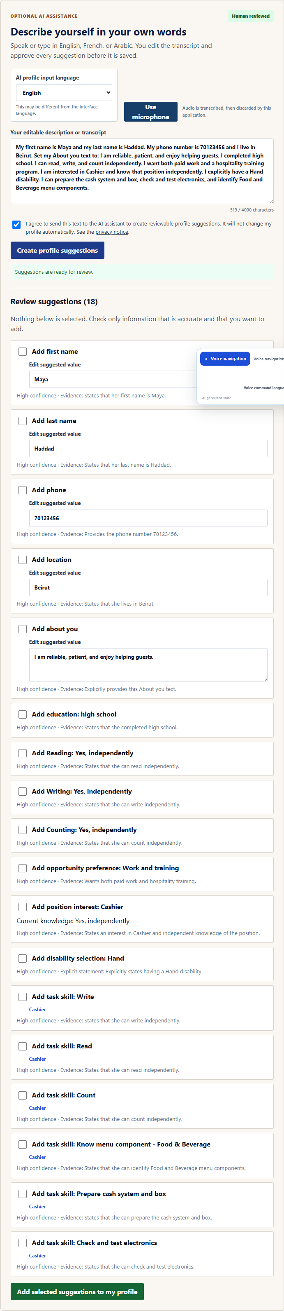
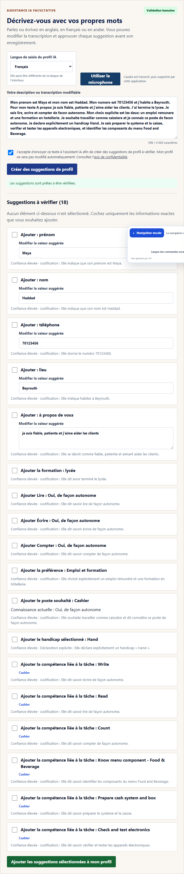

AI PROFILE EVIDENCE
Structured suggestions in English, French and Arabic
Sixty gold-standard narratives covered clean and imperfect wording, abilities, preferences, positions, tasks and safety boundaries.
ENGLISH
FRENCH
ARABIC + RTL
53/60 passed (88.3%) | 7 failures retained | Main weakness: explicit Both work-and-training preference could be omitted
INCLUSIVE WEB PLATFORM | FINAL ENGINEERING PRESENTATION | 14 SEP 2026
15
Notes:
25 seconds - Charbel. Show real deployed outputs, then give the honest result. The assistant did not save any item during the matrix. The principal defect was preference extraction, not unsafe automatic persistence.

Slide 16
VOICE INTERACTION
Bounded voice-navigation execution path
Natural language proposes an action; only the deterministic registry may authorize and execute it.
Record
Transcribe
Classify
Propose
Authorize
Execute
Feedback
WebM / Opus
Whisper-1
Navigate / action / question
Canonical command
Page + role registry
Fixed React behavior
Visual + spoken
Safety boundary
Unregistered routes and cross-role actions are rejected. Submission and reset require confirmation. Context is sanitized and bounded to six turns.
Evidence: 57/57 automated registry/action-safety checks passed. Quiet commands worked reliably; background noise and dictated email characters required correction in some trials.
INCLUSIVE WEB PLATFORM | FINAL ENGINEERING PRESENTATION | 14 SEP 2026
16
Notes:
35 seconds - Charbel. Separate acoustic quality from action safety. The automated suite proves authorization logic, while manual observations show noise and character-sequence limitations.

Slide 17
CORE DECISION ENGINE
Deterministic compatibility: explainable by construction
Matching uses controlled expert assessments rather than a learned model trained on unavailable employment outcomes.
Task score
Sum(adjusted weight x feasibility factor)
Sum(adjusted weight) x 100
Feasibility: 1.00 feasible | 0.75 with offered assistance | 0.00 avoid
Important task multiplier: 1.5
Practical abilities: 25% and education: 10% when configured
Unsafe mandatory tasks and required abilities remain explicit gates
45 / 45
staging formula, eligibility and determinism cases passed
INCLUSIVE WEB PLATFORM | FINAL ENGINEERING PRESENTATION | 14 SEP 2026
17
Notes:
40 seconds - Charbel. Explain the numerator and denominator, then the three feasibility factors. State why deterministic policy is appropriate: versionable expert evidence, reproducibility and individual explanations.

Slide 18

EMPLOYER WORKFLOW
From controlled role to published job or training program
Employers configure the real opportunity; the catalogue supplies consistent tasks and matching inputs.
Choose type
Choose role
Load tasks
Set requirements
Set support
Publish
Job or hospitality training
One of 15 controlled positions
Approved catalogue duties
Education and practical abilities
Important tasks and assistance
Backend validation and matching
INCLUSIVE WEB PLATFORM | FINAL ENGINEERING PRESENTATION | 14 SEP 2026
18
Notes:
25 seconds - Charbel. Emphasize employer control. A role supplies consistent tasks, while the employer supplies actual requirements, priorities and available support for that opportunity.

Slide 19
INTEGRATED WORKFLOW
Human-controlled recruitment and auditable outcomes
Each role contributes a bounded decision; no single AI response creates an employment outcome.
Candidate
Compatibility
Application
Employer
Outcome audit
Verified profile
Interests + abilities
Chooses opportunity
Deterministic score
Task explanation
Eligibility gates
Candidate confirms
Documents stay private
Snapshot recorded
Reviews application
Changes status
Offers human decision
Previous/new status
Actor + timestamp
Notification result
Verifier authorizes disability-card evidence | Administrator maintains controlled catalogues and users
INCLUSIVE WEB PLATFORM | FINAL ENGINEERING PRESENTATION | 14 SEP 2026
19
Notes:
25 seconds - Charbel. Trace one application from verified candidate to employer decision. The stored compatibility snapshot and chronological status events preserve what happened and when.

Slide 20
VERIFICATION METHODOLOGY
Evidence was layered from functions to real users
Passing sign-in alone was a prerequisite; evaluation focused on output correctness, safety, accessibility and quality.
Static and contract checks
Schemas, translations, syntax, routes and build
Service and decision tests
57/57 voice/action safety + 17/17 scoring
Browser end-to-end and integration
26/26 browser scenarios + 25/25 API checks
Cloud staging quality register
310 planned and executed cases across ten areas
Human and assistive-technology evaluation
20-person Arc en Ciel session + separate JAWS workflow
INCLUSIVE WEB PLATFORM | FINAL ENGINEERING PRESENTATION | 14 SEP 2026
20
Notes:
25 seconds - Charbel. Explain why multiple layers are needed. Unit tests prove rules, browser tests prove workflows, staging proves deployment integration, and real users expose barriers automation misses.

Slide 21
FINAL VERIFICATION
All 310 planned staging cases were completed
The register preserves first-run failures and noisy partials instead of hiding them behind the final result.
First execution
93.2%
274
15
21
passed directly
partial in noisy transcription
failed and retained
FINAL PASS RATE
289 final passes
21 retained failures
0 blocked / not run
Retest interpretation
The 15 noisy cases passed after repetition or manual correction. Failures were not silently reclassified; they remain visible in the workbook and report.
Evidence: JoIn Final Test Register - Master Register, Dashboard, Defects and Evidence Index.
INCLUSIVE WEB PLATFORM | FINAL ENGINEERING PRESENTATION | 14 SEP 2026
21
Notes:
35 seconds - Charbel. Lead with 310 executed and 93.2 percent final pass. Explain exactly how 15 noisy partials became final passes, and that the 21 failures remain visible.

Slide 22
FINAL VERIFICATION
Results by engineering test area
Final pass rate is useful only when read together with each area, target and open defect.
AI profile suggestions
88.3%
Security + privacy
95.0%
Voice transcription
100.0%
Accessibility
100.0%
Voice navigation
100.0%
Multilingual + RTL
100.0%
Matching engine
100.0%
Browser + device
100.0%
Complete workflows
100.0%
Performance + reliability
51.9%
Read the pattern, not only the average
Strong functional correctness and language coverage. Improvement work is concentrated in AI preference extraction, one upload behavior, and staging latency under load.
INCLUSIVE WEB PLATFORM | FINAL ENGINEERING PRESENTATION | 14 SEP 2026
22
Notes:
30 seconds - Charbel. Do not read every bar. Say that seven areas reached 100 percent final pass, while AI, security and especially performance expose the main improvement priorities.

Slide 23
ENGINEERING FINDINGS
Testing produced actionable defects, not only pass counts
A final-year engineering project should explain what failed, why it matters and what should change next.
AI preference extraction
Contrast and zoom reflow
Oversized upload behavior
Explicit Both work-and-training wording was intermittently omitted.
Helper text contrast and high-zoom candidate header overflow need remediation.
PHP could drop the file while an application record was still created.
Write-operation latency
Free-tier cold starts
Acoustic robustness
Publishing and application p95 exceeded the one-second target in four cases.
Healthy services may require warm-up; temporary 503s were observed.
Noise and dictated email characters can require repetition or editing.
Engineering response: preserve failures, prioritize by risk, correct, retest and retain traceable evidence.
INCLUSIVE WEB PLATFORM | FINAL ENGINEERING PRESENTATION | 14 SEP 2026
23
Notes:
25 seconds - Charbel. These findings demonstrate the value of testing. Prioritize the upload defect and accessibility issues; latency and acoustic quality require capacity and controlled-environment follow-up.

Slide 24



HUMAN-CENTRED VALIDATION
The platform was evaluated with its intended users
Human evidence complements automated checks; photographs document sessions but do not prove universal accessibility.
JAWS evaluation
Arc en Ciel: 20 participants
Accessibility in context
Noelle completed navigation, registration and job-application interaction on her adapted device.
Users with different needs interacted with the main platform workflows in a real setting.
Simple steps, Arabic support and voice assistance helped broaden participation.
INCLUSIVE WEB PLATFORM | FINAL ENGINEERING PRESENTATION | 14 SEP 2026
24
Notes:
35 seconds - Charbel. Explain the two separate activities: 20-person Arc en Ciel session and focused JAWS evaluation with Noelle. Avoid claiming this proves universal usability or full WCAG conformance.

Slide 25
PERFORMANCE AND RELIABILITY
Functionality held; free-tier latency did not always meet the target
Availability and response-time quality were evaluated separately.
Functional reliability
Latency and dependency limits
144 / 144
96 / 96
3 / 9
4 / 6
shared-load responses succeeded with zero 5xx
publish/application mutations returned HTTP 201
shared-load latency cases met threshold
write p95 checks exceeded one second
The deployed services produced the expected functional output after health warm-up.
Free-service cold starts and external AI availability remain staging constraints. Local bundle budgets passed after removing a blocking external font request.
Conclusion: functionally usable staging evidence, but no production availability or capacity claim.
INCLUSIVE WEB PLATFORM | FINAL ENGINEERING PRESENTATION | 14 SEP 2026
25
Notes:
30 seconds - Charbel. Separate correctness from speed. All shared-load responses succeeded, but most latency targets did not. This supports the prototype while defining production hardening work.

Slide 26
COST, SCALABILITY AND ROADMAP
Control paid AI first; scale only from measured bottlenecks
The prototype uses free staging resources, but production must govern API usage, capacity and sensitive-data handling.
Current bounded design
Production cost controls
Measured scaling plan
10 MB maximum voice payload
500-character voice transcript bound
4,000-character profile narrative
Six sanitized context turns
Manual edit and confirmation fallback
Per-user daily AI and voice quotas
Rate limits and cooldowns
Budget alarms and usage dashboards
Lower-cost model for classification
Browser speech fallback where suitable
Warm non-sleeping capacity when justified
Profile slow queries and database writes
Queue burst work where appropriate
Cache only safe public catalogues
Never casually cache private profile output
Why no cache yet? Measurements point first to cold starts, external AI and write paths; sensitive and mutable data require careful invalidation.
INCLUSIVE WEB PLATFORM | FINAL ENGINEERING PRESENTATION | 14 SEP 2026
26
Notes:
30 seconds - Charbel. Distinguish implemented bounds from proposed production quotas. Caching was deferred because measurement did not yet prove it was the correct first fix and because private mutable data creates safety and invalidation risks.

Slide 27
CONCLUSION
A validated bridge from ability to opportunity
The project demonstrates technical feasibility and practical relevance while keeping its limitations explicit.
Delivered
5-minute demonstration
+ Four protected role workflows
+ Multilingual and RTL interface
+ Candidate-controlled AI and voice assistance
+ Deterministic task-level matching
+ Jobs and hospitality training programs
+ Render/Supabase cloud staging
+ 310-case register plus human validation
00:00 Candidate profile + consent
01:00 Match score + explanation
02:00 Employer job/training workflow
03:00 Verifier/admin + deployment evidence
04:00 Language, keyboard and voice path
If the paid AI dependency is unavailable, use the retained multilingual screenshots and continue the deterministic live workflows.
INCLUSIVE WEB PLATFORM | FINAL ENGINEERING PRESENTATION | 14 SEP 2026
27
Notes:
20 seconds - Charbel. Close with the engineering contribution and transition directly into the demonstration. Do not attempt a paid AI call if the provider has no credit; use retained evidence and demonstrate the remaining live workflows.

Slide 28
Thank you
Questions?
https://join-hospitality-zm-staging.onrender.com/
Accessible recruitment | Explainable matching | Human control
Notes:
Leave this slide visible during questions.

Slide 29
APPENDIX A
Detailed 310-case verification register
Backup evidence for jury questions; excluded from the timed presentation.
TEST AREA
EXECUTED
FINAL PASS
FAIL
FINAL RATE
AI Profile Suggestions
60
53
7
88.3%
Voice Transcription
30
30
0
100.0%
Voice Navigation
60
60
0
100.0%
Matching Engine
45
45
0
100.0%
Complete Workflows
20
20
0
100.0%
Security and Privacy
20
19
1
95.0%
Accessibility
18
18
0
100.0%
Multilingual and RTL
18
18
0
100.0%
Browser and Device
12
12
0
100.0%
Performance and Reliability
27
14
13
51.9%
TOTAL
310
289
21
93.2%
First run: 274 pass, 15 partial noisy-transcription cases and 21 fail. The 15 partials passed after repetition or manual correction.
INCLUSIVE WEB PLATFORM | FINAL ENGINEERING PRESENTATION | 14 SEP 2026
29
Notes:
Appendix only. Use if the jury asks for the exact denominator and per-area counts.

Slide 30
APPENDIX B
Selected WCAG 2.1 AA evidence mapping
Representative criteria; the complete matrix remains in the report and WCAG audit evidence.
CRITERION
REQUIREMENT
PLATFORM EVIDENCE / BOUNDARY
1.1.1 / 1.3.1
Text alternatives; information and relationships
Semantic headings, labels, descriptions and image alternatives
1.4.3
Contrast (minimum)
Implemented generally; helper-text contrast finding remains open
1.4.10 / 1.4.12
Reflow and text spacing
320-1440 px and spacing tests; two high-zoom overflow cases retained
2.1.1
Keyboard
Critical candidate, employer, verifier and admin workflows completed
2.4.3 / 2.4.7
Focus order and visible focus
Logical tab order, focused recovery and visible focus treatment
3.2 / 3.3
Predictability and input assistance
Consistent navigation, instructions, validation and confirmation
4.1.2 / 4.1.3
Name, role, value and status messages
Native controls plus accessible status / alert announcements
Manual AT evidence
JAWS workflow
Navigation, registration and application completed on adapted device
Conformance statement: target and evidence only; an independent audit and closure of open findings are required before claiming full WCAG 2.1 AA conformance.
INCLUSIVE WEB PLATFORM | FINAL ENGINEERING PRESENTATION | 14 SEP 2026
30
Notes:
Appendix only. Use if the jury asks which specific WCAG success criteria were considered.

Slide 31
APPENDIX C
Verified voice trace and rejected-command example
Illustrative redacted console structure using the implemented labels and registered actions.
[VOICE AUDIO] Exact uploaded recording: { type: audio/webm;codecs=opus, bytes: 18432, durationMs: 2300 }
[VOICE STT] Transcript: Open my profile
[VOICE CLASSIFIER] Category: { category: navigation, language: en, confidence: 0.99 }
[VOICE INTENT] Proposal: { command: NAVIGATE, target: candidate_profile, language: en }
[VOICE ROUTER] Decision: { status: authorized, action: { type: route_and_tab, value: /candidate, tab: PROFILE } }
[VOICE FEEDBACK] Text: Opening your profile.
Rejected example: Open the secret admin page -> target absent from candidate registry -> no action executed.
Raw audio bytes and API keys are not logged. Sensitive values are redacted. Request IDs correlate the bounded pipeline stages.
INCLUSIVE WEB PLATFORM | FINAL ENGINEERING PRESENTATION | 14 SEP 2026
31
Notes:
Appendix only. Use if the jury asks how a natural-language command becomes a controlled React action.

Slide 32
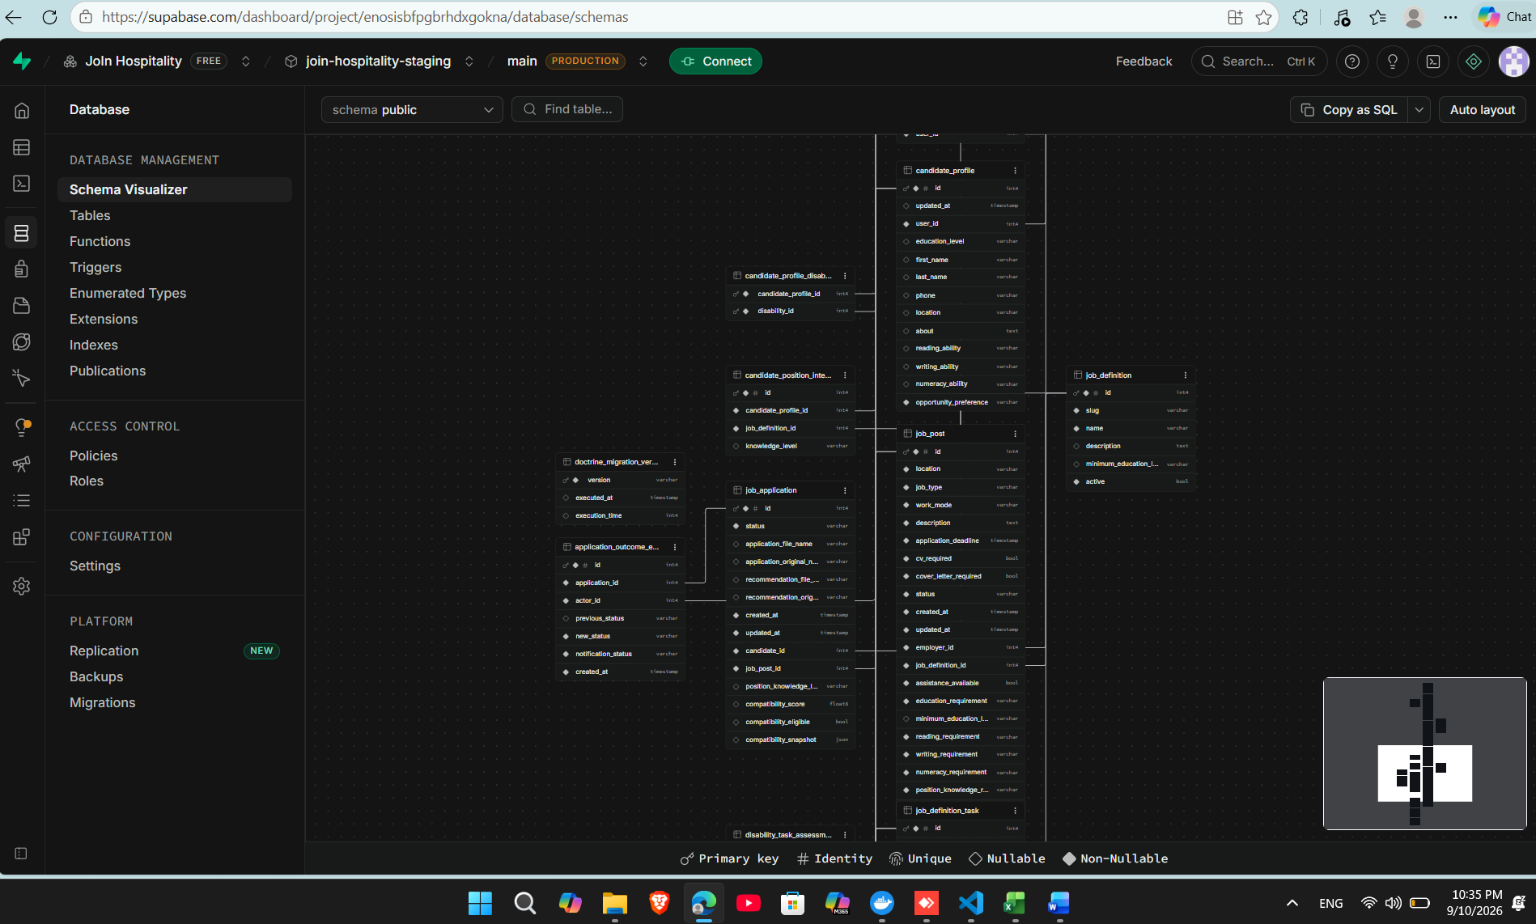
APPENDIX D
Deployed relational model and storage separation
The screenshots provide deployment evidence without exposing credentials or secret values.
Recorded staging data
9 accounts across four roles
15 job definitions
923 controlled tasks
14,453 disability-task assessments
74 published opportunities
INCLUSIVE WEB PLATFORM | FINAL ENGINEERING PRESENTATION | 14 SEP 2026
32
Notes:
Appendix only. Use if the jury asks for database proof, dataset scale or storage isolation.

Slide 33
APPENDIX E
Principal references and evidence locations
Full citations and traceability appear in the submitted final report.
Research and standards
Project evidence
WHO - Disability and Health (1.3 billion / 16%)
ILO - Advancing disability inclusion in the global labour market (2025)
ILOSTAT - Labour market indicators for persons with disabilities
W3C - Web Content Accessibility Guidelines 2.1
Business Disability Forum / Evenbreak candidate survey
Final engineering report - September 2026
JoIn Final Test Register - 310 cases
docs/testing/staging-2026-09-10/
docs/wcag-audit/
render.yaml and staging-deployment branch
https://join-hospitality-zm-staging.onrender.com/
Evidence policy: automated logs, screenshots, human observations and team-confirmed manual cases remain explicitly distinguished.
INCLUSIVE WEB PLATFORM | FINAL ENGINEERING PRESENTATION | 14 SEP 2026
33
Notes:
Appendix only. Use if the jury asks for source traceability.

