Slide 1


Université Saint-Joseph de Beyrouth
Faculté d’Ingénierie et d’Architecture
École Supérieure d’Ingénieurs de Beyrouth
Inclusive Employment Platform: AI-Powered Accessible Recruitment Platform for Persons with Physical Disabilities
Soutenu par :
Zaidan MANSOUR
Charbel RIZK
Département de génie informatique et communications
Génie logiciel
Supervisor(s):
Dr. Jean Yves Youssef
Dr. Roger Obeid
Dr. Rima Kilany
Le 15/9/2026

Slide 2

BUSINESS NEED | REQUIRMENT ELICITATION
Capability and opportunity remain disconnected
1.3B
30% lower
>80%
people experience significant disability worldwide
labour-market participation than persons without disabilities
of 700+ surveyed candidates named identifying inclusive employers as the greatest barrier
The engineering problem is not a lack of ability.
It is the distance between candidates, accessible recruitment processes, structured job tasks, workplace support and employers prepared to evaluate ability.
INCLUSIVE WEB PLATFORM | FINAL ENGINEERING PRESENTATION | 14 SEP 2026
02
Notes:
25 seconds - Zaidan. State the three business numbers and the precise problem: capability and opportunity remain disconnected. The platform reduces recruitment barriers; it does not claim to create jobs.

Slide 3
BACKGROUND RESEARCH | REQUIRMENT ELICITATION
From disability-as-deficit to accessible decision support
01
02
03
04
05
Medical / deficit focus
Social / rights model
Online job portals
AI recruitment
JoIn approach
Recruitment starts from limitation.
Barriers exist in processes and environments.
Visibility increases, but profiles stay generic.
Scale increases, with bias and opacity risks.
Ability-to-task evidence with human control.
Software contribution: change the recruitment interaction and explanation, not the candidate.
INCLUSIVE WEB PLATFORM | FINAL ENGINEERING PRESENTATION | 14 SEP 2026
03
Notes:
20 seconds - Zaidan. Explain the evolution from physical processes to online portals and AI assistance, with new accessibility, privacy and opacity risks.

Slide 4
RESEARCH GAP | REQUIRMENT ELICITATION
Related approaches and the remaining gap
A synthesis of solution categories studied in Phase I and Phase II; not an exhaustive commercial benchmark.
General job platforms
Inclusive job portals
Automated AI screening
Human coaching
Strength: reach and familiar workflows.
Gap: generic profiles and limited disability-specific support.
Strength: targeted visibility and employer awareness.
Gap: listings may not explain task-level feasibility.
Strength: speed and scale.
Gap: data quality, bias, privacy and individual explainability.
Strength: contextual judgement and adaptation.
Gap: intensive case-by-case work is difficult to scale digitally.
Research gap
One accessible workflow joining controlled hospitality tasks, candidate abilities, workplace assistance, explainable matching and human review.
INCLUSIVE WEB PLATFORM | FINAL ENGINEERING PRESENTATION | 14 SEP 2026
04
Notes:
25 seconds - Zaidan. Compare solution categories and identify the integration gap: accessible interaction, task evidence, explainability and human control.

Slide 5
SOFTWARE LIFE CYCLE
An iterative lifecycle with V-model traceability
01
Needs
02
Specification
03
Design
04
Programming
Stakeholders, context, problem
FR, NFR, data, acceptance
Architecture, interfaces, algorithms
Components, integration, configuration
05
Tests + debugging
06
Documentation
07
Deployment + maintenance
08
Conclusion
Static + dynamic V&V
SRS, design, tests, operations
Staging, correction, evolution
Evidence, limits, next cycle
Chosen process: evolutionary prototyping + iterative increments | Quality control: requirement-to-test traceability inspired by the V-model
INCLUSIVE WEB PLATFORM | FINAL ENGINEERING PRESENTATION | 14 SEP 2026
05
Notes:
30 seconds - Zaidan. Name the course lifecycle stages. Explain that JoIn used evolutionary prototyping and iterative increments, with V-model-style requirement-to-test traceability inside each cycle.

Slide 6

NEEDS ELICITATION | REQUIRMENT ELICITATION
Needs came from documents, prototypes and real users
People and stakeholders
Documents and domain sources
Elicitation techniques
Candidates with varied access needs
Employers and hospitality teams
Verifier and administrator roles
Supervisors and institutional context
Phase I artefacts and feedback
WCAG 2.1 and accessibility research
Hospitality job descriptions and tasks
Security, privacy and deployment constraints
Background reading
Iterative prototyping and review
Scenario-based task observation
Arc en Ciel and JAWS evaluation
Needs that shaped the product
Low literacy and digital confidence -> simple flows and voice support
Motor or visual barriers -> keyboard, reflow and assistive-technology support
Privacy and trust -> consent, private evidence and human confirmation
Employer uncertainty -> controlled tasks and explainable compatibility
INCLUSIVE WEB PLATFORM | FINAL ENGINEERING PRESENTATION | 14 SEP 2026
06
Notes:
30 seconds - Zaidan. Present elicitation sources and techniques. The Arc en Ciel and JAWS sessions are later validation evidence, while early prototypes, documents and stakeholder feedback refined the needs.

Slide 7
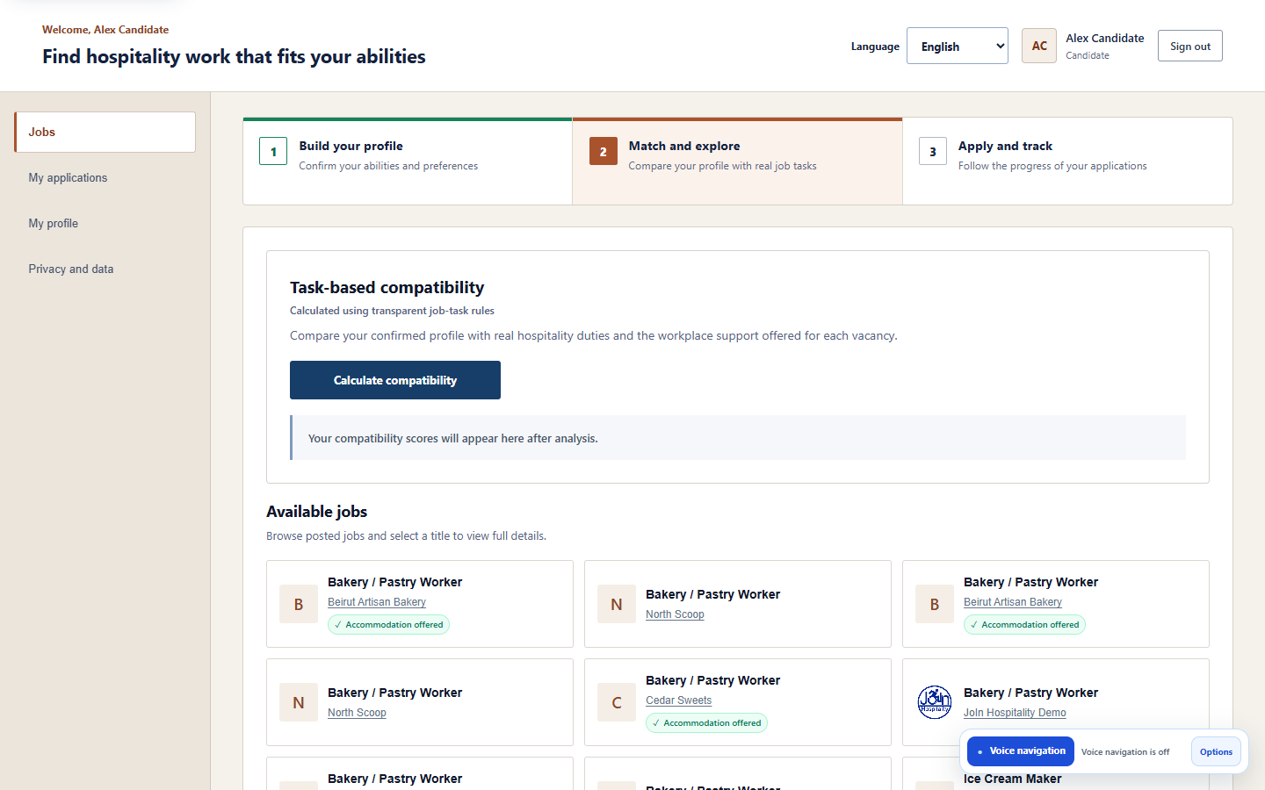
ENGINEERING OBJECTIVES | REQUIRMENT ELICITATION
What Our Phase delivered
4
15
923
14,453
74
3
authorized user roles
hospitality positions
catalogue tasks
task assessments
published opportunities
interface languages
Integrated outcome
Candidate-controlled AI profile assistance
Jobs, hospitality training, or both
Deterministic explainable compatibility
Employer requirements and assistance
Verifier and administrator oversight
English, French and Arabic with RTL
INCLUSIVE WEB PLATFORM | FINAL ENGINEERING PRESENTATION | 14 SEP 2026
07
Notes:
25 seconds - Zaidan. Translate the needs into the delivered scope and engineering scale. The staging figures are implementation evidence, not production or employment-impact claims.

Slide 8
SOFTWARE SPECIFICATION | SPECIFICATIONS
Requirements were measurable, reviewable and traceable
NEED / REQUIREMENT
DESIGN + IMPLEMENTATION
TEST / EVIDENCE
Accessible candidate workflow
Semantic React controls + translated UI
18/18 workflows + JAWS
Role isolation and private evidence
Symfony JWT/RBAC + private storage
51/51 route probes; 19/20 security
Explainable compatibility
Versioned deterministic scoring policy
45/45 staging decisions
Multilingual human-controlled AI
Consent + schema validation + review
60 cases; 53 pass; 7 retained defects
Traceability chain: stakeholder need -> specification -> design decision -> code/service -> test oracle -> retained evidence
INCLUSIVE WEB PLATFORM | FINAL ENGINEERING PRESENTATION | 14 SEP 2026
08
Notes:
30 seconds - Zaidan. State the seven SRS qualities from the course, then trace one example across need, design and test. Requirements describe what and how well, not premature implementation choices.

Slide 9
SOFTWARE SPECIFICATION | SPECIFICATIONS
Functional requirements implemented by role
Candidate
Employer
Register and verify email
Submit private evidence
Build or reset profile
Choose work, training or both
Match, explore and apply
Manage company profile
Publish job or training offer
Set education and abilities
Prioritize tasks and assistance
Review and update applications
Verifier
Administrator
Access authorized requests
Retrieve private evidence
Approve or reject verification
Record auditable decisions
Manage users and catalogue
Import validated role datasets
Inspect jobs and applications
Maintain controlled definitions
INCLUSIVE WEB PLATFORM | FINAL ENGINEERING PRESENTATION | 14 SEP 2026
09
Notes:
25 seconds - Zaidan. Walk across the four actors and their use-case responsibilities. Mention nominal flows, rejected roles and error extensions.

Slide 10
SOFTWARE SPECIFICATION | SPECIFICATIONS
Non-functional requirements and measurable qualities
Accessibility
Security + privacy
WCAG 2.1 AA target
Keyboard and assistive technology
Responsive reflow and reduced motion
Clear status and error recovery
JWT and server-side RBAC
Private documents and bounded uploads
Consent, export, withdrawal and erasure
Audit events without sensitive payloads
Reliability + performance
Maintainability + i18n
Health endpoints and Docker boundaries
Repeatable p50 / p95 measurements
No silent rollback on email failure
Transparent cold-start and latency limits
Component-based React interface
Controller-service-repository backend
Versioned scoring policy
Three locales with stable codes and IDs
INCLUSIVE WEB PLATFORM | FINAL ENGINEERING PRESENTATION | 14 SEP 2026
10
Notes:
25 seconds - Zaidan. Define NFRs as measurable quality constraints and identify the principal trade-off: stronger security and external services can affect response time.

Slide 11
ACCESSIBILITY SPECIFICATION | SPECIFICATIONS
WCAG 2.1 Level AA: target, implementation and evidence
Perceivable
Operable
Understandable
Robust
Labels and alternatives
Structure and headings
Status not based on colour alone
Contrast target
Keyboard workflows
Visible focus
No pointer-only critical path
Reduced-motion support
Consistent navigation
Instructions and linked errors
Confirmation and recovery
Plain-language feedback
Semantic controls
ARIA status / alert patterns
Stable focus management
JAWS-tested workflow
Evidence
18/18 accessibility workflow cases completed | 104 automated route-layout scenarios | JAWS registration and application completed
Honest boundary: 16 scenarios retained axe findings and 2 high-zoom scenarios showed overflow; therefore this is a WCAG 2.1 AA target, not a full conformance claim.
Standard: W3C Web Content Accessibility Guidelines (WCAG) 2.1, Recommendation, Level A and AA success criteria.
INCLUSIVE WEB PLATFORM | FINAL ENGINEERING PRESENTATION | 14 SEP 2026
11
Notes:
35 seconds - Zaidan. Define POUR and Level AA. Show implemented examples and explicitly retain the open contrast and high-zoom findings; this is a target with evidence, not a conformance certificate.

Slide 12
ARCHITECTURAL DESIGN | SOFTWARE DESIGN
Cloud architecture and explicit trust boundaries
Supabase
Symfony API
Voice / profile
React / Vite
PostgreSQL
Private documents
Public employer logos
OpenAI API
JWT + RBAC
Validation
Workflow orchestration
Transcription
Schema-constrained AI
Safe command registry
Static frontend
Role workspaces
i18next + RTL
External provider
No database authority
Replaceable adapter
Scoring service
Deterministic
Versioned rules
Explainable JSON
Shared service tokens protect Symfony-to-Python calls; secrets stay server-side and HTTPS protects public origins.
INCLUSIVE WEB PLATFORM | FINAL ENGINEERING PRESENTATION | 14 SEP 2026
12
Notes:
35 seconds - Zaidan. Walk across the architecture and trust boundaries. React presents; Symfony authorises; storage, scoring and AI services have separate responsibilities.

Slide 13
DETAILED DESIGN | CONCEPTION
Design patterns used to control complexity
The implementation combines patterns at the presentation, application, integration and decision layers.
Layered / MVC
Controller-Service-Repository
Adapter / Gateway
React presentation, Symfony APIs, Doctrine persistence, isolated Python services.
HTTP, orchestration and data access remain separately testable.
OpenAI is accessed through bounded replaceable service contracts.
Strategy / Policy
Command Registry + FSM
Audit + Immutable Snapshot
Versioned weights, assistance factors and eligibility gates.
Allowlisted voice actions and mutually exclusive interaction states.
Consent, verification, status events and score context remain traceable.
Engineering value: lower coupling, safer external AI, reproducible decisions and independent verification.
INCLUSIVE WEB PLATFORM | FINAL ENGINEERING PRESENTATION | 14 SEP 2026
13
Notes:
25 seconds - Zaidan. Connect the patterns to course goals: low coupling, high cohesion, localised change and traceable decisions.

Slide 14
SECURITY DESIGN | CONCEPTION
Sensitive data is controlled by the backend, not the interface
Frontend checks improve usability; Symfony authorization remains decisive for every protected request.
Identity and role isolation
Private evidence and uploads
Consent and auditability
Email verification
JWT via X-Auth-Token
Candidate | Employer | Verifier | Admin
Anonymous, forged and cross-role rejection
Private candidate-verification bucket
Private application documents
Public employer logos only
MIME and size restrictions
Explicit AI consent
No unconfirmed suggestion saved
Export, withdrawal and account erasure
Audited status and verifier decisions
Evidence: 51/51 prerequisite route checks passed | Final security register: 19/20 | Open upload-validation defect retained
INCLUSIVE WEB PLATFORM | FINAL ENGINEERING PRESENTATION | 14 SEP 2026
14
Notes:
30 seconds - Zaidan. Explain backend-controlled RBAC, private evidence, consent and auditability. End with the retained oversized-upload issue.

Slide 15
IMPLEMENTATION QUALITY | PROGRAMMATION
Implementation separated concerns and protected behaviour
Coding was one lifecycle activity: integration, configuration management, refactoring and repeatable tests were developed with it.
Implemented components
Configuration and integration
Refactoring discipline
React/Vite presentation layer
Symfony/Doctrine business boundary
Python deterministic scoring
Python voice/profile assistance
PostgreSQL and object storage
Version-controlled staging branch
Docker service boundaries
render.yaml infrastructure as code
Environment-only secrets and JWT keys
Versioned migrations and datasets
External behaviour preserved
Smaller cohesive services
Adapters localise OpenAI changes
Command registry limits voice actions
Regression tests before and after fixes
Design objective: low coupling, high cohesion and localised change - not simply more source code.
INCLUSIVE WEB PLATFORM | FINAL ENGINEERING PRESENTATION | 14 SEP 2026
15
Notes:
25 seconds - Zaidan. Close the first half: programming included integration, configuration and regression-safe refactoring, not only writing code. Hand over to Charbel.

Slide 16


DEPLOYMENT AND CONFIGURATION | PROGRAMMATION
Render and Supabase staging topology
The deployed system proves multi-service integration over public HTTPS; it is a staging prototype, not a production SLA.
Render Blueprint
Supabase data layer
React static site + Symfony API + voice/profile service + scoring service
SSL PostgreSQL pooler + three purpose-specific storage buckets
INCLUSIVE WEB PLATFORM | FINAL ENGINEERING PRESENTATION | 14 SEP 2026
16
Notes:
20 seconds - Charbel. Show the deployed Render and Supabase topology. render.yaml is configuration management and infrastructure as code; HTTPS supports remote microphone testing.

Slide 17
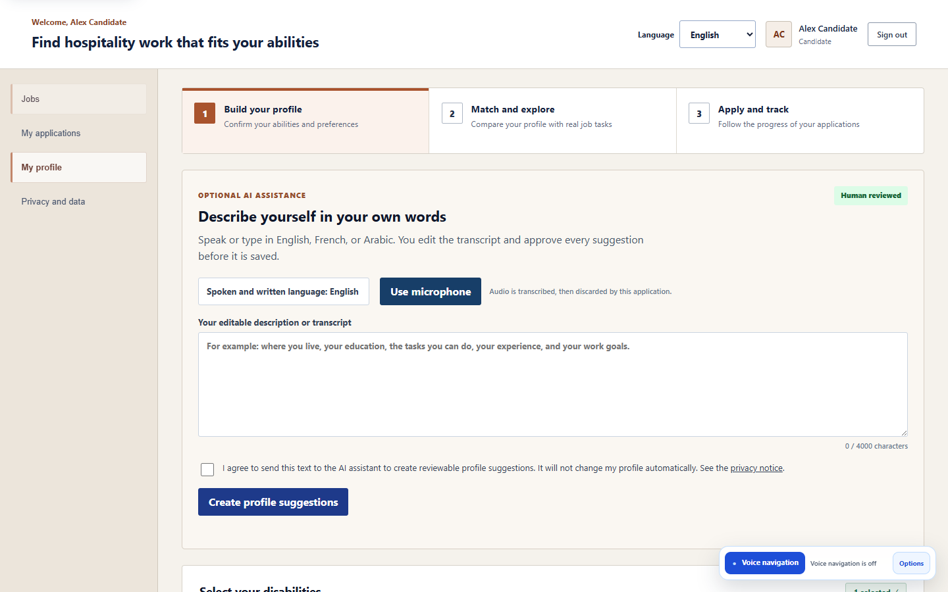
CANDIDATE WORKFLOW | PROGRAMMATION
AI-assisted profile: advisory, consent-gated and reversible
The candidate can type or speak; every AI result remains a suggestion until explicit confirmation.
Describe
Edit transcript
Consent
Interpret
Review
Confirm
Select EN, FR or AR; type or record.
Correct speech-to-text before processing.
Approve sending the text to the assistant.
Return schema-constrained suggestions.
Accept, edit or reject every item.
Symfony validates and saves selected values only.
INCLUSIVE WEB PLATFORM | FINAL ENGINEERING PRESENTATION | 14 SEP 2026
17
Notes:
25 seconds - Charbel. Trace editable text, consent, schema-constrained suggestions, human review and Symfony validation. Nothing is saved without confirmation.

Slide 18
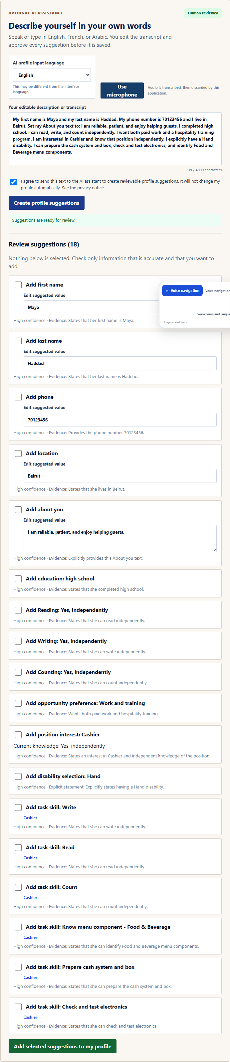
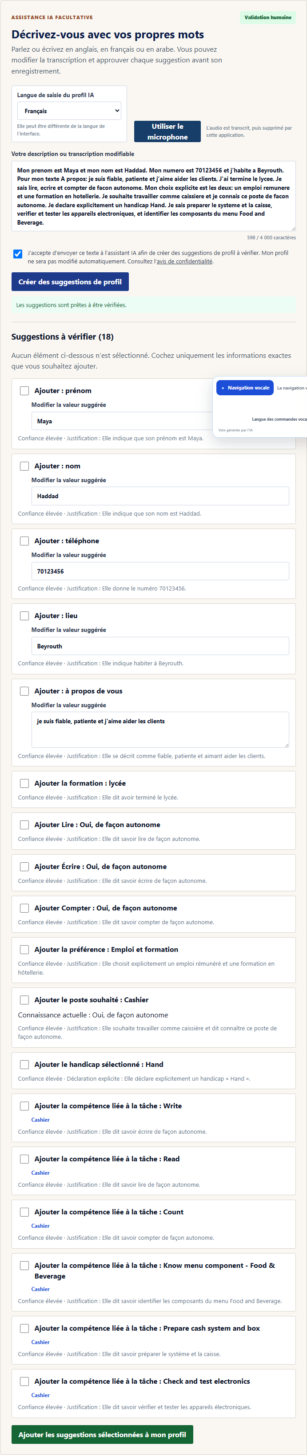

AI EVIDENCE | PROGRAMMATION
Structured suggestions in English, French and Arabic
Sixty gold-standard narratives covered clean and imperfect wording, abilities, preferences, positions, tasks and safety boundaries.
ENGLISH
FRENCH
ARABIC + RTL
53/60 passed (88.3%) | 7 failures retained | Main weakness: explicit Both work-and-training preference could be omitted
INCLUSIVE WEB PLATFORM | FINAL ENGINEERING PRESENTATION | 14 SEP 2026
18
Notes:
20 seconds - Charbel. Give the multilingual AI result: 53 of 60 passed, seven extraction defects retained, and no unsafe automatic persistence.

Slide 19
VOICE INTERACTION | PROGRAMMATION
Bounded voice-navigation execution path
Natural language proposes an action; only the deterministic registry may authorize and execute it.
Record
Transcribe
Classify
Propose
Authorize
Execute
Feedback
WebM / Opus
Whisper-1
Navigate / action / question
Canonical command
Page + role registry
Fixed React behavior
Visual + spoken
Safety boundary
Unregistered routes and cross-role actions are rejected. Submission and reset require confirmation. Context is sanitized and bounded to six turns.
Evidence: 57/57 automated registry/action-safety checks passed. Quiet commands worked reliably; background noise and dictated email characters required correction in some trials.
INCLUSIVE WEB PLATFORM | FINAL ENGINEERING PRESENTATION | 14 SEP 2026
19
Notes:
30 seconds - Charbel. Separate transcription quality from action safety. The deterministic registry authorises commands; noise and dictated character sequences sometimes require correction.

Slide 20
DECISION ALGORITHM | PROGRAMMATION
Deterministic compatibility: explainable by construction
Matching uses controlled expert assessments rather than a learned model trained on unavailable employment outcomes.
Task score
Sum(adjusted weight x feasibility factor)
Sum(adjusted weight) x 100
Feasibility: 1.00 feasible | 0.75 with offered assistance | 0.00 avoid
Important task multiplier: 1.5
Practical abilities: 25% and education: 10% when configured
Unsafe mandatory tasks and required abilities remain explicit gates
45 / 45
staging formula, eligibility and determinism cases passed
INCLUSIVE WEB PLATFORM | FINAL ENGINEERING PRESENTATION | 14 SEP 2026
20
Notes:
35 seconds - Charbel. Explain the deterministic formula, feasibility factors and explicit gates. Forty-five of forty-five staging decisions matched their expected oracle.

Slide 21

EMPLOYER WORKFLOW | PROGRAMMATION
From controlled role to published job or training program
Employers configure the real opportunity; the catalogue supplies consistent tasks and matching inputs.
Choose type
Choose role
Load tasks
Set requirements
Set support
Publish
Job or hospitality training
One of 15 controlled positions
Approved catalogue duties
Education and practical abilities
Important tasks and assistance
Backend validation and matching
INCLUSIVE WEB PLATFORM | FINAL ENGINEERING PRESENTATION | 14 SEP 2026
21
Notes:
20 seconds - Charbel. Employers choose a controlled role, then configure actual requirements, priority tasks and available assistance for work or training.

Slide 22
INTEGRATED WORKFLOW | PROGRAMMATION
Human-controlled recruitment and auditable outcomes
Each role contributes a bounded decision; no single AI response creates an employment outcome.
Candidate
Compatibility
Application
Employer
Outcome audit
Verified profile
Interests + abilities
Chooses opportunity
Deterministic score
Task explanation
Eligibility gates
Candidate confirms
Documents stay private
Snapshot recorded
Reviews application
Changes status
Offers human decision
Previous/new status
Actor + timestamp
Notification result
Verifier authorizes disability-card evidence | Administrator maintains controlled catalogues and users
INCLUSIVE WEB PLATFORM | FINAL ENGINEERING PRESENTATION | 14 SEP 2026
22
Notes:
20 seconds - Charbel. Trace candidate, compatibility, application, employer decision and immutable audit history.

Slide 23
TESTS ET MISE AU POINT
Verification and validation across the lifecycle
Verification asks whether specifications were implemented correctly; validation asks whether the right system was built for users and context.
Static and contract checks
Schemas, translations, syntax, routes and build
Service and decision tests
57/57 voice/action safety + 17/17 scoring
Browser end-to-end and integration
26/26 browser scenarios + 25/25 API checks
Cloud staging quality register
310 planned and executed cases across ten areas
Human and assistive-technology evaluation
20-person Arc en Ciel session + separate JAWS workflow
INCLUSIVE WEB PLATFORM | FINAL ENGINEERING PRESENTATION | 14 SEP 2026
23
Notes:
30 seconds - Charbel. Define verification versus validation, then show the layered static, service, integration, system and human evidence. Testing was planned from the specifications.

Slide 24
TESTS ET MISE AU POINT
All 310 planned staging cases were completed
The register preserves first-run failures and noisy partials instead of hiding them behind the final result.
First execution
93.2%
274
15
21
passed directly
partial in noisy transcription
failed and retained
FINAL PASS RATE
289 final passes
21 retained failures
0 blocked / not run
Retest interpretation
The 15 noisy cases passed after repetition or manual correction. Failures were not silently reclassified; they remain visible in the workbook and report.
Evidence: JoIn Final Test Register - Master Register, Dashboard, Defects and Evidence Index.
INCLUSIVE WEB PLATFORM | FINAL ENGINEERING PRESENTATION | 14 SEP 2026
24
Notes:
30 seconds - Charbel. Lead with all 310 executed. Explain 274 first passes, 15 noisy partials corrected on repetition or editing, 21 retained failures and 289 final passes: 93.2 percent.

Slide 25
MESURES ET METRIQUES
Results by engineering test area
Final pass rate is useful only when read together with each area, target and open defect.
AI profile suggestions
88.3%
Security + privacy
95.0%
Voice transcription
100.0%
Accessibility
100.0%
Voice navigation
100.0%
Multilingual + RTL
100.0%
Matching engine
100.0%
Browser + device
100.0%
Complete workflows
100.0%
Performance + reliability
51.9%
Read the pattern, not only the average
Strong functional correctness and language coverage. Improvement work is concentrated in AI preference extraction, one upload behavior, and staging latency under load.
INCLUSIVE WEB PLATFORM | FINAL ENGINEERING PRESENTATION | 14 SEP 2026
25
Notes:
25 seconds - Charbel. Do not read every rate. Seven areas reached 100 percent; AI, security and especially performance define the remaining work.

Slide 26
MISE AU POINT
Testing produced actionable defects, not only pass counts
A final-year engineering project should explain what failed, why it matters and what should change next.
AI preference extraction
Contrast and zoom reflow
Oversized upload behavior
Explicit Both work-and-training wording was intermittently omitted.
Helper text contrast and high-zoom candidate header overflow need remediation.
PHP could drop the file while an application record was still created.
Write-operation latency
Free-tier cold starts
Acoustic robustness
Publishing and application p95 exceeded the one-second target in four cases.
Healthy services may require warm-up; temporary 503s were observed.
Noise and dictated email characters can require repetition or editing.
Engineering response: preserve failures, prioritize by risk, correct, retest and retain traceable evidence.
INCLUSIVE WEB PLATFORM | FINAL ENGINEERING PRESENTATION | 14 SEP 2026
26
Notes:
20 seconds - Charbel. A successful test campaign exposes defects. Link each finding to corrective work and non-regression retesting.

Slide 27


VALIDATION UTILISATEUR
The platform was evaluated with its intended users
Human evidence complements automated checks; photographs document sessions but do not prove universal accessibility.
JAWS evaluation
Arc en Ciel: 20 participants
Accessibility in context
Noelle completed navigation, registration and job-application interaction on her adapted device.
Users with different needs interacted with the main platform workflows in a real setting.
Simple steps, Arabic support and voice assistance helped broaden participation.
INCLUSIVE WEB PLATFORM | FINAL ENGINEERING PRESENTATION | 14 SEP 2026
27
Notes:
30 seconds - Charbel. Distinguish the 20-person Arc en Ciel session from Noelle Marie Gabrielle's JAWS workflow. These validate relevance for tested users, not universal accessibility.

Slide 28
MESURES ET METRIQUES
Functionality held; free-tier latency did not always meet the target
Availability and response-time quality were evaluated separately.
Functional reliability
Latency and dependency limits
144 / 144
96 / 96
3 / 9
4 / 6
shared-load responses succeeded with zero 5xx
publish/application mutations returned HTTP 201
shared-load latency cases met threshold
write p95 checks exceeded one second
The deployed services produced the expected functional output after health warm-up.
Free-service cold starts and external AI availability remain staging constraints. Local bundle budgets passed after removing a blocking external font request.
Conclusion: functionally usable staging evidence, but no production availability or capacity claim.
INCLUSIVE WEB PLATFORM | FINAL ENGINEERING PRESENTATION | 14 SEP 2026
28
Notes:
25 seconds - Charbel. Apply the course measurement process: define objective, method and reference. Correctness held under shared load, but latency targets exposed free-tier limits.

Slide 29
ESTIMATION DU COUT ET MAINTENANCE
Cost is effort plus infrastructure, external services and change
The prototype used free staging resources; production planning must estimate both fixed engineering effort and variable operational demand.
Estimation approach
Main cost drivers
Controls and trade-offs
Bottom-up by subsystem and lifecycle activity
Cross-check with analogous deployments
Use scenarios for active users and AI calls
No unsupported COCOMO claim without calibrated effort history
Human engineering and verification effort
Non-sleeping compute and managed database
Storage, email and monitoring
OpenAI transcription and structured suggestions
Accessibility and security maintenance
Per-user daily AI and voice quotas
Rate limits, cooldowns and budget alerts
Lower-cost model routing and manual fallback
Measure queries before caching
Cache only repeated non-sensitive reads
Maintenance categories: corrective defects | adaptive provider/platform change | perfective features | preventive refactoring and monitoring
INCLUSIVE WEB PLATFORM | FINAL ENGINEERING PRESENTATION | 14 SEP 2026
29
Notes:
35 seconds - Charbel. Define cost as engineering effort plus infrastructure, external services and maintenance. Explain bottom-up subsystem estimates, usage scenarios, AI quotas and why a general cache was deferred.

Slide 30
DOCUMENTATION
Every lifecycle stage produced a reviewable artefact
Documentation supports communication, verification, change control, deployment and future maintenance.
Needs + SRS
Design
Implementation
V&V evidence
Operations
Report requirements
FR/NFR + WCAG
Architecture
Data + flows + patterns
Source + migrations
render.yaml + Docker
Test register
JSON + screenshots
Deployment guide
Limits + recovery
Repository evidence audit
26 engineering Markdown documents | 40 JSON evidence files | 181 PNG evidence images | final report + 310-case workbook
INCLUSIVE WEB PLATFORM | FINAL ENGINEERING PRESENTATION | 14 SEP 2026
30
Notes:
25 seconds - Charbel. Show the artefact chain from needs to operations. Documentation and evidence support communication, reproduction, maintenance and change control.

Slide 31
CONCLUSION
A validated bridge from ability to opportunity
The project demonstrates technical feasibility and practical relevance while keeping its limitations explicit.
Delivered
5-minute demonstration
+ Four protected role workflows
+ Multilingual and RTL interface
+ Candidate-controlled AI and voice assistance
+ Deterministic task-level matching
+ Jobs and hospitality training programs
+ Render/Supabase cloud staging
+ 310-case register plus human validation
00:00 Candidate profile + consent
01:00 Match score + explanation
02:00 Employer job/training workflow
03:00 Verifier/admin + deployment evidence
04:00 Language, keyboard and voice path
If the paid AI dependency is unavailable, use the retained multilingual screenshots and continue the deterministic live workflows.
INCLUSIVE WEB PLATFORM | FINAL ENGINEERING PRESENTATION | 14 SEP 2026
31
Notes:
20 seconds - Charbel. Conclude with the delivered engineering contribution and limitations, then transition directly to the five-minute demonstration.

Slide 32

Thank you
Questions?
https://join-hospitality-zm-staging.onrender.com/
Accessible recruitment | Explainable matching | Human control
Notes:
Leave this slide visible during questions. Slides 33 to 37 are hidden appendix evidence.

Slide 33
APPENDIX A
Detailed 310-case verification register
Backup evidence for jury questions; excluded from the timed presentation.
TEST AREA
EXECUTED
FINAL PASS
FAIL
FINAL RATE
AI Profile Suggestions
60
53
7
88.3%
Voice Transcription
30
30
0
100.0%
Voice Navigation
60
60
0
100.0%
Matching Engine
45
45
0
100.0%
Complete Workflows
20
20
0
100.0%
Security and Privacy
20
19
1
95.0%
Accessibility
18
18
0
100.0%
Multilingual and RTL
18
18
0
100.0%
Browser and Device
12
12
0
100.0%
Performance and Reliability
27
14
13
51.9%
TOTAL
310
289
21
93.2%
First run: 274 pass, 15 partial noisy-transcription cases and 21 fail. The 15 partials passed after repetition or manual correction.
INCLUSIVE WEB PLATFORM | FINAL ENGINEERING PRESENTATION | 14 SEP 2026
33
Notes:
Appendix only. Use if the jury asks for the exact denominator and per-area counts.

Slide 34
APPENDIX B
Selected WCAG 2.1 AA evidence mapping
Representative criteria; the complete matrix remains in the report and WCAG audit evidence.
CRITERION
REQUIREMENT
PLATFORM EVIDENCE / BOUNDARY
1.1.1 / 1.3.1
Text alternatives; information and relationships
Semantic headings, labels, descriptions and image alternatives
1.4.3
Contrast (minimum)
Implemented generally; helper-text contrast finding remains open
1.4.10 / 1.4.12
Reflow and text spacing
320-1440 px and spacing tests; two high-zoom overflow cases retained
2.1.1
Keyboard
Critical candidate, employer, verifier and admin workflows completed
2.4.3 / 2.4.7
Focus order and visible focus
Logical tab order, focused recovery and visible focus treatment
3.2 / 3.3
Predictability and input assistance
Consistent navigation, instructions, validation and confirmation
4.1.2 / 4.1.3
Name, role, value and status messages
Native controls plus accessible status / alert announcements
Manual AT evidence
JAWS workflow
Navigation, registration and application completed on adapted device
Conformance statement: target and evidence only; an independent audit and closure of open findings are required before claiming full WCAG 2.1 AA conformance.
INCLUSIVE WEB PLATFORM | FINAL ENGINEERING PRESENTATION | 14 SEP 2026
34
Notes:
Appendix only. Use if the jury asks which specific WCAG success criteria were considered.

Slide 35
APPENDIX C
Verified voice trace and rejected-command example
Illustrative redacted console structure using the implemented labels and registered actions.
[VOICE AUDIO] Exact uploaded recording: { type: audio/webm;codecs=opus, bytes: 18432, durationMs: 2300 }
[VOICE STT] Transcript: Open my profile
[VOICE CLASSIFIER] Category: { category: navigation, language: en, confidence: 0.99 }
[VOICE INTENT] Proposal: { command: NAVIGATE, target: candidate_profile, language: en }
[VOICE ROUTER] Decision: { status: authorized, action: { type: route_and_tab, value: /candidate, tab: PROFILE } }
[VOICE FEEDBACK] Text: Opening your profile.
Rejected example: Open the secret admin page -> target absent from candidate registry -> no action executed.
Raw audio bytes and API keys are not logged. Sensitive values are redacted. Request IDs correlate the bounded pipeline stages.
INCLUSIVE WEB PLATFORM | FINAL ENGINEERING PRESENTATION | 14 SEP 2026
35
Notes:
Appendix only. Use if the jury asks how a natural-language command becomes a controlled React action.

Slide 36
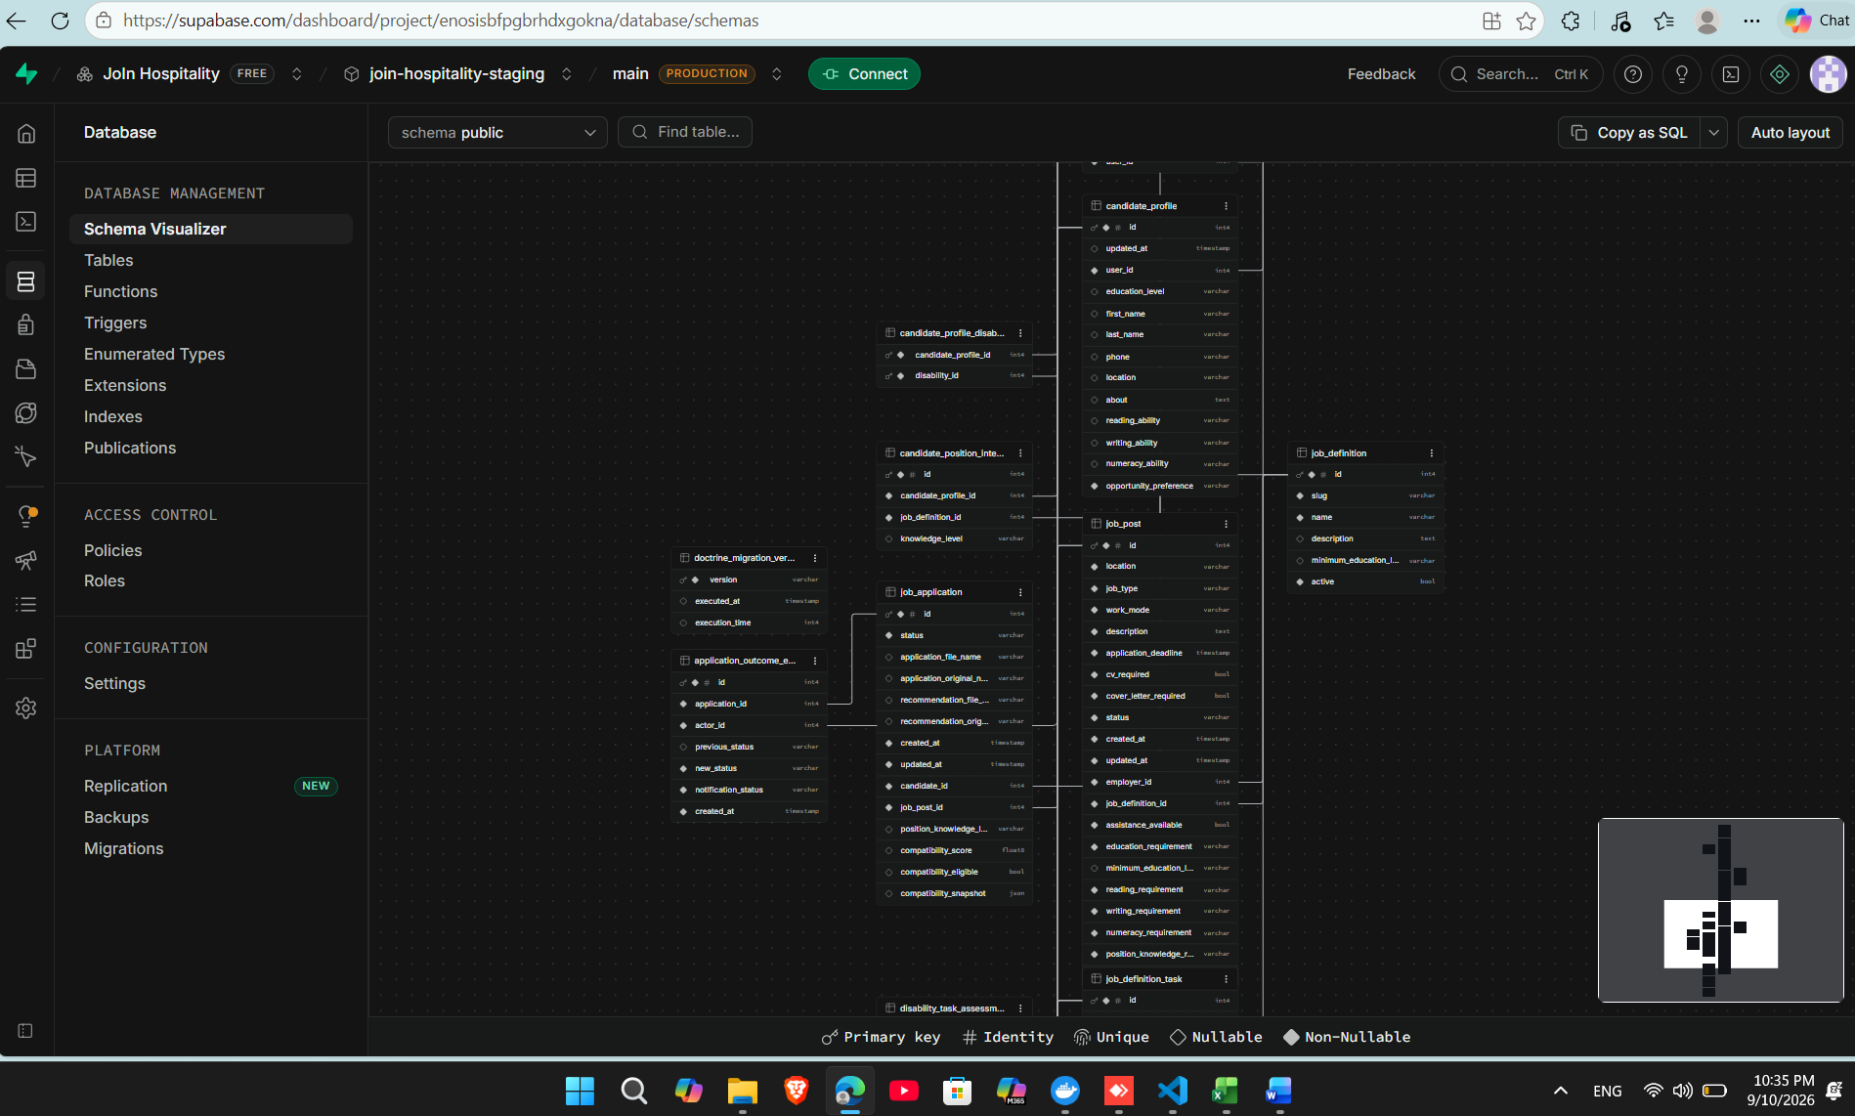
APPENDIX D
Deployed relational model and storage separation
The screenshots provide deployment evidence without exposing credentials or secret values.
Recorded staging data
9 accounts across four roles
15 job definitions
923 controlled tasks
14,453 disability-task assessments
74 published opportunities
INCLUSIVE WEB PLATFORM | FINAL ENGINEERING PRESENTATION | 14 SEP 2026
36
Notes:
Appendix only. Use if the jury asks for database proof, dataset scale or storage isolation.

Slide 37
APPENDIX E
Principal references and evidence locations
Full citations and traceability appear in the submitted final report.
Research and standards
Project evidence
WHO - Disability and Health (1.3 billion / 16%)
ILO - Advancing disability inclusion in the global labour market (2025)
ILOSTAT - Labour market indicators for persons with disabilities
W3C - Web Content Accessibility Guidelines 2.1
Business Disability Forum / Evenbreak candidate survey
Final engineering report - September 2026
JoIn Final Test Register - 310 cases
docs/testing/staging-2026-09-10/
docs/wcag-audit/
render.yaml and staging-deployment branch
https://join-hospitality-zm-staging.onrender.com/
Evidence policy: automated logs, screenshots, human observations and team-confirmed manual cases remain explicitly distinguished.
INCLUSIVE WEB PLATFORM | FINAL ENGINEERING PRESENTATION | 14 SEP 2026
37
Notes:
Appendix only. Use if the jury asks for source traceability.

