Slide 1
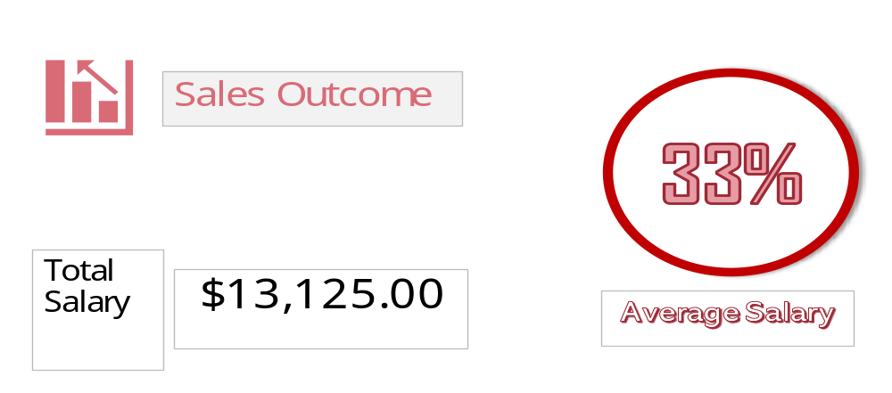
Sum of Deal Value ($)
$706,195
Alex
Alice
Bob
Charlie
Chris
Craig
Darren
David
Diana
Emma
Evan
Grace
Ian
Jake
James
Josh
Karol
Liam
Melissa
Mimi
Molly
Paul
Richard
Rick
Vicky
Will
Average of Call Drop Rate (%)
4.99%
63%
Call Drop %

