Slide 1
DEEP LEARNING
Waste Image Classification
MobileNetV2 transfer learning on TrashNet
Student Name · Roll Number
Notes:
Start by saying your name, your roll number, and that this is your Deep Learning semester project. The title is waste image classification. Say that the network is MobileNetV2, fine-tuned on the public TrashNet dataset, and that the rest of the talk covers the data, the training setup, the test numbers, and where the weights live.

Slide 2
The decision this model makes
• Recycling works when cardboard, paper, plastic, glass, and metal are separated.
• The model looks at one photograph and chooses one of six classes.
• The sixth class, trash, is residual material that does not fit the other five.
• The result is a semester demo with downloadable weights, not a plant controller.
Notes:
Explain the problem in plain language. Recycling depends on separating cardboard, paper, plastic, glass, and metal. The model takes one photograph and picks one of those classes, or trash when the object does not fit. Pause, then say clearly that this is a course demo with published weights, not a system that should run a sorting plant.

Slide 3
What the project delivers
• A public secondary dataset, TrashNet, with a fixed stratified split.
• A fine-tuned MobileNetV2 checkpoint and a matching ONNX file.
• predict.py, which prints class probabilities for one image.
• A Vercel page with the demo, this deck, and the written report.
Notes:
Walk through the four deliverables. First, TrashNet with a fixed split. Second, the MobileNetV2 checkpoint and the ONNX file made from it. Third, predict.py, so a test script can score one image. Fourth, the Vercel page, which shows the demo, the report, and this presentation.

Slide 4
TrashNet
• Gary Thung and Mindy Yang, Stanford CS 229. Resized JPEGs, 512×384.
• 2527 images: cardboard 403, glass 501, metal 410, paper 594, plastic 482, trash 137.
• Stratified split, seed 42: 1768 train, 379 validation, 380 test.
• Objects sit on a plain posterboard. That is both why the task is learnable and why wild photos are harder.
Notes:
Credit Gary Thung and Mindy Yang. Say the resized set has 2527 photographs, with trash the smallest class at 137 images. Give the split: 1768 train, 379 validation, 380 test, seed 42. Mention the plain posterboard background, because that fact explains both the accuracy and the limitation you will come back to.

Slide 5
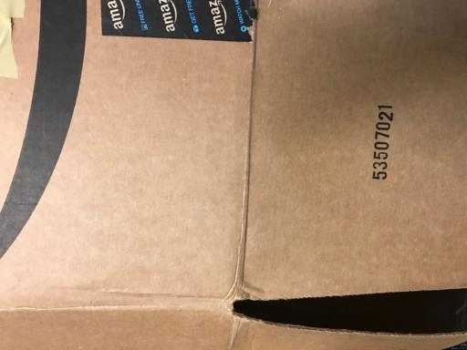
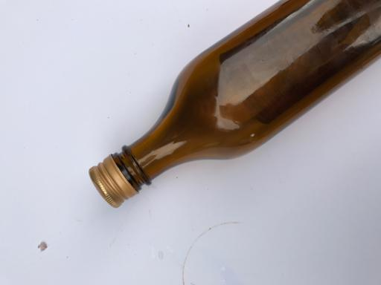
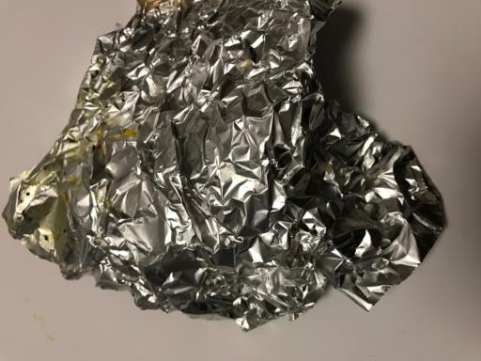

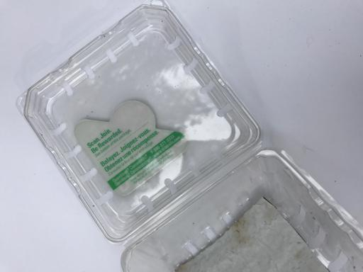
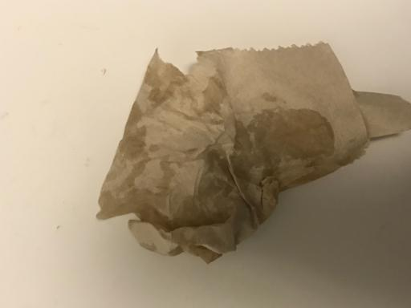
One test image from each class
cardboard
glass
metal
paper
plastic
trash
Notes:
Point across the six photos: cardboard, glass, metal, paper, plastic, and trash. Say these are held-out test images the trained model classified correctly, kept in the repository so the website has something to click. Mention that every photo is a single object on a light background.

Slide 6
MobileNetV2 with a six-way head
• ImageNet-1K initialization, then a new linear layer with 6 outputs.
• Inverted residual blocks: expand, depthwise 3×3, linear project.
• 2,231,558 parameters. Small enough for Git and for the browser.
• Input 224×224 after a shorter-side resize to 256 and a center crop. Output is logits.
Notes:
Name MobileNetV2 and the ImageNet initialization. In one sentence, describe an inverted residual: expand, depthwise filter, project back down. Say the old 1,000-way layer was replaced by a 6-way layer, and the network has 2,231,558 parameters. Close with the input recipe: shorter side to 256, center crop 224, ImageNet normalization, logits out.

Slide 7
Two-phase fine-tuning
• Device: NVIDIA GeForce RTX 5070. Batch size 32. Adam, weight decay 0.0001.
• Loss: class-weighted cross-entropy. Trash receives the largest weight.
• Head only, then feature blocks from index 14. 17 epochs ran.
• Best validation accuracy 88.39%. Test labels were not used to pick the epoch.
Notes:
Say training used NVIDIA GeForce RTX 5070 and Adam. Mention class weights, because trash would otherwise be ignored. Describe the two phases: classifier head first, then the later feature blocks. Say 17 epochs ran and the best validation accuracy was 88.39%. Stress that the test set did not choose the checkpoint.

Slide 8
Held-out test results
88.68% accuracy 88.83% macro F1
Class | Precision | Recall | F1 | Support
cardboard | 96.49% | 91.67% | 94.02% | 60
glass | 93.85% | 80.26% | 86.52% | 76
metal | 80.82% | 95.16% | 87.41% | 62
paper | 92.94% | 88.76% | 90.80% | 89
plastic | 79.76% | 91.78% | 85.35% | 73
trash | 100.00% | 80.00% | 88.89% | 20
Notes:
Read the headline slowly: test accuracy 88.68%, macro F1 88.83%. Explain that macro F1 averages the six classes, so a rare class still counts. Then say cardboard has the highest F1 at 94.02% on 60 test images, and plastic has the lowest at 85.35% on 73 images.

Slide 9
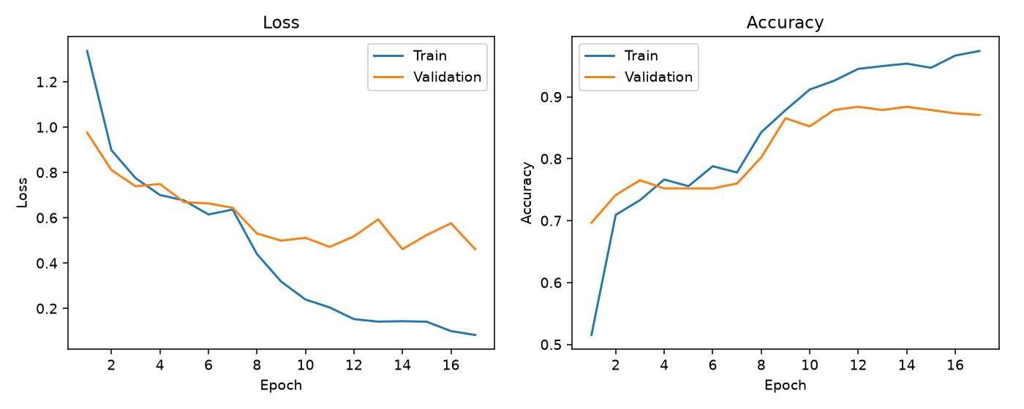
Learning curves
Notes:
Describe the plots. The left panel is loss and the right panel is accuracy, for train and validation. Say the curve flattens, which is why early stopping kept the best validation epoch instead of the last one.

Slide 10
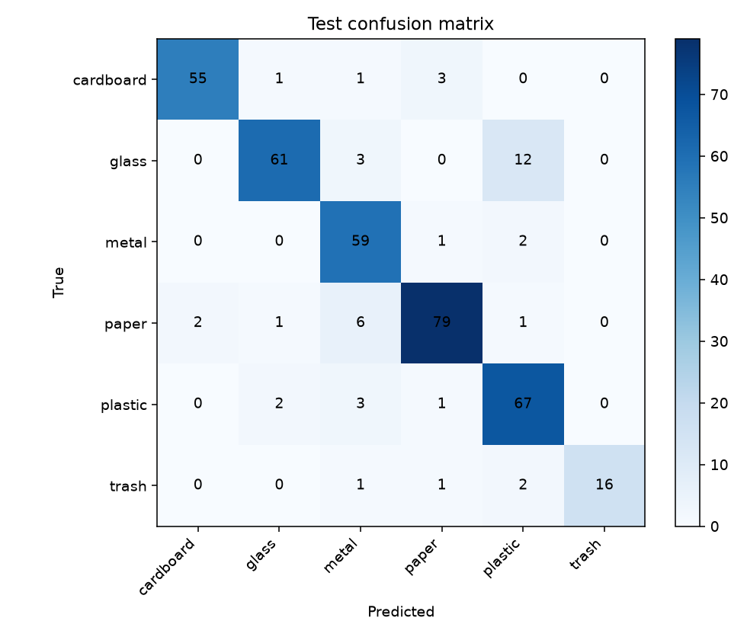
Where the errors go
The largest confusions were 12 glass images predicted as plastic; 6 paper images predicted as metal; 3 cardboard images predicted as paper.
Notes:
Tell the audience that rows are the true class and columns are the prediction. Then read this sentence: The largest confusions were 12 glass images predicted as plastic; 6 paper images predicted as metal; 3 cardboard images predicted as paper. Add that glass, plastic, and metal are the mix-ups you would expect from reflective or transparent objects.

Slide 11
What an evaluator can download
• weights/model.pth — load state_dict with build_model() from model.py.
• weights/model.onnx — the file the Vercel page runs in the browser.
• predict.py --image <path> prints JSON with the class and six probabilities.
• Class order is cardboard, glass, metal, paper, plastic, trash.
Notes:
This is the slide to slow down on if the evaluation is automated. Say the PyTorch file is weights/model.pth, the browser file is weights/model.onnx, and model.py rebuilds the architecture. Read the class order once: cardboard, glass, metal, paper, plastic, trash. Mention predict.py as the command that prints probabilities for a single image.

Slide 12
What this model should not be asked to do
• TrashNet backgrounds are plain. A real bin is a different problem.
• Glass, plastic, and metal reflect light, so they trade errors.
• Trash has only 137 images in the whole dataset.
• Do not use the demo to decide whether waste is hazardous.
Notes:
Be direct. The training photos use a clean background, so a picture of a real bin can fail. Trash has only 137 images, so that score moves around. End by saying the demo must not be used to judge hazardous waste.

Slide 13
Links and closing
• Dataset: github.com/garythung/trashnet
• GitHub: [GitHub URL — add this before submission]
• Vercel: [Vercel URL — add this before submission]
• YouTube: [YouTube URL — add this before submission]
• LinkedIn: [LinkedIn URL — add this before submission]
Notes:
Read the dataset credit, then the GitHub, Vercel, YouTube, and LinkedIn links if they are already filled in. If a link is still a placeholder, say it will be on the submission form. Thank the audience and stop.

