Slide 1




DATA ANALYST USECASE
Pablo ATALAYA

Slide 2
I/ User Acquisition : Main KPIs
Need synthetic KPI’s for a population of 1 to N individuals
We want our KPI’s :
Does not reduce too much the information and heterogeneity of a cohort (Keep distribution KPI's, median, ,…)
Allow us to compare populations registered at the “same period” (Example : “Does revenue better for SEO than SEA this year ?”, “Does mean acquisition cost higher for SEA than Affiliation?... )
Allow comparisons over time for different seniority cohorts (Example : “Are the income projections better for the 2020 cohort compared to 2019?” )

Slide 3
I/ User Acquisition : Main KPIs
Basic KPI’s of a campaign
New_clients
Total Revenue
Mean Revenue
Total Acquisition Cost
Mean Acquisition Cost
Total Profit : Total Revenue – Total Cost
Mean Profit
Revenue KPI’s : keys data but imperfect (censored by time, variability, outliers,…) need to introduce other indicators to complete “revenue vision”
Acquisition_Cost KPI’s : Acquisition are fixed over time (once paid) and these data are sufficient for the "cost revenue vision"

Slide 4
I/ User Acquisition : Main KPIs
Revenue is imperfect for many reasons :
Truncated data (we don’t know future revenues) => Difficulty to compare old and new cohorts (old cohorts have “more value”)
=> We introduce Mean_revenue after 1month, 2 months, 6 months, etc… to compare performance cohorts from their beginning
=> Cash_Balance_Category to try to anticipate the future activity or inactivity
Variability of revenue
=> It’s betting and sometimes, the activity is well but results are wrong
We take into account a new variable => Betting_Amount
Outliers effects and mean
=> We introduce quantiles of Mean_Revenue : Median_Revenue
Complete “revenue vision”

Slide 5
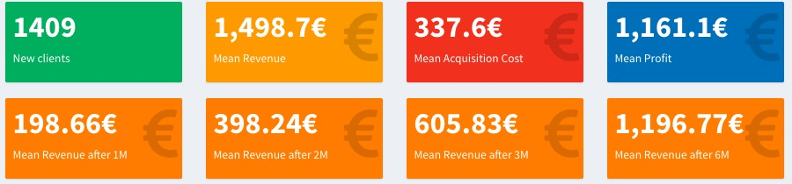
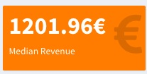
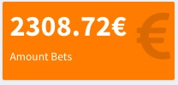

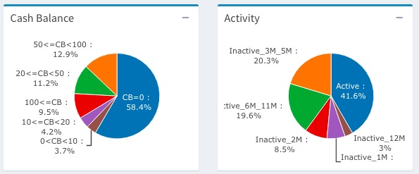
I/ User Acquisition : Main KPIs
Summary

Slide 6
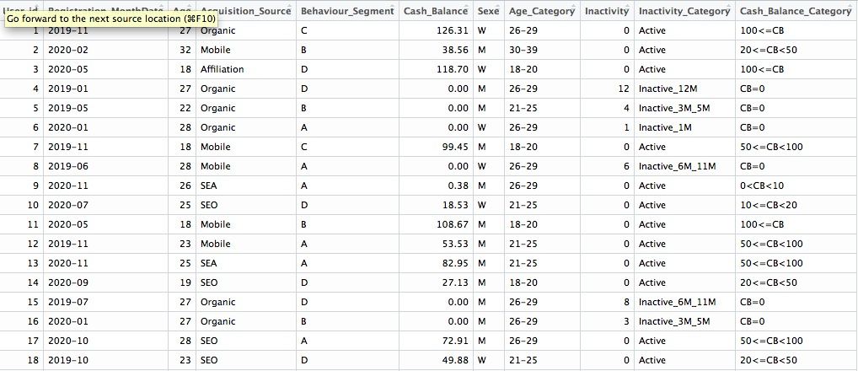
I/ User Acquisition : Main KPIs
Table User
Cash_Balance_Category
Inactivity_Category : ‘active’ (active next month),’inactive_1M’ (inactive from 1M), ‘inactive_2M’, ’inactive_3M_5M’, ‘inactive_6M_11M)

Slide 7
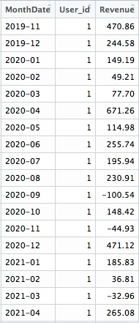

I/ User Acquisition : Main KPIs
Table User
Amount bets

Slide 8
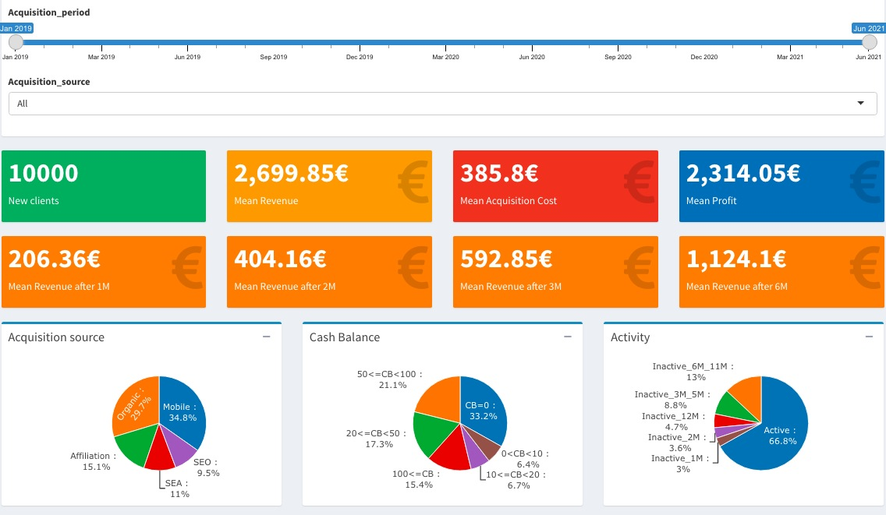
I/ User Acquisition : Data Viz
I created a small example of dashboard to represent main KPI’s
https://bva-data-viz.shinyapps.io/appli_shiny/

Slide 9
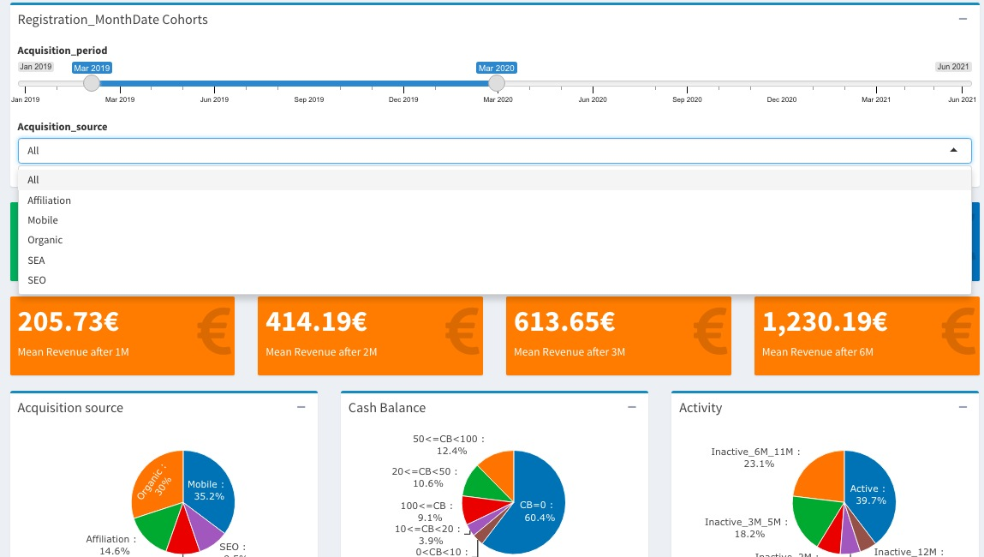
I/ User Acquisition : Data Viz
We can visualize main KPIS defined previously in the 2 main dimensions :
By selected acquisition periods of our choice
By traffic sources (all or specifically)

Slide 10
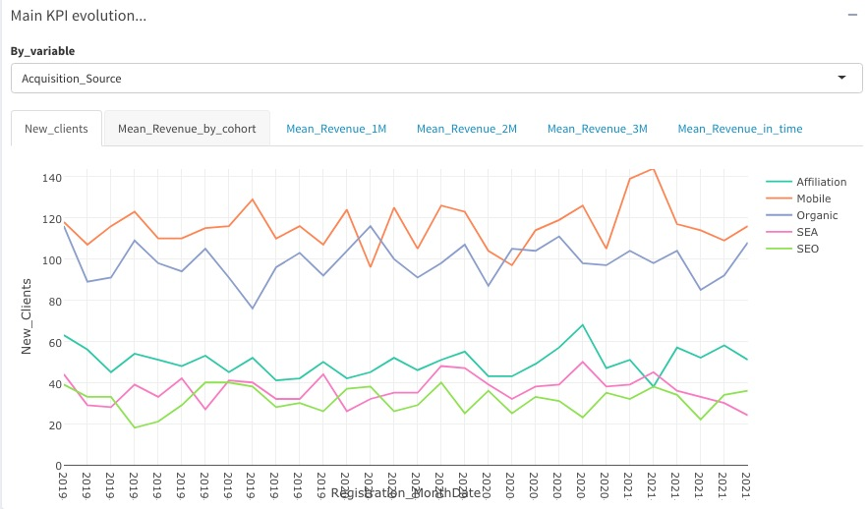
I/ User Acquisition : Data Viz
We can visualize the evolution of the main KPIs, globally or crossed by any variable (sex, age, behavior_segment, cash_balance_category, ...)

Slide 11
I/ User Acquisition : Data Viz

Slide 12
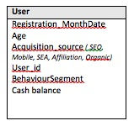
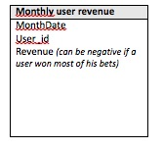
I/ User Acquisition : SQL request
Monthly activities recorded*
(1,n)
Activity belongs user …
1
* Important : We consider that all the months of activity are recorded even if the bets or the revenue are 0 for all the months between "Registration_MonthDate" and the month of today.

Slide 13
I/ User Acquisition : SQL request
2 examples of requests allowing to calculate KPIs and to see their evolution.
New clients KPI and evolution
select Registration_MonthDate, count(distinct user_id) as New_Clients from user
group by Registration_MonthDate
order by Registration_MonthDate;
Mean Revenue generated by Registration cohorts
select a.Registration_MonthDate, round(avg(b.Revenue),2) as Revenue from user a
left join (select User_id, sum(Revenue) as Revenue from monthly_user_revenue group by User_id) b
on a.User_id = b.User_id
group by Registration_MonthDate;

Slide 14
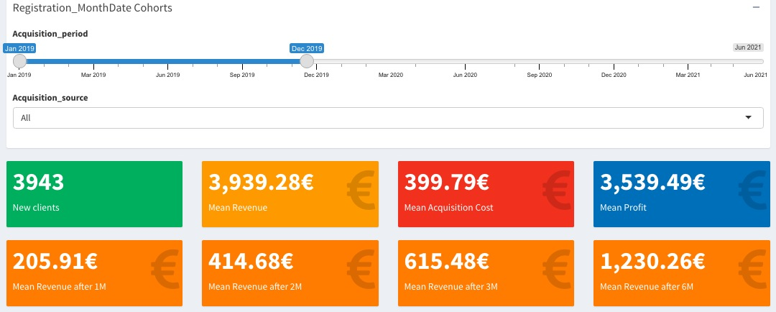
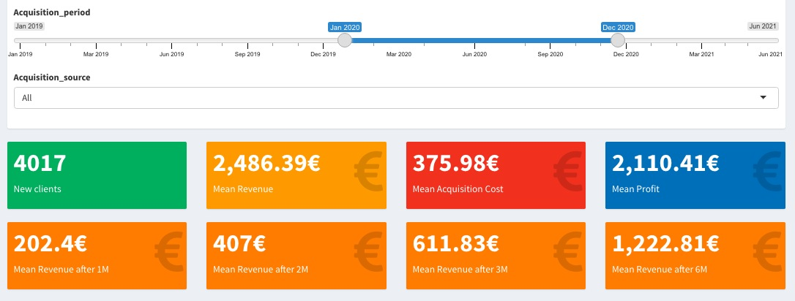
I/ User Acquisition : First Analysis
In this first example of analysis, we compare the performance of the 2019 acquisition cohort versus the 2020 cohort for simulated data
Number of new clients stable (3943 for 2019, 4017)
Good profit for the 2 cohorts !
Near mean cost acquisition
Average mean revenue and so mean profit is better for 2019 then 2020
Looking the Mean_Revenue at 1, 2 months, 3 and 6months, it seems however that the 2 cohorts have the same “revenue potential”, just that the 2019 cohort has a higher revenue correlated to a higher period of activity

Slide 15
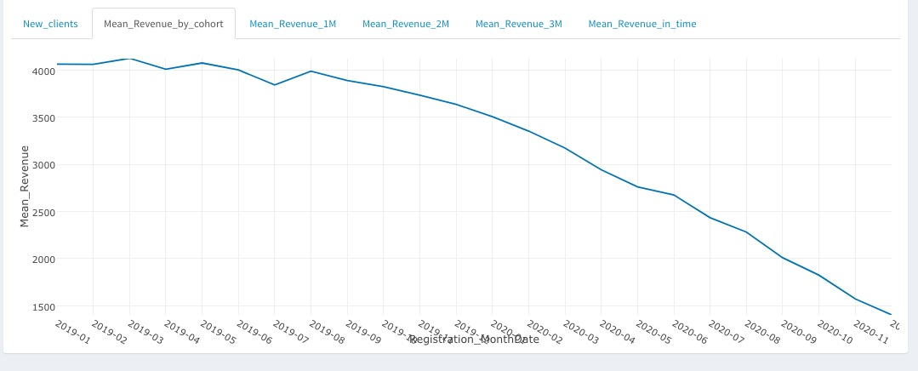
I/ User Acquisition : First Analysis
On this graph, we look at the average revenue by cohort, no longer over a whole year (2019 vs 2020) but in relation to all the acquisition months from 2019-01 to 2020-12. The higher mean revenue in 2019 compared to 2020 is well illustrated on these graphs : the older the cohort, the more income it brings revenues. This shows clearly the effect of senority in the mean revenue and no "break point" of mean revenue should worry us.

Slide 16
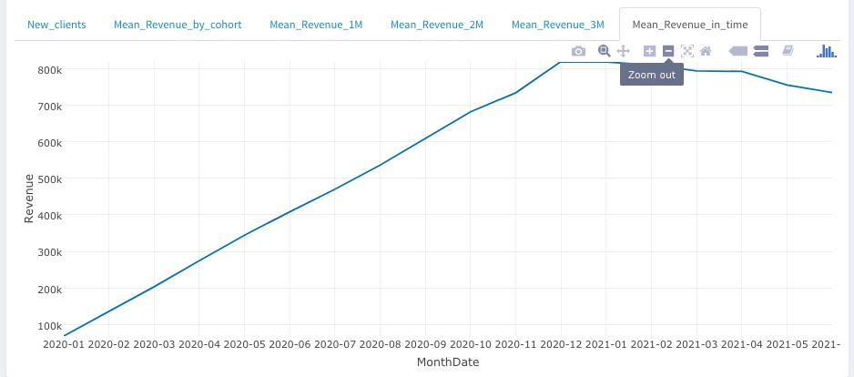
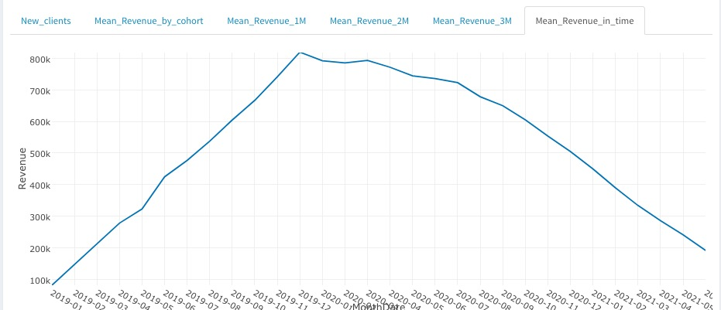
I/ User Acquisition : First Analysis
On these graphs (2019 on the left, 2020 on the right), we observe in which periods the average income was earned.
We observe a strong decreasing for mean revenue of 2019 cohort while 2020 is currently reaching its peak. We can therefore assume that the results for 2020 will continue to improve compared to 2019.

Slide 17
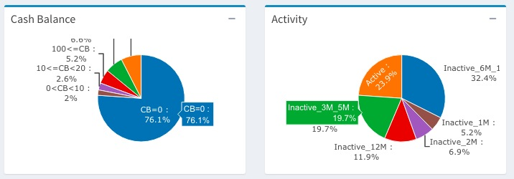
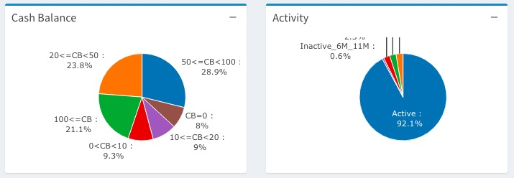
I/ User Acquisition : First Analysis
On these graphics, we can see why the average income of the 2019 cohort is falling. 76% of clients have a bankroll of 0 euros and only 23% were active last month with betting activities. Conversely, 93% of 2020 clients were active last month and they are only 8% with a bankroll equal to 0. These graphics confirm that the 2020 cohort will surely bring more additional revenues than 2019 in the next months.

Slide 18
II/ CRM performance : main insights
 | Target |  |  |  | Control
Campaign | Volume of users | Take up rate | Total Cost | Total Gross Revenue | Volume of users | Take up rate | Total Cost | Total Gross Revenue | Ind Gross Revenue | Ind cost active | Ind cost | Ind Net_Rev_Target | Ind Net_Rev_Control | Net ROI | ROI %
Reactivation 2017 | 20000 | 0,2 | 40 000,00 € | 1 200 000,00 € |  |  |  |  | 60,00 € | 10,00 € | 2,00 € | 58,00 €
Reactivation 2018 | 35000 | 0,22 | 61 600,00 € | 2 450 000,00 € | 5000 |  |  | 300 000,00 € | 70,00 € | 8,00 € | 1,76 € | 68,24 € | 60,00 € | 8,24 € | 468%
Reactivation 2019 | 45000 | 0,21 | 113 400,00 € | 2 925 000,00 € | 5000 |  |  | 250 000,00 € | 65,00 € | 12,00 € | 2,52 € | 62,48 € | 50,00 € | 12,48 € | 495%
Reactivation 2020 | 50000 | 0,38 | 380 000,00 € | 3 650 000,00 € | 5000 |  |  | 300 000,00 € | 73,00 € | 20,00 € | 7,60 € | 65,40 € | 60,00 € | 5,40 € | 71%
The 3 reactivation campaigns 2018, 2019, 2020 produced positive effects with higher net revenues in the target groups than control
68,24 € vs 60 € for 2018 (+8,24 €)
62,48 € vs 50 € for 2019 (+12,48 €)
65,40 € vs 60 € for 2020 (+5,40 €)
The take up of campaigns seem to be correlated with the financial incentive amount => The 2020 reactivation campaign presents a higher take up then others reactivation (38% VS 20%, 22%, 21% respectively 2017,2018, 2019) and a higher incentive (column Ind Cost Active & Ind Cost)

Slide 19

II/ CRM performance : main insights
 | Target |  |  |  | Control
Campaign | Volume of users | Take up rate | Total Cost | Total Gross Revenue | Volume of users | Take up rate | Total Cost | Total Gross Revenue | Ind Gross Revenue | Ind cost active | Ind cost | Ind Net_Rev_Target | Ind Net_Rev_Control | Net ROI | ROI %
Reactivation 2017 | 20000 | 0,2 | 40 000,00 € | 1 200 000,00 € |  |  |  |  | 60,00 € | 10,00 € | 2,00 € | 58,00 €
Reactivation 2018 | 35000 | 0,22 | 61 600,00 € | 2 450 000,00 € | 5000 |  |  | 300 000,00 € | 70,00 € | 8,00 € | 1,76 € | 68,24 € | 60,00 € | 8,24 € | 468%
Reactivation 2019 | 45000 | 0,21 | 113 400,00 € | 2 925 000,00 € | 5000 |  |  | 250 000,00 € | 65,00 € | 12,00 € | 2,52 € | 62,48 € | 50,00 € | 12,48 € | 495%
Reactivation 2020 | 50000 | 0,38 | 380 000,00 € | 3 650 000,00 € | 5000 |  |  | 300 000,00 € | 73,00 € | 20,00 € | 7,60 € | 65,40 € | 60,00 € | 5,40 € | 71%
I suggest to reconduct the 2019 reactivation campaign
Best net ROI and ROI % with an average cost of 2.52 € to produce a 12,48 € revenue (495%!)
Additionally, I think the stronger incentive tested in 2020 showed inelasticity revenue – incentive. If the amount is too large, the excess cost is not offset by the increase in income, probably by creating too much opportunistic behavior

Slide 20
1/ Definition of a core target ‘player’
We must agree on what is a “best client” and define metrics to identify them. We can for example use scoring methods to define groups of core_target
II/ CRM performance : Targeting
2/ Better Knowledge of Acquisition source
To allow better management of digital campaigns and targeting, we also need to introduce into all our analyzes a sublevel of the source acquisition in order to know more precisely the source of the traffic (Keyword for SEA, URL web page of entry for SEO, Affiliate for affiliation)
3/ Dashboarding & Statistics tools
Dashboarding and descriptive statistics combining core target, acquisition source and other variables (sex, age, region, device, ….) of interest to identify which diferencies “best clients” from others
Statistics tools to search systematically what differentiates “best clients” (age, sex, device, region, day_of_activity, ...) from others :
=> Scoring or Classification methods (discriminant analysis) for example

Slide 21
Thanks !
https://bva-data-viz.shinyapps.io/appli_shiny/
https://github.com/Zailaoui75/betclic_data

