Slide 1
Test Data Scientist Yassine ZAIM 25/06/2024

Slide 2
Data Science Use Case Assignment: Reducing Train Delays in Belgium Using Infrabel Open Data Background
Infrabel, the Belgian railway infrastructure manager, provides open data regarding train operations, delays, infrastructure issues, and other relevant factors. This assignment focuses on analyzing this data to identify actionable strategies to reduce train delays and improve overall punctuality.
Objective
Identify the key factors contributing to train delays in Belgium using Infrabel open data.
Propose a data-driven approach to reduce these delays and improve punctuality.
Develop and present a data science-centric solution, including code, to support your analysis and recommendations.
https://opendata.infrabel.be/explore/?disjunctive.keyword&sort=explore.popularity_score

Slide 3
Plan
The key factors of train delays in Belgium.
A data-driven approach to reduce the train delays and improve punctuality in Belgium.

Slide 4
I. The key factors of train delays in Belgium.

Slide 5
The key factors of train delays in Belgium
To study the different key factors contributing to train delays in Belgium, I used the following open Infrabel dataset: Incidents les plus importants en terme d'impact sur la ponctualité, https://infrabel.opendatasoft.com/explore/dataset/belangrijkste-incidenten/information/?disjunctive.lijn&disjunctive.lieu&disjunctive.description_de_l_incident
Another important dataset which will be used is: Ponctualité par type de train et par moment, https://infrabel.opendatasoft.com/explore/dataset/stiptheid-per-type-trein-en-per-moment/table/?disjunctive.rel&disjunctive.instant&sort=maand

Slide 6
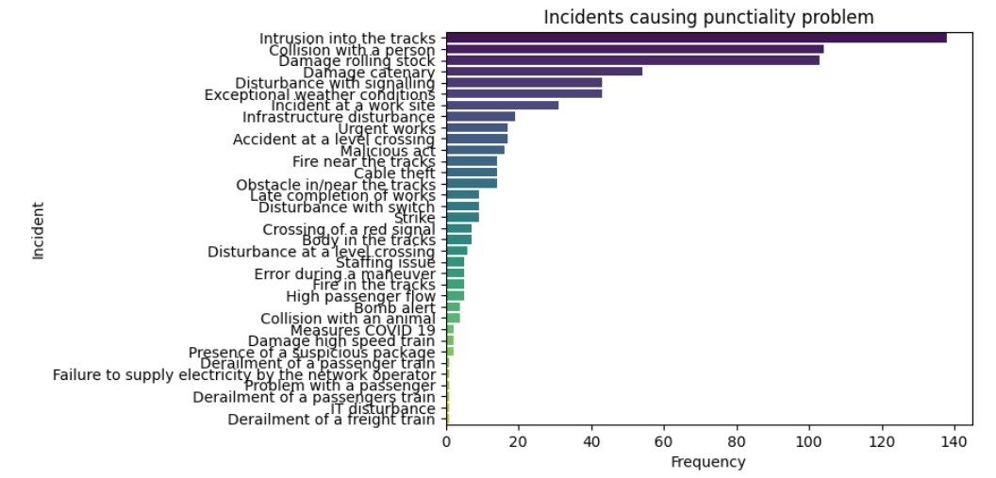
The key factors of train delays in Belgium Delay per Incident
The frequency of train with delays in term of the kind of incident.
We observe that the incident causing more delays are:
Intrusion into the tracks.
Collision with a person.
Damage rolling stock.
Damage Catenary
etc.

Slide 7
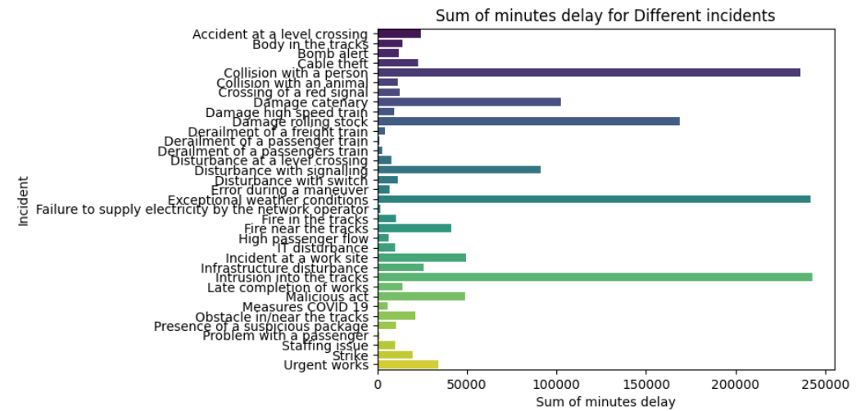
The key factors of train delays in Belgium Delay per Incident
It is more appropriate to study the duration delay in minutes caused by the different incidents instead of the frequency of train with delays.
Based on that we observe that the incident causing more delays are:
Intrusion into the tracks.
Weather conditions
Collision with a person.
etc.

Slide 8
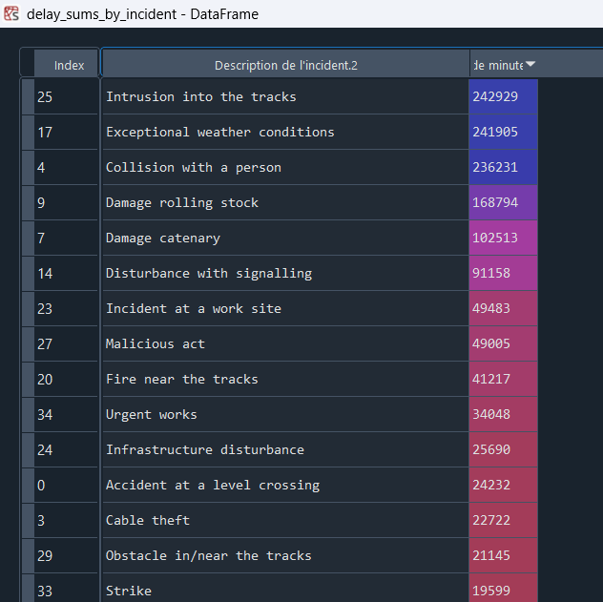
The key factors of train delays in Belgium Delay per Incident
If we look to the first graph of frequencies of the different incidents causing the delay, we will see that the principal reasons causing the delay are:
Intrusion into the tracks
Collision with peason
Damage rolling stock
Damage Catenary
But, if we consider the sum of time delay (mins) for the different incidents (see the figure on the right), we will see that the primary causes of delays are intrusions into the tracks and exceptional weather conditions, both causing approximately the same amount of delay.

Slide 9
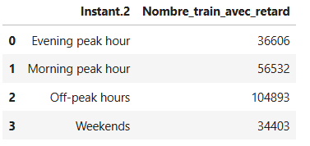
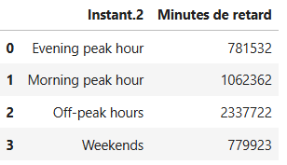
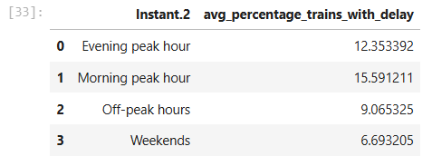
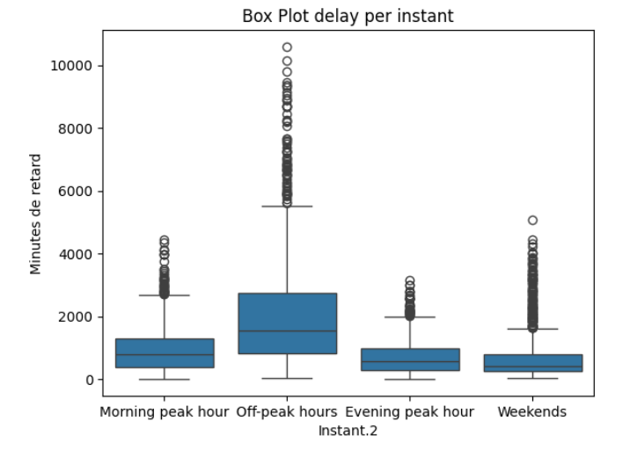
The key factors of train delays in Belgium Delay per moment
It is clear from the statistics of the number of train with delay in term of moments that there is more trains with delay in the Off-peak hours than in the Morning peak hour, etc.
It is clear from the statistics of the sum of minutes of train delay in term of moments and box plot the same remark that: In the Off-peak hours and Morning peak hour there is more minutes of delay.
However, it is clear from the average percentage of trains with delay in term of moments that in the Morning-peak hours there is more trains with delay than in the Evening peak hour, etc. ⬆ This make more sens

Slide 10
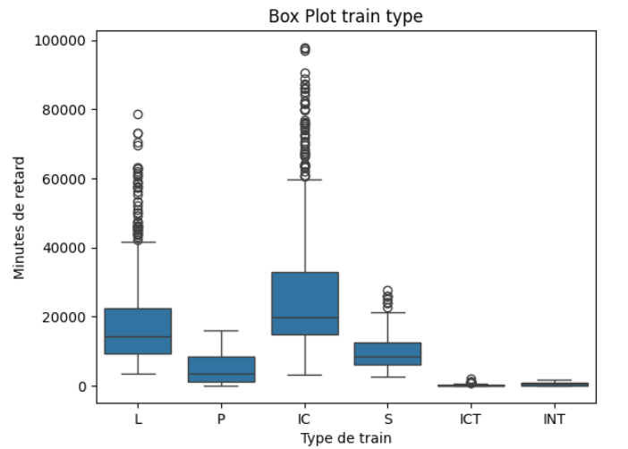
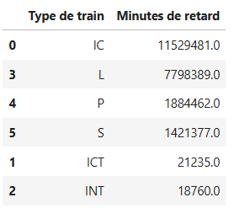
The key factors of train delays in Belgium Delay per train type
It is clear from the statistics of the sum of minutes of train delay, in terms of train type and the box plot, that the IC trains cause the most delay, followed by L, P, and S. The train types causing the least delay are ICT and INT.
We also note that, even though P trains cause more delay than S trains, in the box plot, the Quantile Q1, median, and Q3 of train S are higher than those of train P.

Slide 11
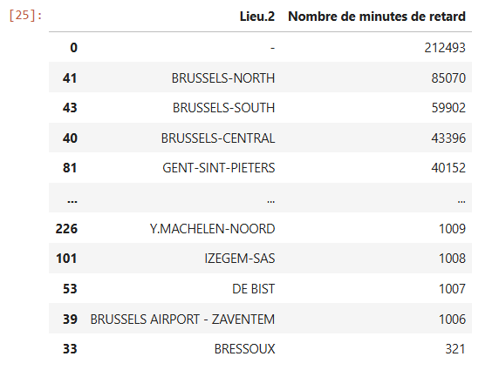
The key factors of train delays in Belgium Delay per station
It is clear from the statistics of the sum of minutes of train delay, in terms of train station, that in Brussels stations there is more delay after that in Gent station, etc.

Slide 12
II. A data-driven approach to reduce the train delays and improve punctuality in Belgium.

Slide 13
A data-driven approach to reduce the train delays and improve punctuality in Belgium.
To achieve this goal, I downloaded different delay data from infrabel open data (94 datasets) to see what kind of variables we have and how we can use them to predict the delays. I downloaded the following:
Data punctuality per train type
Data delays allocation per month
Data incidents with impact on punctuality
Data nationale punctuality based on canceled train
Data national punctuality per month
Data punctuality d-1
Data punctuality per train type and per moment
Data punctualite TGV
Data punctuality train arrived_in brussels per moment
Data punctuality train arrived in brussels per moment and long line
Data punctuality train ICE
Data distance station to station
Data Monthly correspondence.

Slide 14
A data-driven approach to reduce the train delays and improve punctuality in Belgium.
As we saw before, two of the reasons for delays are Damage rolling stock and Damage Catenary. To prepare a study in this direction, we need some data such as:
Data about the state of the trains.
Data about the catenary state.
Data about the tracks state.
However, the majority of these datasets don’t have any relevant variables that would allow us to conduct such a study correctly to predict the delays or even to train a model for predictive maintenance to avoid these problems.

Slide 15
A data-driven approach to reduce the train delays and improve punctuality in Belgium.
As we saw before, there is also Weather conditions reasons for the delays. However, there is also no data about about weather. I thought to have these latter by webscraping or using the open data of: https://opendata.meteo.be/downloadPage.php
I found some research papers which support my idea, such as P. Lapamonpinyo et al., Real-Time Passenger Train Delay Prediction using Machine Learning: A Case Study with Amtrak Passenger Train Routes, 2022, Click.
The data used in this paper are given in the next diapo:

Slide 16
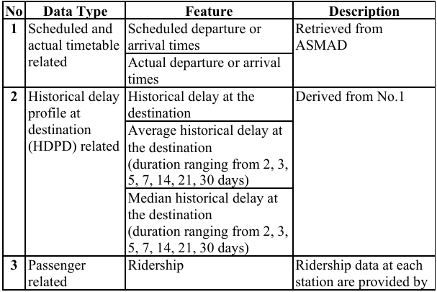
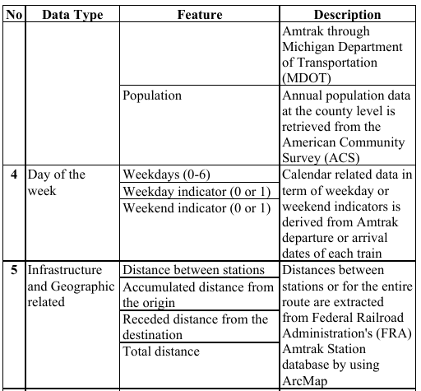
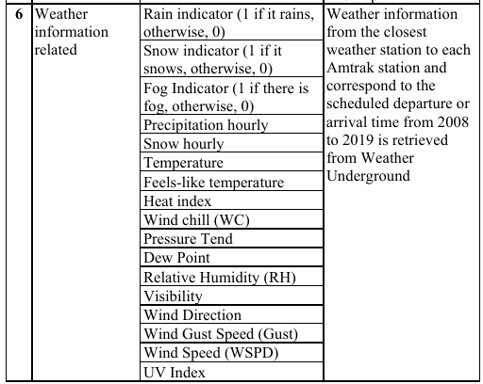
A data-driven approach to reduce the train delays and improve punctuality in Belgium.

Slide 17
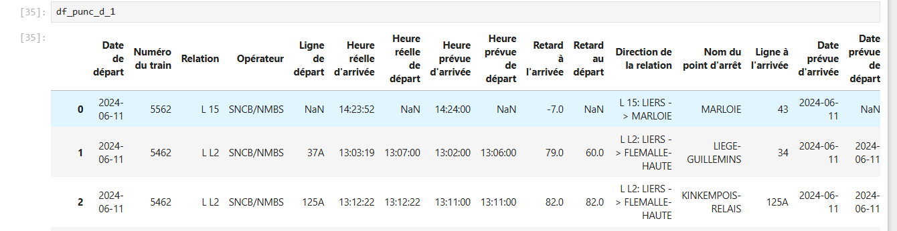
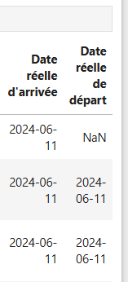
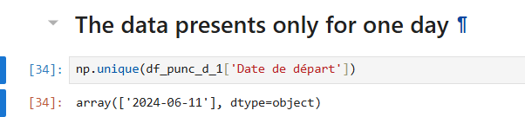
A data-driven approach to reduce the train delays and improve punctuality in Belgium.
The dataset of punctuality for day d-1 is the only one similar to what was used in the paper. However, when we examine the data, we see that it covers only a single day (see the figure on the right). Additionally, we do not know whether the cause of the delay on that day was weather-related or due to another factor.

Slide 18
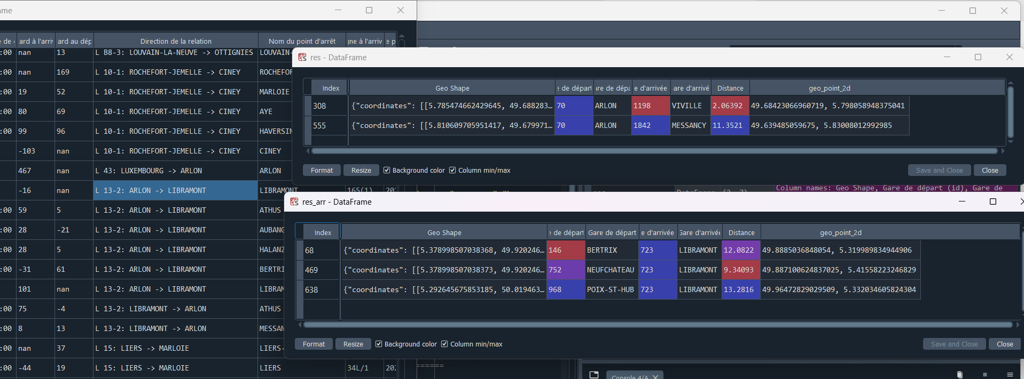
A data-driven approach to reduce the train delays and improve punctuality in Belgium.
If we want to add the distances between the different stations as it is done in the paper. We don’t find all distances (see for example the travel from ARLON -> LIBRAMONT

Slide 19
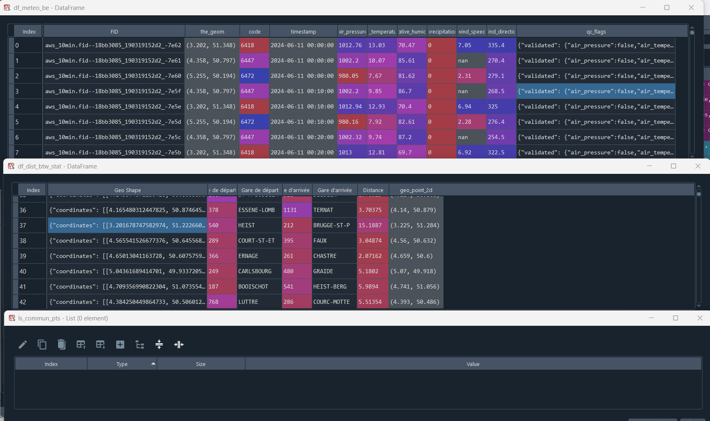
A data-driven approach to reduce the train delays and improve punctuality in Belgium.
To add the weather data, I tried to match between geolocalisation points to join the right weather data to the right station. However, when I tried to match the geolocalisation points, I didn’t find any commun commun points between the weather data and distances data from station to station. It will be appropriate to find some threshold to do that but it will be not easy to be accurate.

Slide 20
A data-driven approach to reduce the train delays and improve punctuality in Belgium.
As I can’t use data in a similar way as in the literature. We don’t have information about the passenger neither. I will train two regression models even if it not the best solution. But, with the data we have, this is what I think it is possible.
Model 1:
Sum_Dealy(mins) = Function(Train_type, Punctuality, Train_nbr, Train_nbr_with_less_6min_delay, Instant)
Correlation(): Train_nbr will be deleted as it very correlated to Train_nbr_with_less_6min_delay
Model 2:
Sum_Dealy(mins) = Function(Canceled_train_nbr, Station_place, Incident_description)

Slide 21
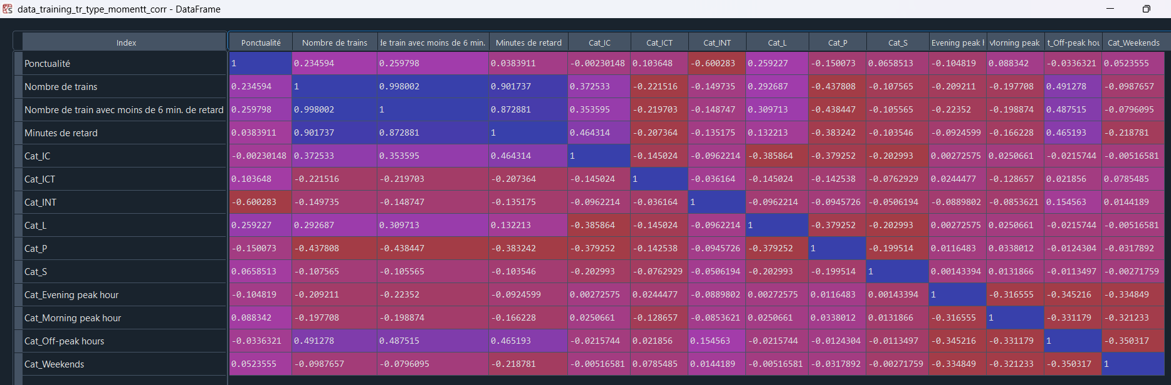
A data-driven approach to reduce the train delays and improve punctuality in Belgium.
Model 1: Correlation analysis

Slide 22
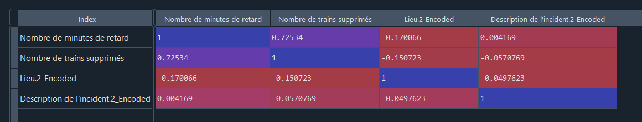
A data-driven approach to reduce the train delays and improve punctuality in Belgium.
Model 2: Correlation analysis

Slide 23
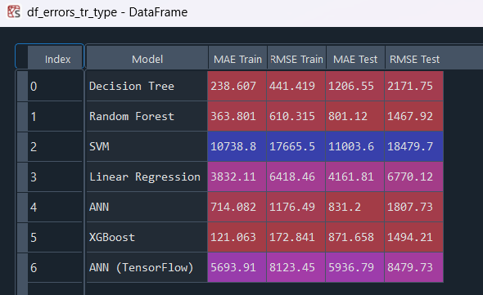
A data-driven approach to reduce the train delays and improve punctuality in Belgium.
Different models are trained, notably, Linear Regression, Random Forest, Decision tree, XGBoost and ANN. The results were as follow:
Model 1:

Slide 24
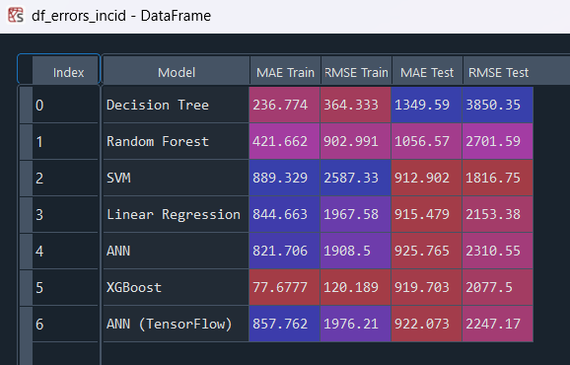
A data-driven approach to reduce the train delays and improve punctuality in Belgium.
Different models are trained, notably, Linear Regression, Random Forest, Decision tree, XGBoost and ANN. The results were as follow:
Model 2:

Slide 25
A data-driven approach to reduce the train delays and improve punctuality in Belgium.
As XGBoost give good results, for the both training and test sets for the both use cases. I do some tuning of the parameters to see the best one in {"n_estimators":[10,50,100,150,200, 250, 500, 1000], 'max_depth': [5, 10, 15, 20, 30, 50, None], 'learning_rate': [0.01, 0.05, 0.1]}, using the GridsearchCV and I foud the following:
Model 1:
The best score for incident data is -733.2237373335932
The best parameters for the incident data are {'learning_rate': 0.01, 'max_depth': None, 'n_estimators': 500}
Model 2:
The best score for train type data is -805.0391094823968
The best parameters for the train type data are {'learning_rate': 0.05, 'max_depth': None, 'n_estimators': 1000}

Slide 26
A data-driven approach to reduce the train delays and improve punctuality in Belgium.
Achievement of Goals:
Adjust the Scheduling: After predicting the time delay, we can for example based on that to schedule the connecting train correctly in order to avoid the cumulated delay and decrease the total delays.
Resource Allocation: Reallocating resources like additional staff or support at key stations to manage expected passenger congestion due to delays.
Communication: Informing passengers about potential delays and alternative options in advance.
Dynamic Routing: If feasible, adjust the routes or speeds of the trains to avoid congestion and delays.

Slide 27
A data-driven approach to reduce the train delays and improve punctuality in Belgium.
Many other analyses can be performed if we have more variables, such as analyzing interesting variables using feature importance, correlations, or other methods. However, given our current limitation in terms of available variables, we will work with the few variables we have.
Additionally, I would like to train predictive maintenance models to prevent damage problems.
Furthermore, we could train some computer vision models to alert about intrusions onto the tracks to avoid collisions with people problems.
etc.

Slide 28
Thanks for your attention

Slide 29
State of the art references on the subject
[1] P. Lapamonpinyo et al., Real-Time Passenger Train Delay Prediction using Machine Learning: A Case Study with Amtrak Passenger Train Routes, 2022.
[2] See the papers of the refs_papers folder and their references as well.

