Slide 1
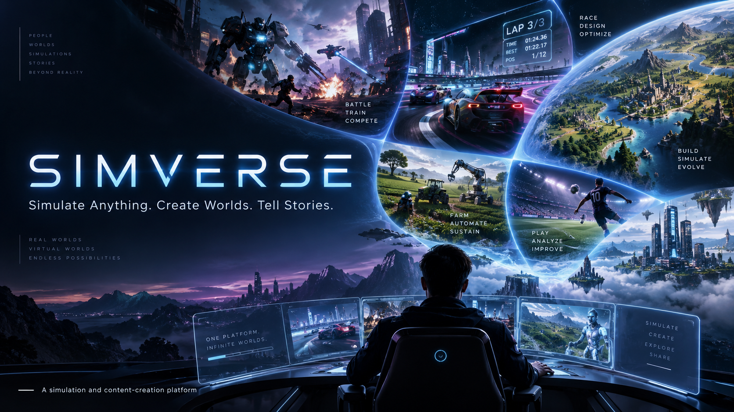

Slide 2
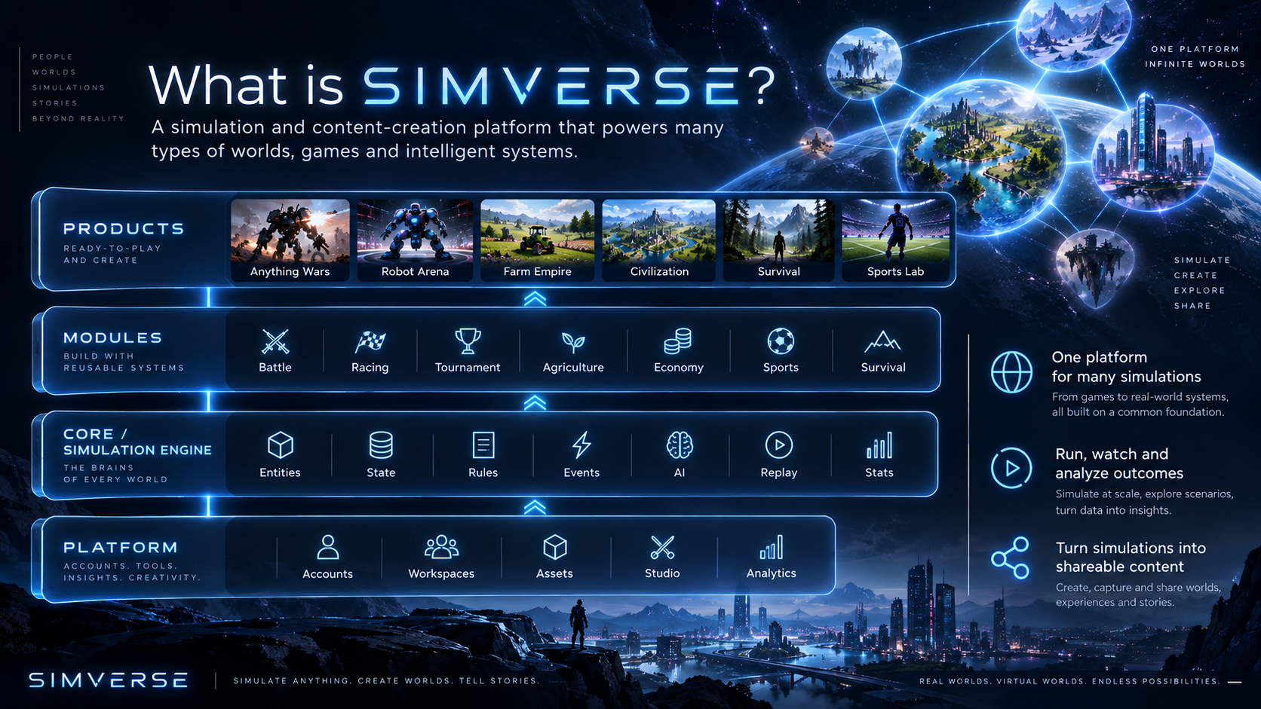

Slide 3
SIMVERSE is the universe — products live inside it
The platform provides shared services; the engine provides reusable simulation technology; modules add mechanics; products package them into experiences.
PRODUCTS
User-facing experiences
Anything Wars • Robot Arena • Farm Empire • Civilization • Survival • Sports Lab
MODULES
Reusable simulation mechanics
Battle • Racing • Tournament • Agriculture • Economy • Sports • Survival
CORE
Simulation technology
Entities • State • Rules • Events • AI • RNG • Replay • Statistics
PLATFORM
Shared product infrastructure
Accounts • Workspaces • Assets • Studio • Analytics • Teams • Billing
Anything Wars is the flagship product; SIMVERSE itself remains broader than any single game mode.

Slide 4
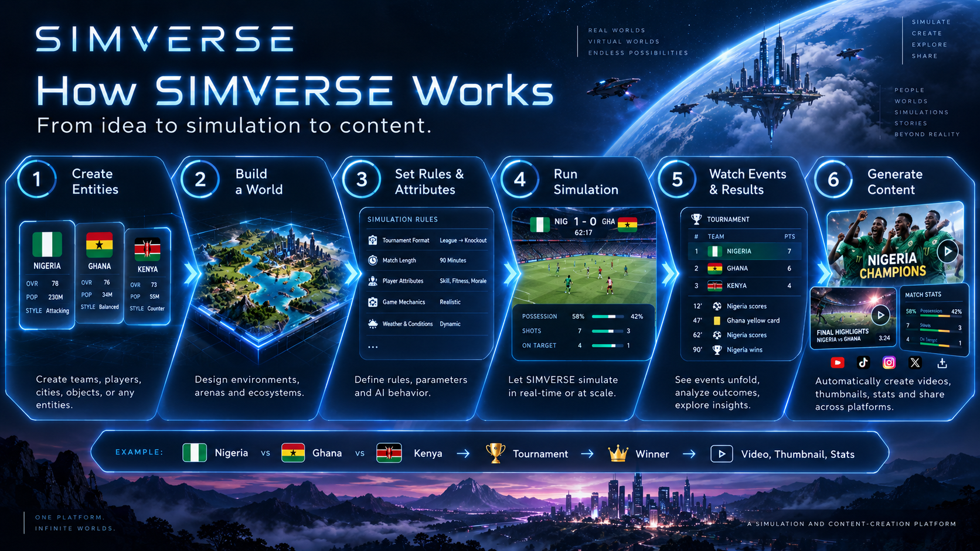

Slide 5
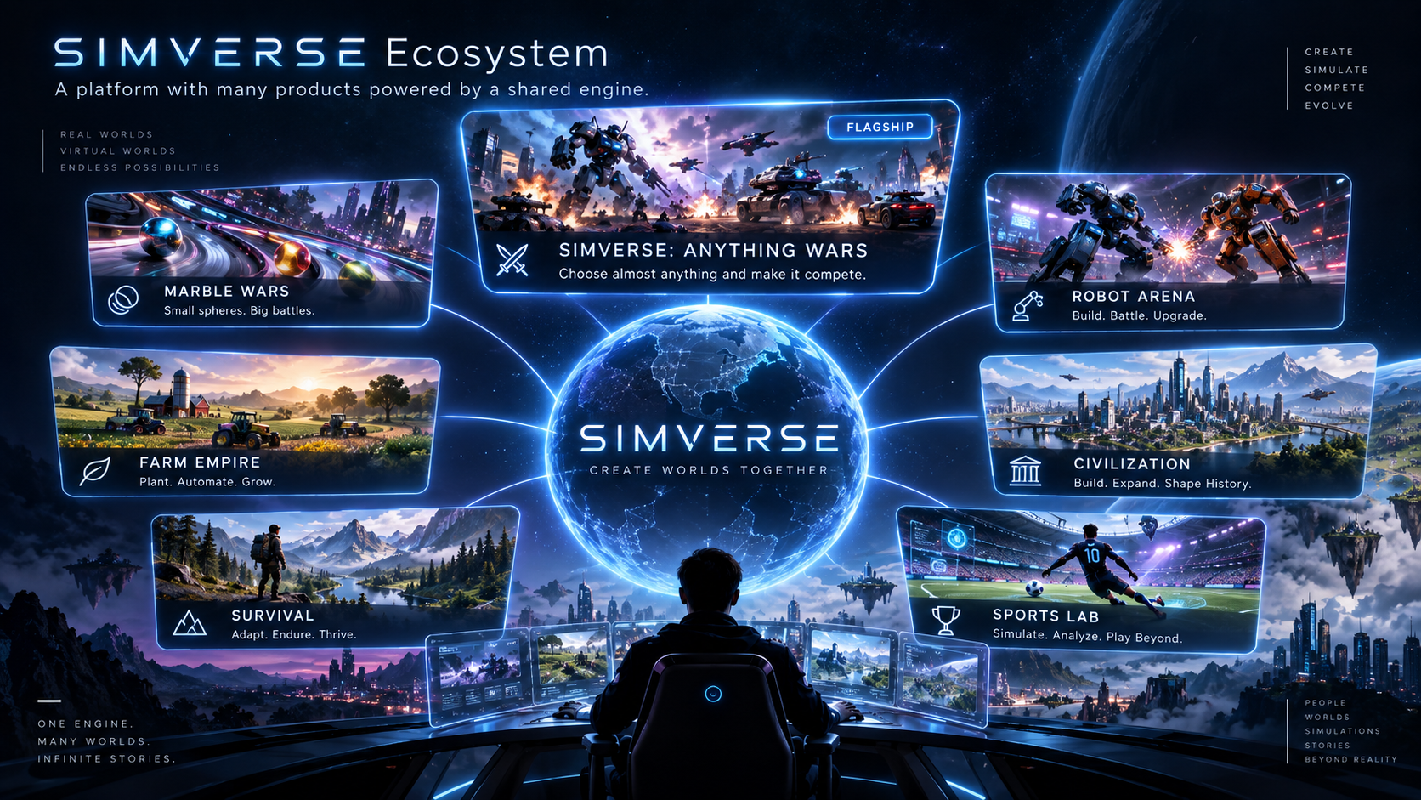

Slide 6
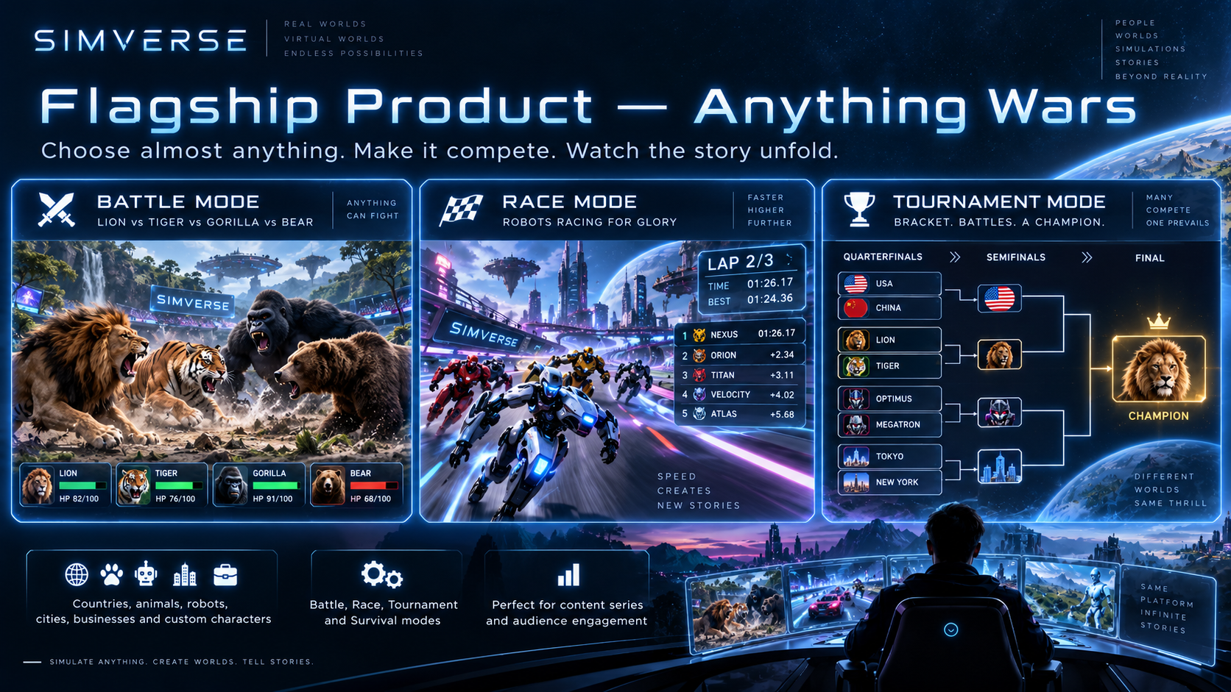

Slide 7
Anything Wars — choose almost anything
Anything Wars is designed around broad entity types rather than one fixed cast of characters.
🌍
COUNTRIES
◈
ANIMALS
⬡
ROBOTS
Nigeria vs Ghana vs Kenya
Lion vs Tiger vs Gorilla
Custom machines & AI agents
▦
CITIES
▣
BUSINESSES
✦
FANTASY
Lagos vs Accra vs Nairobi
Farm vs logistics vs restaurant
Kingdoms, heroes & custom lore
Entity categories are presentation labels; internally SIMVERSE can keep a generic entity model so future products stay flexible.

Slide 8
The SIMVERSE Core
A headless simulation runtime that determines what happens — independent of the visual renderer.
01
Entity System
Objects, agents and resources inside the world
02
State Engine
The authoritative state of the simulated world
03
Rule Engine
What actions are allowed and how they resolve
04
Event Engine
Structured record of meaningful changes
05
Seeded RNG
Reproducible randomness for fairness and replay
06
Simulation Clock
Ticks, speed, pause, time progression
07
Snapshots & Replay
Reconstruct runs, seek events and review outcomes
08
Results & Stats
Winners, rankings, histories and analytics

Slide 9
Simulation modules
Modules teach the Core how a class of simulation behaves. They can be reused by more than one product.
BATTLE
RACING
TOURNAMENT
SURVIVAL
Health, attack, defense, targeting, elimination
Movement, acceleration, checkpoints, laps, finish
Brackets, seeding, advancement, champion
Resources, hazards, stamina, environmental pressure
AGRICULTURE
ECONOMY
SPORTS
CIVILIZATION
Crops, soil, weather, machinery, production
Markets, resources, prices, trade, growth
Teams, fixtures, seasons, rankings, statistics
Population, cities, diplomacy, technology, territory
The long-term advantage: new products can combine existing modules instead of rebuilding the simulation stack.

Slide 10
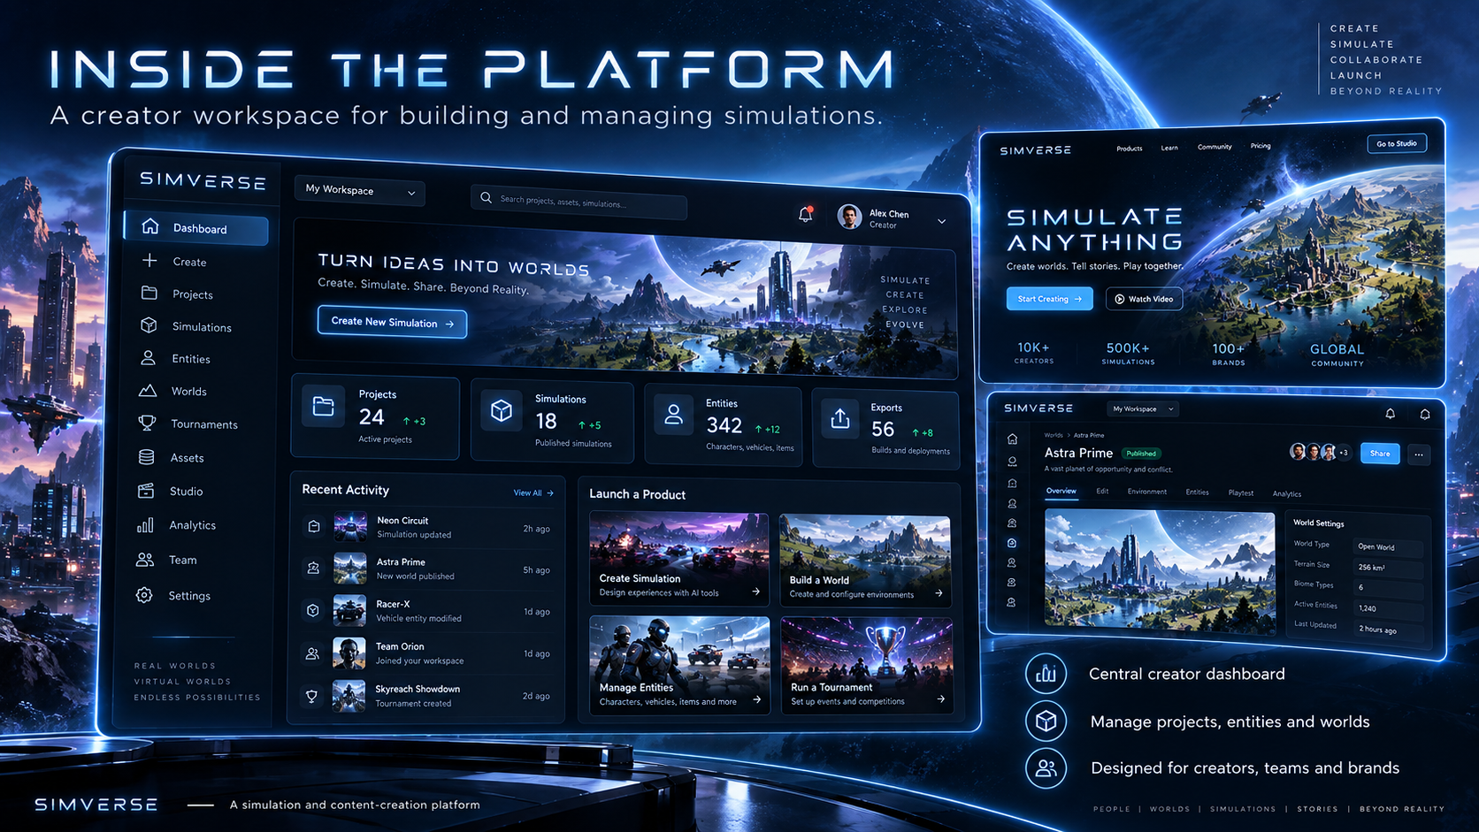

Slide 11
Creator workflow
A creator should be able to go from idea to publishable content without rebuilding the process each time.
1
2
3
4
5
6
Create Project
→
Create Entities
→
Build World
→
Set Rules
→
Run Simulation
→
Publish Story
Organize entities, worlds, simulations and content
Names, visuals, attributes, abilities and metadata
Arena, track, farm, city, island or custom environment
Choose modules, parameters, AI and win conditions
Watch live or execute at scale
Replay, highlights, graphics, captions and video

Slide 12
The Simulation Viewer
The engine determines the truth. The viewer turns that truth into something people want to watch.
VIEWER LAYERS
Arena / world renderer
Entity visuals & status
Camera system
Leaderboard & live stats
Event feed
Pause / speed / replay
Focus entity / cinematic mode

Slide 13
Tournaments create recurring stories
Persistent history turns one-off simulations into seasons, rivalries and fan narratives.
TOURNAMENT
PERSISTENT HISTORY
Nigeria
SEMIFINAL
Wins, losses and championships
Head-to-head records
Rankings and streaks
Rivalry detection
Achievements and records
Season history and legacy
Ghana
Kenya
Egypt
Morocco
FINAL
Rwanda
South Africa
Nigeria vs Ghana
CHAMPION
Ethiopia
18 meetings • Nigeria 10 wins • Ghana 8 wins

Slide 14
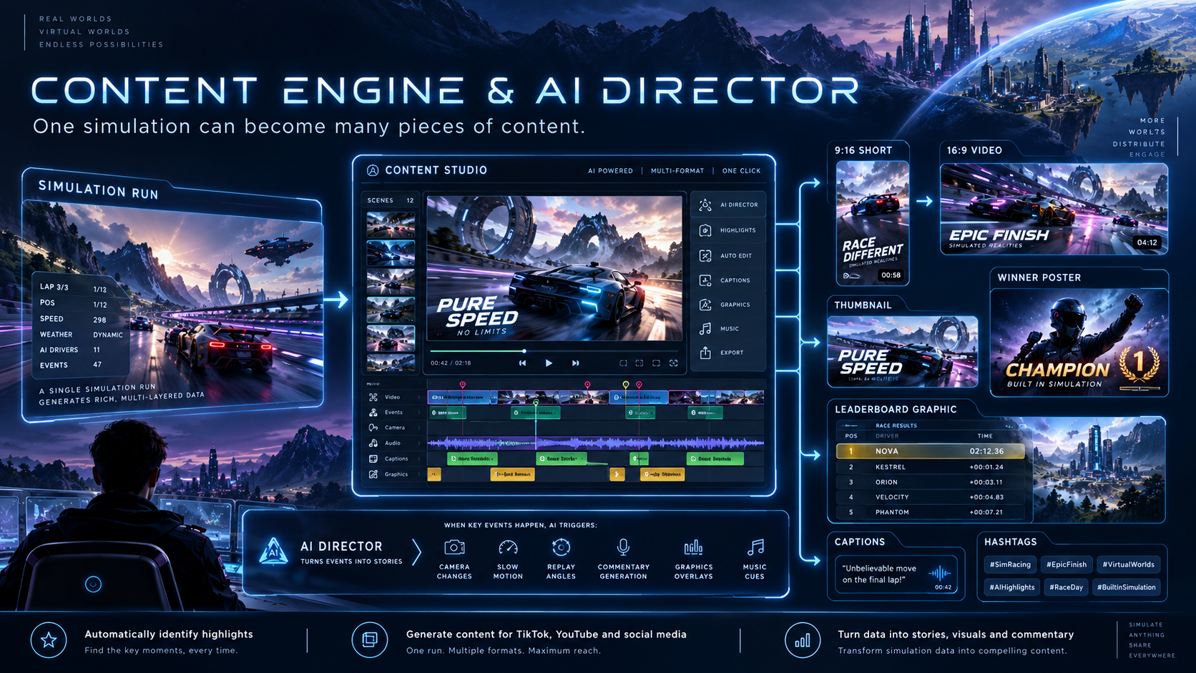

Slide 15
AI Director — simulation becomes entertainment
The Director does not decide who wins; it decides how important moments are presented.
EVENT
IMPORTANCE
DIRECTOR
OUTPUT
Leader change
Critical hit
Elimination
Photo finish
Score 1–10
Storyline context
Rivalry / comeback
Camera
Replay
Slow motion
Commentary
Shorts
Full recap
Thumbnail
Result graphics
→
→
→
The same event stream can later drive graphics, commentary, camera logic, sound cues and automated highlight selection.

Slide 16
The audience should participate — not only watch
Anything Wars can create a loop where viewers predict, vote, follow competitors and return for the next event.
WATCH
Simulation / video
CREATE
VOTE
Viewer becomes creator
SIMVERSE
FLYWHEEL
Predictions & fan choices
SHARE
RETURN
Bring new viewers
Finals, rematches, seasons

Slide 17
Built for creators, teams and brands
A serious creator platform needs permissioned workflows so one person does not have to operate everything.
OWNER
ADMIN
CREATOR
OPERATOR
Full control
Manage platform & people
Build simulations
Run approved events
EDITOR
ANALYST
SPONSOR MGR
Create content
Read analytics
Brand campaigns
Later phases add invitations, approvals, audit logs and fine-grained workspace permissions.

Slide 18
Monetization can come from several layers
The goal is not to rely on advertising alone.
FREE
CREATOR
PRO
BUSINESS
Basic simulations
Watermark
Entry-level limits
More runs
1080p exports
Branding tools
AI content
Team features
Commercial use
Sponsored worlds
Advanced analytics
Custom workflows
Additional revenue streams
Marketplace fees • Premium assets • Sponsored competitions • API / developer usage • Enterprise simulation services

Slide 19
Marketplace — let the ecosystem build with you
Creators and developers can eventually sell reusable pieces instead of SIMVERSE building every asset itself.
Simulation Modules
Worlds & Arenas
Entity Packs
Battle variants, agriculture systems, economy systems
Tracks, stadiums, islands, cities, fantasy maps
Robots, vehicles, animals, teams, fictional characters
Visual Assets
Content Templates
Audio
Models, textures, animations, effects, overlays
Scoreboards, intros, graphics, thumbnail packs
Music, ambience, commentary packs, sound effects

Slide 20
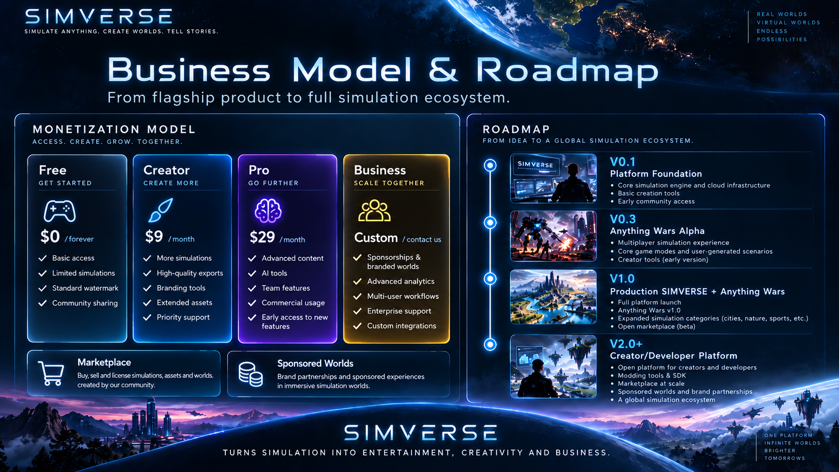

Slide 21
Version milestones
Each version should ship something useful before SIMVERSE expands further.
V0.1
Platform Foundation
Accounts, workspaces, entity/project foundations
V0.2
Simulation Engine Alpha
Core runtime, battle, viewer, race
V0.3
Anything Wars Alpha
Tournament, stats, replay, basic content
V0.4
Creator Platform
Commentary, AI Director, worlds, assets, teams
V0.5
Business & Community
Subscriptions, public platform, seasons, admin
V1.0
Production Release
Hardened Core + Anything Wars V1
V1.5
Multiple Products
Robot Arena, Farm Empire, Civilization, Sports Lab
V2.0+
Developer Ecosystem
SDK, visual builder, marketplace, AI creator, API

Slide 22
SIMVERSE
Where anything can become a simulation.
Create it. Simulate it. Watch it. Share it.
SIMULATE ANYTHING • CREATE WORLDS • TELL STORIES

