Slide 1
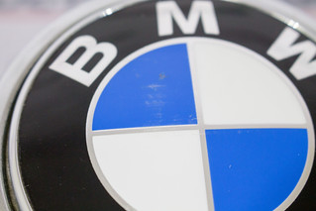


NAME OF THE GROUP MEMBERS
NAME
Asad Hayat
Akshay Sekhar Umar Tariq Butt Majed Nashat Khaqan Zaroof Mohammed Irfan
STUDENT’S ID
S2151558
S2152007
S2164196
S2164219
S2164512
S2165296

Slide 2
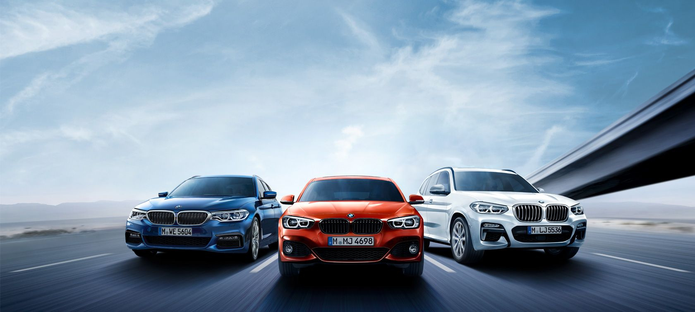


BMW Automobile

Slide 3
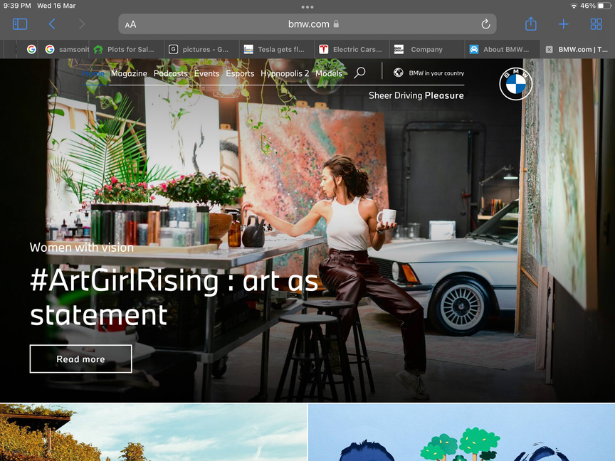
About Us
Bayerische Motoren Werke AG, commonly known as Bavarian Motor Works, BMW or BMW AG, is a German automobile, motorcycle and engine manufacturing company founded in 1916.
BMW is headquartered in Munich, Bavaria. It also owns and produces Mini cars, and is the parent company of Rolls-Royce Motor Cars.
BMW produces motorcycles under BMW Motorrad.
In 2012, the BMW Group produced 1,845,186 automobiles and 117,109 motorcycles across all of its brands.
BMW is part of the “German Big 3” luxury automakers, along with Audi and Mercedes-Benz, which are the three best-selling luxury automakers in the world.

Slide 4
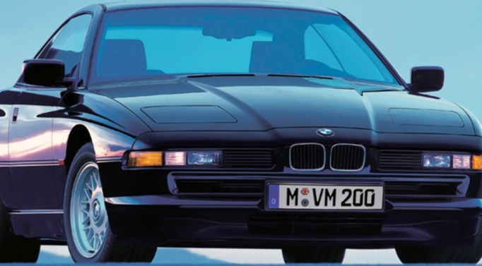
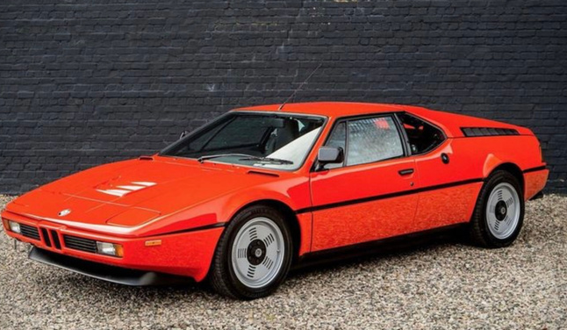

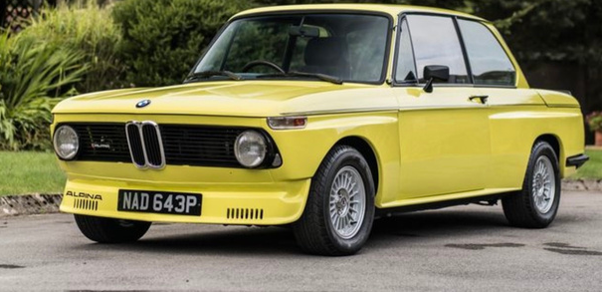
BMW 8 Series E31
BMW
Products
BMW M1
BMW 2002

Slide 5
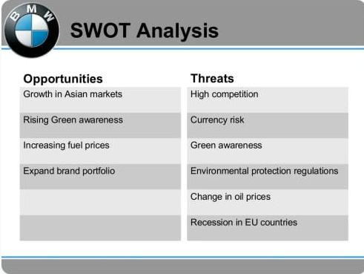

Slide 6
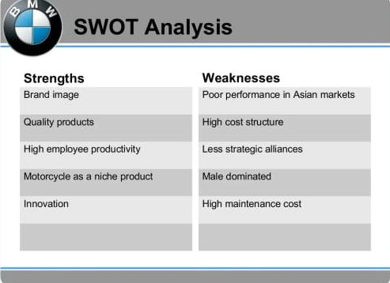

Slide 7
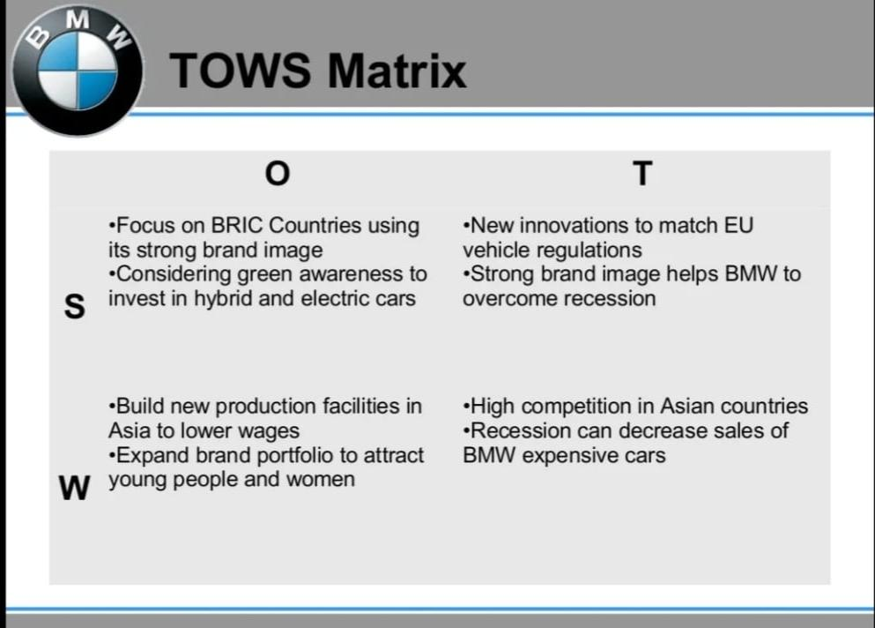

Slide 8




External Analysis (PESTLE)
Political Factors
Economical Fcators
Social Factors
Bmw sales are highly impacted by the political environment.
Political uncertainty across the Europe, tensions in Middle East, Latin American and African Markets.
Lockdown situation and COVID-19 panedemic crises.
Political instability is a bigger threat to the sales of BMW.
Factors including political corruption, new policies and regulations , changes sales dynamics.
Political environment changes companies sales by decreasing buyer tendency and changes purchasing patterns.
There are certain economic factors that creates threat for BMW company.
Worldwide economic fluctuations are creating numerous for the company by affecting its sales and profits as well as organisational performance.
Tariffs also impacts the company and influence the rising price of the vehicle components.
Also, during COVID-19 lockdown situation, worldwide trade was banned and international markets were shutdown, hence it drastically decreased the sales and profit for the BMW company.
Moreover, strong GDP growth in emerging market.
And Volatile currency movements aslo impacts their sales.
Social factors also impacts their sales, for instance the people preference of environmental friendly transportation in mellennials.
In world of globalisation, there exists cultural differences of different countries and communitie, these diffrences are considered as influencing factors for the company.
To tackle the social factors, BMW is required to invest in the research of diverse buying patterns and differs buying decisions of the people.

Slide 10



External Analysis (PESTLE)
Technological Factors
Legal Factors
Environmental Factots
Technological factors plays a pivitol role in the sales and business growth of an organisation.
BMW is a reputed organisation, it can surely enhance its business by implementing the new technologies and advancements in its vechincles.
Technologies such as wifi and Bluetooth are interesting addition for caputuring the consumers mindset.
In addition to this, BMW is required to focus on R & D and innovation of new technologies.
Moreover, Collaboration with reputed technological firms can be a valuable addition for the company.
There are certain legal factors that can impact the company , such as change in regulations and policies concerning automobile industry.
Also, involvement of company in controversies and lawsuits can impact the organisational performance and sales.
Regulations and strict policies during the COVID-19 , hindered the sales and production of the BMW company.
Moreover, company has to follow certain laws and rules for its production and sales, these laws sometimes constrains the company profit margins.
There are certain environmental factors which BMW company has to follow during its production.
These environmental factors includes, carbon emission and fuel utilisationby automobiles, ending up creating constraints for the company.
Also, company has to follow certain carbon emissions laws and rules.
Moreover, company is required to maintain sustainability during the group operations.

Slide 11

Internal Analysis (Core Comptencies)
Unique
Important
Strategically well
BMW products are unique in its design and innovation, they are producing products different than its competitors.
BMW products are important for the company, as they are helping company to enhance its sales and productivity.
The products of BMW company are strategically well, it means it is hard for other automobile companies to copy their products.

Slide 12

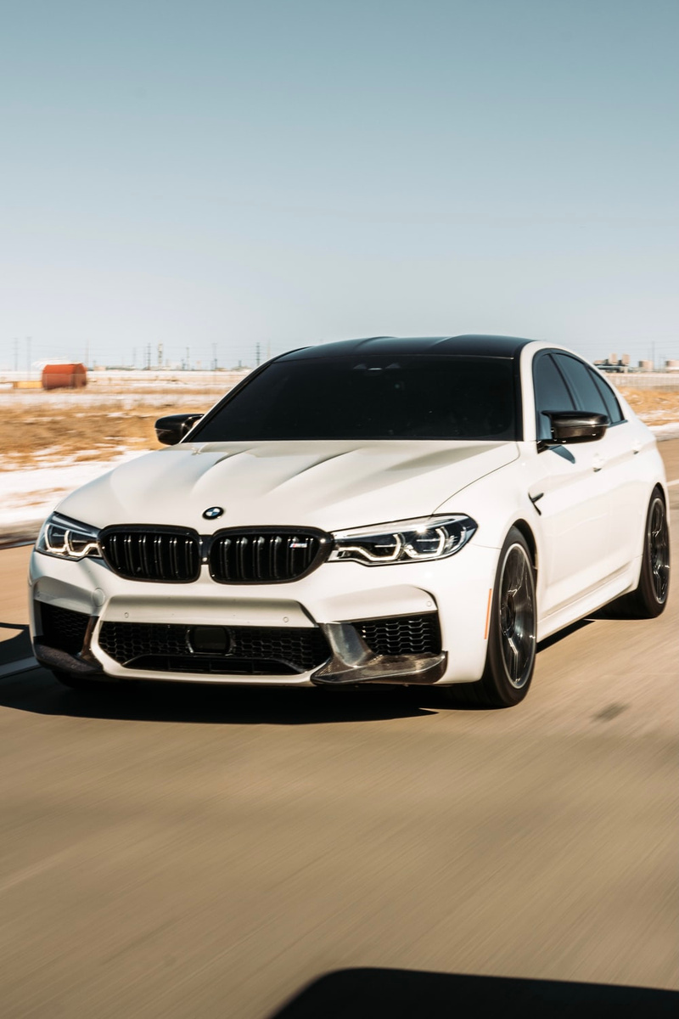
Internal Analysis
Core competensies:
The BMW company core competencies includes everything it does is underpinned by its innovative and active design philosophy.
The uniquesness of the BMW company has resulted in history of it’s unique and high performance speed cars.
Even if the compatitors of the BMW company tries to match the speed of the cars, they are still unable to produce the complete and “ultimate driving experience” as provided by BMW.
BMW competitors are unable to produce such automobile products.
In short, BMW contains a complete premium driving experience for its consumers.

Slide 13



Internal Analysis
We are a customer-centric business.
FEATURES
BENEFITS
Top quality products
Reputed brand
Budget-friendly
Unique products
Innovative products
High speed luxury cars
R & D focused innovation
Value for money
Varied options
Great customer service
Ultimate driving experience
Well designed and stylish cars
Technological advancements
Customer Centric

Slide 14
S
W
O
T
Strengths
Weaknesses
Opportunities
Threats
Reputed and valuable automobile brand in the world.
Diverse and wide revenue generation system.
It has suscessful partnership with China.
It has well formed strategies to tackle future problems .
Increasing debt during COVID-19.
Lower differences in its products.
Poor brand portfolio.
Takata air bag inflators issues causing car recall.
High priced products.
Few strategic partnerships.
Formation of environmental friendly vehicles.
Expansion of brand portfolio.
Including low costs variants.
More Strategic Partnerships
Changes in world currencies.
Increase in the cost of vehicle parts and raw materials.
Intensified computition.

Slide 15
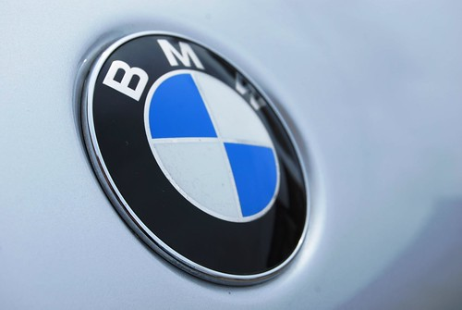
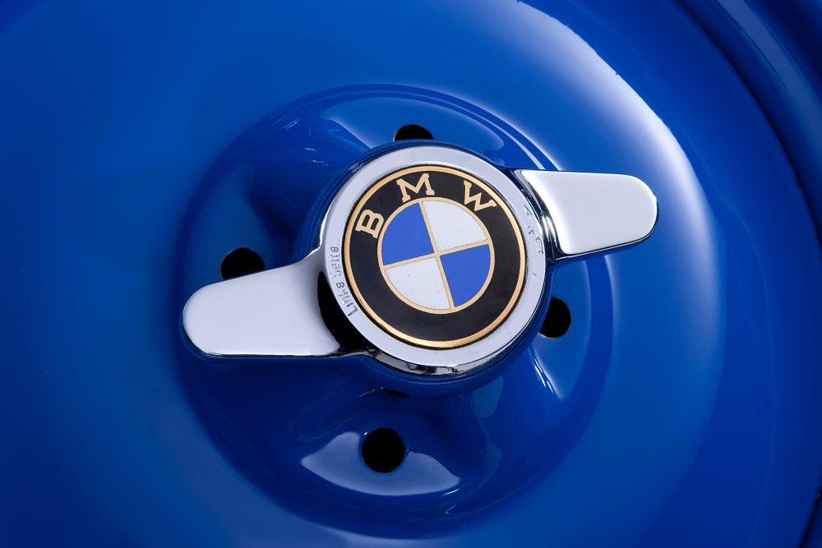
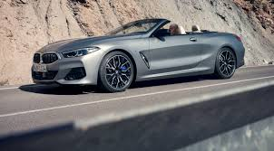
REFERENCES
Direction, S. (2013). Surviving a global crisis: Sustainable leadership at BMW.
Singh, K. J., & Chaudhary, S. (2014). Your strengths can be your weaknesses too! a critique on swot analysis. Zenith International Journal of Multidisciplinary Research, 4(7), 1-9.
Pozo Cardenal, A., & Carrió Garcia, F. (2013). Qualitative and quantitative financial analysis of BMW GROUP.
Shtal, T. V., BURIAK, M. M., AMIRBEKULY, Y., UKUBASSOVA, G. S., KASKIN, T. T., & TOIBOLDINOVA, Z. G. (2018). Methods of analysis of the external environment of business activities. Revista Espacios, 39(12).

Slide 16
Thank You!

