Slide 1

Manara University · Department of Robotics and Intelligent Systems Engineering
Chest X-Ray Pneumonia Classification
A Comparative Analysis of VGG16, VGG19, and EfficientNetB0
Team Members:
Zain Alabidin Shbani · Lana Al Wazzeh · Beilassan Hdewa
Supervisor:
Dr. Eng. Mohammad Mashi
Course:
Deep Learning
Academic Year:
2025 – 2026

Slide 2
Table of Contents
2
01
Introduction
06
Experimental Results
Problem motivation & clinical importance
Accuracy, sensitivity, AUC, F1-score
02
Dataset Description
07
Complexity Analysis
Source, splits, class distribution
Parameters, inference time, trade-offs
03
Preprocessing & Augmentation
08
Medical Interpretation
Pipeline and reproducibility
Clinical meaning of metrics
04
Model Architectures
09
Explainability (Grad-CAM)
VGG16, VGG19, EfficientNetB0
Visual decision interpretation
05
Training Methodology
10
Conclusion & Future Work
Transfer learning, fine-tuning, callbacks
Findings and recommendations
Chest X-Ray Pneumonia Classification | Manara University

Slide 3
Introduction
3
Problem Motivation & Research Objective
Clinical Motivation
Objective & Approach
🔹 Pneumonia kills ~2.5 million people annually worldwide
🔹 Early, accurate diagnosis is critical for patient survival
🔹 Manual radiograph interpretation is slow and prone to inter-observer variability
🔹 Shortage of specialist radiologists in low-resource settings
🔹 Deep learning can automate and accelerate chest X-ray diagnosis
Research Objective:
Evaluate and compare three CNN architectures (VGG16, VGG19,
EfficientNetB0) for binary pneumonia classification using transfer
learning on chest X-ray images.
Why CNNs & Transfer Learning?
• CNNs excel at hierarchical feature extraction from images
• Transfer learning overcomes limited labeled medical data
• ImageNet pre-training provides strong low-level feature priors
• Enables high performance with fewer training samples
Chest X-Ray Pneumonia Classification | Manara University

Slide 4
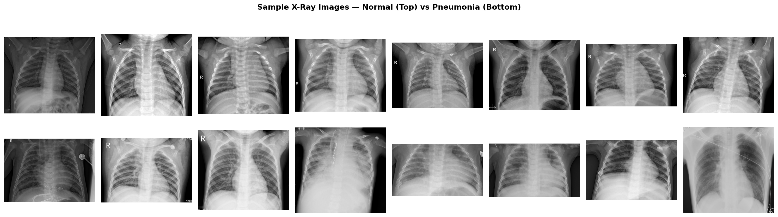
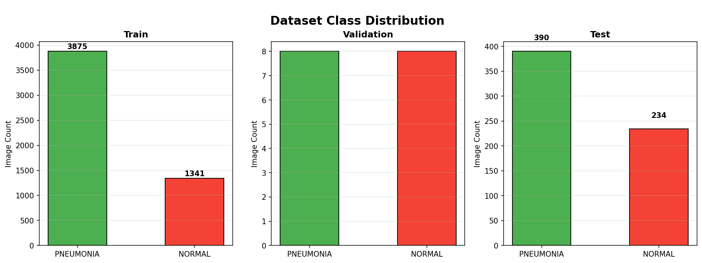
Dataset Description
4
Chest X-Ray Images (Kaggle / Guangzhou Women and Children's Medical Center)
Sample Dataset Images
Source:
Kaggle — Chest X-Ray Images (Pneumonia)
Guangzhou Women and Children's Medical Center
Classes:
• NORMAL — Healthy chest X-rays
• PNEUMONIA — Bacterial & viral pneumonia
Data Splits:
• Training set: ~5,216 images
• Validation set: ~16 images (original) → augmented
• Test set: 624 images
Class Imbalance:
~74% PNEUMONIA / ~26% NORMAL in training set
Addressed via class-weighted loss & augmentation
Class Distribution
Chest X-Ray Pneumonia Classification | Manara University

Slide 5
Preprocessing & Data Augmentation
5
Pipeline Design and Reproducibility
Preprocessing Pipeline
Reproducibility & Rationale
Training Augmentation Pipeline:
• Resize all images to 224 × 224 px
• Random horizontal flip
• Random rotation (±15°)
• Width & height shift (±10%)
• Shear transformation (±10%)
• Zoom range (±10%)
• Normalization: mean subtraction per ImageNet channel
Validation & Test Preprocessing:
• Resize to 224 × 224 px
• ImageNet mean/std normalization only
• No augmentation applied
Reproducibility Settings:
• All random seeds fixed to 42 (NumPy, Python, TensorFlow, Keras)
• Deterministic data loading order
• GPU determinism enabled where supported
Design Rationale:
• Augmentation combats class imbalance
• Simulates real-world X-ray variation (patient positioning, scanner differences)
• Prevents overfitting on small dataset
• Consistent preprocessing ensures fair model comparison
Chest X-Ray Pneumonia Classification | Manara University

Slide 6
Model Architectures
6
VGG16 · VGG19 · EfficientNetB0 with Unified Classification Head
VGG16
VGG19
EfficientNetB0
14.86 M params
20.17 M params
4.40 M params
• 13 convolutional layers (3×3 filters)
• 5 max-pooling layers
• 3 fully-connected layers (frozen)
• ReLU activations throughout
• Consistent, simple architecture
• 16 convolutional layers (3×3 filters)
• 5 max-pooling layers
• 3 fully-connected layers (frozen)
• Deeper than VGG16; more representational power
• Higher memory & computation cost
• Compound scaling (depth/width/resolution)
• MBConv blocks with Squeeze-and-Excitation
• Significantly fewer parameters
• Designed for efficiency on standard benchmarks
• Sensitive to hyperparameter tuning
Unified Classification Head (all models):
Global Average Pooling → Dense(256, ReLU) → Dropout(0.5) → Dense(1, Sigmoid)
Key Difference: VGG models use sequential stacking of uniform 3×3 convolutions; EfficientNetB0 uses compound scaling with inverted residual blocks — optimized for compute efficiency but requiring careful tuning.
Chest X-Ray Pneumonia Classification | Manara University

Slide 7
Training Methodology
7
Two-Phase Transfer Learning Strategy
Transfer Learning Phases
Optimizer, Callbacks & Config
Phase 1 — Feature Extraction:
• Freeze all pre-trained (ImageNet) base layers
• Train only the custom classification head
• Optimizer: Adam | LR: 1e-3
• Loss: Binary Cross-Entropy
• Epochs: 20 | Batch size: 32
• Allows head to converge without disturbing learned feature representations
Phase 2 — Fine-Tuning:
• Unfreeze top N layers of base model
• End-to-end training with smaller LR: 1e-5
• Epochs: 20 | Batch size: 32
• Allows domain adaptation to chest X-rays
Optimizer & Loss:
• Adam optimizer with weight decay
• Binary cross-entropy loss
• Class weights applied for imbalance
Callbacks Used:
• ModelCheckpoint — save best weights
• EarlyStopping — patience=10 on val_loss
• ReduceLROnPlateau — reduce LR on plateau
• TensorBoard logging
Common Hyperparameters:
• Input size: 224 × 224 × 3
• Batch size: 32
• Random seed: 42
• Validation split: stratified
Chest X-Ray Pneumonia Classification | Manara University

Slide 8
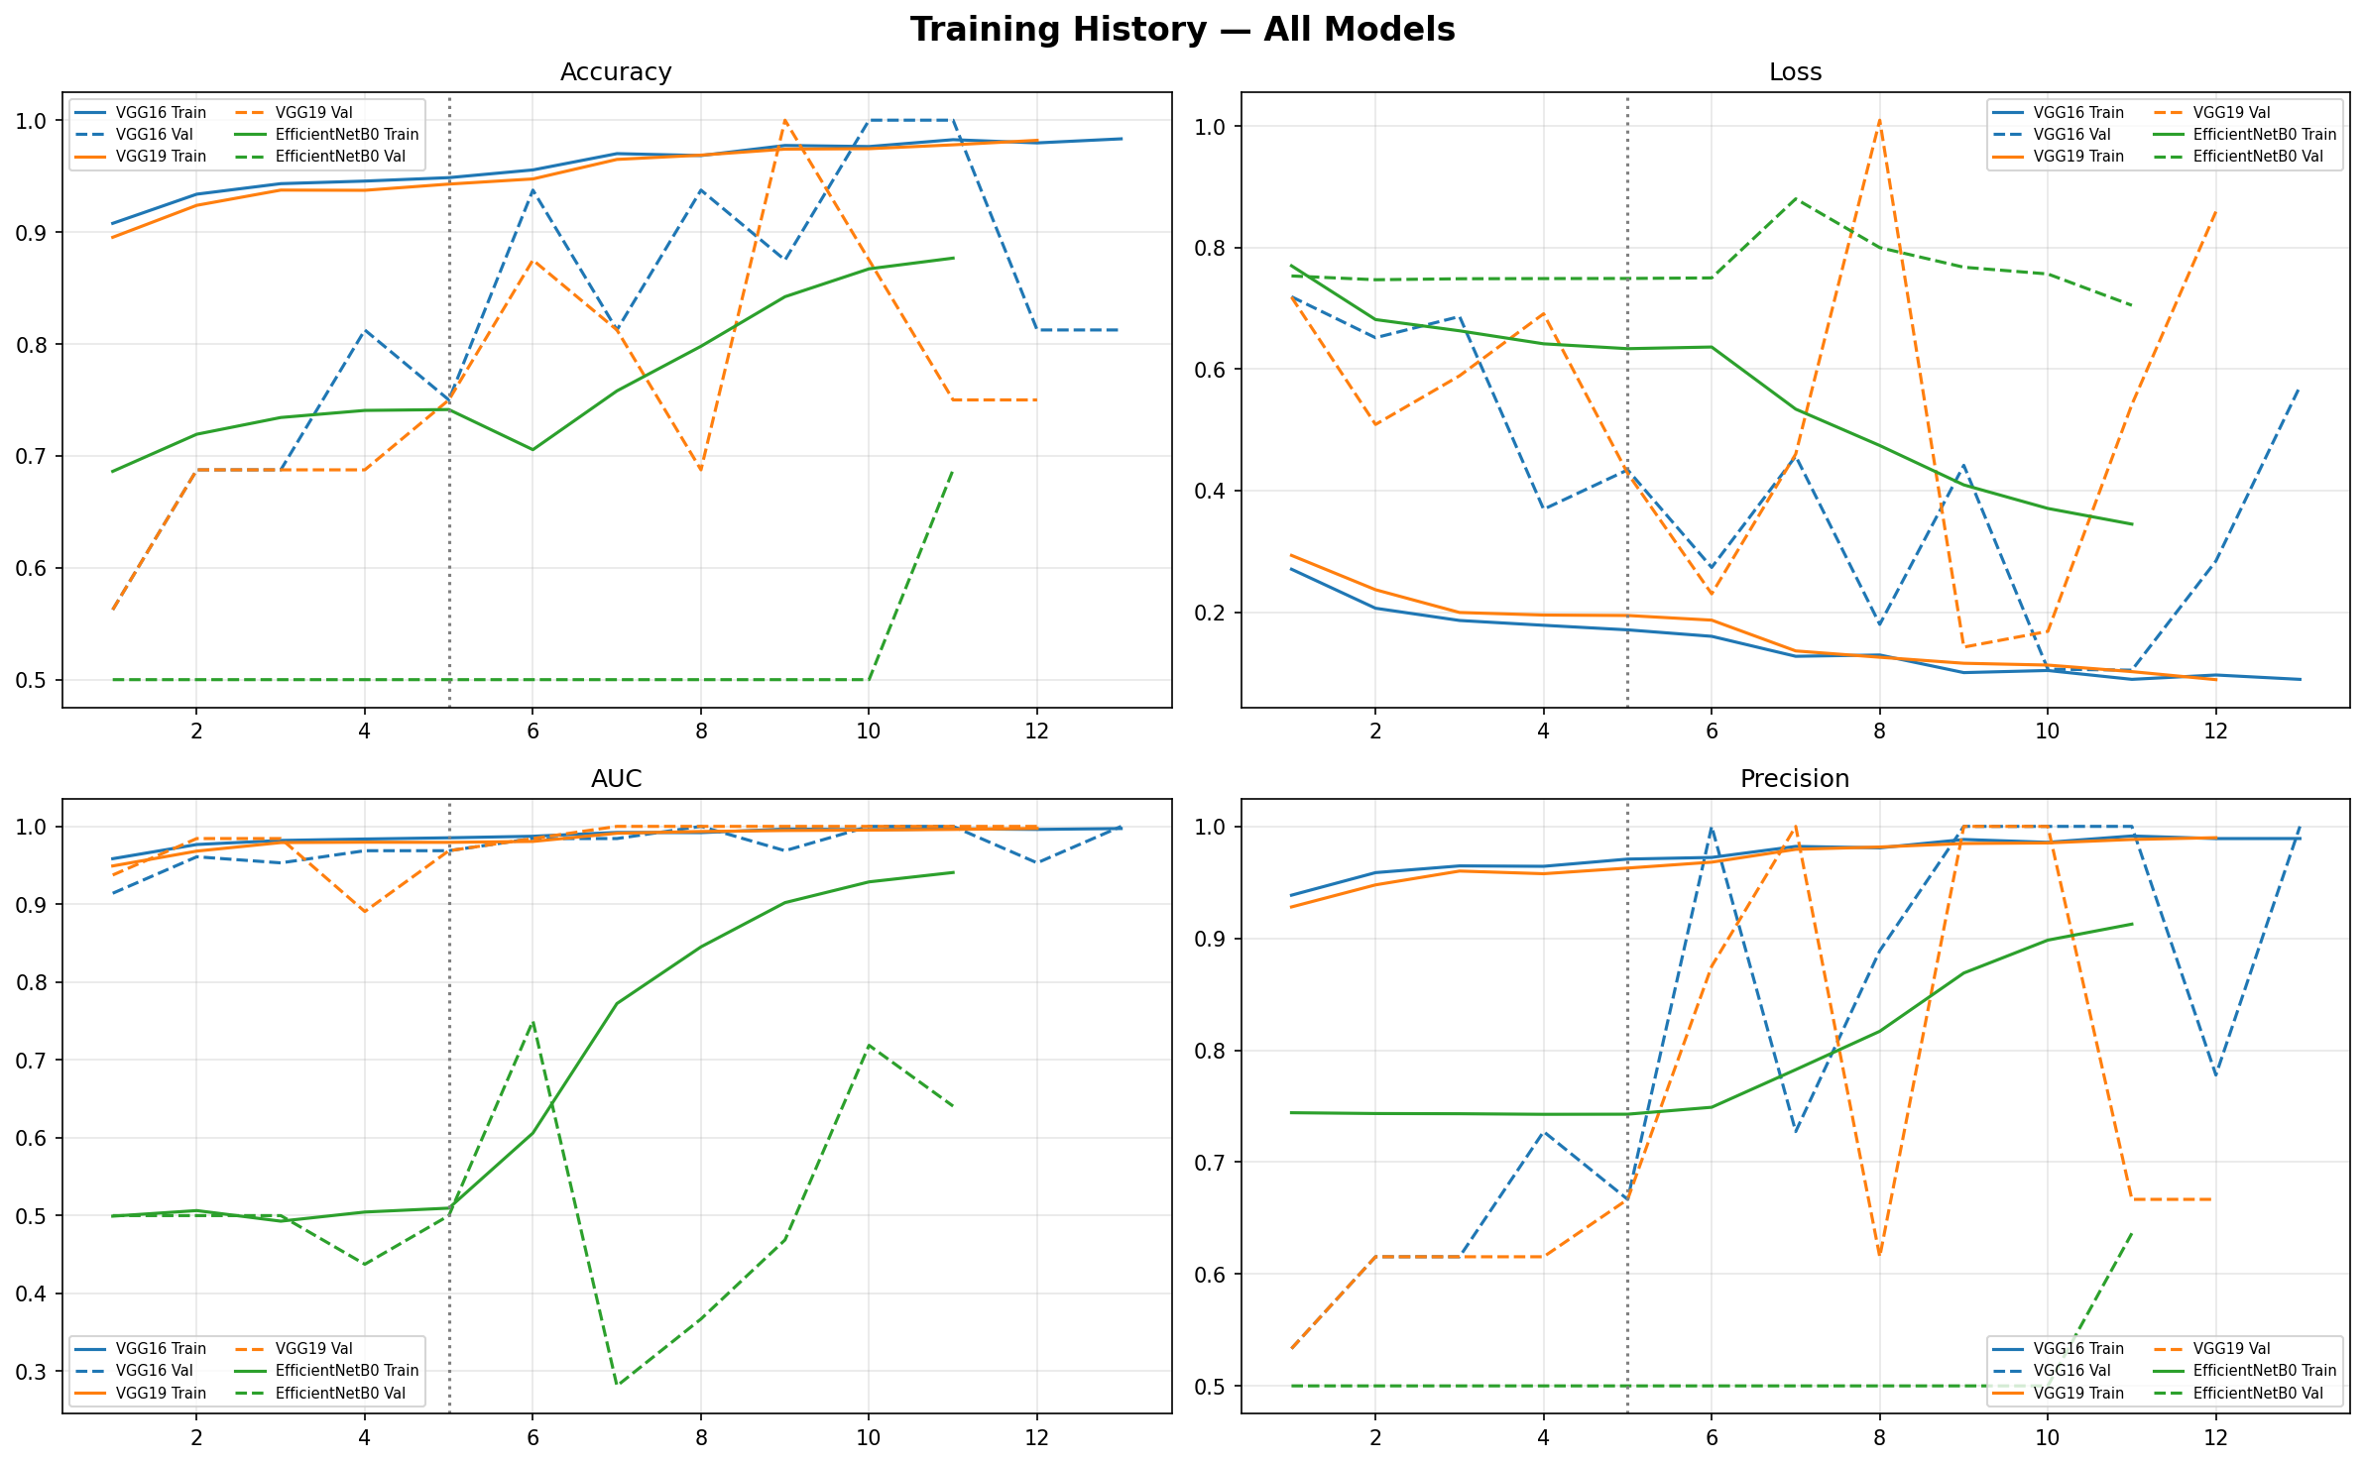
Training Curves
8
Loss and Accuracy over Epochs — All Models
Chest X-Ray Pneumonia Classification | Manara University

Slide 9
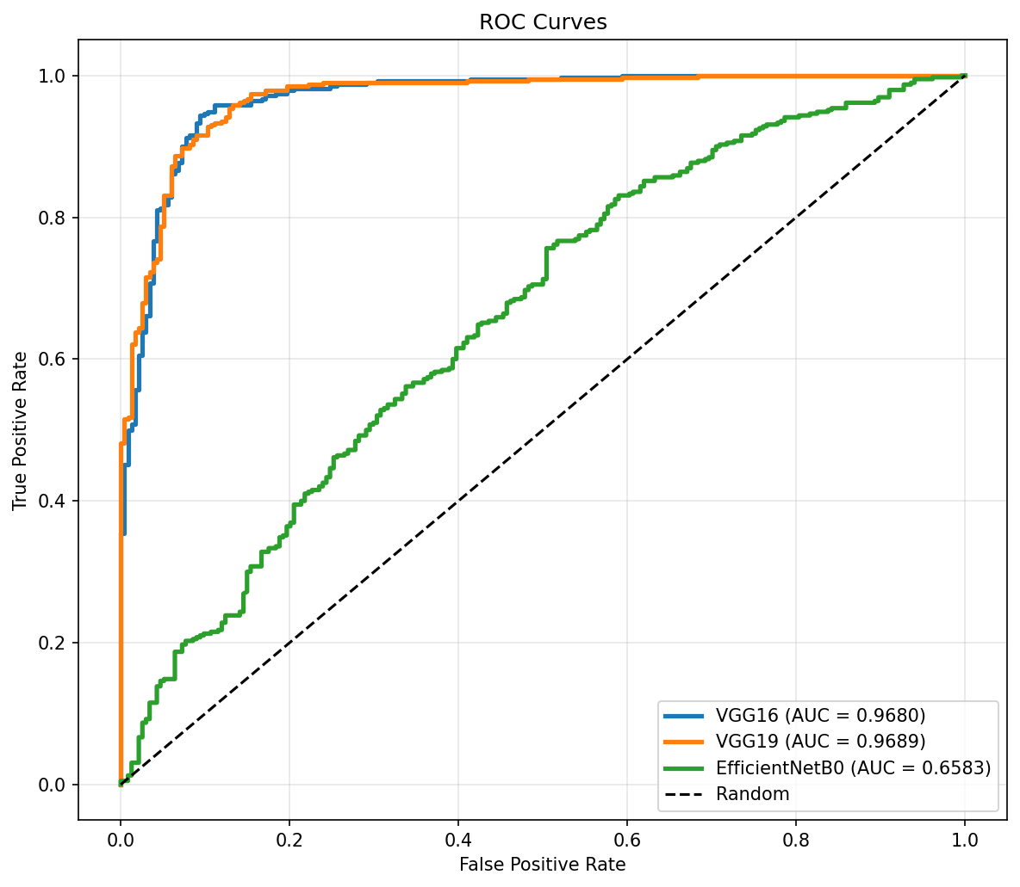
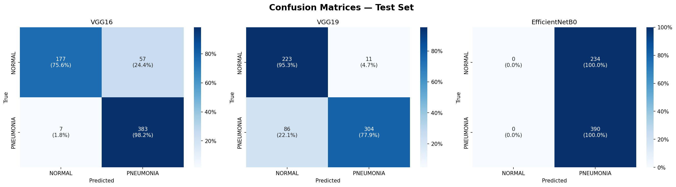
Experimental Results
9
Test Set Performance — All Models
Model | Accuracy | Sensitivity | Specificity | Precision | F1-Score | AUC | Params (M) | Infer. (ms)
VGG16 | 89.74% | 98.21% | 75.64% | 87.05% | 92.29% | 0.968 | 14.86 | 19.93
VGG19 | 84.46% | 77.95% | 95.30% | 96.51% | 86.24% | 0.969 | 20.17 | 14.47
EfficientNetB0 | 62.50% | 100% | 0.00% | 62.50% | 76.92% | 0.658 | 4.40 | 10.23
✅ Best overall performer — highest accuracy, sensitivity, and F1-score
🔷 Best specificity & precision — superior at ruling out false positives
⚠️ Collapsed classifier — predicted all samples as PNEUMONIA (specificity = 0%)
Chest X-Ray Pneumonia Classification | Manara University

Slide 10
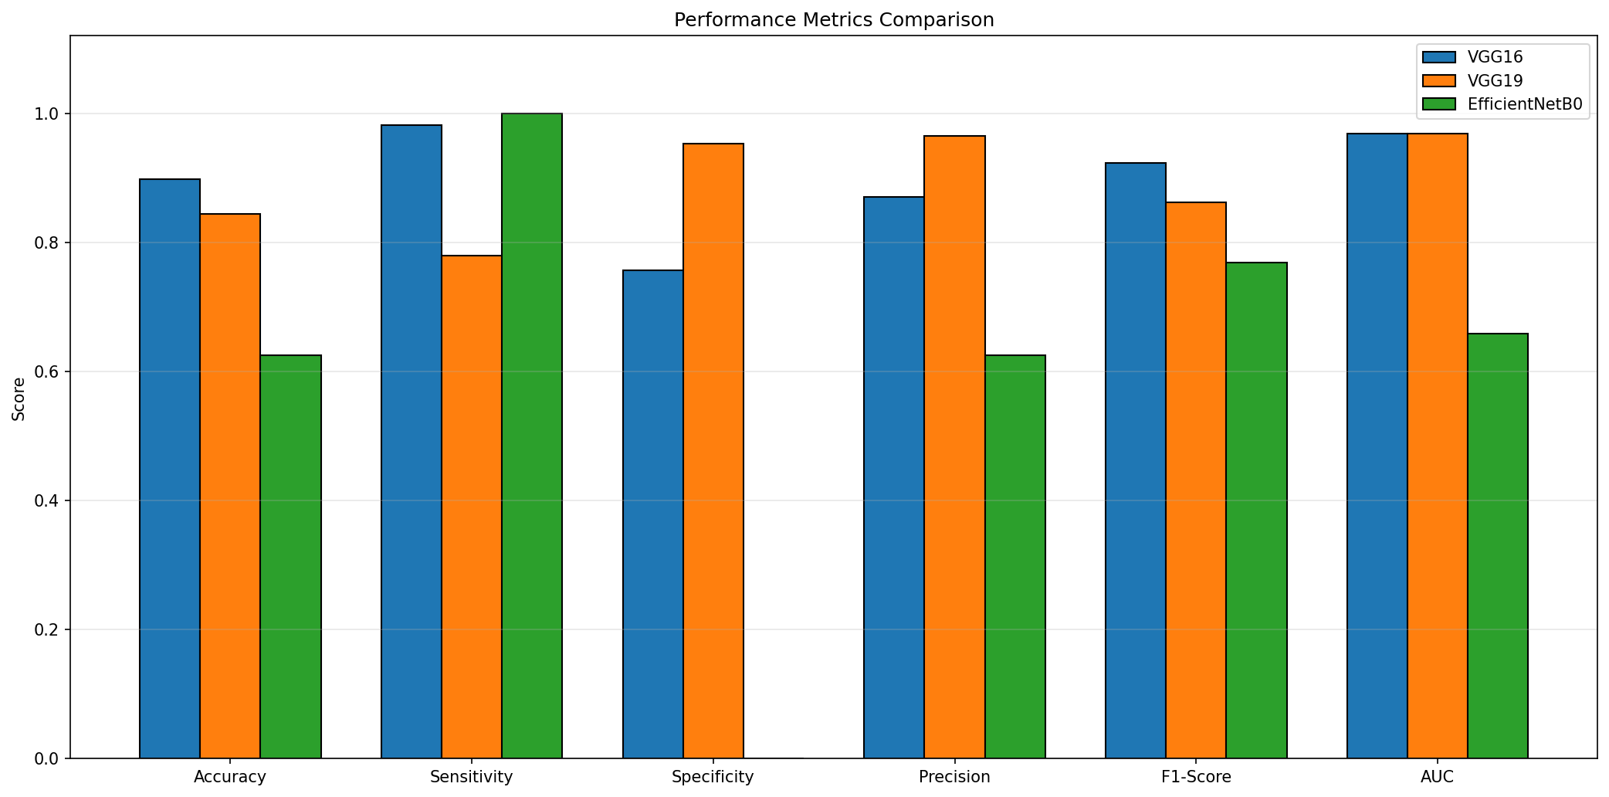
Performance Metrics Comparison
10
Visual Comparison Across All Models and Metrics
Chest X-Ray Pneumonia Classification | Manara University

Slide 11
Model Complexity Analysis
11
Parameters, Inference Time, and Accuracy–Efficiency Trade-off
Complexity Metrics
Trade-off Analysis
Complexity Metrics (Test Set):
Key Observations:
• EfficientNetB0 is 3.4× smaller than VGG16
• EfficientNetB0 is 2× faster than VGG16
• VGG19 is largest but not slowest
• VGG16 provides the best accuracy per unit of computation cost
Accuracy–Efficiency Trade-off:
• EfficientNetB0 offers best efficiency but completely fails (collapsed classifier)
• VGG19 is more expensive with lower overall accuracy than VGG16
• VGG16 strikes the best balance: 89.74% accuracy at moderate cost
Why EfficientNetB0 Failed?
• Architecture requires careful LR tuning
• Batch normalization sensitive to small batches
• May need different augmentation strategy
• Compound scaling less robust to domain-specific medical imaging
• Requires deeper hyperparameter search
Model | Params | Inference
VGG16 | 14.86 M | 19.93 ms
VGG19 | 20.17 M | 14.47 ms
EfficientNetB0 | 4.4 M | 10.23 ms
Chest X-Ray Pneumonia Classification | Manara University

Slide 12
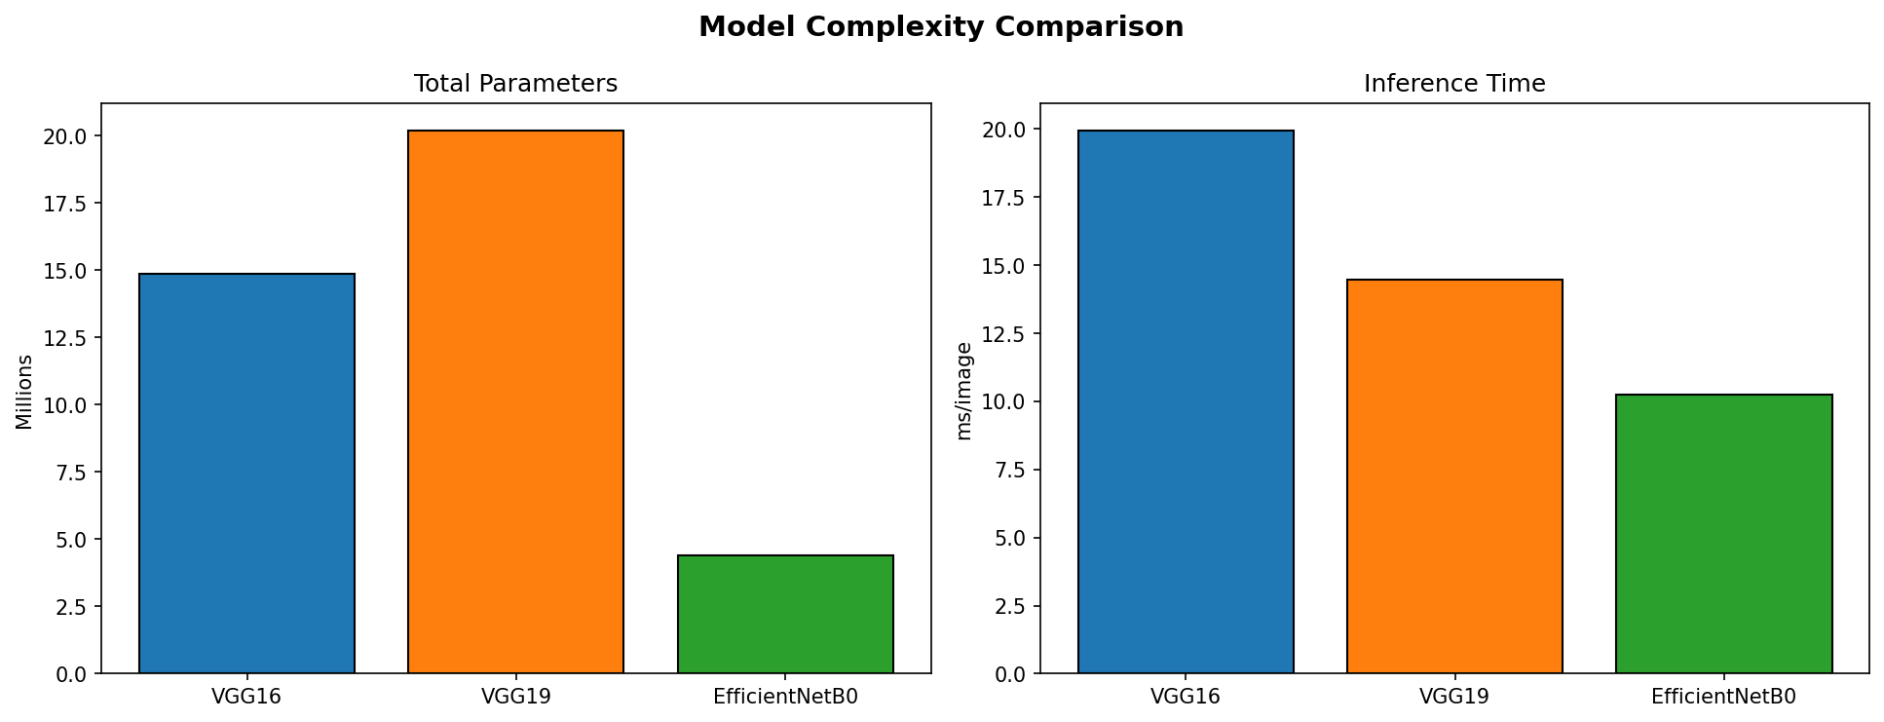
Model Complexity Comparison
12
Parameters, Inference Time, and Accuracy–Efficiency Trade-off
Chest X-Ray Pneumonia Classification | Manara University

Slide 13
Medical Interpretation
13
Clinical Significance of Model Performance
Sensitivity vs. Specificity
Clinical Model Assessment
Sensitivity (Recall for PNEUMONIA):
• Probability of correctly identifying a sick patient as PNEUMONIA
• High sensitivity → fewer missed diagnoses
• Critical for screening tools where missing a case is dangerous → VGG16 achieves 98.21% sensitivity
Specificity (Recall for NORMAL):
• Probability of correctly identifying a healthy patient as NORMAL
• High specificity → fewer false alarms
• Important to avoid unnecessary treatment → VGG19 achieves 95.30% specificity
VGG16 — Best Overall Model:
• 98.21% sensitivity ensures pneumonia cases are rarely missed
• 89.74% accuracy with strong AUC (0.968)
• Best candidate for clinical screening
VGG19 — Best for Ruling Out Disease:
• 95.30% specificity reduces false positives
• 96.51% precision — very reliable positives
• Useful when confirmation testing is costly
EfficientNetB0 — Clinically Unsafe:
• 0% specificity: every normal case classified as PNEUMONIA
• Not suitable for deployment without complete retraining & tuning
Chest X-Ray Pneumonia Classification | Manara University

Slide 14
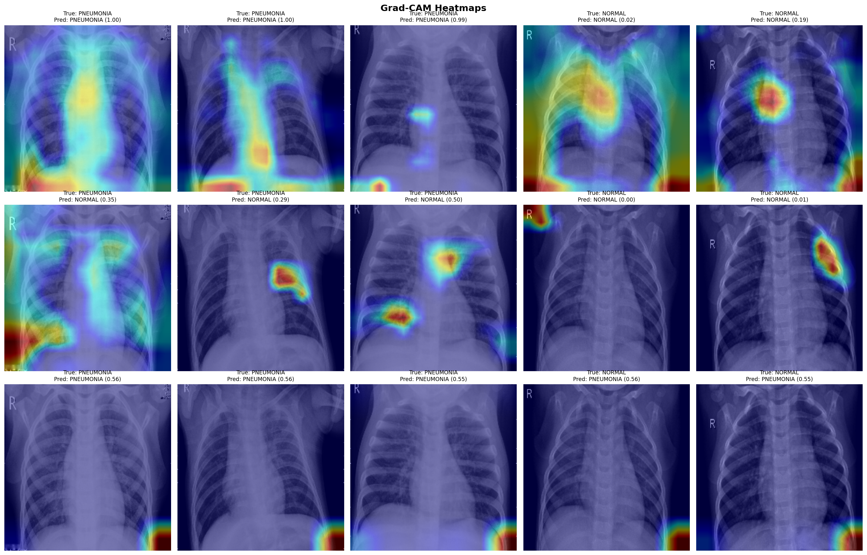
Explainability — Grad-CAM
14
Gradient-weighted Class Activation Mapping
What is Grad-CAM?
Gradient-weighted Class Activation Mapping
(Grad-CAM) visualizes which regions of an
input image were most important for the
model's classification decision.
How it Works:
• Compute gradients of the class score
w.r.t. the last convolutional feature maps
• Weight feature maps by global-average
pooled gradients
• Produce a coarse localization heatmap
• Overlay heatmap on original X-ray
Why It Matters in Medical AI:
• Provides interpretable evidence for
model decisions
• Helps radiologists verify model focus
• Builds clinical trust and accountability
• Reveals pathological lung regions
highlighted by the network
Chest X-Ray Pneumonia Classification | Manara University

Slide 15
Conclusion & Future Work
15
Key Findings and Recommendations
Summary of Findings
Future Directions
Main Findings:
1. VGG16 achieved the best overall balance: 89.74% accuracy, 98.21% sensitivity, AUC = 0.968 — recommended for deployment
2. VGG19 excels in specificity (95.30%) and precision (96.51%) — suitable when minimizing false positives is the priority
3. EfficientNetB0 collapsed to predicting only PNEUMONIA — specificity = 0%, rendering it clinically unusable under the current training setup
4. Transfer learning from ImageNet enables strong performance on limited medical data
5. Grad-CAM confirms models focus onclinically relevant lung regions
Future Work:
• Retrain EfficientNetB0 with dedicatedLR scheduling and class-rebalancing
• Explore EfficientNetB3/B4 orResNet50/DenseNet121 for comparison
• Apply attention mechanisms and Vision Transformers (ViT) for medical imaging
• Extend to multi-class classification:Bacterial vs. Viral vs. Normal
• Clinical validation on external datasets (e.g., CheXpert, NIH ChestX-ray14)
• Deploy as a web-based diagnostic assistance tool for radiologists
• Federated learning for privacy-preservingmulti-hospital training
Chest X-Ray Pneumonia Classification | Manara University

Slide 16
Manara University · Department of Robotics and Intelligent Systems Engineering
Thank You
Questions & Discussion
Project Repository: https://github.com/ZainAlabidinShbani/ml-ai-projects/tree/main/ChestXRay_Pneumonia
Zain Alabidin Shbani · Lana Al Wazzeh · Beilassan Hdewa
Deep Learning Course · Manara University · 2025–2026

