Slide 1

Bayesian Medical Risk Analyzer
Probabilistic Medical Diagnosis Using Bayesian Inference
Authors: Beilassan Hdewa | Lana Alwazzeh | Zain Alabidin Shbani
Supervisor: Dr. Eng. Mohammad Mashi
Course: Machine Learning — Practical Project
Institution: Manara University, Dept. of Robotics & Intelligent Systems
Date: 2026

Slide 2
Problem Statement
Why probabilistic diagnosis matters
• Traditional ML models output deterministic class labels — no uncertainty estimate
• Medical decisions require confidence levels, not just yes/no predictions
• Risk of missed diagnoses when the model is uncalibrated or overconfident
• Goal: Build a system that outputs probability distributions over diagnoses
Output: P(Disease | Patient_Data) — a calibrated posterior probability
2 / 14

Slide 3
Theoretical Background
Gaussian Naïve Bayes from first principles
P(c | x) ∝ P(c) × ∏ᵢ P(xᵢ | c)
• Prior P(c) — initial class probability; estimated from training frequency or set manually
• Likelihood P(xᵢ | c) — Gaussian PDF per feature: P(xᵢ|c) = N(μᵢ,c , σ²ᵢ,c)
• Posterior P(c|x) — updated belief after observing patient measurements
• Log-space inference — prevents numeric underflow; log-sum-exp trick for normalization
Variance smoothing: σ²ᵢ,c ← σ²ᵢ,c + ε where ε = λ · max(σ²) [Laplace-style regularization]
3 / 14

Slide 4
System Architecture
Single-file WinForms application — clean layered design
Data Loader
→
Preprocessor & Validator
→
Bayesian Engine
→
UI / Charts
Application Tabs:
Training
Model Lab
Inference
Analytics
• C# .NET Framework 4.0 — no external ML library; GNB from scratch
• 11 classes in a single source file (BayesianAnalyzer.cs)
• Local dataset-based training — CSV import/export, .mdl model persistence
4 / 14

Slide 5
Dataset & Preprocessing
Four clinical features, binary classification
Feature
CSV Column
Typical Range
Clinical Meaning
Fasting Glucose
Glucose
50–300 mg/dL
Blood sugar level
Age
Age
18–90 years
Patient age
BMI
BMI
15–50 kg/m²
Body-mass index
Blood Pressure
BloodPressure
80–200 mmHg
Systolic BP
Class Label
Status
Healthy / Patient
Binary diagnosis
CSV: Glucose,Age,BMI,BloodPressure,Status
72,24,21.0,110,Healthy | 118,41,28.0,138,Patient
• Minimum 6 total samples; at least 3 per class for valid training
• Stratified 80/20 Train/Test split preserves class ratio in both subsets
5 / 14

Slide 6
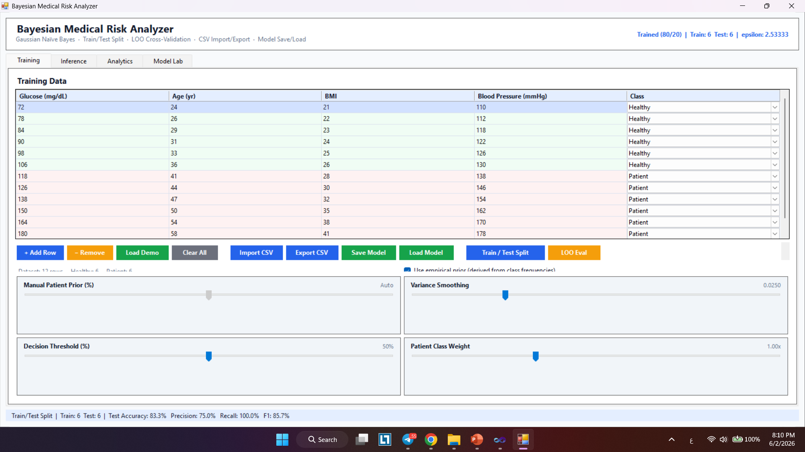
Training Module
Data entry, hyperparameter sliders, and model fitting
• Model learns per-class Gaussian distributions (μ, σ²) via Maximum Likelihood Estimation
• Four interactive sliders: Prior, Variance Smoothing (λ), Decision Threshold, Class Weight
• Supports manual entry, demo dataset, or CSV import; retraining updates all tabs instantly
• Stratified 80/20 split or Leave-One-Out (LOO) cross-validation selectable by user
6 / 14

Slide 7
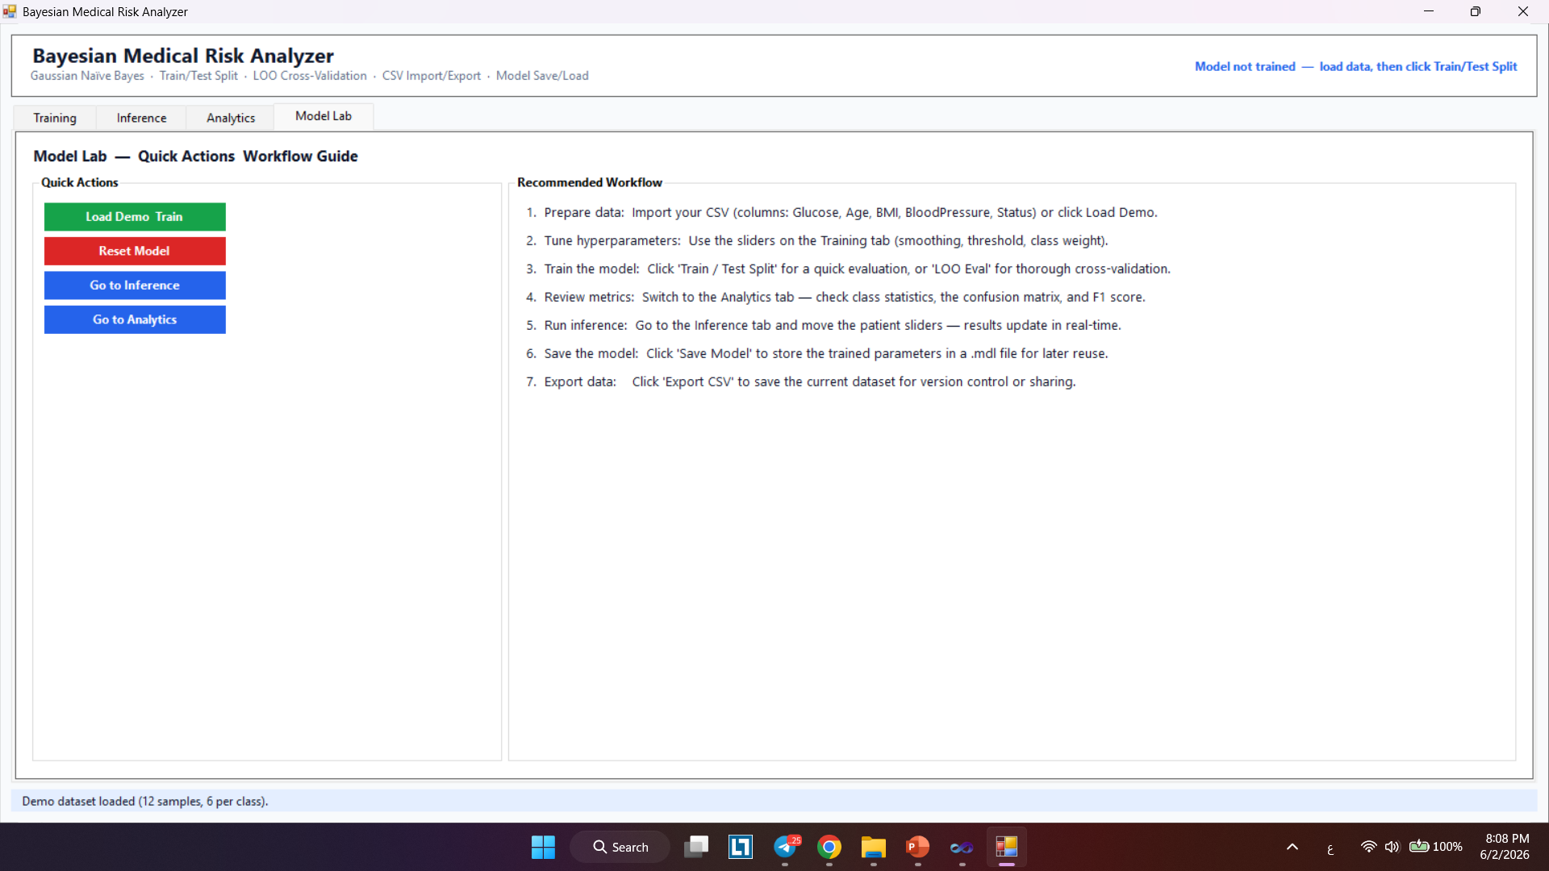
Model Lab
Quick-action control panel and workflow guide
• One-click shortcuts: Load Demo & Train, Reset Model, Go to Inference / Analytics
• Seven-step Recommended Workflow guide built into the tab
• Allows rapid model iteration without navigating multiple tabs
• Supports Save Model (.mdl) and Load Model for session persistence
7 / 14

Slide 8
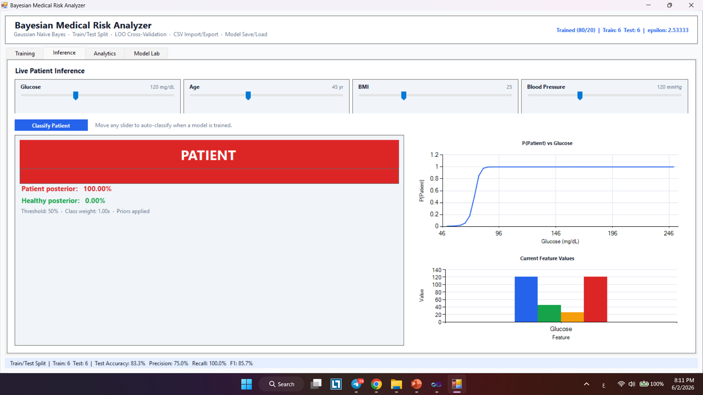
Inference Engine
Real-time posterior probability computation
• User adjusts four sliders (Glucose, Age, BMI, BP) → RunInference() fires automatically
• Output: PATIENT / HEALTHY banner + posterior % via animated RiskBar control
• Z-score outlier detection warns when input lies outside the learned distribution
• P(Patient) vs Glucose line chart updates in real time across 50–250 mg/dL sweep
8 / 14

Slide 9
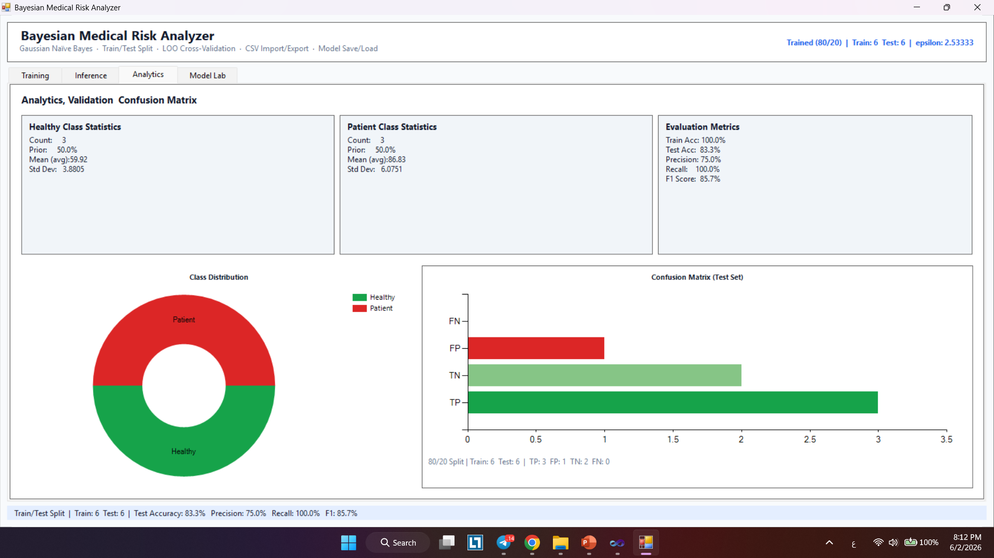
Analytics Engine
Quantifying model performance on held-out test data
Metrics: Accuracy, Precision, Recall, F1-Score per class
Confusion matrix visualization for multi-class diagnosis evaluation
Model benchmarked on held-out test set for unbiased performance reporting
9 / 14

Slide 10
Analytics & Evaluation
Validation results on the demo dataset (12 samples, 80/20 split)
Train Accuracy
Test Accuracy
Precision
100.0 %
83.3 %
75.0 %
Recall
F1 Score
100.0 %
85.7 %
10 / 14

Slide 11
Core: Posterior Probability Computation
Log-space GNB inference — TrainedBayesianClassifier.Predict()
C# BayesianAnalyzer.cs — Predict(double[] features)
// 1. Compute log-joint score for each class
foreach (var model in _classModels) {
double logScore = Math.Log(model.Prior);
for (int i = 0; i < features.Length; i++) {
logScore += LogGaussianPDF(features[i],
model.Means[i], model.Vars[i]);
}
if (model.Label == PositiveLabel)
logScore += Math.Log(settings.PositiveClassWeight);
logScores[model.Label] = logScore;
}
// 2. Log-sum-exp normalization → posterior probabilities
double logZ = LogSumExp(logScores.Values);
double posterior = Math.Exp(logScores[PositiveLabel] - logZ);
return posterior >= settings.DecisionThreshold ? "Patient" : "Healthy";
11 / 14

Slide 12
Challenges & Design Decisions
Trade-offs encountered during implementation
Feature Independence Assumption
Naïve Bayes assumes conditional independence — BMI and BP are correlated in reality;
accepted as a design trade-off for interpretability and computational simplicity.
Zero-Frequency Problem
Collapsed variance → undefined Gaussian PDF; solved with Laplace-style smoothing:
ε = max(λ · globalMaxVariance, 1×10⁻⁶) added to every feature variance.
Prior Selection for Imbalanced Data
Empirical prior (class frequency) vs. manual override via slider;
class weight multiplier on the log-prior enables asymmetric cost adjustment.
C# vs. Python Ecosystem
No sklearn / NumPy — full GNB pipeline, CSV parser, and chart engine built from scratch;
model serialized to portable plain-text .mdl format (locale-invariant floats).
12 / 14

Slide 13
Conclusion & Future Work
Summary and roadmap for extension
Conclusions
Future Work
• Full GNB binary classifier implemented from first principles in C#
• Real-time, uncertainty-aware risk assessment with interpretable outputs
• LOO + Train/Test validation; 83.3% test accuracy on demo dataset
• Portable .mdl model persistence; no external ML library required
• Stratified k-fold cross-validation (k = 5 or 10)
• ROC curve & SHAP feature importance on Analytics tab
• Dynamic feature schema from CSV header (not hard-coded)
• Multi-class extension via one-vs-rest Bayesian classifiers
• Deploy as ASP.NET Core web service with real EHR dataset
• Export trained model as ONNX / PMML for interoperability
🔗 GitHub: github.com/ZainAlabidinShbani/ml-ai-projects/tree/main/Bayesian_Medical_Risk_Analyzer
13 / 14

Slide 14
Thank You
Questions & Discussion
Project Repository: https://github.com/ZainAlabidinShbani/ml-ai-projects/tree/main/ Bayesian_Medical_Risk_Analyzer
Zain Alabidin Shbani · Lana Al Wazzeh · Beilassan Hdewa
Machine Learning Course · Manara University · 2025–2026

