Slide 1


STATISTICAL LEARNING AND DATA MINING
Classification Challenge on Alzheimer’s Disease using MRIs and Gene Expression Data
By
MUHAMMAD ZAIN AMIN
U N I V E R S I T Y O F C A S S I N O A N D S O U T H E R N L A Z I O
01

Slide 2
DATA ANALYSIS
The initial stage of the challenge involves examining the datasets. Here's a brief overview of the summarized outcomes:
• Dimensionality Analysis:
We examine the quantity of features and samples in each dataset.
◦ Task 1 Dataset: samples = 164, features = 429 -> High dimensionality
◦ Task 2 Dataset: samples = 172, features = 63 -> Low dimensionality
◦ Task 3 Dataset: samples = 172, features = 593 -> High dimensionality
• Balance:
we examine the number of samples corresponding to each class:
◦ Task 1 Dataset: 81 AD patients, 83 CTL patients
◦ Task 2 Dataset: 82 AD patients, 90 MCI patients
◦ Task 3 Dataset: 82 CTL patients, 90 MCI patients
Also, we noticed some extreme values also known as extreme data points.
◦ Extreme values significantly deviate from the expected pattern of other data points.
◦ Can have a disproportionate impact on statistical analyses or machine learning models.
◦ Can occur due to measurement errors, data entry mistakes, or rare events.
◦ Task 1 Dataset has 5 extreme values
◦ Task 2 Dataset has 6 extreme values
◦ Task 3 Dataset has 4 extreme values
02

Slide 3
Classification Framework
Data Preprocessing
To prevent any positive bias towards test samples, preprocessing is applied within each fold during k-fold cross- validation.
Feature Selection
To address the issue of high dimensionality and obtain a more informative subset of predictors. Also mitigates overfitting, interpretability, and
reduces computational complexity.
◦ Principal Component Analysis
PCA is used to reduce the number of features in a dataset while preserving the most important information. PCA achieves this by transform the
original variables into new set of uncorrelated variables called principal components. Applied PCA with thresholds (0.75, 0.80, 0.85, 0.90, 0.95).
◦ Removing Correlated Features
To eliminate features that exhibit a correlation exceeding a predefined threshold with any other predictors, a correlation filter is
employed. Various thresholds (0.6, 0.7, 0.8) are tested.
◦ Recursive Feature Elimination
RFE helps to identify and retain the most relevant and informative features by considering their rank on the model's accuracy or predictive
power. We applied different sizes of subset of features like (1, 5, 10, 25, 50, 100, 250).
Classification and Prediction
We applied Logistic Regression and Random Forest model for the classification tasks.
03

Slide 4
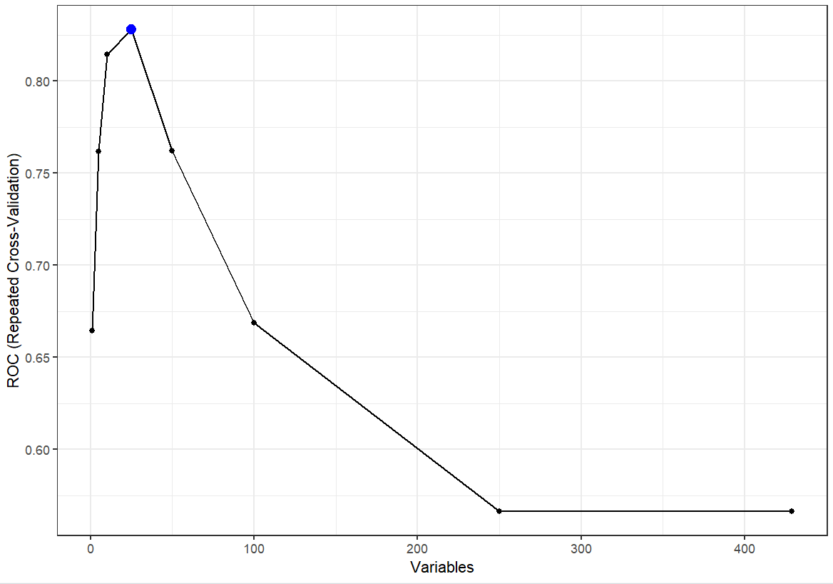
TASK 1 Classification Problem
Let’s take Task 1 as an example. Same approach is applied on other tasks.
• In task 1, we classify Alzheimer disease and Control patients.
• Let’s take Logistic Regression as an example for explanation.
The exact implementation is applied to the Random Forest
model.
◦ For feature selection, RFE is applied with subsets of sizes 1, 5
10,25, 50, 100, and 250.
◦ Results validated using 5-fold repeated cross-validation.
◦ In the graph, you can clearly see that the RFE suggested to use
top 25 variables.
◦ Table 1. shows that the ROC score tops when we use the 25
variables.
Table 1. RFE performance
Variables | ROC | Sensitivity | Specificity
1 | 0.6644 | 0.6046 | 0.6379
5 | 0.7618 | 0.7078 | 0.7018
10 | 0.8145 | 0.7182 | 0.7471
25 | 0.8279 | 0.7724 | 0.7446
50 | 0.7621 | 0.7259 | 0.7388
100 | 0.6688 | 0.6622 | 0.5979
04

Slide 5
TASK 1 Classification Problem (Cont.)
Let’s built a classification model grid to measure the performance of all the feature selection models at multiple thresholds.
◦ We added the RFE model suggested to use the 25 variables.
◦ Added correlation removal with thresholds of 0.6, 0.7, 0.8.
◦ Also applied PCA with thresholds 0.75, 0.8, 0.85, 0.9, 0.95.
• The entire model grid is trained using 10-fold repeated cross validation.
• All models are analyzed according to the area under the AUC.
• Table. shows the results with respect to AUC/ROC.
• From the results, it is seen that the Logistic Regression model that gives the best median scores, achieves AUC = 0.9531250 and MCC = 0.7638 with a PCA threshold of 0.80.
Table 2. Logistic Regression Performance on Task 1
Feature Selection | AUC | MCC
Corr 0.6 | 0.7539062 | 0.50819889
Corr 0.7 | 0.7569444 | 0.41666667
Corr 0.8 | 0.5295139 | 0.05555556
PCA 0.75 | 0.9531250 | 0.75000000
PCA 0.8 | 0.9531250 | 0.76388889
PCA 0.85 | 0.9375000 | 0.75000000
PCA 0.90 | 0.9153646 | 0.63894619
PCA 0.95 | 0.9487847 | 0.76388889
RFE | 0.9062500 | 0.62994079
05

Slide 6
Performance Analysis on Task 1, 2 and 3
Task 1 Classification Results : Alzheimer Disease vs. Control patients
Model | Best feature selection method found | Number of features/components used | AUC | MCC
Logistic Regression | PCA Threshold 0.80 | 15 | 0.9531 | 0.76388
Random Forest | Recursive Feature Elimination | 10 | 0.9492 | 0.77459
Task 2 Classification Results: Alzheimer Disease vs. Mild Cognitive Impairment patients
Model | Best feature selection method found | Number of features/components used | AUC | MCC
Logistic Regression | PCA Threshold 0.85 | 12 | 0.80555 | 0.416666
Random Forest | Recursive Feature Elimination | 40 | 0.7808 | 0.49959
06

Slide 7
Performance Analysis on Task 1, 2 and 3 (Cont.)
Task 3 Classification Results: Mild Cognitive Impairment vs. Control patients
Model | Best feature selection method found | Number of features/components used | AUC | MCC
Logistic Regression | PCA Threshold 0.85 | 16 | 0.8888 | 0.6017
Random Forest | Recursive Feature Elimination | 10 | 0.8750 | 0.5493
• It is clearly seen from the results that the model that achieved the best Area under the curve / ROC is Logistic Regression with Principal Component Analysis that uses 15, 12, 16 features for the task 1, task 2, and task 3 respectively.
• We test the accuracy of the best model i.e. Logistic Regression using all the samples in the training set from one hand and after removing the extreme data points from another. The results show that in Task 1, Task 2 and Task 3 removing the extreme data points does not change the results of the Logistic Regression model.
• The best model, Logistic Regression is used to predict the classes for the test datasets of task 1, task 2 and task 3.
07

Slide 8


