Slide 1


Machine Learning and Deep Learning
Automated Skin Lesion Classification: A Comprehensive Analysis of Transfer Learning and Machine Learning Techniques
By
Muhammad Zain Amin
Md Imran Hossain
Taiabur Rahman
01

Slide 2
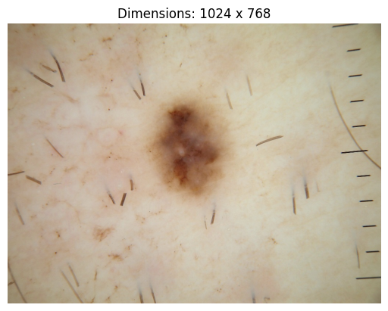
Skin Lesion
Skin lesion refers to an abnormal growth or appearance on the skin that deviates from the surrounding healthy skin.
According to the World Health Organization (WHO) estimates, Globally in 2020, over 1.5 million cases of skin cancers were diagnosed and over 120,000 skin cancer associated deaths were reported.
Causes and Risk factors:
Age factor
Exposure to radiation
Ultra-violet from the sun
Substance abuse, chemicals, environment pollutants
02

Slide 3
Treatment and Detection of Skin Cancer
To reduce mortality growth rate due to skin cancer, early detection and treatment is essential.
But the problem is that:-
“Even an experienced dermatologists analysing the skin lesions manually may reach to wrong decision in grading”.
Problem Solution:-
“Automatically getting the most significant information from skin lesion images, we can use machine learning and deep learning technique for detection and classification of skin lesions types”.
03

Slide 4
Project Objective
To develop a computer aided diagnosis (CAD) system in order to detect skin lesions using deep learning and machine learning techniques.
The ISIC2017 challenge dataset is used to classify the lesions categories such as benign, melanoma, and seborrheic keratosis.
A two-step hierarchal classification pipeline is developed: the first stage is “benign vs. others” and the second stage is “melanoma vs. seborrheic keratosis”.
04

Slide 5
ISIC 2017 Skin Lesion Dataset
The ISIC 2017 dataset has been widely used for training and evaluating machine learning and deep learning models in skin classification tasks.
The ISIC 2017 dataset has high resolution and different sizes (from 540x722 to 4000x6000 pixels) images.
ISIC2017 Data Info
Lesion Types | Number of Images
 | Train | Validation | Test
Benign | 1372 | 78 | 393
Melanoma | 374 | 30 | 117
Seborrheic keratosis | 254 | 42 | 90
Total | 2000 | 150 | 600
* https://challenge.isic-archive.com/data/#2017
05

Slide 6
ISIC 2017 Skin Lesion Dataset
Training Ground Truth Data
Validation Ground Truth Data
Testing Ground Truth Data
image id | melanoma | seborrheic keratosis
ISIC_0000000 | 0 | 0
ISIC_0000001 | 0 | 0
ISIC_0000002 | 1 | 0
ISIC_0000003 | 0 | 0
ISIC_0000004 | 1 | 0
image id | melanoma | seborrheic keratosis
ISIC_0001769 | 0 | 0
ISIC_0001852 | 0 | 0
ISIC_0001871 | 0 | 0
ISIC_0003462 | 0 | 0
ISIC_0003539 | 0 | 0
image id | melanoma | seborrheic keratosis
ISIC_0012086 | 0 | 1
ISIC_0012092 | 0 | 0
ISIC_0012095 | 0 | 0
ISIC_0012134 | 0 | 1
ISIC_0012136 | 0 | 1
* https://challenge.isic-archive.com/data/#2017
06

Slide 7
Dataset Handling
Two-step hierarchal data handling:
ISIC 2017 Dataset
benign
others
melanoma
seborrheic
keratosis
1st Step
2nd Step
07

Slide 8
Dataset Handling
Given Training Ground Truth Data
Modified Training Ground Truth Data
image id | melanoma | seborrheic keratosis
ISIC_0000000 | 0 | 0
ISIC_0000001 | 0 | 0
ISIC_0000002 | 1 | 0
ISIC_0000003 | 0 | 0
ISIC_0000004 | 1 | 0
image id | melanoma | seborrheic keratosis | benign | others
ISIC_0000000 | 0 | 0 | 1 | 0
ISIC_0000001 | 0 | 0 | 1 | 0
ISIC_0000002 | 1 | 0 | 0 | 1
ISIC_0000003 | 0 | 0 | 1 | 0
ISIC_0000004 | 1 | 0 | 0 | 1
benign = 1 ; if melanoma and seborrheic keratosis both are 0
Others = 1 ; if either melanoma and seborrheic keratosis is 1
* We used the similar technique for both the validation and test data set
08

Slide 9
Data Balancing
Training dataset is highly imbalanced [ benign 1372 vs others 628].
To perform the first step of the hierarchal classification, we have downsampled the Benign cases to 1000 samples from 1372 samples. Others class consisting of melanoma and seborrheic keratosis cases have been upsampled to 1000 samples from 628 samples.
To perform the second step of the hierarchal classification, we have removed the benign cases from the training set in order to perform the melanoma vs. seborrheic keratosis classification.
1327
628
benign
others
1000
1000
benign
others
09

Slide 10
Data Preprocessing
Before feeding the images to the network, few steps are necessary: For each skin lesion image the following preprocessing pipeline is applied:
Resizing the images to 128x128.
Normalization of dataset images. [Each pixel of images is divided by 255. By dividing by 255, the pixel values are scaled to the range of 0 to 1. This is a common technique for normalizing pixel values in images, as it brings them to a standardized range]
10

Slide 11
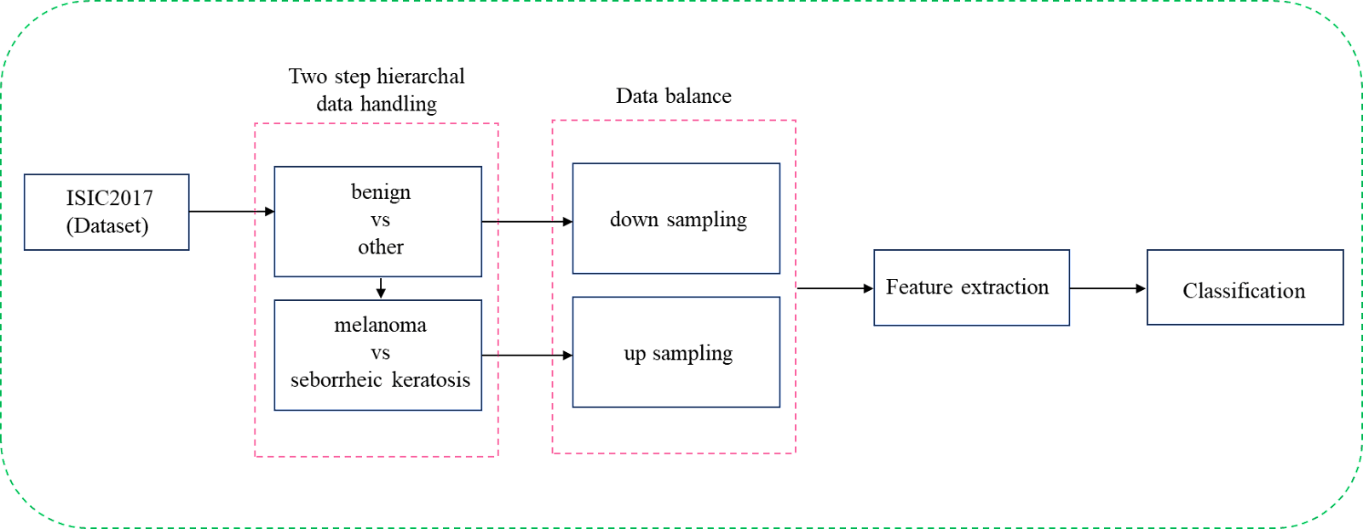
Proposed Computer Aided Diagnosis (CAD) System
Our CAD system is developed based on a two-step binary hierarchal classification. Several models based on Hybrid Architecture and Transfer Learning Techniques have been evaluated.
11

Slide 12

Transfer Learning Approach
Training a model from scratch requires a lot of data, and even if such data are available, it would require a lot of time.
We download several pretrained CNN models (e.g., VGG16, ResNet50, Xception, Inception, EfficientNetV2) from Keras Application and retrained mentioned models using ISIC 2017 dataset for the classification challenge.
Step1:
We used the pretrained model as feature extractor.
Freeze all network parameters (to keep parameters fixed during retraining).
Remove the last layer (classification layer).
Replace final layer (with a sigmoid function for binary classification)
$$s= \frac{1}{1+ e^{−x}}$$
= S [0,1]
Sigmoid Function,
12

Slide 13
Transfer Learning Approach
Step 2:
We have fine tuned the pretrained model on our Skin lesion dataset.
We retrained the pretrained imagenet models using our own data (ISIC 2017) without weight initialization.
Its not what we trained from scratch since the network weights are those of the pretrained nets.
13

Slide 14
Experimental Environment for the Training
The experiment mainly uses deep learning models. The hyperparameters uniformly set for these models are shown in Table.
The goal of the optimizer is to update the parameters of a model iteratively in order to minimize the loss function.
The learning rate determines the step size taken during optimization. It controls how much the weights of the model are updated based on the calculated gradients.
Parameters | Value
Batch Size | 16
Epochs | 10
Learning Rate | 0.001, 0.005 [varies]
Optimizers | Adam, SGD
14

Slide 15
Experimental Environment for the Training
(iii) In deep learning, Batch size refers to the number of training examples or data points that are processed together in a single forward and backward pass during the training of a neural network. In this case, our entire train data will be divided into 16 batches.
(iv) In deep learning, an epoch refers to a complete iteration through the entire dataset during the training process of a neural network. In our project, we used 10 epoch for training the model.
15

Slide 16
Hybrid Approach
Extracting features using pretrained CNN models and execute classification task using
machine learning classifier models.
Working Steps:
We used the pretrained CNN models (e.g., VGG16, ResNet50, Xception, Inception, EfficientNetV2) from Keras Application as feature extractor.
Freeze all network parameters (to keep parameters fixed during retraining).
Remove the last layer and train traditional Machine Learning Classifiers (e.g,. Random Forest, XGBoost, SVM, Logistic Regression) on top of the CNN features.
16

Slide 17
Binary Cross Entropy
In addition, we have used the binary cross entropy loss function for our classification purpose. It measures the dissimilarity between the predicted probability distribution and the true binary labels. The formula can be expressed as:
Binary Cross Entropy = - (y * log σ (p) + (1 - y) * log(1 - σ (p))
where,
p = prediction of the model
y = ground truth
σ = sigmoid function.
17

Slide 18
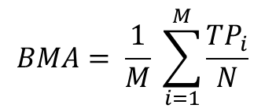
Best Result for the Hybrid Model
Feature Extractor | Classification Model | Benign vs Other |  |  | Melanoma vs Seborrheic Keratosis |  |  | BMA
 |  | Accuracy | Sensitivity | Specificity | Accuracy | Sensitivity | Specificity
Xception | Random Forest | 0.70 | 0.82 | 0.47 | 0.76 | 0.74 | 0.80 | 0.79
 | Naïve Bayes | 0.56 | 0.48 | 0.72 | 0.71 | 0.74 | 0.69 | 0.63
 | Support Vector Machine | 0.68 | 0.73 | 0.59 | 0.73 | 0.72 | 0.74 | 0.74
 | Logistic Regression | 0.70 | 0.75 | 0.62 | 0.72 | 0.70 | 0.74 | 0.73
 | Decision Tree | 0.60 | 0.65 | 0.50 | 0.70 | 0.66 | 0.76 | 0.69
 | K Nearest Neighbors | 0.56 | 0.46 | 0.75 | 0.70 | 0.82 | 0.54 | 0.60
 | Gradient Boosting Machines | 0.70 | 0.72 | 0.67 | 0.72 | 0.68 | 0.77 | 0.72
 | XGBoost | 0.70 | 0.77 | 0.57 | 0.70 | 0.66 | 0.76 | 0.73
$$BMA= \frac{1}{M} \sum_{i=1}^{M}{\frac{{TP}_{i}}{N}}$$
M = Number of class.
TP = Ture positive.
N = Total number of sample.
* Performance matrix of all the models are available in the report.
18

Slide 19
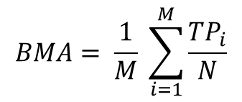
Best Results for the Transfer Learning Models
Model | Optimizer | Learning Rate | Benign vs Other |  |  | Melanoma vs Seborrheic Keratosis |  |  | BMA
 |  |  | Accuracy | Sensitivity | Specificity | Accuracy | Sensitivity | Specificity
VGG16 | Adam | 0.005 | 0.72 | 0.90 | 0.38 | 0.70 | 0.71 | 0.68 | 0.76
 | SGD | 0.005 | 0.72 | 0.83 | 0.52 | 0.70 | 0.66 | 0.76 | 0.75
InceptionResNetv2 | Adam | 0.005 | 0.77 | 0.83 | 0.64 | 0.67 | 0.53 | 0.86 | 0.74
 | SGD | 0.005 | 0.77 | 0.79 | 0.75 | 0.74 | 0.75 | 0.73 | 0.76
DenseNet201 | Adam | 0.005 | 0.69 | 0.75 | 0.58 | 0.75 | 0.71 | 0.82 | 0.76
 | SGD | 0.001 | 0.66 | 0.62 | 0.73 | 0.70 | 0.76 | 0.62 | 0.67
$$BMA= \frac{1}{M} \sum_{i=1}^{M}{\frac{{TP}_{i}}{N}}$$
M = Number of class.
TP = Ture positive.
N = Total number of sample.
* Performance matrix of all the models are available in the report.
19

Slide 20
Conclusion and Future Scope
The results show a potential of improvement in this task using hybrid technique.
Possible future work includes more optimization and preprocessing in the feature engineering step of machine learning, further fine tuning of the model parameters in deep learning.
It is clear that some models performed outstanding with benign and other classes and some models performed better with melanoma and seborrheic keratosis classes.
Therefore, a new model with the combination of the best performed model with benign and other classes and melanoma and seborrheic keratosis classed can be proposed in future.
20

Slide 21


