Slide 1
Social Network Analysis IS 324
January 23, 2024
Jaihyun Park
jaihyun2@Illinois.edu

Slide 2
Introducing our TA
Jinmo Kim (jinmok2@Illinois.edu)

Slide 3
Computational social science
Our life is full of networks.
We check emails, message friends, make phone calls, check out books from libraries, and make purchases with credit cards.
We also use social media to get in touch with friends.
It has become an important component of living.
Imagine how often we open Snapchat, Instagram, or YouTube.
Imagine how lonely we will be if we are disconnected from family and friends.
Humans are social being: Emotional support + Entertaining

Slide 4
Computational social science
What is connecting us? : Real-life network
Family
Hobby (e.g., Sports)
Friends
Co-workers or mentor-mentee
Neighbors
What is connecting us? : Virtual/Online network
Social media
Online games
The lines between real-life network and online network have become blurry.

Slide 5
Computational social science
How do we know we are connected? : Real-life
What is being connected?
Entities (e.g., Humans, companies, or geographic locations)
How are they connected?
Relations (e.g., Friends, co-workers, or neighbors)
How do we know we are connected? : Virtual/Online
What is being connected?
Entities (e.g., User accounts)
How are they connected?
Relations (e.g., Follow, likes, or teams)

Slide 6
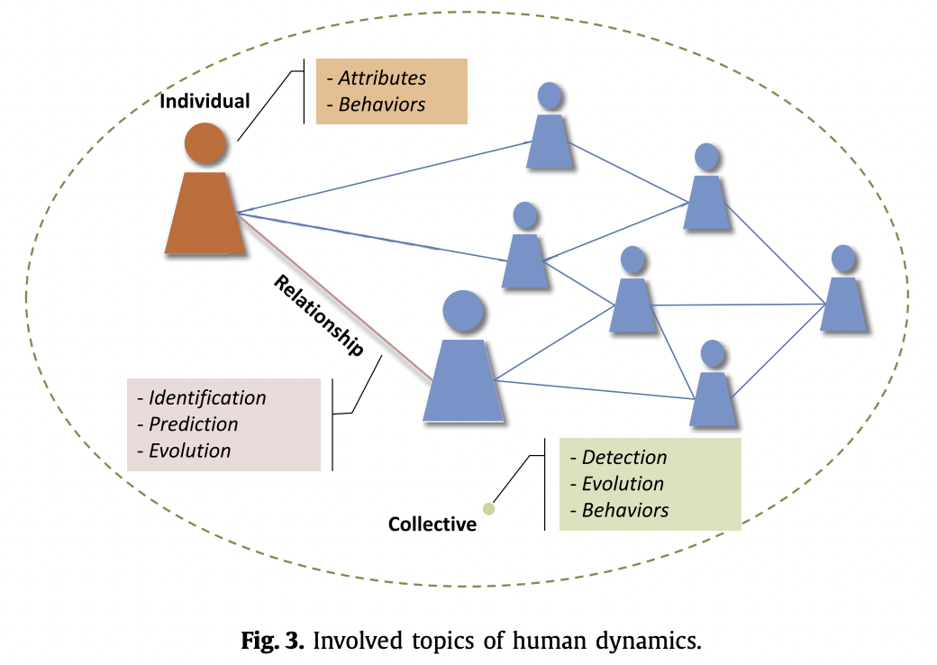
Computational social science
What do we learn from social networks?
Zhang et al. 2020
Notes:
Individual-level VS. macro-level

Slide 7
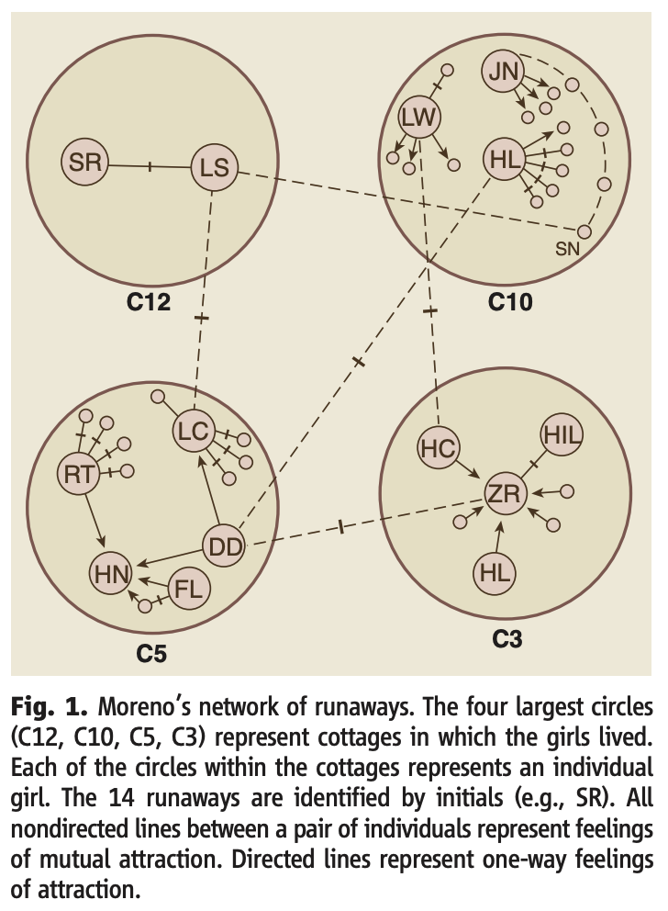
Network analysis in the social sciences
In 1932, there was an epidemic of runways at the Hudson School for Girls in upstate NY. In just 2 weeks, 14 girls had run away.
Moreno (1934) suggested the reason for the spike of runways had less to do with individual factors than underlying social network.
Moreno (1934) argued that social network unconsciously worked to determine whether and when they ran away.
Moreno, J. L. (1934) Who Shall Survive? A new approach to the problem of human interrelations. Nervous and Mental Disease Publishing Co.

Slide 8
Network analysis in the social sciences
The society is not just the sum of the individuals but rather more than the sum of the individuals composing the society.
In the 1940s and 1950s social network studies adopted social-psychological concepts, making it possible to discover emergent group.
Notes:
So what does Moreno study implies?

Slide 9
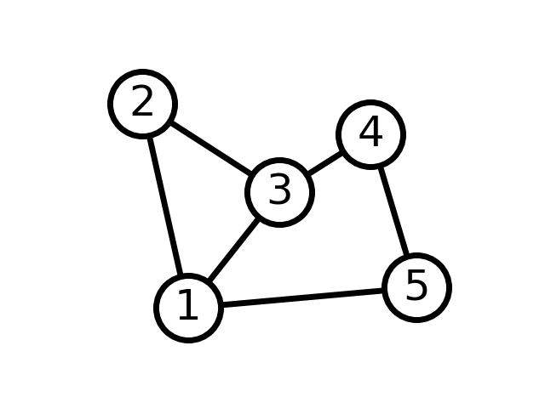
Basic concepts in network analysis
Nodes (i.e., vertices, agents, or points) = Entities
Nodes are what are being connected in the network.
Edges (i.e., links, ties, or arcs) = Relations
Edges represent the connection.

Slide 10
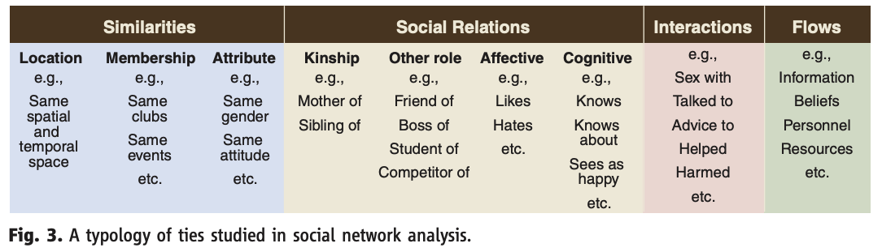
Basic concepts in network analysis
Borgatti et al. (2009). “Network analysis in the social sciences.” Science, 323 (5916), 892-895.
Notes:
Types of edges

Slide 11
Basic concepts in network analysis
Attributes
Attributes are additional information associated with nodes or edges.
Attributes can be categorical, numerical, or textual.
Node attributes
Age, gender, or location
Centralities (e.g., degree, betweenness, or eigenvector)
Edge attributes (i.e., Edge weights)
Frequency of connection
Notes:
Frequency of connection can show the strength of communication between two nodes. Attributes can be represented in colors in the visualization.

Slide 12
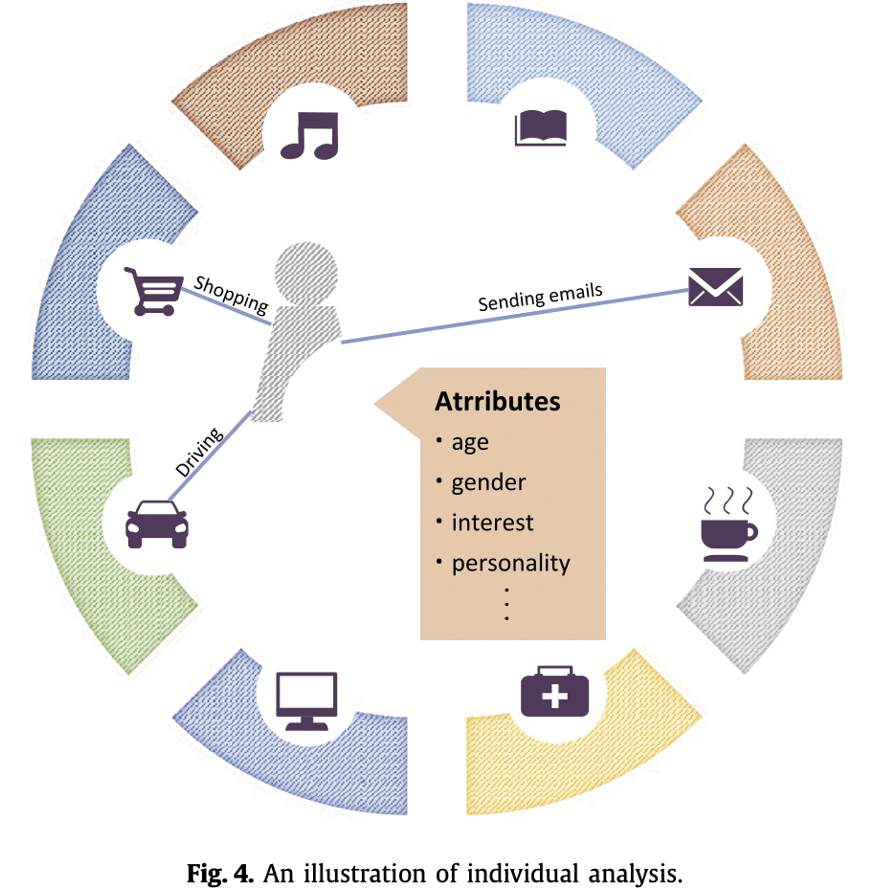
Basic concepts in network analysis
Zhang et al. 2020

Slide 13
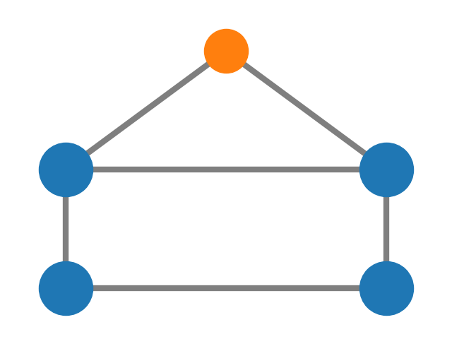
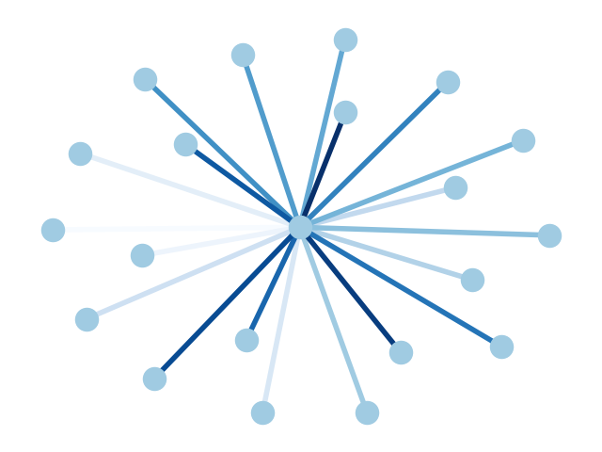
Basic concepts in network analysis
What information about attributes can we find from these two graphs (networks)?
Notes:
What information do these network convey?
Node attribute on the left
Edge attribute on the right

Slide 14
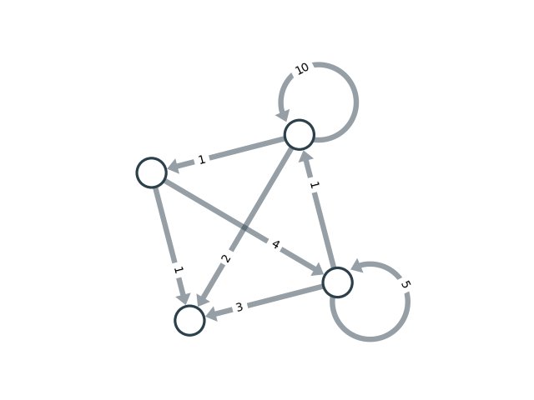
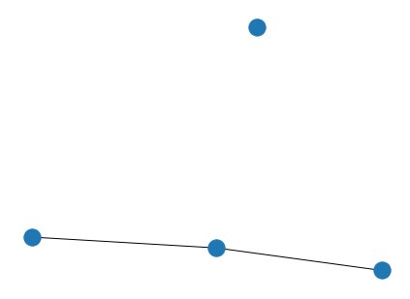
Basic concepts in network analysis
Types of irregular nodes
Self-loop nodes
Isolates
Notes:
This becomes important in visualization.

Slide 15
Basic concepts in network analysis
Types of graph
Directions
Undirected graph
Directed graph (Diagraph)
Attributes
Weighted graph
Unweighted graph

Slide 16
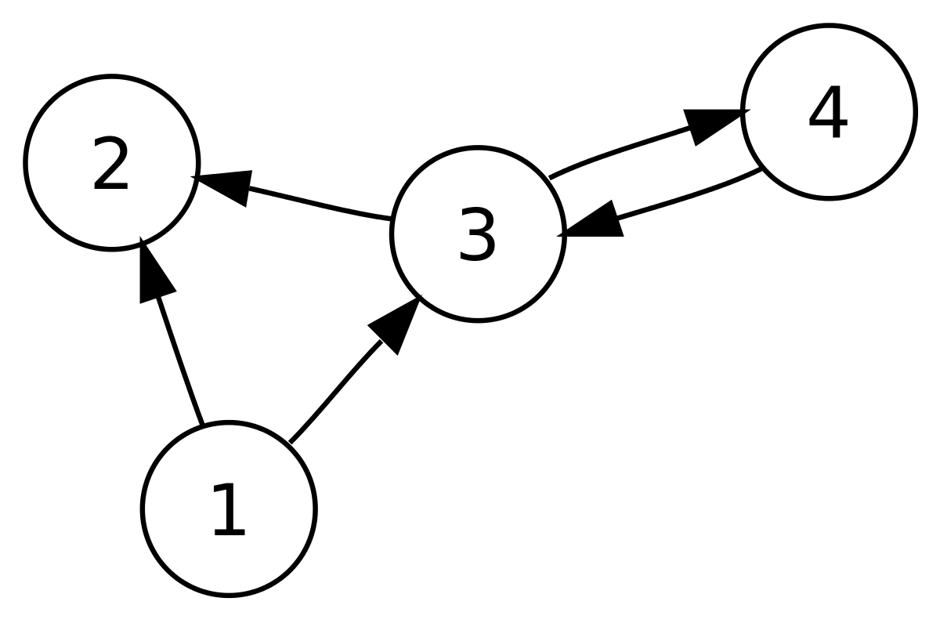
Basic concepts in network analysis

Slide 17
Basic concepts in network analysis
Group discussion (2-3ppl)
What are the examples of directed graphs?
Directed graphs are for asymmetrical and one-way connections.
What are the examples of undirected graphs?
Undirected graphs are symmetrical and have edges with no directions.
Notes:
Hyperlinks, mention, retweet networks

Slide 18
Basic concepts in network analysis
Examples of directed graphs:
Phone calls
Emails
Web pages with hyperlinks
Examples of undirected graphs:
Friendship??? (can be directed graphs)
Transportation network (e.g., two-way roads)

Slide 19
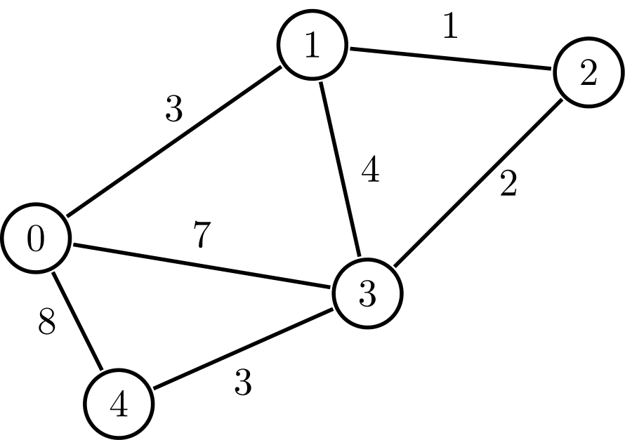
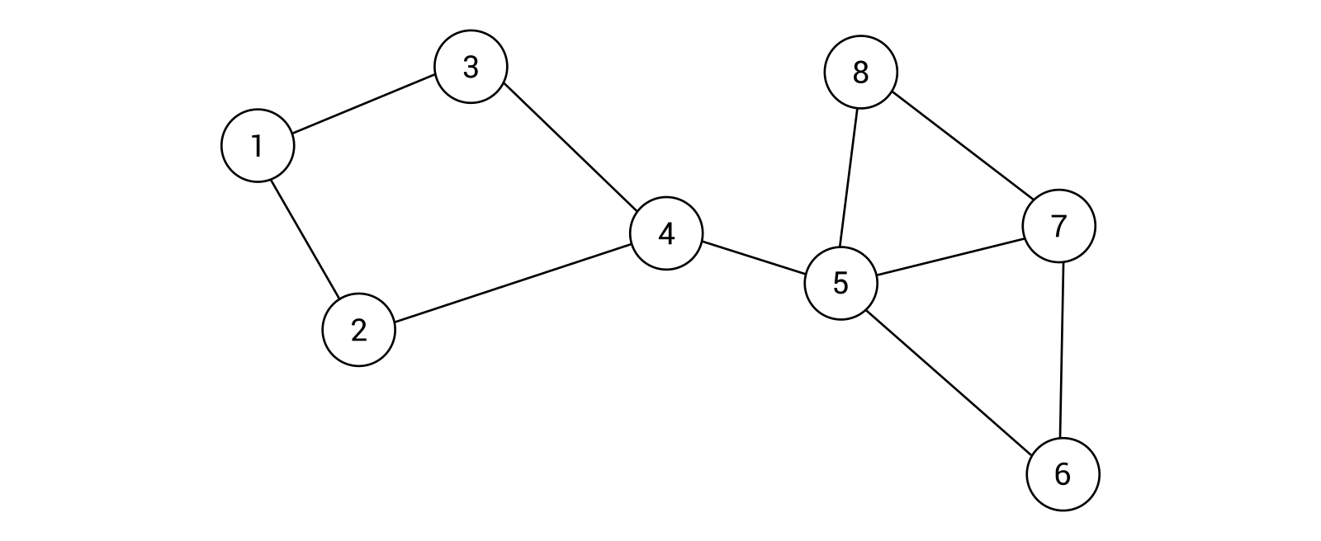
Basic concepts in network analysis
Group discussion (2-3 ppl)
What are the examples of weighted graphs?
Weighted graphs can have numerical or categorical values to indicate the strength or distance of the relationship between nodes.
What are the examples of unweighted graphs?
Unweighted graphs represent all edges to have equal value.
Notes:
A weighted graph assigns numerical values (or weights) to edges, indicating the strength, distance or cost of the relationship between nodes
Transportation network where edge weights represent travel distances.

Slide 20
Metrics in network analysis
What are the network analysis metrics?
Degree centrality (popularity)
Betweenness centrality (shortest path)
Closeness centrality (close)

Slide 21
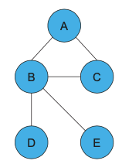
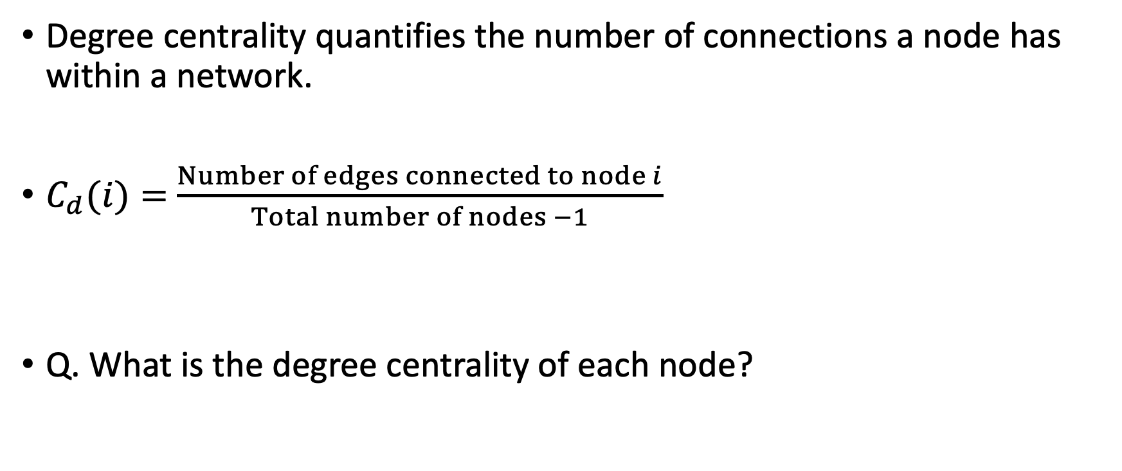
Metrics in network analysis
Degree centrality quantifies the number of connections a node has within a network.
$C_{d}(i)=$ $\frac{Number of edges connected to node i}{Total number of nodes −1}$
Q. What is the degree centrality of each node?

Slide 22
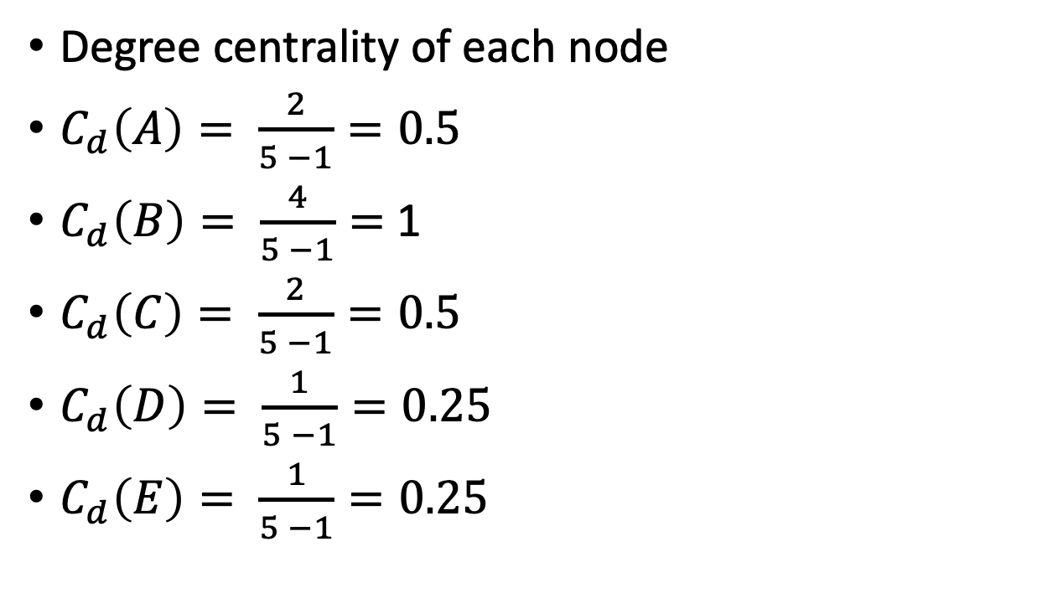
Metrics in network analysis
Degree centrality of each node
$C_{d}\left(A\right)= \frac{2}{5 −1}=0.5$
$C_{d}\left(B\right)= \frac{4}{5 −1}=$ 1
$C_{d}\left(C\right)= \frac{2}{5 −1}=0.5$
$C_{d}\left(D\right)= \frac{1}{5 −1}=0.25$
$C_{d}\left(E\right)= \frac{1}{5 −1}=0.25$

Slide 23
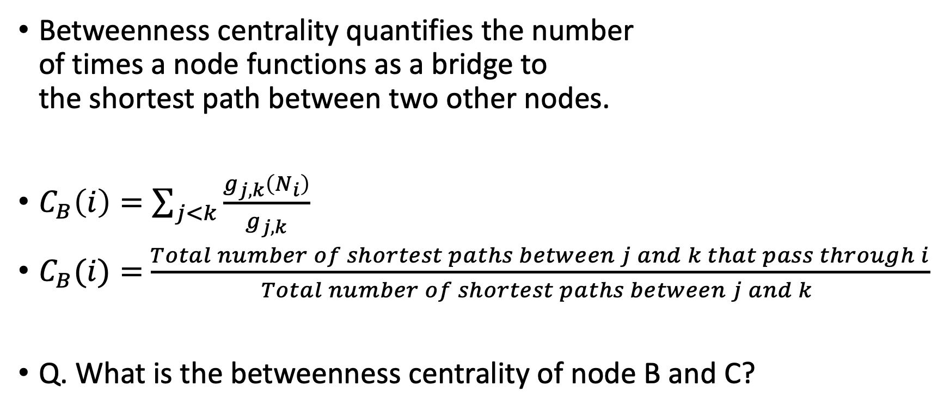
Metrics in network analysis
Betweenness centrality quantifies the number of times a node functions as a bridge to the shortest path between two other nodes.
$C_{B}\left(i\right)=\sum_{j<k}{\frac{g_{j,k}\left(N_{i}\right)}{g_{j,k}}}$
$C_{B}(i)=$ $\frac{Total number of shortest paths between j and k that pass through i}{Total number of shortest paths between j and k }$
Q. What is the betweenness centrality of node B and C?

Slide 24
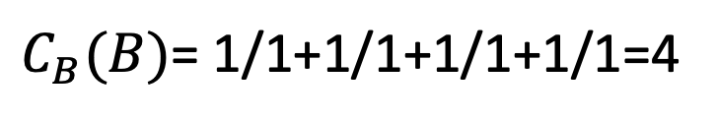
Metrics in network analysis
Pairs | Shortest paths thru B | Shortest paths thru B
(A,C) | 0 | 1
(A,D) | 1 | 1
(A,E) | 1 | 1
(C,D) | 1 | 1
(C,E) | 1 | 1
(D,E) | 0 | 0
$C_{B}(B)$= 1/1+1/1+1/1+1/1=4

Slide 25
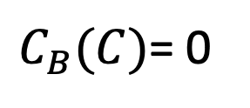
Metrics in network analysis
Pairs | Shortest paths thru C | Shortest paths
(A,B) | 0 | 1
(A,D) | 0 | 1
(A,E) | 0 | 1
(B,D) | 0 | 1
(B,E) | 0 | 1
(D,E) | 0 | 0
$C_{B}(C)$= 0

Slide 26
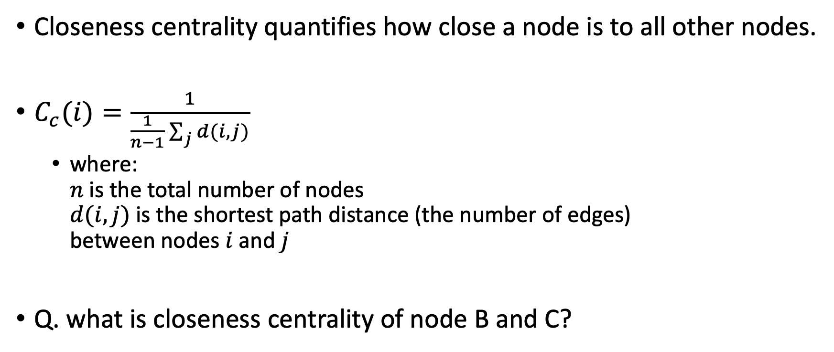
Metrics in network analysis
Closeness centrality quantifies how close a node is to all other nodes.
$C_{c}(i)=\frac{1}{\frac{1}{n−1}\sum_{j}{d(i,j)}}$
where: $n$ is the total number of nodes $d(i,j)$ is the shortest path distance (the number of edges) between nodes $i$ and $j$
Q. what is closeness centrality of node B and C?

Slide 27
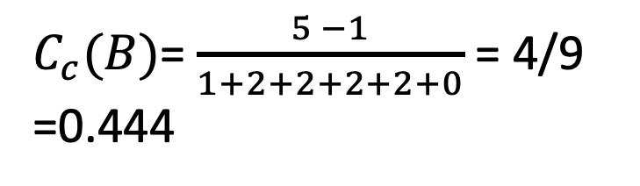
Metrics in network analysis
Pairs | Shortest path distance
(A,C) | 1
(A,D) | 2
(A,E) | 2
(C,D) | 2
(C,E) | 2
(D,E) | 0
$C_{c}(B)$= $\frac{5 −1}{1+2+2+2+2+0}$ = 4/9 =0.444

Slide 28
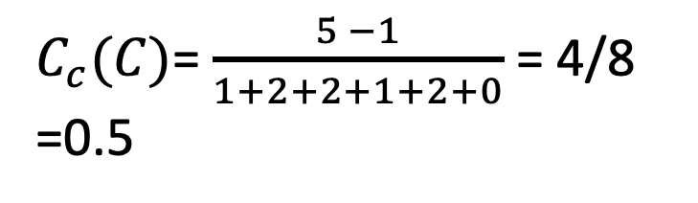
Metrics in network analysis
Pairs | Shortest path distance
(A,B) | 1
(A,D) | 2
(A,E) | 2
(B,D) | 1
(B,E) | 2
(D,E) | 0
$C_{c}(C)$= $\frac{5 −1}{1+2+2+1+2+0}$ = 4/8 =0.5

Slide 29
Metrics in network analysis
What are the implications of these metrics?
Degree centrality: node connectivity, local influence
Between centrality: bridging roles, broker
Closeness centrality: proximity to others, efficient communication

