Slide 1
Social Network Analysis IS 324
January 25,2024
Jaihyun Park
jaihyun2@Illinois.edu

Slide 2
Assignment 1 is due Feb 8th
It is 10pt of your total grade
There are four individual assignments + group project
https://github.com/park-jay/SP2024-IS324

Slide 3
Recap
Nodes, edges, attributes
Directed, undirected (edge-level)
Weighted, unweighted (attribute)

Slide 4
Metrics in network analysis
What are the network analysis metrics?
Degree centrality (popularity)
Betweenness centrality (shortest path)
Closeness centrality (close)

Slide 5
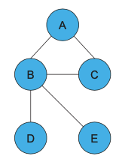
Metrics in network analysis
Degree centrality quantifies the number of connections a node has within a network.
$C_{d}(i)=$ $\frac{Number of edges connected to node i}{Total number of nodes −1}$
Q. What is the degree centrality of each node?

Slide 6
Metrics in network analysis
Degree centrality of each node
$C_{d}\left(A\right)= \frac{2}{5 −1}=0.5$
$C_{d}\left(B\right)= \frac{4}{5 −1}=$ 1
$C_{d}\left(C\right)= \frac{2}{5 −1}=0.5$
$C_{d}\left(D\right)= \frac{1}{5 −1}=0.25$
$C_{d}\left(E\right)= \frac{1}{5 −1}=0.25$

Slide 7
Metrics in network analysis
Betweenness centrality quantifies the number of times a node functions as a bridge to the shortest path between two other nodes.
$C_{B}\left(i\right)=\sum_{j<k}{\frac{g_{j,k}\left(N_{i}\right)}{g_{j,k}}}$
$C_{B}(i)=$ $\frac{Total number of shortest paths between j and k that pass through i}{Total number of shortest paths between j and k }$
Q. What is the betweenness centrality of node B and C?

Slide 8
Metrics in network analysis
Pairs | Shortest paths thru B | Shortest paths
(A,C) | 0 | 1
(A,D) | 1 | 1
(A,E) | 1 | 1
(C,D) | 1 | 1
(C,E) | 1 | 1
(D,E) | 0 | 0
$C_{B}(B)$= 1/1+1/1+1/1+1/1=4

Slide 9
Metrics in network analysis
Pairs | Shortest paths thru C | Shortest paths
(A,B) | 0 | 1
(A,D) | 0 | 1
(A,E) | 0 | 1
(B,D) | 0 | 1
(B,E) | 0 | 1
(D,E) | 0 | 0
$C_{B}(C)$= 0

Slide 10
Metrics in network analysis
Closeness centrality quantifies how close a node is to all other nodes.
$C_{c}(i)=\frac{1}{\frac{1}{n−1}\sum_{j}{d(i,j)}}$
where: $n$ is the total number of nodes $d(i,j)$ is the shortest path distance (the number of edges) between nodes $i$ and $j$
Q. what is closeness centrality of node B and C?

Slide 11
Metrics in network analysis
Pairs | Shortest path distance
(A,C) | 1
(A,D) | 2
(A,E) | 2
(C,D) | 2
(C,E) | 2
(D,E) | 0
$C_{c}(B)$= $\frac{5 −1}{1+2+2+2+2+0}$ = 4/9 =0.444

Slide 12
Metrics in network analysis
Pairs | Shortest path distance
(A,B) | 1
(A,D) | 2
(A,E) | 2
(B,D) | 1
(B,E) | 2
(D,E) | 0
$C_{c}(C)$= $\frac{5 −1}{1+2+2+1+2+0}$ = 4/8 =0.5

Slide 13
Metrics in network analysis
What are the implications of these metrics?
Degree centrality: node connectivity, local influence
Between centrality: bridging roles, broker
Closeness centrality: proximity to others, efficient communication

Slide 14
Recap
Degree centrality
Betweenness centrality
Closeness centrality

Slide 15
Degree centrality
Degree centrality quantifies the number of connections a node has within a network.
$C_{d}(i)=$ $\frac{Number of edges connected to node i}{Total number of nodes −1}$
Q. What is the degree centrality of each node?

Slide 16
Betweenness centrality
Betweenness centrality quantifies the number of times a node functions as a bridge to the shortest path between two other nodes.
$C_{B}\left(i\right)=\sum_{j<k}{\frac{g_{j,k}\left(N_{i}\right)}{g_{j,k}}}$
$C_{B}(i)=$ $\frac{Total number of shortest paths between j and k that pass through i}{Total number of shortest paths between j and k }$
Q. What is the betweenness centrality of node B and C?

Slide 17
Closeness centrality
Closeness centrality quantifies how close a node is to all other nodes.
$C_{c}(i)=\frac{1}{\frac{1}{n−1}\sum_{j}{d(i,j)}}$
where: $n$ is the total number of nodes $d(i,j)$ is the shortest path distance (the number of edges) between nodes $i$ and $j$
Q. what is closeness centrality of node B and C?

Slide 18
Social network theory
Homophily (echo chamber)
Reciprocity
Structural hole
The strength of weak ties
Structural balance theory

Slide 19
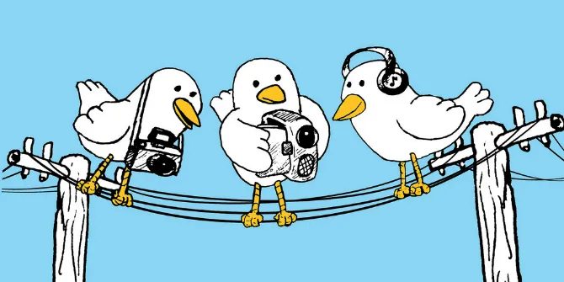

Homophily
Birds of a feather (McPherson et al., 2001)
People have a tendency to form like-minded groups and exhibit homophilic behavior
Is polarized society bad or is it good?
A lack of social cohesion takes its toll on to struggle to find common ground + can lead to a breakdown of social bonds
https://blogs.lse.ac.uk/impactofsocialsciences/2017/07/12/scientific-birds-of-a-feather-flock-together-science-communication-on-social-media-rarely-happens-across-or-beyond-disciplinary-boundaries/
https://www.psychologytoday.com/intl/blog/love-lies-and-conflict/202007/you-will-never-win-your-political-or-relationship-arguments
Notes:
Homophily explains the phenomenon that people have a tendency to form like-minded groups and exhibit homophilic behavior.
Trade offs?

Slide 20
Homophily
Driving factors toward homophily (van Baar & FeldmanHall, 2022)
Cognitive dissonance
(Festinger, 1957)
Selective exposure
(Knobloch-Westerwick & Meng, 2009)
Confirmation bias
(Nickerson, 1998)
Cognitive
influences
Contextual
influences
Filter bubble
(Pariser, 2011)
Echo chamber
(Sunstein, 2001)
Algorithmic bias
(Noble, 2018)
interplay
e.g., individual traits, needs, beliefs
e.g., news, social media, social environment

Slide 21

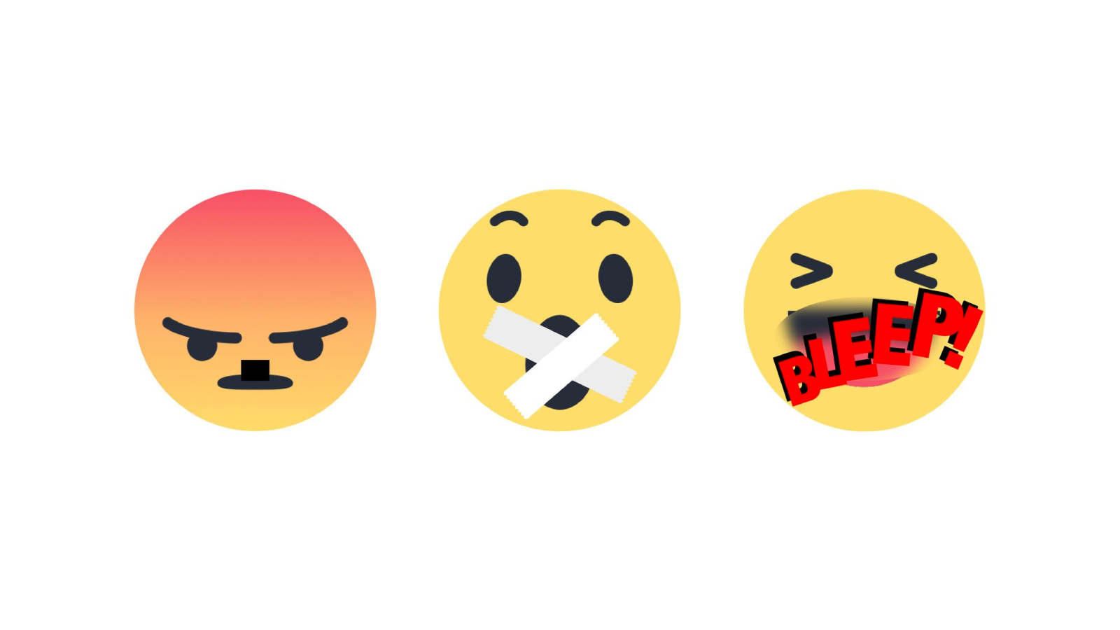
Polarization on social media
Affective polarization in US (Iyengar et al., 2019; Iyengar & Westwood, 2015)
Democrats and Republicans both perceive the other party’s members as hypocritical, selfish, and close-minded.
The emotional response toward non-like-minded others can escalate the communication to be rude, disrespectful, or unreasonable to make people likely to leave a discussion.
https://www.vecteezy.com/vector-art/4435778-emoticons-with-different-emotions-happy-sad-confused-vector-graphics-isolated-on-white-background
https://www.nytimes.com/interactive/2017/10/13/technology/facebook-hate-speech-quiz.html
Notes:
Especially in the US context, polarization on social media have led people to exhibit hate speech on social media.

Slide 22
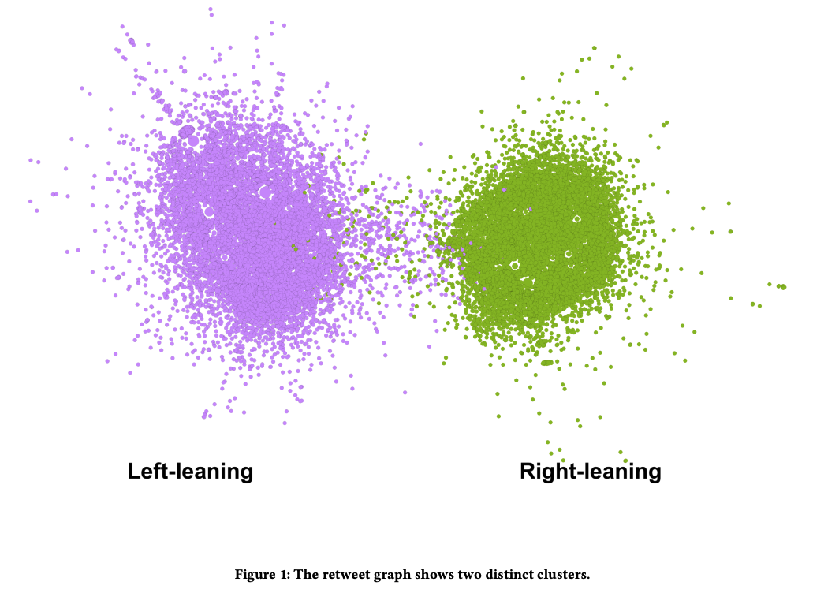
Echo chamber
An environment or social network where individuals are exposed to information, opinions, or beliefs that align with their existing views and perspectives.
People are surrounded by like-minded individuals or information that reinforces and amplifies their own opinions.

Slide 23
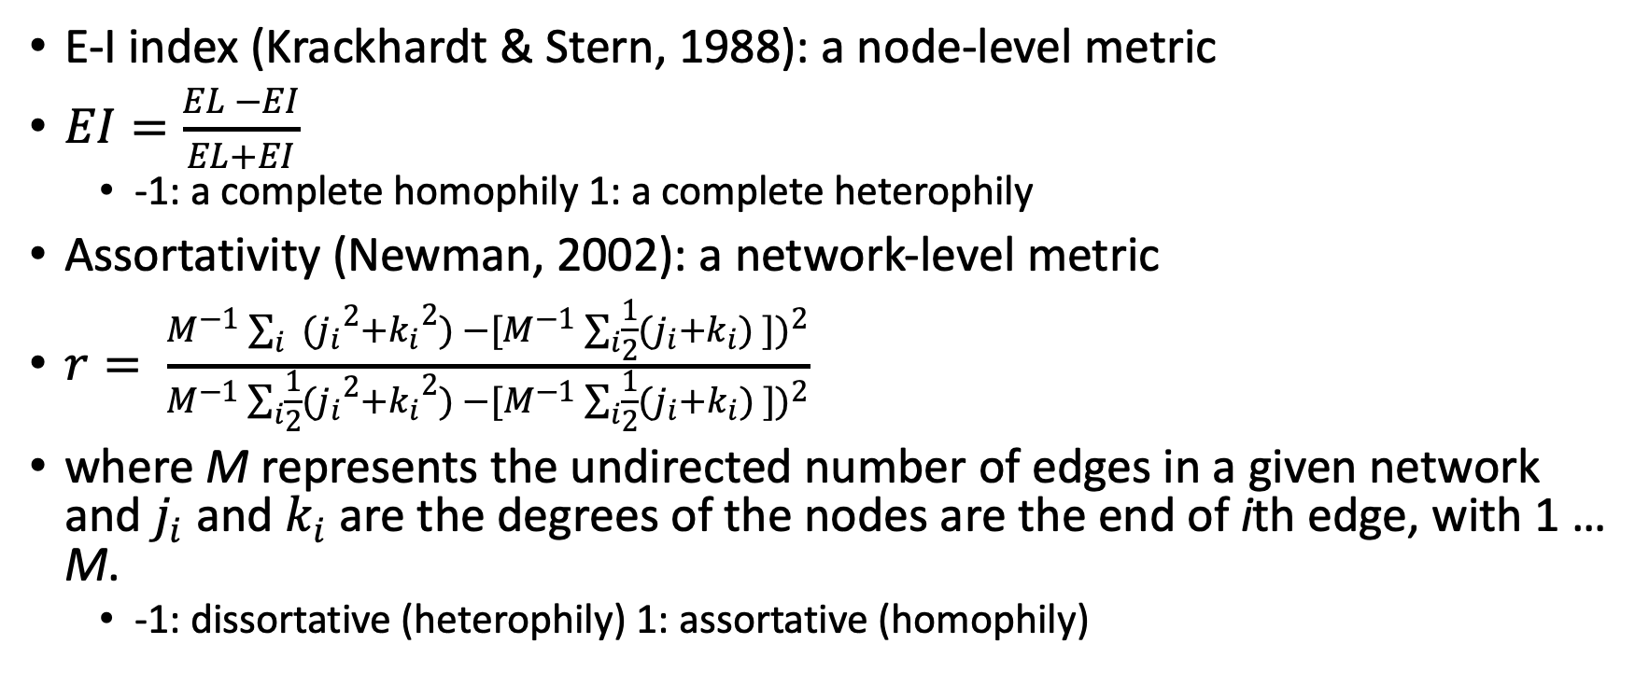
Homophily metrics
E-I index (Krackhardt & Stern, 1988): a node-level metric
$EI=\frac{EL −EI}{EL+EI}$
-1: a complete homophily 1: a complete heterophily
Assortativity (Newman, 2002): a network-level metric
$r= \frac{M^{−1}\sum_{i}{ ({j_{i}}^{2}+{k_{i}}^{2}) −{[M^{−1}\sum_{i}{\frac{1}{2}(j_{i}+k_{i})} ])}^{2}}}{M^{−1}\sum_{i}{\frac{1}{2}({j_{i}}^{2}+{k_{i}}^{2}) −{[M^{−1}\sum_{i}{\frac{1}{2}(j_{i}+k_{i})} ])}^{2}}}$
where M represents the undirected number of edges in a given network and $j_{i}$ and $k_{i}$ are the degrees of the nodes are the end of ith edge, with 1 … M.
-1: dissortative (heterophily) 1: assortative (homophily)

Slide 24
Reciprocity
The act of giving benefits to another in return for benefits received (Molm & Cook, 1995).
A process of exchanging things with other people to gain a mutual benefit.
Humans are social beings and in order to maintain social harmony and trust, reciprocity became a fundamental aspect of social interactions.
Directed graph
Trust
Online social media context:
If you follow someone’s account, will this person follow you back?
If someone likes your post, will you like this person’s post?

Slide 25

Reciprocity metrics
$r= \frac{\left|\left(u,v\right)∈G\right||(v,u)∈G|}{|(u,v)∈G|}$
The ratio of the number of edges in both directions (e.g., the node $u$ to the node $v$ ) to the total number of edges attached to node $u$.

Slide 26
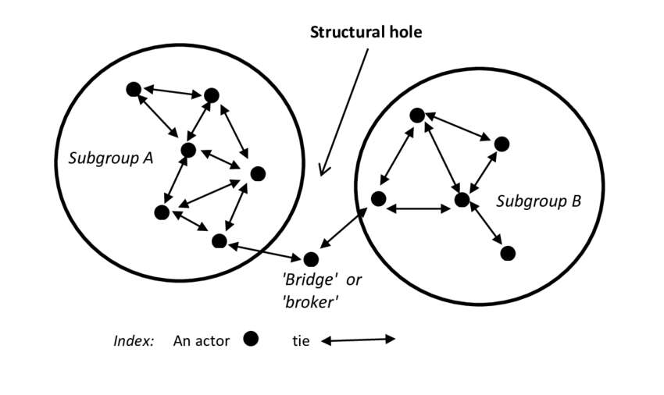
Structural hole
Structural hole theory focuses on gaps or missing links between individuals or groups.
Structural holes represent potential opportunities for individuals who can bridge them, providing diverse information and resources.
Ward, Wesley. (2016). Exploring in-person and technologically-mediated communication within international agricultural research teams. 10.13140/RG.2.2.22226.96962.

Slide 27
Structural hole
Applications:
Broker: Individuals rich in structural holes have a better opportunity to manipulate information.
Creativity: A network rich in structural holes has been found to facilitate the development of novel valuable ideas by merging the distinct sources of information in new ways.
Trust and gossip: An individual who occupies a broker position in the organizational network connects people who are not connected with one another.
Labun, A., Wittek, R. (2014). Structural Holes. In: Alhajj, R., Rokne, J. (eds) Encyclopedia of Social Network Analysis and Mining. Springer, New York, NY. https://doi-org.proxy2.library.illinois.edu/10.1007/978-1-4614-6170-8_263

Slide 28
The strength of weak ties
Granovetter (1973) proposed the theory that the role of the network (edges) varies.
Strong ties: close, intimate relationships like family, friends, or colleagues with whom there is frequent interaction.
Weak ties: distant connections such as acquaintances or individuals with who there is infrequent interaction.
Notes:
Two different types of edges (or ties)

Slide 29
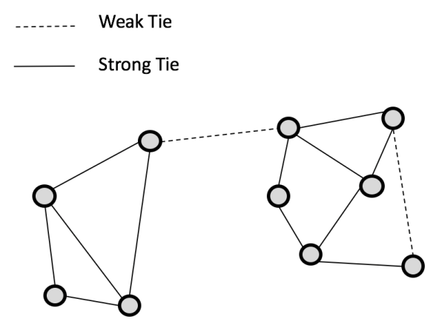
The strength of weak ties
Weak ties can serve as bridges between social groups.
Weak ties are crucial in providing information about job opportunities.
Weak ties provide access to novel information and diverse perspectives.
Notes:
Several implications of weak ties

Slide 30
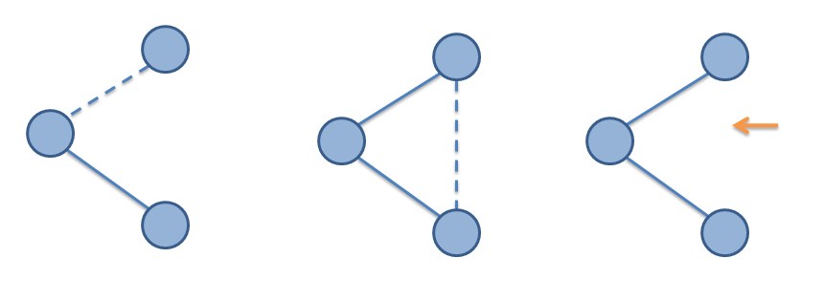
Structural balance theory
Structural balance theory looks for triads.

Slide 31
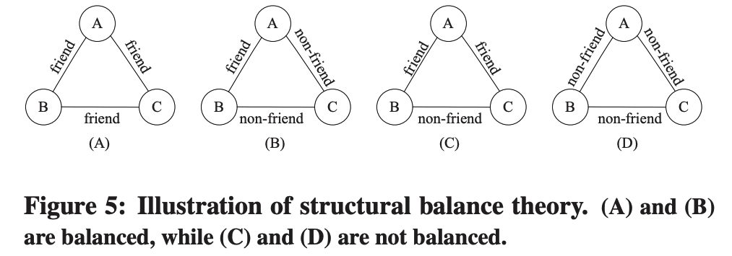
Structural balance theory
The enemy of my enemy is my friend.

