Slide 1

Z-Search Content-based Image Retrieval (CBIR)

Slide 2
Searching a large database for images that match a query
What is a Query?
an image you already have
a rough sketch you draw

Slide 3
Applications:
Art Collections
Medical Image Databases
Scientific Databases
The World Wide Web
Some Systems You Can Try
Corbis Stock Photography and Pictures
IBM’s QBIC
Like.com

Slide 4



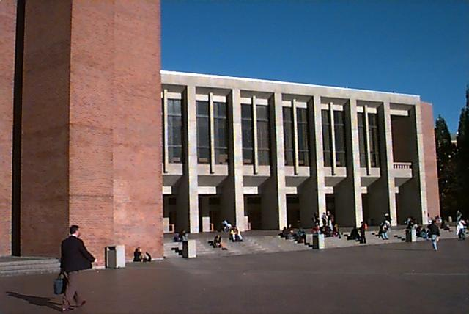
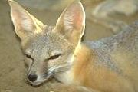
Image Features / Distance Measures
Query Image
Retrieved Images
User
Image Database
Images
Feature Space

Slide 5
Regioning and Tiling Schemes
Tiles
Regions

Slide 6
Features
Color
Texture
Shape

Slide 7
color
Produce a color signature for region/whole image
Typically done using color correllograms or color histograms

Slide 8

Global Color Histogram

Slide 9
Texture
Produce a mathematical characterisation of a repeating pattern in the image
Smooth
Sandy
Grainy
Stripey
9

Slide 10
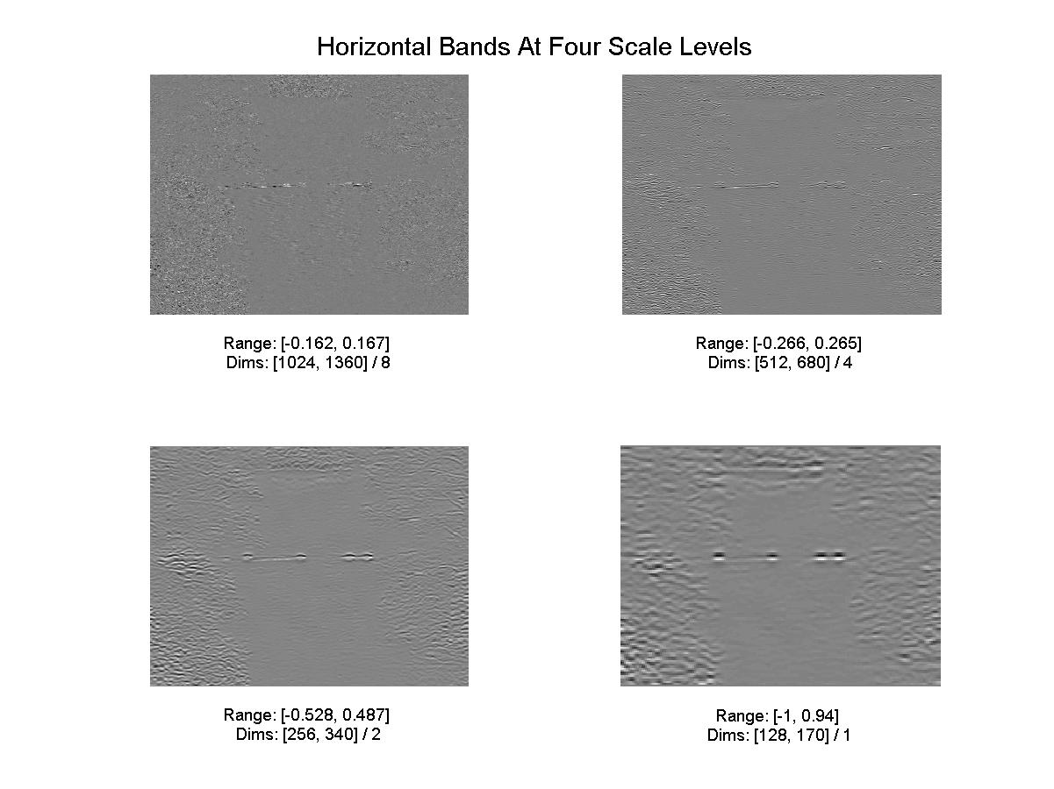

Slide 11
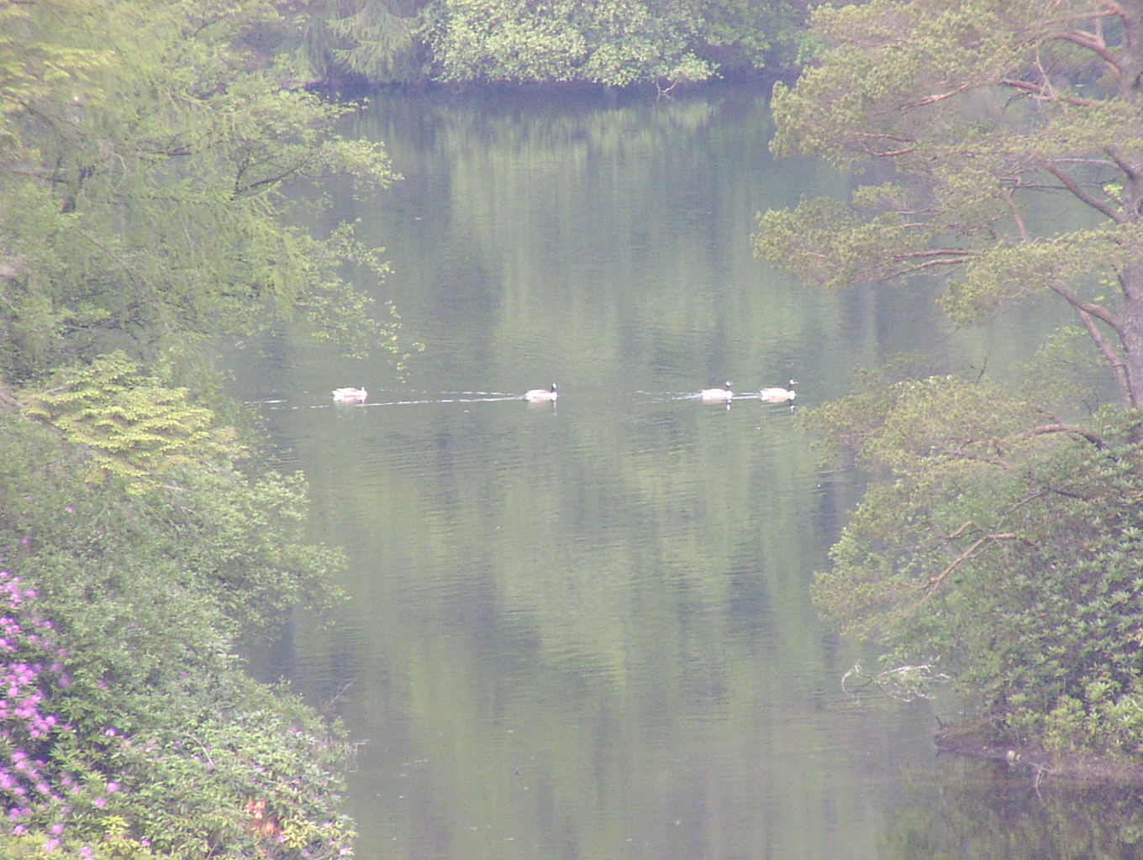
Shape
Straying into the realms of object recognition
Difficult and Less Commonly used
All objects have closed boundaries
Shape interacts in a rather vicious way with segmentation
Find the duck shapes
11

Slide 12
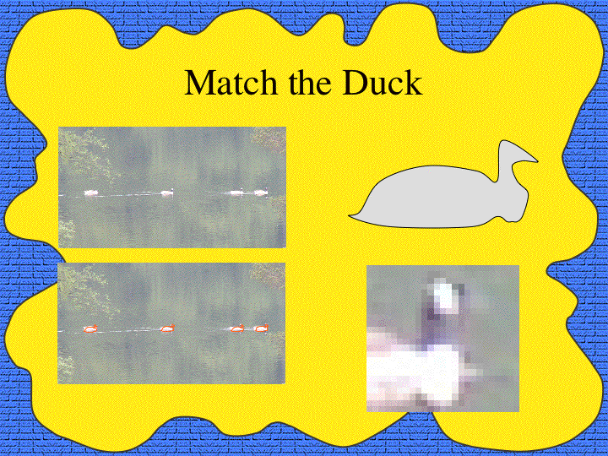

Slide 13
Summary of Image Representation
Pixels and Raster
Image Segmentation
Tiles
Regions
Low-level Image Features
Color
Texture
Shape

