Slide 1


Slide 2

CREATIVE THINKING

Slide 3
What Is Creative Thinking?
What Is Creative Thinking For Students?
What are the main benefits of creative thinking?
Steps Of Creative Problem-solving?
Elements Of Creativity.

Slide 4
What Is Creative Thinking ?
*Creative thinking is the ability to look at things differently, and find new ways of solving problems.

Slide 5

*Thinking out of the box
*creative thinking is intentionally gaining new insights and different ideas through existing information.

Slide 6
What is creative thinking for students?
Creative thinking encourages students to use a variety of approaches to solve problems, analyze multiple viewpoints, adapt ideas, and arrive at new solutions.

Slide 7
(Developing your creative thinking skills is highly beneficial for any field of work )
What are the main benefits of creative thinking?
ability to create the best solutions
improvement on problem-solving
a better understanding of data
focus on self-improvement

Slide 8
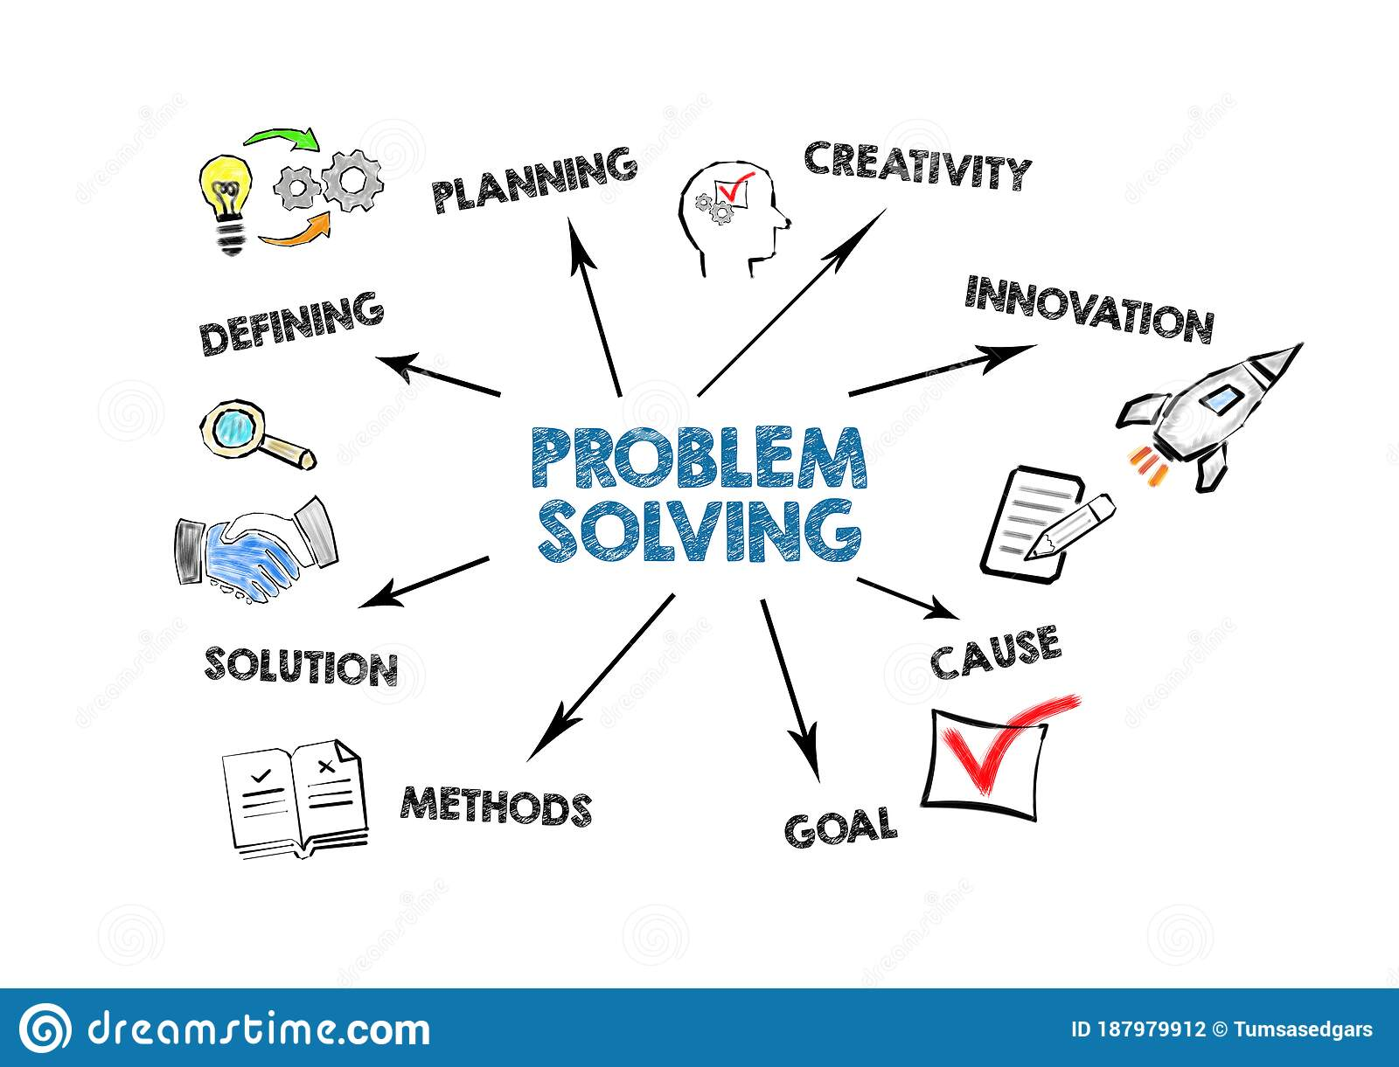

Slide 9
STEPS OF CREATIVE PROBLEM-SOLVING.
Four stages involved:
Preparation
Incubation
Illumination
Verification

Slide 10

1: Preparation
( Collection of Information )
This is the stage of collecting raw material about the program at hand.

Slide 11

2: Incubation
اس مرحلے کے دوران، شخص مسئلہ کے بارے میں شعوری طور پر نہیں سوچتا بلکہ اس کا دماغی عمل لاشعوری طور پر حل تلاش کرنے میں شامل ہوتا ہے۔
( Let go and absorb )
During this stage , The person is not thinking about the problem consciously but his mental process are involved in finding a solution unconsciously.

Slide 12

3: Illumination
( Insight – The –Aha-moment )
It is the stage of AHA moment. This experience is the result of immedicate solution or insight into the problem at hand.

Slide 13

4: Verification
( Craft the-Message & Make it Real )
During this last stage, The worth of the insight is judged by the person.

Slide 14


Slide 15
Elements Of Creativity.
Four Components of Creativity:
Fluency
Flexibility
Originality
Elaboration

Slide 16
1:Fluency
( no of ideas )

Slide 17
2:Flexibility
( variety of ideas )

Slide 18
3:Originality
( unique ideas )

Slide 19
4:Elaboration
to expand something in detail

Slide 20
Thank You !

