Slide 1
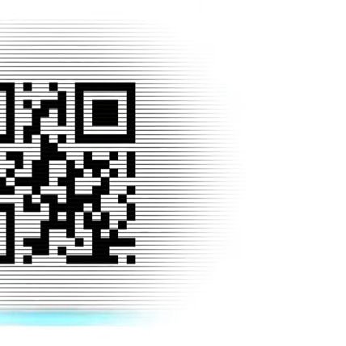
1D 2D BAR CODES
Presenting by Zain Haider Naqvi

Slide 2
1D BarCodes
Difference between 1d bar codes families.

Slide 3
GTIN NUMBER
Global Trade Item Numbers, also known as UPC/EAN numbers are used by companies to uniquely identify all of their trade items. Trade items include any product that is priced, ordered or invoiced by a company.

Slide 4
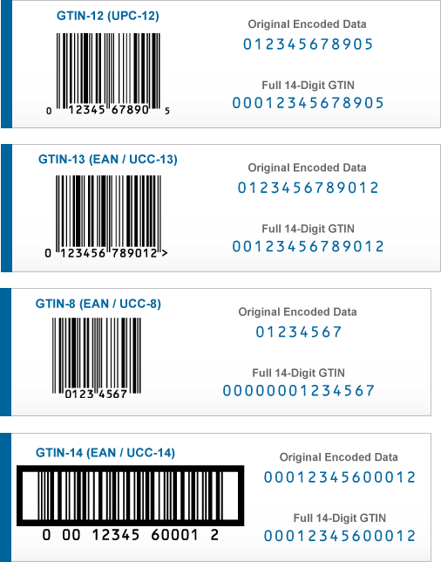
GTIN-8 - used mostly for EAN-8 barcodes.
GTIN-12 - used mostly for UPC barcodes.
GTIN-13 used for EAN-13 barcodes except america.
GTIN-14 – mostly used for trade items , products or services

Slide 5


Slide 6
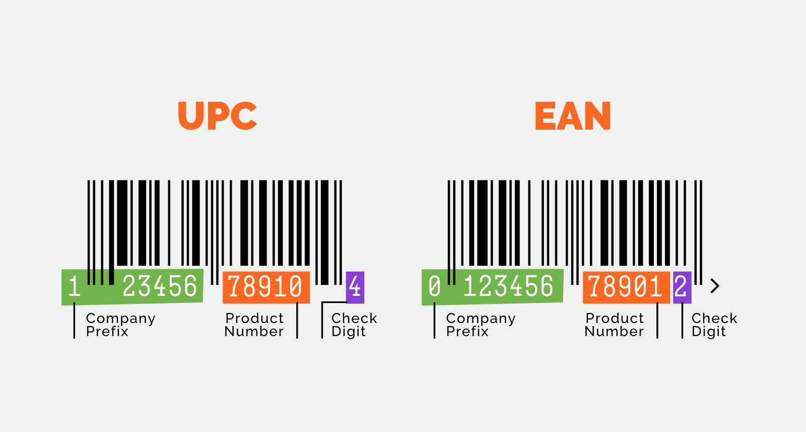

Slide 7
2:EAN
EAN originally stood for "European Article Number," but has since been changed to "International Article Number." The term refers to the bar code used by retailers outside of North America.
1:UPC
A UPC, which stands for Universal Product Code, is a 12-digit bar code used primarily in Canada and the United States. Retailers add UPCs to each item they sell in order to track their product inventory.

Slide 8
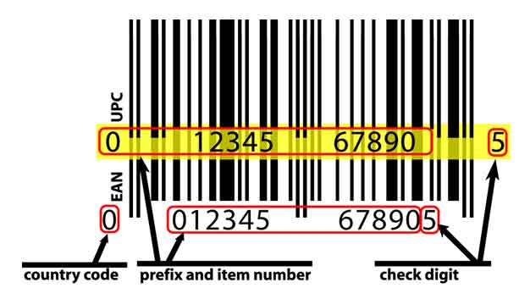

Slide 9
Code 39 vs Code 128
Code 39 and Code 128 are both 1D barcodes that support both numeric and alpha data. They are widely used in non-retail environments, such as library books, membership cards, small items, etc.

Slide 10
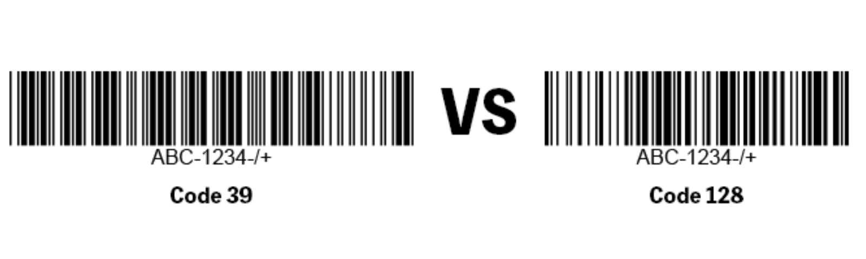

Slide 11
Barcode Types | Code 39 | Code 128
Density | Moderate density | High density
Character Set | Alphanumeric Code 39 also support these characters: Percent sign (%), Plus sign (+), Dollar sign ($), Slash mark (/), Period (.), Hyphen (-) | Full ASCII
Maximum Capacity | Unlimited (Usually contains 20 to 23 alphanumeric characters) | Unlimited (Usually up to 48 alphanumeric characters)
Error Detection | Code 39 is self-detection, a check digit normally isn’t necessary | Code 128 has a modulo-103 check digit to detect error
Error Correction | Code 39 does not support error correction | Code 128 has a mandatory error correction character

Slide 12
Usage Scenarios | Asset labeling Library books Membership cards Internal inventory tracking Supply chain Serial shipping container codes

Slide 13
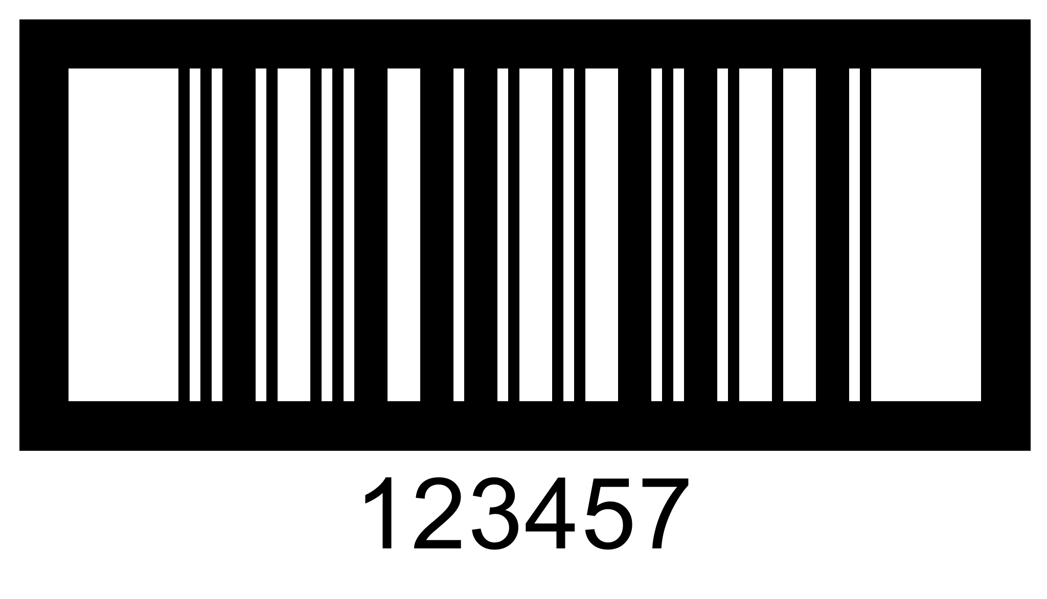
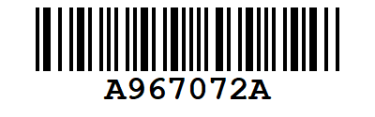
Name |  | ITF |  | CODABAR
Symbol
Character type |  | Numeric values (0 to 9) only |  | Numeric values (0 to 9) Symbol (-,$,/,.,+) Start/stop character (a to d)
Features |  | Allows a barcode size smaller than other barcode types with the same digits. |  | Possible to indicate some alphabets and symbols.
Printable digits |  | Even digits only |  | Any digits
Bar structure |  | Two bar sizes No start/stop character Indicates one character with five bars (or five spaces) . |  | Two bar sizes Uses a to d for start/stop character. Indicates one character with four bars and three spaces.
Application performance |  | Standardized as the distribution code. |  | Blood bank Slip of door-to-door delivery service (Japan)

Slide 14
Name | EAN, UPC |  | CODE39 |  | CODE128
Character type | Numeric values (0 to 9) only |  | Numeric values (0 to 9) Alphabet Symbol (-,.,space,$,/,+,%) Start/stop character (*:asterisk) |  | All ASCII codes Numeric values (0 to 9) Alphabet upper case/lower case Symbol Control character (［CR］［STX］etc.)
Features | Standardized as the distribution code. |  | Availability of alphabet and symbol allows indication of article numbers. |  | Supports all types of characters. Allows the minimum size of barcode for indication with the numeric values only. (more than 12 digits)
Printable digits | 13 digits or 8 digits |  | Any digits |  | Any digits
Bar structure | Four bar sizes No start/stop character Indicates one character with two bars and two spaces. |  | Two bar sizes Uses asterisk * for start/stop character. Indicates one character with five bars and four spaces. |  | Four bar sizes Three types of start/stop characters. Each type supports its own character type. Indicates one character with three bars and three spaces.
Application performance | World universal code Marked on most daily goods Book industry |  | Widely used as the industrial barcode. Automobile Industry Action Group (AIAG) Electronic Industries Alliance (EIA) |  | Starts to be used as GS1-128 in each industry. Distribution business industry Food industry Medical industry

Slide 15
2D BAR CODES
Matrix barcodes are a two-dimensional way of representing data.

Slide 16
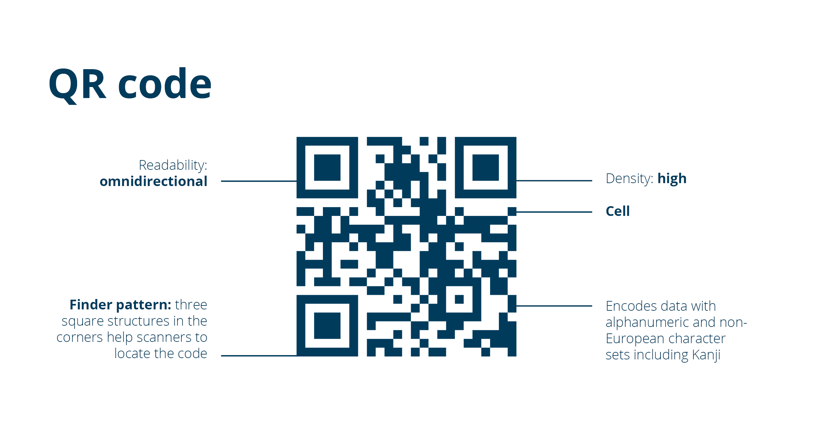

Slide 17
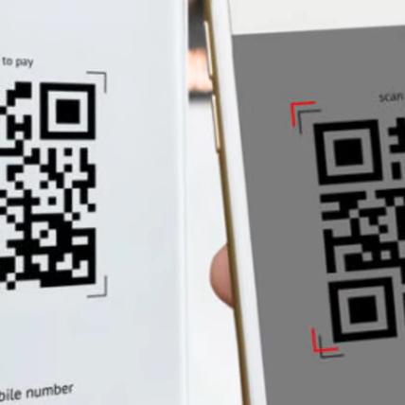
What’s the difference between a Data Matrix code and a QR code?

Slide 18
Maximum capacity | Numeric: 3116 Alphanumeric characters: 2335 Bytes: 1556 | Numeric: 7089 Alphanumeric characters: 4296 Bytes: 2953
Size | Min 10×10 cells Max 144×144 cells | Min 21×21 cells Max 177×177 cells
Error correction | Reed-Solomon Error Correction algorithm Error correction capability of 25–33% Level is not adjustable | Reed-Solomon Error Correction algorithm Error correction for QR codes can be adjusted to allow for greater error correction capabilities. Four error correction levels are available – for each level a greater amount of back-up data is required, which increases the size of the QR code. Level L 7% Level M 15% Level Q 25% Level H 30%
Code type | Data Matrix code | QR code

Slide 19
DATA MATRIX QR CODE?

Slide 20

Character Set | Length | Check Digit | Size, Module Width X, Print Ratio
ASCII | 1556 ASCII (8 Bit), 2335 alphanumerical or 3116 numeric characters | Error correction | Dynamically variable physical size from .001 inch square to 14.0 inches square; Please contact us for more details...
Applications | Used for encoding large amount of data characters; ideal for marking very small containers. Used by the pharmaceutical industry for unit dose and product marking. Originally developed for the Space Shuttle Program, where millions of parts must be tracked.
Notes | Two-dimensional matrix code that use a visual representation of binary code (0 or 1).

Slide 21
MaxiCode 2D BAR CODE?

Slide 22

Character Set | Length | Check Digit | Size, Module Width X, Print Ratio
ASCII | 93 ASCII characters | Error correction | Fixed in size: 1.11 x 1.054 inches; please contact us for more details...
Applications | Developed and used by UPS (United Parcel Service) on packing slips for package sorting and addressing world-wide.
Notes | Made up of offset rows of hexagonal modules arranged around a unique finder pattern; Supports 4 different modes of operation; UPS Modes are Mode 2 (US Carrier) and Mode 3 (Intern. Carrier)

Slide 23
PDF 417 2D BAR CODE?

Slide 24

Character Set | Length | Check Digit | Size, Module Width X, Print Ratio
ASCII | 1108 ASCII/ Bytes, 1850 alphanumerical, 2725 numeric characters | Error correction | Please contact us for more details...
Applications | Used for encoding large amount of data characters; the US Department of Defense has recently (late 1996) declared PDF417 its "official 2-D symbology".
Notes | 2 dimensional barcode symbology; developed in 1989 by Symbol Technologies; Density: up to 900 characters per square inch.

Slide 25
PDF 417 Truncated 2D BAR CODE?

Slide 26

Character Set | Length | Check Digit | Size, Module Width X, Print Ratio
ASCII | 1108 ASCII/ Bytes, 1850 alphanumerical, 2725 numeric characters | Error correction | Please contact us for more details...
Applications | Used for encoding large amount of data characters
Character Set | Length | Check Digit | Size, Module Width X, Print Ratio

Slide 27
QR Code® 2D BAR CODES

Slide 28

Character Set | Length | Check Digit | Size, Module Width X, Print Ratio
ASCII | 4296 alpha, 7089 numeric characters | Error correction | Please contact us for more details...
Applications | Used for mobile applications and encoding large amount of data characters; developed 1994 by DENSO.
Notes | ISO/IEC 18004:2015; supports also Kana, binary, and Kanji characters; please find more information on our QR Code page.

Slide 29
Micro QR Code 2D BAR CODES

Slide 30

Character Set | Length | Check Digit | Size, Module Width X, Print Ratio
ASCII | 21 alpha, 35 numeric, 15 byte or 9 Kanji characters | Error correction | 4 different symbol sizes (M1-M4) Please contact us for more details...
Applications | The Micro QR-Code was developed for fast readability by DENSO.
Notes | Small variant of QR-Code with a reduced number of overhead modules and a restricted range of sizes. The maximum amount of data is 21 alphanumeric, 35 numeric, 15 byte or 9 Kanji characters, in conjunction with the lowest error correction level.

Slide 31
Swiss QR Code 2D BAR CODES

Slide 32

Character Set | Length | Check Digit | Size, Module Width X, Print Ratio
Latin Character Set (Latin-1/alphanumerical) | up to 997 characters (incl. separators) | Error correction | Maximum symbol size: Version 25 (117x117) Minimum module width: 0.4 mm
Applications | Used for Swiss banking and payment services.
Notes | QR code based; Swiss QR Code version 1.0 and version 2.0. Identification symbol: Swiss cross in the middle of the QR code (size: 7x7 mm). The Swiss QR Code contains all relevant payment information for digital payment or further processing of a QR invoice.

Slide 33
Codablock F 2D BAR CODES

Slide 34
Character Set | Length | Check Digit | Size, Module Width X, Print Ratio
ASCII (0-127) + Extended ASCII | up to 2725 ASCII or 5450 numeric characters | Error recognition | 2-44 rows; 4-62 cols; module width X>=0.19mm; row height Y>=8X or Y>=(0.55 * columns)+3; row separator >= X; quiet zone>=10X; bar/space width tolerance Tb = +-(0.4X-0.013mm)
Applications | Health Industry Barcode (HIBC), used for small labels and secure data. Codablock F is a 2D bar code developed by ELMICRON, as an extension of Code 128. Within its capacities, it is possible to cut a given Code 128 into several pieces and to arrange them in a multi-row symbol.
Notes | Multi-row symbology conform to Uniform Symbology Specification; symbol characters identical to Code 128; begins with Code 128 Start A; supports all 128 ASCII Characters and numeric compaction (also values 128-255); EAN/UCC application identifier;

Slide 35
Aztec Code 2D BAR CODES

Slide 36

Character Set | Length | Check Digit | Size, Module Width X, Print Ratio
ASCII (0-127) + Extended ASCII | 3067 alphanumeric, 3832 numeric, 1914 Bytes | Error correction | Quiet Zone left/right/top/bottom: 0X
Applications | For a variety of patient-safety applications, including patient identification wristbands and labels for unit-of-use medications, IV mixtures, blood products and specimens.
Notes | Aztec Code can encode from small to large amounts of data with user-selected percentages of error correction. The symbol size adjusts automatically depending on the amount of input data. TBarCode V8.1: The input data is always analyzed and the appropriate encoding mode is chosen automatically. Mode switching is done as required to produce the most efficient encoding.

Slide 37
THANK YOU!!!

