Slide 1

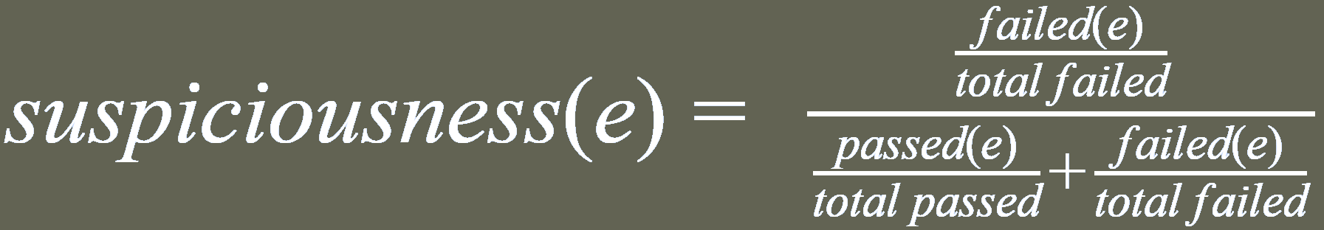
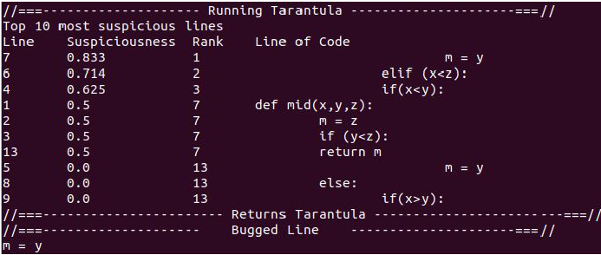
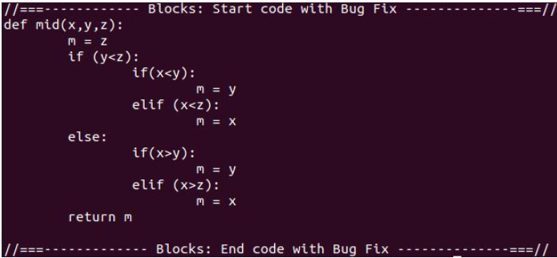
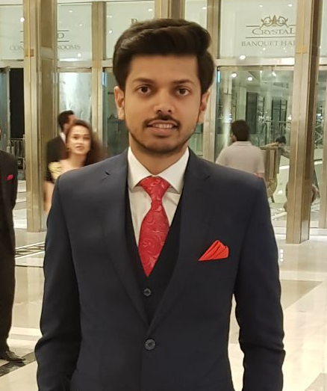
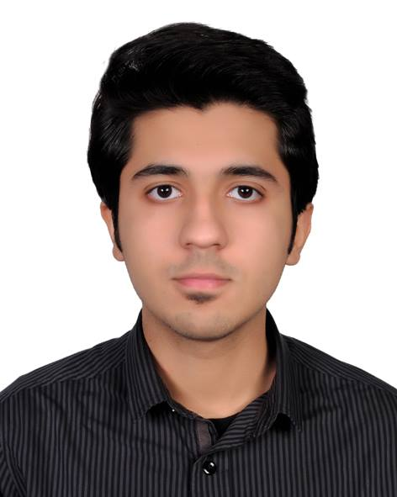
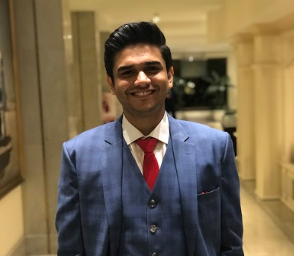
Advisor: Junaid Haroon Siddiqui
PyFix (Fault Localization & Automated Program Repair in Python)
sProj Overview
PyFix – a technique that uses existing test cases to automatically generate repairs of real-world bugs in simple Python programs.
PyFix is a dual – layered engine:
TarantulaPy: predicts and localizes erroneous statements in bugged programs.
Program Repair: a module which attempts to repair the bug and returns a bug-free code with suggested fixes that atleast passes all the given test cases.
Project Specification
(1): Fault Localization:
Uses Python’s settrace method to evaluate the coverage information of lines of code against test cases.
Computes the suspiciousness score of lines of code based on this arithmetic formula:
The most suspicious line is selected as buggy line.
Project Specification
(2): Program Repair:
Divides the script into distinct code blocks
Computes similarity of code blocks with bugged block
Repairs the code by:
Permuting and mapping variables
Permuting arithmetic operators
Permuting bool statements
Executes the newly generated scripts against given test cases
The Algorithm
Input:
A python program with bug(s)
A file with test case results for Tarantula
A test case suite
Output:
Python program with problem fixed OR
Python program bug(s) (signifying our tool could not rectify the error)
Begin:
Identify the most suspicious line by running TarantulaPy and extract the block around it.
Compare the blocks & select three most similar blocks.
Different program variants are generated and evaluated against all test cases
Results
Future Work:
Machine Learning techniques can be applied to understand the code writing pattern of the user and based on that, intuit the possible cause of error, resulting in reduced sample space & no. of permutations currently performed.
A browser based interactive GUI could be developed that loads the test program & test cases into the client and displays them on an interactive screen
Unit test cases can be auto-generated against given programs
Zain Qasmi
Dawood Jehangir
Ali Ahsan
Notes:
I guess you guise already submitted :p
no.
krnay lagay hein
omg
do it
I already did
Its due at 11
submit nai ki?
kardo bhai
I cant ever get a good headshot
headshot?

