Slide 1

The Life of Prophet Muhammad
Lesson 44

Slide 2
The March To Uhud
The Prophet marched with 1000 soldiers on the morning of the 7th of Shawwāl, 3AH
He asks Abdullah ibn Umm Maktum, the blind companion, to lead prayers in Medina during his absence.
The Prophet divided his army into three main groups:
He gave the standard (liwāʾ) of the Khazraj to Saʿd ibn ʿUbādah or Ḥubāb ibn Mundhir; the standard (liwāʾ) of Aws to Usayd ibn Ḥuḍayr; the standard (liwāʾ) of the Muhājirīn to Muṣʿab ibn ʿUmayr and his own standard (rāyah) to Imam Ali.

Slide 3
The March To Uhud
Before Islam, when Quraysh waged war on another tribe, they received from the hands of Quṣayy the liwāʾ, which was a piece of white cloth Quṣayy had tied to a lance.
During the Prophet’s lifetime, flags were indifferently called liwāʾ and rāyah, and less commonly, ʿalam.
One tradition contrasts the rāyah, the Prophet’s black flag, with his liwāʾ, or white.
In other traditions liwāʾ and rāyah are synonymous
The use of the rāyah was not exclusive to Muslims, since at Badr, Ṭalḥah carried the rāyah of the pagans

Slide 4
The March to Uhud
The eve of the battle coincided with Hanzalah ibn Abi ’Amir’s wedding to Jamilah, the daughter of Abdullah ibn Ubayy.
When Hanzala asks the Prophet for permission to continue with the wedding, the Prophet blesses the couple and instructs Hanzala not to postpone the marriage.
That night Jamilah dreams that the door to paradise opened to let Hanzala in, and then closed behind him.
The next morning, Hanzala leaves to catch up with the rest of the army, which has already left for Uhud.

Slide 5
The March to Uhud
Another companion and recent widower, Abdullah ibn ’Amr experiences a dream that he will be martyred on the battlefield.
Before leaving for Uhud, he instructs his only son, Jabir, to stay behind and take care of Abdullah’s seven younger daughters.
Jabir is not the only person disappointed to have to stay behind. Several other young boys try to join the expedition, but the Prophet does not allow them.

Slide 6
The March To Uhud
Shortly after setting out with his men, Abdullah ibn Ubayy defects with 300 soldiers and returns to the city.
وكانوا الف رجل، فلما كانوا في بعض الطريق انخذل عنهم عبد الله بن أبي بثلث الناس، وقال: والله ما ندري على ما نقتل أنفسنا والقوم قومه
“They were 1000 men. On their way, Abdullah ibn Ibn Ubay defected with a third of the army. They said: ‘By God we don’t understand why we are fighting while these people are his people?’

Slide 7
The March To Uhud
He explains that the Prophet disobeyed his counsel and suggests that his men are not necessary because there will be no actual fighting.
Despite Abdullah ibn Ubayy’s betrayal, his son, Abdullah, stays to fight alongside the Prophet.
Indeed, one of the main benefits of Uhud was that it exposed the hypocrites among the Muslims.

Slide 8
The March to Uhud
مَّا كَانَ ٱللَّهُ لِيَذَرَ ٱلْمُؤْمِنِينَ عَلَىٰ مَآ أَنتُمْ عَلَيْهِ حَتَّىٰ يَمِيزَ ٱلْخَبِيثَ مِنَ ٱلطَّيِّبِ وَمَا كَانَ ٱللَّهُ لِيُطْلِعَكُمْ عَلَى ٱلْغَيْبِ وَلَـٰكِنَّ ٱللَّهَ يَجْتَبِى مِن رُّسُلِهِۦ مَن يَشَآءُ فَـَٔامِنُوا۟ بِٱللَّهِ وَرُسُلِهِۦ وَإِن تُؤْمِنُوا۟ وَتَتَّقُوا۟ فَلَكُمْ أَجْرٌ عَظِيمٌ
“God would not leave the believers in that [state] you are in [presently] until He separates the evil from the good. Nor would God reveal to you the unseen. But [instead], God chooses of His messengers whom He wills, so believe in God and His messengers. And if you believe and fear Him, then for you is a great reward.” Quran 3:179

Slide 9
The March to Uhud
Abdullah ibn Amr, the father of the famous Jabir, when he sees Abdullah ibn Ubayy going away, he runs to him on his horse and says to him:
"I remind you to fear God, and not leave your Prophet or the people at this time when the enemy is about to attack. Did you not promise him that you would protect him and defend him like you defend your own families?”
Days later, Surat Al-Imran addresses the sudden betrayal:

Slide 10
The March to Uhud
وَمَآ أَصَـٰبَكُمْ يَوْمَ ٱلْتَقَى ٱلْجَمْعَانِ فَبِإِذْنِ ٱللَّهِ وَلِيَعْلَمَ ٱلْمُؤْمِنِينَ وَلِيَعْلَمَ ٱلَّذِينَ نَافَقُوا۟ وَقِيلَ لَهُمْ تَعَالَوْا۟ قَـٰتِلُوا۟ فِى سَبِيلِ ٱللَّهِ أَوِ ٱدْفَعُوا۟ قَالُوا۟ لَوْ نَعْلَمُ قِتَالًا لَّٱتَّبَعْنَـٰكُمْ هُمْ لِلْكُفْرِ يَوْمَئِذٍ أَقْرَبُ مِنْهُمْ لِلْإِيمَـٰنِ يَقُولُونَ بِأَفْوَٰهِهِم مَّا لَيْسَ فِى قُلُوبِهِمْ وَٱللَّهُ أَعْلَمُ بِمَا يَكْتُمُونَ
"So what you suffered on the day the two armies met was by God’s will, so that He might distinguish the [true] believers and expose the hypocrites. When it was said to them, 'Come fight in the cause of God, or [at least] defend yourselves,' they replied, 'If we had known there was fighting, we would have definitely gone with you.' They were closer to disbelief than to belief on that day—for saying with their mouths what was not in their hearts. God is All-Knowing of what they hide. Quran 3:166-167

Slide 11
The March to Uhud
When the Muslims saw such a large group (~300 people) leaving, two things happened:
1. They started talking amongst themselves what is to be done with this group of 300. One group said, "We should turn back and fight them as traitors, and then come back to Uhud." Another group said, "We will fight the Quraysh first, and deal with them later."

Slide 12
The March to Uhud
فَمَا لَكُمْ فِى ٱلْمُنَـٰفِقِينَ فِئَتَيْنِ وَٱللَّهُ أَرْكَسَهُم بِمَا كَسَبُوٓا۟ أَتُرِيدُونَ أَن تَهْدُوا۟ مَنْ أَضَلَّ ٱللَّهُ وَمَن يُضْلِلِ ٱللَّهُ فَلَن تَجِدَ لَهُۥ سَبِيلًا
“What is [the matter] with you [that you are] two groups concerning the hypocrites, while God has made them fall back [into error and disbelief] for what they earned. Do you wish to guide those whom God has sent astray? And he whom God sends astray - never will you find for him a way [of guidance].” Quran 4:88

Slide 13
The March to Uhud
2. Abdullah ibn Ubayy’s sizeable defection causes confusion in the Muslim army. When two other clans, Banu Salamah of Khazraj and Banu Harithah of Aws, consider withdrawing as well, some companions remind them of their oath to fight alongside the Prophet.
وَإِذْ غَدَوْتَ مِنْ أَهْلِكَ تُبَوِّئُ ٱلْمُؤْمِنِينَ مَقَـٰعِدَ لِلْقِتَالِ وَٱللَّهُ سَمِيعٌ عَلِيمٌ
Remember that morning, when you left your family to assign the believers to their battle stations. God was listening and He knew (all about it). Quran 3:121

Slide 14
The March to Uhud
إِذْ هَمَّت طَّآئِفَتَانِ مِنكُمْ أَن تَفْشَلَا وَٱللَّهُ وَلِيُّهُمَا وَعَلَى ٱللَّهِ فَلْيَتَوَكَّلِ ٱلْمُؤْمِنُونَ
“When two parties among you were about to lose courage, but God was their ally; and upon God the believers should rely.” Quran 3:122

Slide 15
The March to Uhud
Now reduced to 700 men, the Prophet and his men camp between the enemy and Mount Uhud. After the morning prayer, the Prophet tells his men:
“Verily this day, you are at a station that is rich in reward and rich in treasure, for him who is mindful of what he is about and who devotes his soul to patience and certainty and earnestness and effort.”

Slide 16
Arriving at Uhud
Eventually, 700 Muslims reached Uhud, and they set up their camps. Ibn Ishaq mentions that their backs were facing the mountain, and they were facing the city of Medina.
Abdullah ibn Jubayr is chosen to lead 50 archers at a rise to the left of the main army. The Prophet instructs the archers to keep the Makkan cavalry at bay with their arrows, whatever the cost:
“Whether we win the battel or lose it, stand steadily in your position and mind that we are not attacked from your side…”

Slide 17
Arriving at Uhud
To further emphasize the point, he adds:
“If you see us snatched into pieces by birds, do not leave this position of yours till I send for you. And if you see that we have defeated the enemy and trodden on them do not desert your position till I send for you.”

Slide 18
Arriving at Uhud
700 participated in Uhud - therefore, we can infer that in the whole world at this time, there were not more than 1,000 Muslim men.
This is the max - because every man above the age of 15, some even at the age of 14, had to fight in this war.
You can add a few dozen here and there (some secret Muslims in Makkah, some maybe in Yemen, etc.), but otherwise, in the whole world, there wasn't even 1,000.

Slide 19
Arriving at Uhud
And from this small group of mostly Ansari farmers and emigrants, look at how God changed the world.
Within a couple decades they will conquering the Persian Empire.
Within 50 years, they will be in Spain.
Within 100 years, from China all the way to western Europe.
And there are over 1.5 billion Muslims today

Slide 20
Why Uhud?
Why did the Prophet go to Uhud?
Now that the Prophet has agreed to fight the Makkans outside of Medina, he has two options
1. Fight in an open battlefield
2. Fight in a constrained area that you know better than the enemy (there is an advantage because of the layout of the land).
Thus by going to Uhud, the Prophet is maximizing the effectiveness of a small army against a large army.

Slide 21
Why Uhud?
There's only one narrow patch of land —a focused patch— where the enemy has to attack from, and he is protected by three sides.
Two sides of Uhud are protecting him
One side is open but there's a small mountain, Jabal al-Ruma/جبل الرماة, and that's where he puts the 50 archers, so a third side is now blocked.
Then he has one open side left where you can concentrate your troops, and the Quraysh are going to have to come from this narrow place

Slide 22
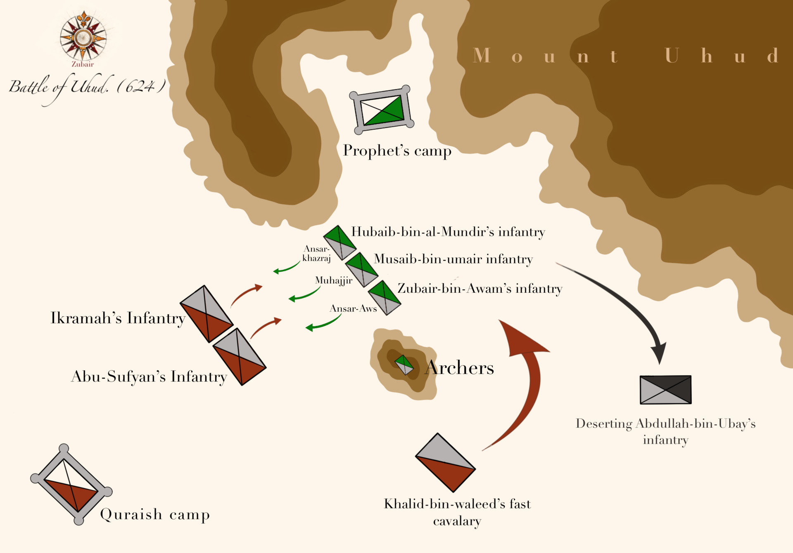
Why Uhud?

Slide 23
The Merits of Mount Uhud
The Mountain of Uhud is not just one mountain, it's a whole series of mountains. They are over 1 mile long; and they are north of Medina
There are a few narrations about Uhud:
1. The Prophet said, "Uhud is a mountain of Jannah." Some scholars say this means Uhud is a beloved mountain. Others say Uhud will be transported into Jannah.
2. In one hadith, when the Prophet came back from an expedition, the first thing he saw was the Mountain of Uhud, and he said, "Uhud is a mountain that loves us, and we love it”
وعن أبي حميد الساعدي: قال: أقبلنا مع رسول الله صلى الله عليه وآله من غزوة تبوك حتى إذا أشرفنا على المدينة، قال: هذه طابة، وهذا أحد، جبل يحبنا ونحبه.

