Slide 1
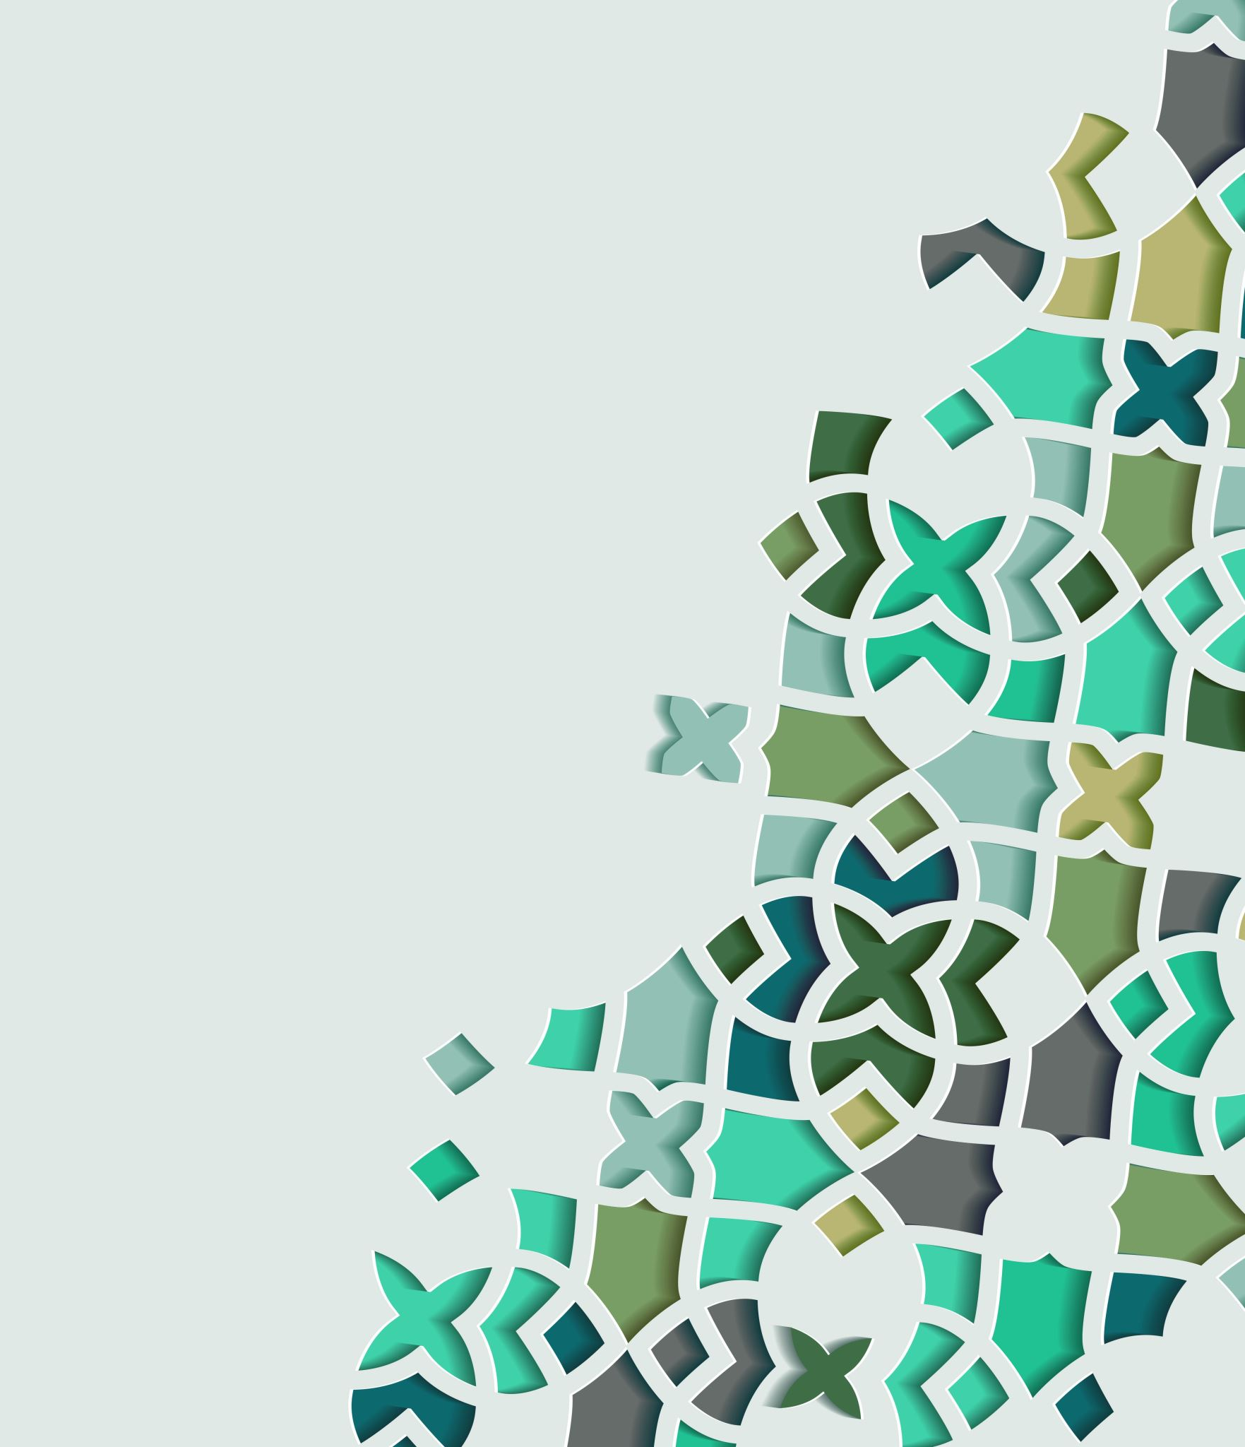
The Life of Prophet Muhammad
Lesson 23

Slide 2
The Ascension
قال: ثم مضيت فإذا أنا بقوم بين أيديهم موائد من لحم طيب ولحم خبيث، يأكلون اللحم الخبيث، ويدعون الطيب،
“We continued on our journey until we reached a group of people, in whose hands were dishes with both good and bad food in them. However, they were eating only from the bad meat.”

Slide 3
The Ascension
فقلت: من هؤلاء يا جبرئيل؟ فقال: هؤلاء الذين يأكلون الحرام ويدعون الحلال، وهم من أمتك يا محمد،
I asked, `Who are these people that are leaving the good food and are busy eating only the bad and putrid food?’ Gabriel replied, `These are the people of your Ummah who used to eat forbidden (haram) food.'

Slide 4
The Ascension
فقال رسول الله (صلى الله عليه وآله): ثم رأيت ملكا من الملائكة جعل الله أمره عجبا، نصف جسده النار، والنصف الآخر ثلج، فلا النار تذيب الثلج، ولا الثلج يطفئ النار، وهو ينادي بصوت رفيع و يقول: سبحان الذي كف حر هذه النار فلا تذيب الثلج، وكف برد هذا الثلج فلا يطفئ حر هذه النار اللهم يا مؤلف بين الثلج والنار ألف بين قلوب عبادك المؤمنين
“After this, I saw an angel whose condition was astounding. One half of the body of this angel was fire, and the other half of it was ice. Even stranger than this was the fact that neither the heat of the fire made the ice turn to water nor did the coldness of the ice put out the flames. With a very quiet voice he said, "I praise the One who is sufficient (to praise) such that the heat of this fire does not melt the ice, nor does the cold of the ice put out the fire. O' Allah! O' the One who has placed such a thing between the fire and ice! You (too) place agreement and love between the hearts of Your servants!"

Slide 5
The Ascension
فقلت: من هذا يا جبرئيل؟ فقال: هذا ملك وكله الله بأكناف السماء وأطراف الأرضين، وهو أنصح ملائكة الله لأهل الأرض من عباده المؤمنين يدعو لهم بما تسمع منذ خلق،
I asked Gabriel concerning this angel. He replied to me that "Allah, the Glorious and Most High, has appointed him as the angel who will offer advice to the believers on earth and is the guardian of the heavens and earth ‑ from the time this angel was created, he has been praying for the believers on earth.”

Slide 6
The Ascension
ورأيت ملكين يناديان في السماء أحدهما يقول: " اللهم أعط كل منفق خلفا " والآخر يقول: " اللهم أعط كل ممسك تلفا
“I also saw two other angels in this heaven, one of them supplicates as such, `O' Allah! Whosoever gives a contribution or donation (in your way), have Mercy upon him. The other one says, `O' Allah, destroy he who is stingy and miserly!'"

Slide 7
The Ascension
ثم مضيت فإذا أنا بأقوام لهم مشافر كمشافر الإبل يقرض اللحم من جنوبهم، ويلقى في أفواههم، فقلت: من هؤلاء يا جبرئيل؟ فقال: هؤلاء الهمازون اللمازون،
Again, we continued on our way. During the journey, we approached a group of people whose lips were like the lips of a camel (large in size), and were being cut with scissors. The meat that had been cut was then forced into their mouths. I asked, ”Gabriel who are these people?” He replied, "These are the people who used to backbite and look for faults in their believing brothers."

Slide 8
The Ascension
ثم مضيت فإذا أنا بأقوام تقذف النار في أفواههم، وتخرج من أدبارهم، فقلت: من هؤلاء يا جبرئيل؟ قال: هؤلاء الذين يأكلون أموال اليتامى ظلما، إنما يأكلون في بطونهم نارا وسيصلون سعيرا
I saw a group of people in which fire was being poured into their mouths and it was coming out of their rear‑ends. I requested an explanation on who they are. Gabriel replied, "These were people who took the property of the orphans unlawfully."

Slide 9
The Ascension
قال: مررنا بملائكة من ملائكة الله عز وجل خلقهم الله كيف شاء، ووضع وجوههم كيف شاء ليس شئ من أطباق أجسادهم إلا وهو يسبح الله ويحمده من كل ناحية بأصوات مختلفة، أصواتهم مرتفعة بالتحميد والبكاء من خشية الله
We proceeded from those people and arrived to a group of angels, who Allah the Glorious and High ‑ by His own desire had created ‑ whose complete existence was spent in the glorification and remembrance of Allah. These angels, in a high voice, were praising and thanking the One God and out of their love and fear for Him were crying.

Slide 10
The Ascension
فسألت جبرئيل عنهم، فقال: كما ترى خلقوا، إن الملك منهم إلى جنب صاحبه ما كلمه قط، ولا رفعوا رؤوسهم إلى ما فوقها ولا خفضوها إلى ما تحتها خوفا من الله وخشوعا، فسلمت عليهم فردوا علي إيماء برؤوسهم لا ينظرون إلي من الخشوع،
I asked regarding them and Gabriel told me, "Just as you can see, each Angel is standing beside another angel yet they do not talk to one other. Their only task is to glorify and praise Allah the High and Glorious ‑ thus they do not even look up or down."I greeted them to which they replied by moving their head without even looking at me.

Slide 11
The Ascension
فقال لهم جبرئيل: هذا محمد نبي الرحمة، أرسله الله إلى العباد رسولا ونبيا، وهو خاتم النبوة وسيدهم، أفلا تكلمونه؟ قال: فلما سمعوا ذلك من جبرئيل أقبلوا علي بالسلام، وأكرموني وبشروني بالخير لي ولامتي.
Gabriel said to them, "This is Muhammad, the seal of the Prophets and the Prophet of Mercy. He is the Leader and Master of all the Prophets. Why are you not speaking to him?" When they heard this, they greeted me, extended their respect to me and gave good tidings to me and to my Ummah."

Slide 12
The Ascension
قال: ثم صعدنا إلى السماء الثانية فإذا فيها رجلان متشابهان، فقلت: من هذان يا جبرئيل؟ فقال لي: ابنا الخالة يحيى وعيسى (عليهما السلام)، فسلمت عليهما وسلما علي واستغفرت لهما، واستغفرا لي،
We continued up into the second heaven. I saw two people who resembled one another. I asked, ”Gabriel who are these two people? 'He replied, "They are Yahya and `Isa, two prophets and cousins of one another." I greeted them both and prayed to Allah for this forgiveness. They both greeted me back and prayed for my forgiveness;

Slide 13
The Ascension
وقالا: مرحبا بالأخ الصالح، والنبي الصالح، وإذا فيها من الملائكة وعليهم الخشوع قد وضع الله وجوههم كيف شاء ليس منهم ملك إلا يسبح الله ويحمده بأصوات مختلفة
and after welcoming me said: "Welcome O' Righteous and good brother of ours!" In that place, there were also angels who were visibly humble. Allah the Almighty had created them in various forms, and in various voices they were busy in praising and glorifying Allah."

Slide 14
The Ascension
ثم صعدنا إلى السماء الثالثة فإذا فيها رجل فضل حسنه على سائر الخلق كفضل القمر ليلة البدر على سائر النجوم، فقلت: من هذا يا جبرئيل؟
“then we ascended to the third heaven and we saw a man whose beauty over others was like the beauty of the full moon compared to other stars. I asked Gabriel: ‘Who is this?’

Slide 15
The Ascension
فقال: هذا أخوك يوسف، فسلمت عليه وسلم علي، واستغفرت له، واستغفر لي، وقال: مرحبا بالنبي الصالح، والأخ الصالح، والمبعوث في الزمن الصالح، وإذا فيها ملائكة عليهم من الخشوع مثل ما وصفت في السماء الأولى والثانية، وقال لهم جبرئيل في أمري ما قال للآخرين، وصنعوا بي مثل ما صنع الآخرون.
“This is your brother Yusuf" I greeted him and prayed for his forgiveness. He returned my greeting and prayed for my mercy and said, "Welcome O' my brother, O' Prophet with exemplary morals who has been sent down at a good and appropriate time." At this place, there were also angels present who in all humility, were prostrating and busy in the remembrance of Allah. I was introduced to them and just like the other angels they too treated me with great respect.

Slide 16
The Ascension
ثم صعدنا إلى السماء الرابعة وإذا فيها رجل، فقلت: من هذا يا جبريل؟ قال: هذا إدريس رفعه الله مكانا عليا، فسلمت عليه، وسلم علي، واستغفرت له، واستغفر لي وإذا فيها من الملائكة الخشوع مثل ما في السماوات التي عبرناها، فبشروني بالخير لي ولامتي
Following this, we continued up to the fourth heaven. There I saw a person and asked Gabriel, "Who is he?" He replied: "This is Idris, the one whom Allah the Great, brought up to a high station." I greeted him and prayed for his forgiveness; he too prayed for my forgiveness. In this heaven too there were angels who like in the previous heavens gave me good tidings.

Slide 17
The Ascension
ثم صعدنا إلى السماء الخامسة فإذا فيها رجل كهل عظيم العين، لم أر كهلا أعظم منه، حوله ثلة من أمته فأعجبتني كثرتهم، فقلت: من هذا يا جبرئيل؟ فقال: هذا المجيب في قومه هارون بن عمران، فسلمت عليه، وسلم علي، واستغفرت له، واستغفر لي، وإذا فيها من الملائكة الخشوع مثل ما في السماوات
We reached the fifth heaven where I saw a tall man, and up until now, I had not seen someone like him. He had large eyes and was very old. His nation (Ummah) was surrounding him. I asked Gabriel” Who is this man?" He said: "This is Harun ‑ the son of `Imran ‑ who had gained the approval of his nation. I greeted him as well and prayed to Allah for his forgiveness. He too greeted me and prayed for my forgiveness. In this heaven as well there were angels who in all humility and humbleness, were busy in the praise of Allah.”

Slide 18
The Ascension
السماء السادسة وإذا فيها رجل آدم طويل كأنه من شبوة ولو أن عليه قميصين لنفذ شعره فيهما، فسمعته يقول: يزعم بنو إسرائيل أني أكرم ولد آدم على الله، وهذا رجل أكرم على الله مني، فقلت: من هذا يا جبرئيل؟ فقال: هذا أخوك موسى بن عمران فسلمت عليه وسلم علي، واستغفرت له واستغفر لي، وإذا فيها من الملائكة الخشوع مثل ما في السماوات.
We continued on towards the higher heaven. In the sixth heaven I saw a very tall man whose body was covered in hair, such that if he were to wear a shirt, the hair would come out of it. The man said, "The Bani Isra'il say that I am the best of the children of Adam in the sight of Allah, however this man is much better and beneficent in the sight of Allah than I am."I greeted him and prayed for his forgiveness; he replied to my greeting and prayed for my forgiveness. In this place as well, angels in humility and humbleness were busy praising Allah just as in the previous heavens.

Slide 19
The Ascension
قال: ثم صعدنا إلى السماء السابعة فما مررت بملك من الملائكة إلا قالوا: يا محمد احتجم، وأمر أمتك بالحجامة،
After this, we reached the seventh heaven. While here, whichever angel we came into contact with said to me, "Perform `cupping’ and command your Ummah to do so as well."

Slide 20
The Ascension
وإذا فيها رجل أشمط الرأس واللحية، جالس على كرسي، فقلت: يا جبرئيل من هذا الذي في السماء السابعة على باب البيت المعمور في جوار الله؟
We then reached a man whose hair color was a mix of black and white. I asked Gabriel, "Who is this man sitting at the door of Bayt al‑Ma'mur, near Allah?

Slide 21
The Ascension
فقال: هذا يا محمد أبوك إبراهيم، وهذا محلك ومحل من اتقى من أمتك، ثم قرأ رسول الله (صلى الله عليه وآله): " إن أولى الناس بإبراهيم للذين اتبعوه وهذا النبي والذين آمنوا والله ولي المؤمنين
Gabrie replied, "He is your father, Prophet Ibrahim, and your house is in this place as well as a group of people from your Ummah who have Taqwa." At that time, I read the following verse of the Qur’an:
“Indeed, the most worthy of Abraham among the people are those who followed him [in submission to Allah] and this prophet, and those who believe [in his message]. And Allah is the ally of the believers.” Quran 3:68

Slide 22
The Ascension
" فسلمت عليه، وسلم علي، وقال: مرحبا بالنبي الصالح، والابن الصالح، والمبعوث في الزمن الصالح، وإذا فيها من الملائكة الخشوع مثل ما في السماوات، فبشروني بالخير لي ولامتي
I greeted him, to which he replied and said, "Welcome O' Prophet and O' virtuous offspring, O' one who has been chosen in a good time.'In this place too, angels, in full humility and humbleness were present. They gave me and my Ummah the glad tidings of goodness.

