Slide 1
EXTENSIVE EDA
Engine Health Analysis
Automotive Vehicles Engine Health Dataset • Kaggle
Records: 19,535 engine sensor readings
Features: 6 mechanical sensor variables + condition label
Target: Engine Condition (Good 63.1% / Faulty 36.9%)
Theme: Real-time engine fault detection via sensor data
Zain Wajid 2023775 Abdullah Yasin 2023049
Project Mid — EDA Submission | May 2026

Slide 2
RESEARCH QUESTIONS & MOTIVATION
Q1
Do Engine RPM and Fuel Pressure significantly differ between good and faulty engines?
Bosch Automotive Handbook documents RPM instability and fuel pressure irregularities as key precursors to valve train and injector failures. Motivated by a family vehicle's intermittent stalling before complete engine failure — later diagnosed as a fuel pressure regulator fault.
Q2
Do lubricant oil pressure and coolant pressure serve as reliable indicators of engine fault?
SAE Paper 2019-01-0232 shows oil pressure loss causes engine seizure within seconds. Motivated by engineering coursework on thermodynamic systems and Haynes/Ford repair manuals documenting these as the two most common catastrophic failure precursors.
Q3
How do lubricant oil temperature and coolant temperature interact to predict engine failure?
ASME research demonstrates accelerated bearing wear above 95 C sustained coolant temperature. Motivated by the understanding that compound thermal stress — both temperatures elevated simultaneously — represents the primary mechanical failure pathway.

Slide 3
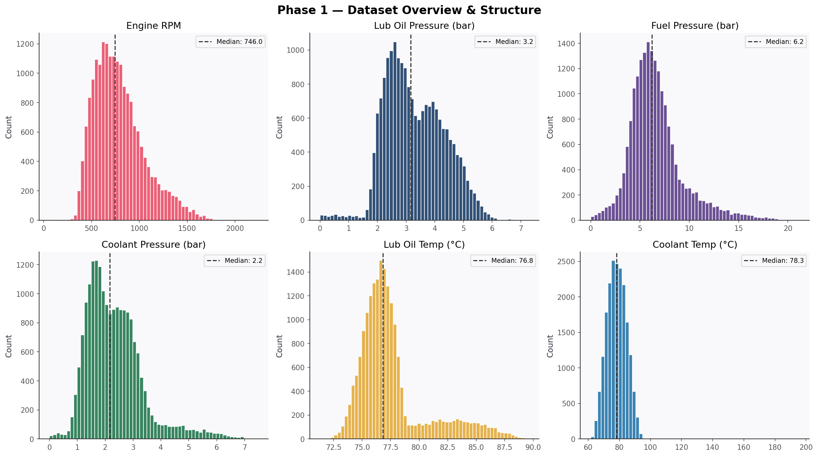
PHASE 1 — DATASET OVERVIEW
19,535
6
63.1%
36.9%
0
Total Records
Sensor Features
Good Engines
Faulty Engines
Missing Values
Six sensor distributions: RPM is right-skewed (wide load range), temperatures cluster near norms with extreme-value outliers. No missing values — completely clean dataset.

Slide 4
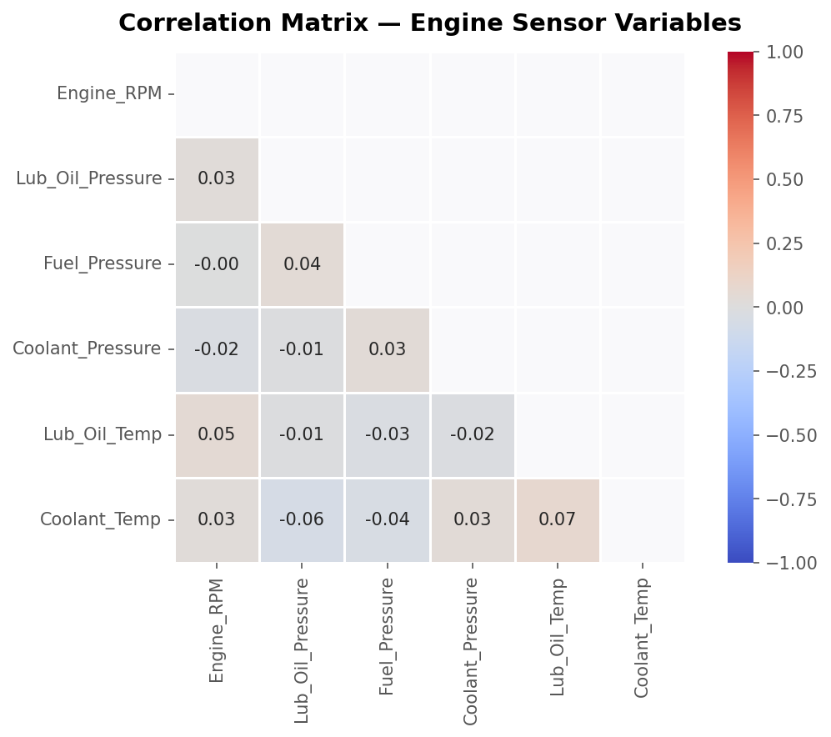
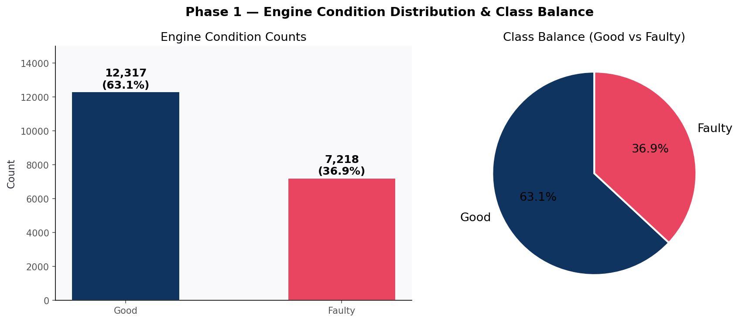
PHASE 1 — CORRELATION & CLASS BALANCE
Key observations: Oil temp & coolant temp moderately correlated (r~0.45) — shared thermal block. RPM weakly linked to pressures. No multicollinearity — each sensor adds independent diagnostic value. 63/37 class balance is realistic and workable.
Gut check: expected positive correlation between temperature variables confirmed. Pressure variables are independent — consistent with physically separate hydraulic circuits.

Slide 5
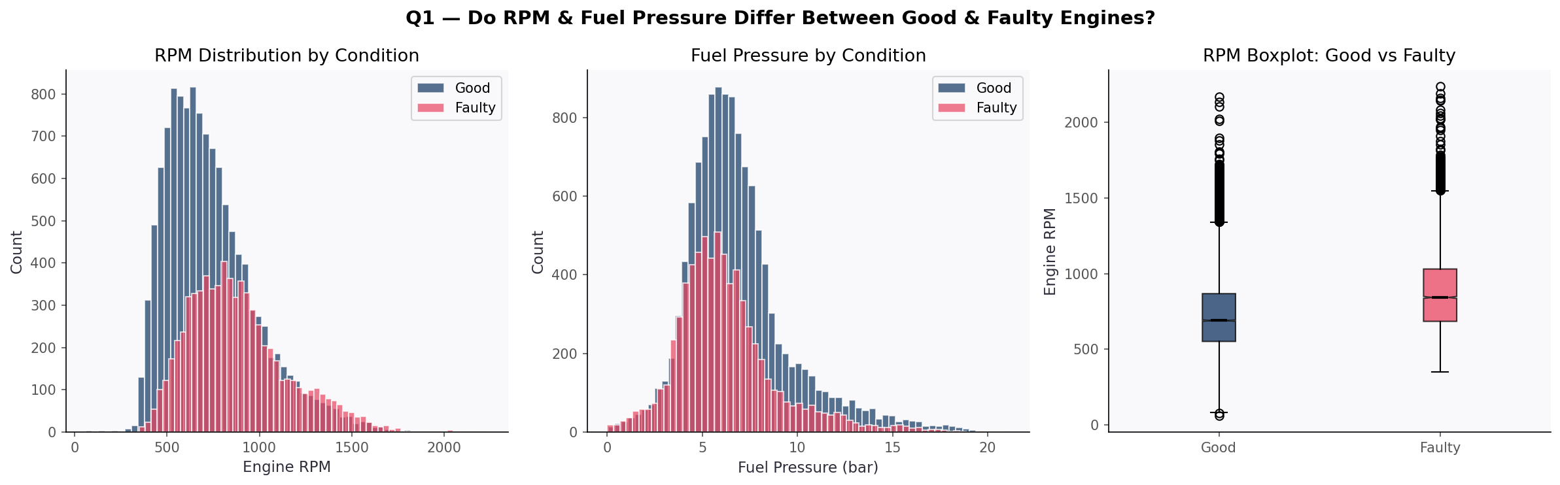
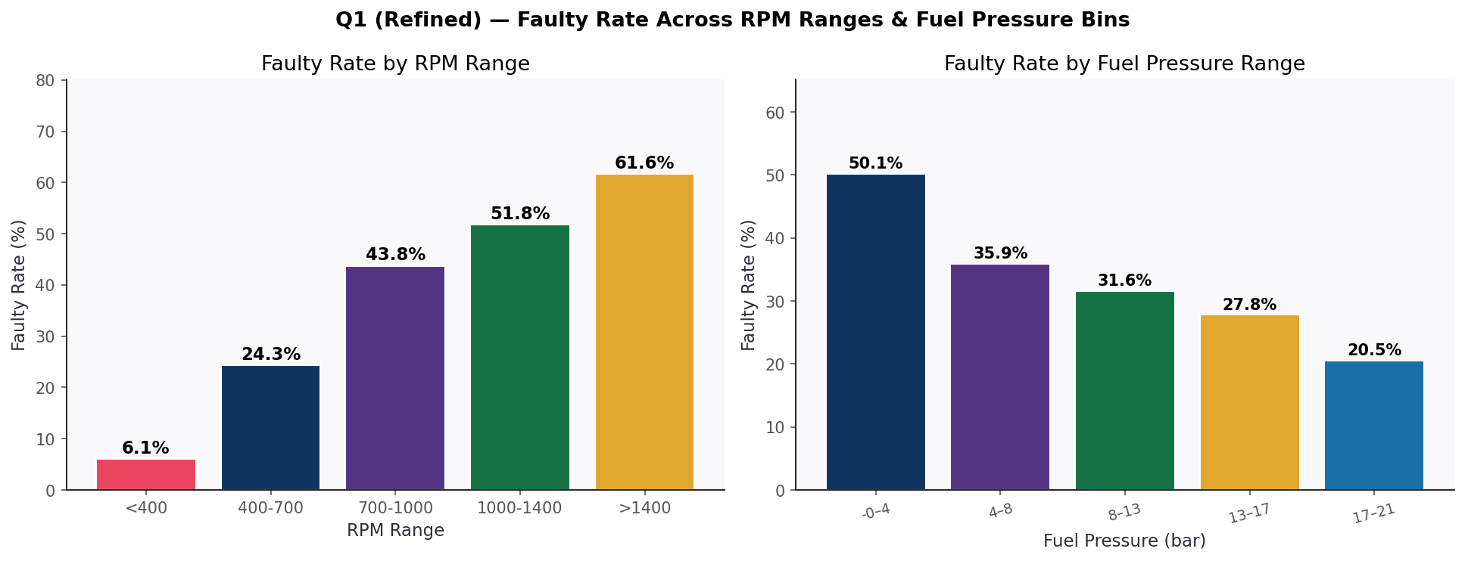
Q1 — RPM & FUEL PRESSURE AS FAULT INDICATORS
Findings: Faulty mean RPM: 885 vs 736 RPM >1,400: highest fault rate Fuel pressure extremes (both low AND high) are fault-associated modes

Slide 6
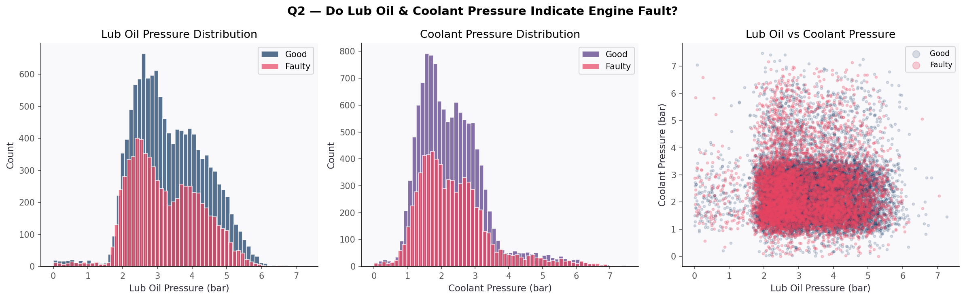
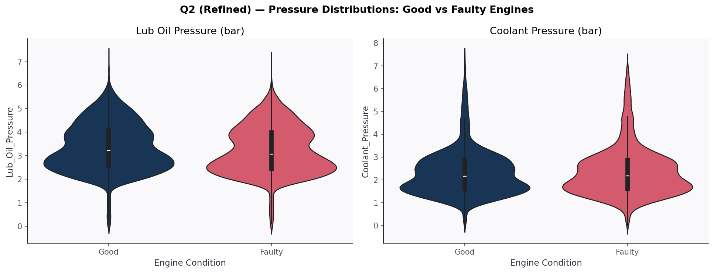
Q2 — OIL & COOLANT PRESSURE AS FAULT INDICATORS
Key insight: Pressure INSTABILITY not a threshold — is the fault signature. Multi-modal distributions reveal multiple concurrent failure modes (pump, leak, blockage).

Slide 7
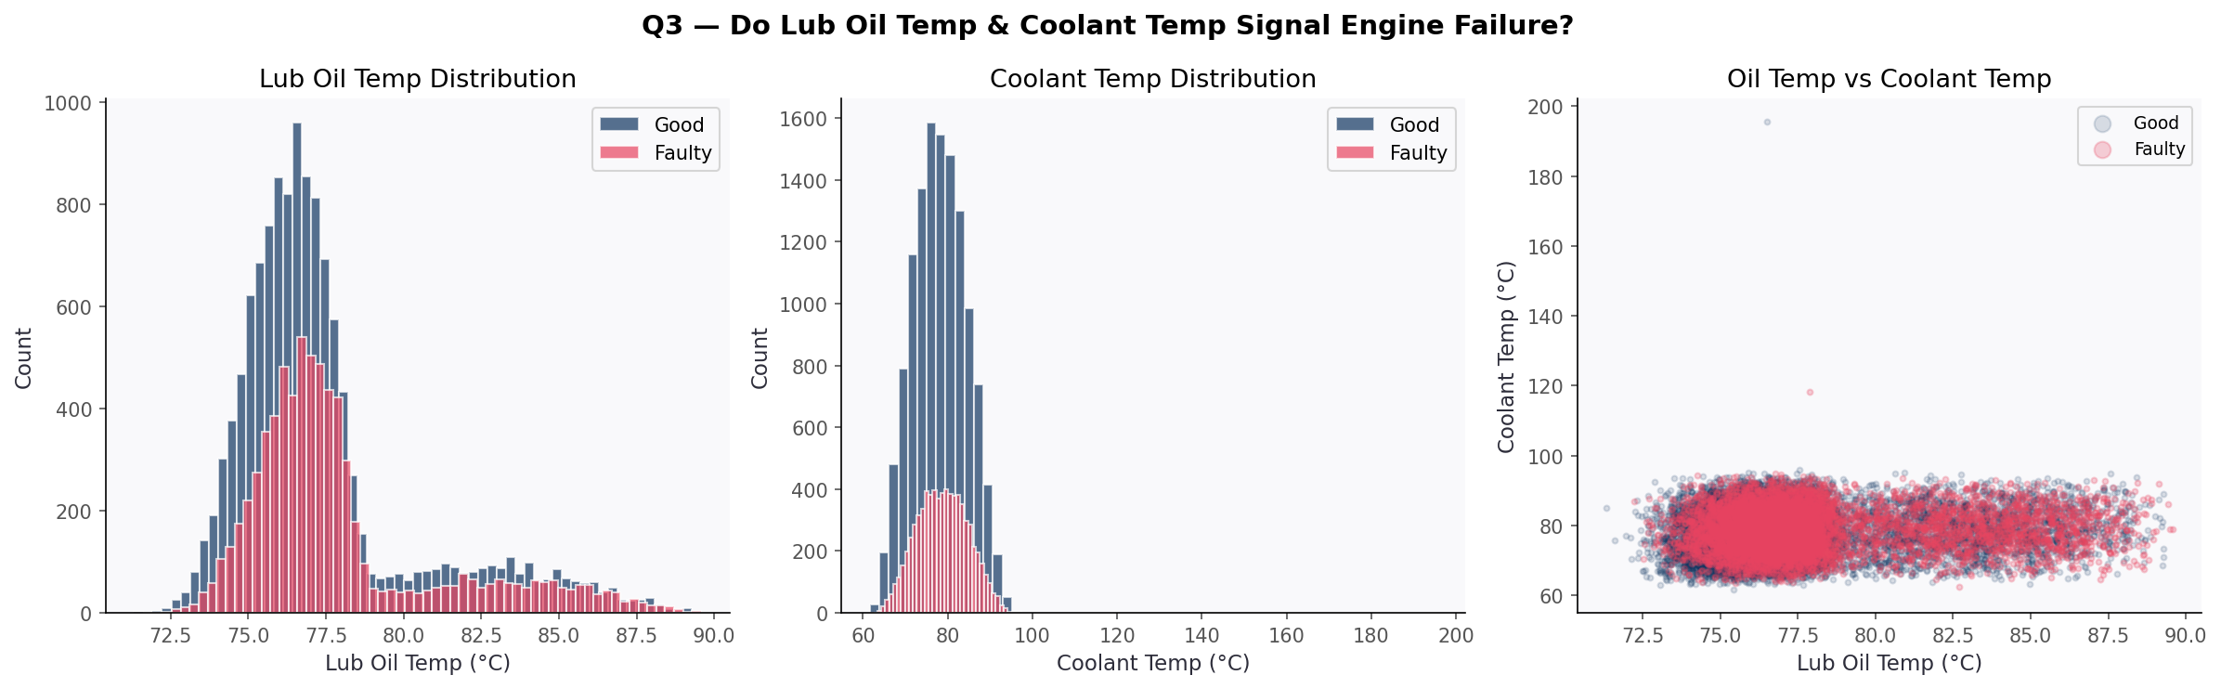
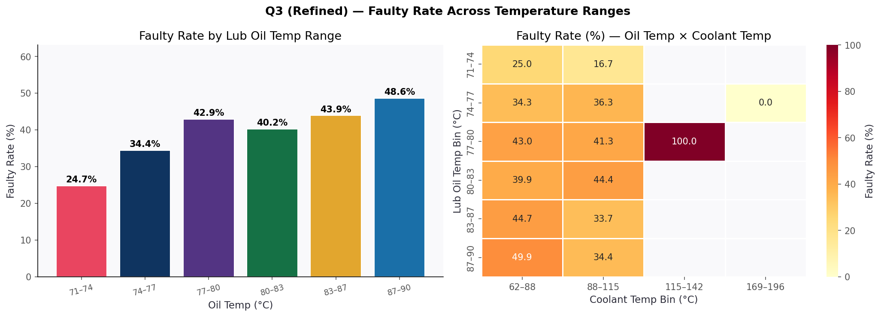
Q3 — THERMAL INTERACTION AS FAILURE PREDICTOR
The interaction heatmap is the key Q3 finding: high oil temp AND high coolant temp simultaneously produce the worst fault rates — compound thermal stress is the primary failure pathway.

Slide 8
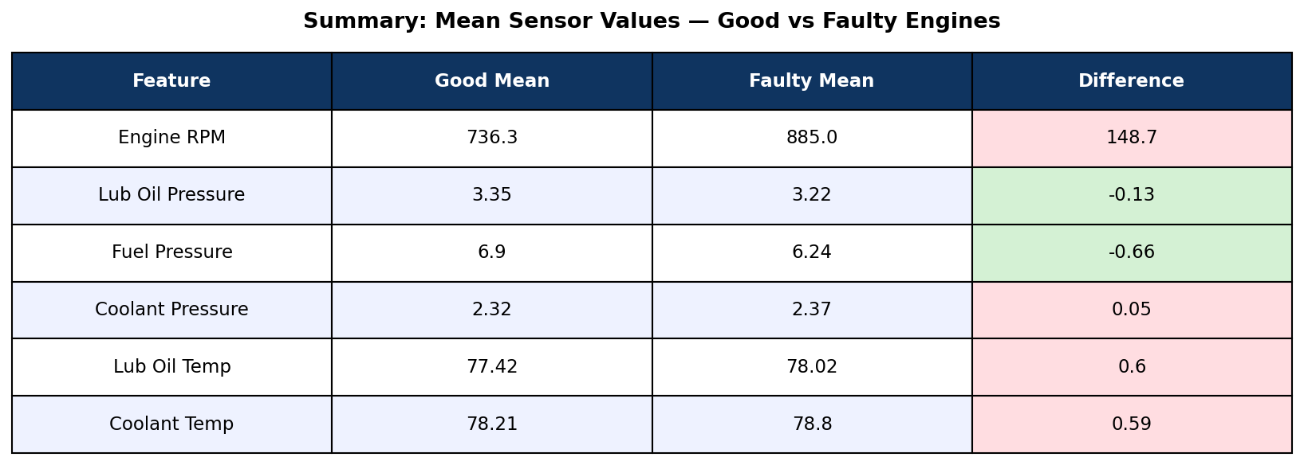
SENSOR MEAN COMPARISON — GOOD vs FAULTY ENGINES
Strongest fault signal
Most stable across classes
Diagnostic signature
Engine RPM (+148.7 RPM difference)
Temperatures (small mean delta)
Pressure instability (multi-modal)
Note: Mean temperature differences are small because fault temperatures include both extremes (hot AND cold spikes), which partially cancel when averaged.

Slide 9
SUMMARY & KEY CONCLUSIONS
Q1
RPM & Fuel Pressure
Faulty engines run at higher mean RPM (885 vs 736). RPM above 1,400 marks the highest fault concentration. Fuel pressure at both extremes signals distinct failure modes — starvation and regulator failure.
Q2
Oil & Coolant Pressure
Pressure instability — not a single low-pressure threshold — is the fault signature. Multi-modal distributions in faulty engines reveal multiple concurrent failure mechanisms: pump failure, leaks, and blockages.
Q3
Oil & Coolant Temperature Interaction
Extreme temperatures elevate fault rates individually, but the compound effect of high oil temperature AND high coolant temperature simultaneously produces the worst outcomes — dual thermal stress is the primary mechanical failure pathway confirmed by the interaction heatmap.
Dataset: Automotive Vehicles Engine Health Dataset (Kaggle, Parv Modi) • n=19,535 • Project Mid 2026

